Slide 1
Module-1 Selenium Overview
Course content
Why do you need to learn selenium
Selenium overview
What is selenium?
Selenium history
Selenium features
Selenium vs QTP
Selenium components
Notes:
https://code.google.com/p/selenium/source/browse/javascript/selenium-core/scripts/selenium-api.js?r=789dad2290856eddeffea32789c9b1339ea60954

Slide 2
Module-2 Selenium IDE
Selenium IDE
Introduction
Setting up Selenium IDE
Record , explain the recorded section and Playback in IDE
Editing Scripts in Selenium IDE
Debugging the script
Verify and assert
IDE in detail – Features and Components
IDE Options
IDE Format
IDE Clipboard format
Selenium Commands
Adding Verification Points
Script Examples
Test Suites
Notes:
https://code.google.com/p/selenium/source/browse/javascript/selenium-core/scripts/selenium-api.js?r=789dad2290856eddeffea32789c9b1339ea60954

Slide 3
Module-3 Installation
Installation & Execution
Downloading and Installing Java
Verifying Java
Setting-up Java Environment Variables
Downloading Eclipse and using eclipse
Downloading Selenium Web-Driver Libraries
Integrating Selenium to Eclipse
Exporting Java TC from IDE and running on eclipse
Notes:
https://code.google.com/p/selenium/source/browse/javascript/selenium-core/scripts/selenium-api.js?r=789dad2290856eddeffea32789c9b1339ea60954

Slide 4
Module-4 Java OverView
Introduction to Java
History of Java
Features of Java
The way java works
Class & Object
Java Class Structure
Object Creation to Class
Notes:
https://code.google.com/p/selenium/source/browse/javascript/selenium-core/scripts/selenium-api.js?r=789dad2290856eddeffea32789c9b1339ea60954

Slide 5
Module-5 Getting Started with Java
Write a Hello World Script
Writing a class with variable and method and accessing them within the class
Introduction to variables and data types
Writing two classes Student & GetStudentDetails, and invoking Student class method and variables from GetStudentDetails
Keywords
Identifiers
Brief Introduction to Access-Modifiers
Notes:
https://code.google.com/p/selenium/source/browse/javascript/selenium-core/scripts/selenium-api.js?r=789dad2290856eddeffea32789c9b1339ea60954

Slide 6
Module-6 Variables
Variables
Instance Variables
Local Variables
Class Variables /Static Variables
Create examples to show Local and Instance Variables
Create examples to show static variable
Notes:
https://code.google.com/p/selenium/source/browse/javascript/selenium-core/scripts/selenium-api.js?r=789dad2290856eddeffea32789c9b1339ea60954

Slide 7
Module-7 Datatypes
Data types
Primitive data types
Byte
Short
Int
Long
Float
Double
Boolean
Character
Reference data types
Notes:
https://code.google.com/p/selenium/source/browse/javascript/selenium-core/scripts/selenium-api.js?r=789dad2290856eddeffea32789c9b1339ea60954

Slide 8
Module-8 Understanding Test Script
Understanding the test script exported from IDE
Writing the test script manually
Initializing the driver
Open the browser with the URL
Understanding implicit wait
Understating the selenium api’s
What is WebElement
What is locator and types of locators
Notes:
https://code.google.com/p/selenium/source/browse/javascript/selenium-core/scripts/selenium-api.js?r=789dad2290856eddeffea32789c9b1339ea60954

Slide 9
Module-9 Locators
Types of Locators
ID
Name
LinkText
ClassName
Partial Link Text
Tag Name
Xpath
CSS

Slide 10
Module-10 XPATH and CSS
XPATH N CSS in Detail
XPATH
CSS

Slide 11
Module-10 WebElement Methods
ReturnType | Method-Name
Void | clear()
void | click()
WebElement | findElement(By by)
java.util.List<WebElement> | findElements(By by)
java.lang.String | getAttribute(java.lang.String name)
java.lang.String | getCssValue(java.lang.String propertyName)
Point | getLocation()
Dimension | getSize()
java.lang.String | getTagName()
java.lang.String | getText()
boolean | isDisplayed()
boolean | isEnabled()
boolean | isSelected()
void | sendKeys(java.lang.CharSequence... keysToSend)
void | submit()

Slide 12
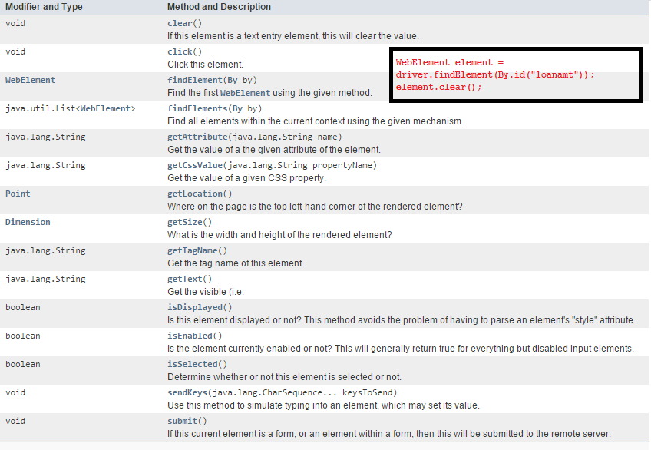
Module-10 WebElement Methods

Slide 13
Module-11 Exploring WebElement Methods

Slide 14
Module Operators
Operators
Arithmetic Operators
Relational Operators
Logical Operators
Assignment Operators
Increment and Decrement Operator
Bitwise Operator
Conditional Operator
Notes:
https://code.google.com/p/selenium/source/browse/javascript/selenium-core/scripts/selenium-api.js?r=789dad2290856eddeffea32789c9b1339ea60954

Slide 15
Module Flow-Control
Decision making statement
If statement
If-else statement
Switch statement
Looping statement
While statement
Do-while statement
For statement
Branching statement
Break statement
Continue statement
Return statement
Notes:
https://code.google.com/p/selenium/source/browse/javascript/selenium-core/scripts/selenium-api.js?r=789dad2290856eddeffea32789c9b1339ea60954

Slide 16
Module-10 Test-NG-Framework
How to use TestNG configuration methods with parameters
How to configure your test
Creating the XML file for TestNG
Lauching your tests with Eclipse
How to make the test design a little better for the future
Reference:-http://www.testng.org/doc/selenium.html

Slide 17
Module-11 Running on Different Browsers
Different Available Web-Drivers
FirefoxDriver
InternetExplorerDriver
ChromeDriver
SafariDriver
OperaDriver
Running the application different browsers

Slide 18
Module-12 Handling Keyboard & Mouse Events
Keyboard events & Mouse Events
clickAndHold()
contextClick()
doubleClick()
dragAndDrop(source, target)
dragAndDropBy(source, x-offset, y-offset)
keyDown(modifier_key)
keyUp(modifier _key) :- modifier_key - Keys.ALT, Keys.SHIFT, or Keys.CONTROL
moveByOffset(x-offset, y-offset)
moveToElement(toElement)
release()
sendKeys(onElement, charsequence)

Slide 19
Module-13 Multiple Windows Handling
Multiple Browser Handling
Handling Popup/Alerts
Handling Frames
Notes:
https://code.google.com/p/selenium/source/browse/javascript/selenium-core/scripts/selenium-api.js?r=789dad2290856eddeffea32789c9b1339ea60954

Slide 20
Module-14 Cookies & ScreenShot
Handling Cookies
Taking Screenshots
Notes:
https://code.google.com/p/selenium/source/browse/javascript/selenium-core/scripts/selenium-api.js?r=789dad2290856eddeffea32789c9b1339ea60954

