Slide 1
Introduction
Selenium is an automation tool which is used to automation web application.
History of Selenium:
Selenium was originally developed by Jason Huggins in 2004 as an internal tool at “Thought Works”, and in the same year it made open source.
Later Thought works and Google continued to develop the selenium.
As its made open source any one can contribute to selenium.
Why Selenium?

Slide 2
FEATURES OF SELENIUM
Selenium is an open source tool (No cost Involved in it).
Browsers Supported:
Firefox, IE, Safari, Chrome, Opera.
Programming Languages Supported:
C#, Haskell, Java, JavaScript, Objective-C, Pearl, PHP, Python, Ruby
Platforms Supported: Selenium test can be executed on any of below platforms,
Windows, Linux and Mac.
Community support, frequent release updates to support new version of browsers, platforms, etc.

Slide 3
Selenium Vs. QTP
Selenium can be used windows, mac, and Linux.
It’s open source tool (free).
It’s supports multiple programming languages.
It’s supports multiple browsers.
Selenium test’s can be developed using any available IDE (such as Eclipse, Net beans, Visual Studio etc.).
It has no official support, since it is an open source.
With new Selenium release the API changes. So Test Scripts need to be updated
QTP can only be used in windows.
It’s licenced tool, hence cost applies.
QTP test’s can be developed by using only VB Script
QTP supports limited browsers such as IE, Firefox.
QTP test’s can be developed by using only QTP IDE.
It has official technical support
QTP support backward compatibility, The latest releases support code written 5 years back.

Slide 4
COMPONETS OF SELENIUM
Selenium is mainly built on 4 components.
Selenium IDE
It’s a Firefox add-on that will do simple record-and-playback of user interactions with the browser.
Selenium Remote Control (RC)
Is a test tool that allows you to write automation test code in any programming language such as c#, java, js, obj-c, pearl, php, python, ruby.
Selenium Web Driver
Selenium Web-Driver is the successor of Selenium Remote Control, and RC is deprecated.
Selenium Grid
Selenium Grid is used to run multiple tests across different browsers, operating systems, and machines in parallel.

Slide 5
Selenium-IDE
Selenium IDE is a Firefox plugin which records and plays back user interactions with the browser.
Use this to either create simple scripts or assist in exploratory testing.
It can also export Remote Control or Web Driver scripts.
The exported scripts can run on other browser with the help of Remote Control or Web Driver.

Slide 6
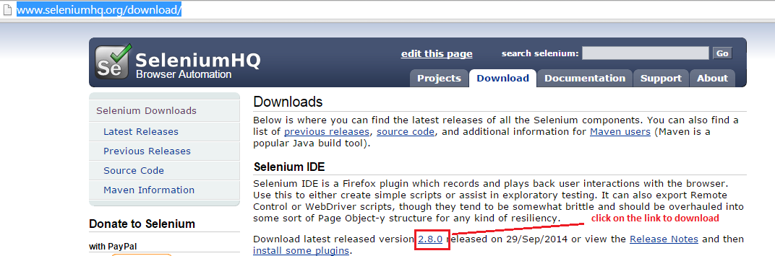
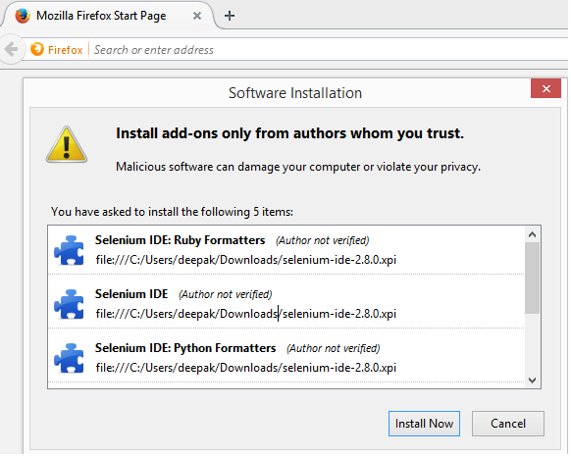
Selenium IDE Installation
Download the Selenium IDE from
http://www.seleniumhq.org/download/
Install the downloaded plugin “” on fire fox browser, just dragging it to browser.

Slide 7
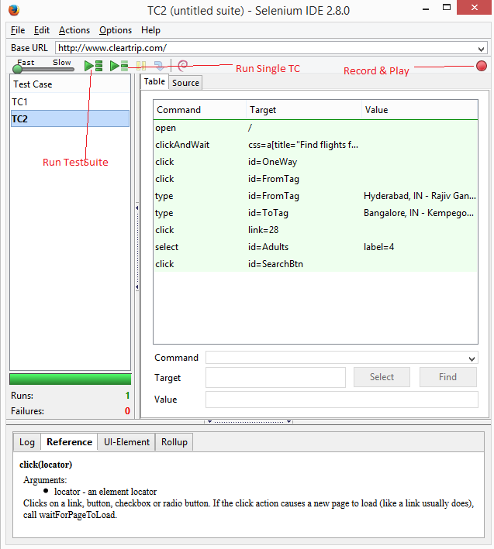
Selenium IDE continuation……
Click on the icon at right corner of browser to launch IDE.

Slide 8
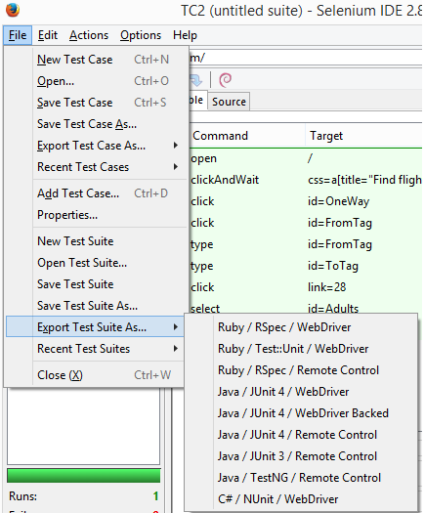
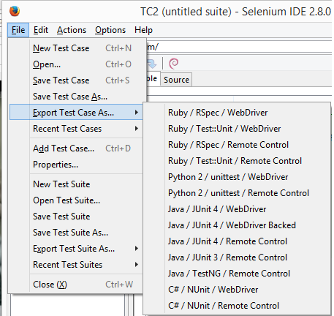
Export TC & TestSuite from IDE

Slide 9
Selenese-Commands
Selenium commands, often called selenese. The set of these commands are nothing but test script.
Open(): To open the url.
Close(): To kill or close the Browser.
windowMaximize(): To maximize the window.
Type(): To enter some text into a text box.
Click(): To click on Button, Radio button and Link.
Select(): To select a value from combo/list/dropdown box.

Slide 10
Selenese-Commands continuation…..
Check(): To check the check box.
selectPopUp(): To identify the pop up window.
selectWindow(): To identify the child window.
selectFrame(): To identify the frame.
getAlert(): To Click ok on alert box.
getConfirmation(): To click ok on confirmation message.
chooseCancelOnNextConfirmation(): To click Cancel on next displayed confirmation message.
chooseOkOnNextConfirmation(): To click Cancel on next displayed confirmation message.
Verify<>
Assert<>

Slide 11
XPATH
WebDriver uses XPath to identify a WebElement on the web page.
XPath is a short name for the XML path.
The HTML for our web page is also one form of the XML document.
The root element is identified as //
To identify all the div elements, the syntax will be //div
To identify the link tags that are within the div element, the syntax will be //div/a
To identify all the elements with a tag, we use *. The syntax will be //div/*
To identify all the div elements that are at three levels down from the root, we can use //*/*/div
To identify specific elements, we use attribute values of those elements, such as //div/a[@id='attrValue'], which will return the anchor element.

Slide 12
Installation
Prerequisites
Java 1.6 above must be installed.
Firefox browser must be installed.
Selenium Installation:

Slide 13
Difference between close and quit
close( ) WebDriver command closes the Browser window which is in focus. If there are more than one Browser window opened by the Selenium Automation, then the close( ) command will only close the Browser window which is having focus at that time. It wont close the remaining Browser windows. Where as quit( ) WebDriver command is generally used to shut down the WebDrivers instance. Hence it closes all the Browser windows that are opened by the Selenium Automation. close( ) and quit( ) work in the similar way when Selenium Automation opens only single Browser window. They differ in their functionality when there are more than one Browser windows opened by the Selenium Automation.

Slide 14
SELENIUM RC
RC stands for Remote Control.
It is a Server and launches the Browser.
It acts as a API and Library of Selenium.
We need to configure the Selenium RC with the supported language, then we can automate the application.

Slide 15
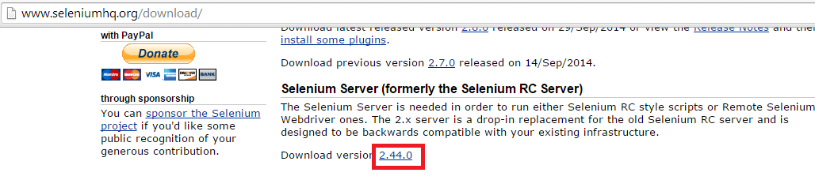
Selenium RC Installation
Download the Selenium RC from
http://www.seleniumhq.org/download/
Add the downloaded jar in the project class path.
“selenium-server-standalone-2.44.0.jar”

Slide 16
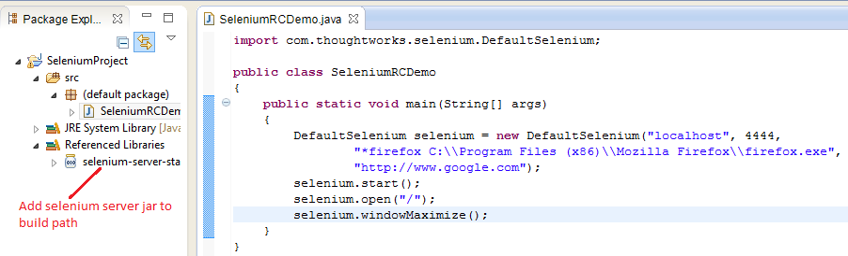
Selenium RC – Start Server & Run Script
To start server,
Selenium RC Script

Slide 17
Selenium RC in other browsers
Selenium RC in chrome

Slide 18
Selenium Web Driver
Selenium WebDriver fits in the same role as RC did.
WebDriver is designed in a simpler and more concise programming interface along with addressing some limitations in the Selenium-RC API.
It drives the browser much more effectively and overcomes the limitations of Selenium 1.x which affected our functional test coverage, like the file upload or download, pop-ups and dialogs barrier

Slide 19
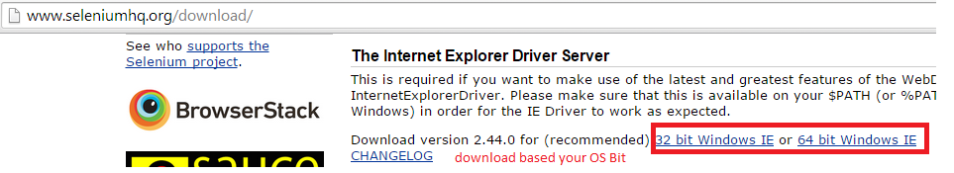
Selenium Web driver - Installation
Download the Selenium Web driver from
http://www.seleniumhq.org/download/
Download above driver for Internet explorer, for fire fox no need to download anything.

Slide 20
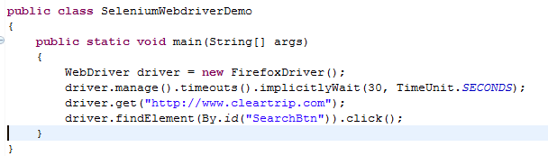
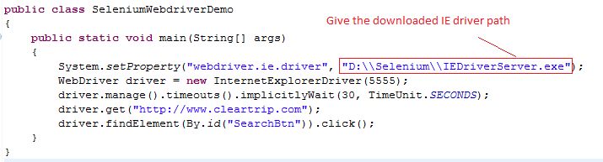
Selenium Web driver- Write & Run Script
Test Script on Firefox browser using selenium webdriver,
Test Script on IE browser using selenium webdriver,
To Run scripts on other browser download corresponding browser drivers.

Slide 21
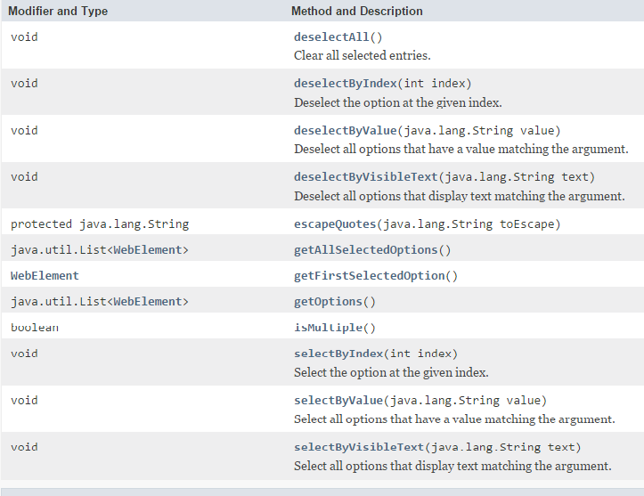
Select functions
A Select function allows you select or deselect values from a drop-down box or a radio button. It includes a list of Selenium API methods to work with select boxes that contain the <select>…</select> tags. These functions interact with the UI comboboxes to select options.

Slide 22
Window functions

Slide 23
Tests on specific Firefox versions

Slide 24
Handling Ajax websites

Slide 25
Timeouts
implicitlyWait():- An implicit wait waits for an element to appear. It lets you to poll the DOM for a specific time period until an element is found. The implicit wait is active from the start to the end of the test execution, that is, till the web page is closed, and is applicable for all elements.
driver.manage().timeouts(). implicitlyWait(long, TimeUnit);
driver.manage().timeouts().implicitlyWait(30, TimeUnit.SECONDS);
pageLoadTimeout(): -The pageLoad timeout method waits for the entire page to be loaded within a specific time period. A timeout exception will be thrown whenever a page takes more than the expected time to load. The following is the syntax for this
driver.manage().timeouts().implicitlyWait(30, TimeUnit.SECONDS);
setScriptTimeout():- The setScript timeout method waits for asynchronous APIs (Ajax) to be loaded in a web page within a certain time period. The following is the syntax for this method:
driver.manage().timeouts().setScriptTimeout(30, TimeUnit.SECONDS)

Slide 26
Waits - ExplicitWait
Waits are used to wait for an element to appear.
ExplicitWait:-An explicit wait waits for certain conditions to occur. It results in TimeoutException only when the conditions fail to meet their target.
There can be instance when a particular element takes more than a minute to load. In that case you definitely not like to set a huge time to Implicit wait, as if you do this your browser will going to wait for the same time for every element.
To avoid that situation you can simply put a separate time on the required element only. By following this your browser implicit wait time would be short for every element and it would be large for specific element.
WebDriverWait wait = new WebDriverWait(driver, 10); wait.until(ExpectedConditions.presenceOfElementLocated(By.locatorType("path")));

Slide 27
The PageObject pattern

Slide 28
The PageFactory class

Slide 29
The EventFiringWebDriver class

Slide 30
The JavascriptExecutor class
http://selenium.googlecode.com/git/docs/api/java/org/openqa/selenium/JavascriptExecutor.html
http://www.w3schools.com/jsref/dom_obj_document.asp

Slide 31
SELENIUM GRID
Selenium Grid is used for launching the multiple browsers with supported operating system in parallel.
We can run the scripts on different browsers in parallel.
It allows you to easily run multiple tests in parallel, on multiple machines, in a heterogeneous environment.

Slide 32
GIT
https://git-scm.com/
Click on “download for windows” and download
Install the downloaded file
Git reset --hard

Slide 33
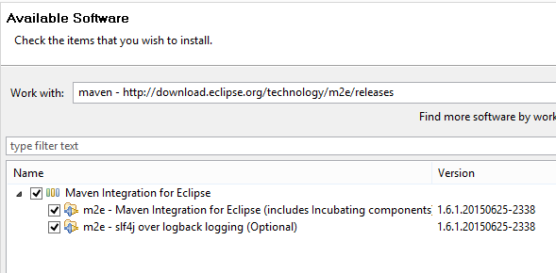
Maven
You can install last M2Eclipse release by using the following update site from within Eclipse:
http://download.eclipse.org/technology/m2e/releases

Slide 34
Maven-Dependencies
Add all these dependency to dependencies section of POM.xml
http://maven.apache.org/surefire/maven-surefire-plugin/examples/junit.html
<dependency>
<groupId>junit</groupId>
<artifactId>junit</artifactId>
<version>4.11</version>
<scope>test</scope>
</dependency>
http://www.seleniumhq.org/download/maven.jsp
<dependency>
<groupId>org.seleniumhq.selenium</groupId>
<artifactId>selenium-java</artifactId>
<version>2.46.0</version>
</dependency>

