Slide 1

Maximizing Airbnb Revenue in New York through Data -Driven Strategies
For Head of Acquisition & Operations and Head of user experience
Presented By,
Sudheer N Poojari, Jyothi Kappala, Hemant Kondhalkar

Slide 2
Objective Background Key Findings Recommendations Appendix Data source Data methodology Data model assumptions
AGENDA
1
2
3
4
5

Slide 3
OBJECTIVES
Assess the current state of Airbnb property and host acquisitions in New York
Identify key opportunities for improving property acquisition and optimizing services offered
Provide actionable strategies to optimize the user experience and property listings, enabling increased property traction, to the Head of Acquisitions and Operations.

Slide 4
BACKGROUND
The average price per night for an Airbnb rental in NYC increased by 4% between 2018 and 2019.
Prices increased the most in Manhattan (6%) and Brooklyn (5%) during this time period.
The highest prices per night are typically seen in the summer months, with prices peaking in July (average price of $202 per night).

Slide 5
TOP THREE CAUSES FOR DECLINING REVENUE ARE:
Properties not being functional for enough days in a year.
Properties not allowing a maximum number of minimum night stay booking window for the end user.
The average price range preferred by customers being between $81 to $160, whereas the most popular neighborhoods such as Manhattan and Brooklyn offer a higher price range which may discourage customers from booking.

Slide 6
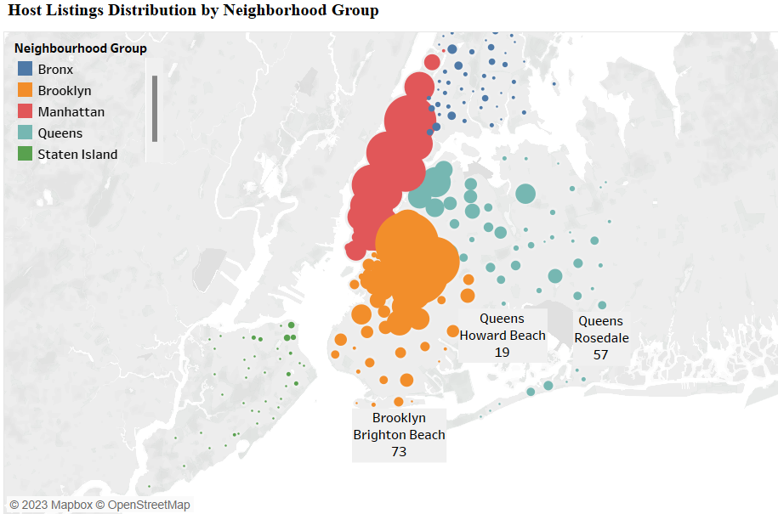
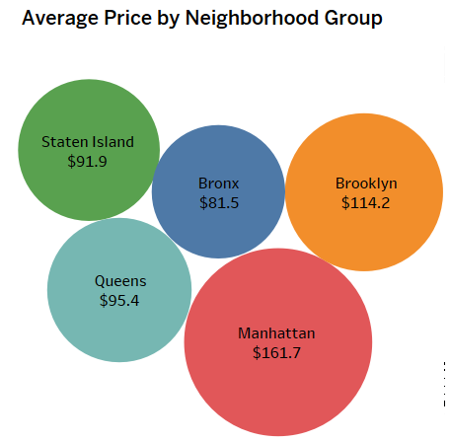
AIRBNB LISTINGS IN NYC CONCENTRATED IN HIGH-DENSITY, TOURIST AREAS; MANHATTAN HIGHEST AVG PRICE, BRONX MOST AFFORDABLE
Airbnb listings are concentrated in manhattan, brooklyn, and queens due to their high population density and tourist attractions.
Manhattan has the highest average price for listed properties at 161.7, followed by brooklyn at 114.2, while the bronx is the most affordable with an average price around half of manhattan's.
Staten island has the least number of listings due to its low population density and lack of tourism destinations.

Slide 7
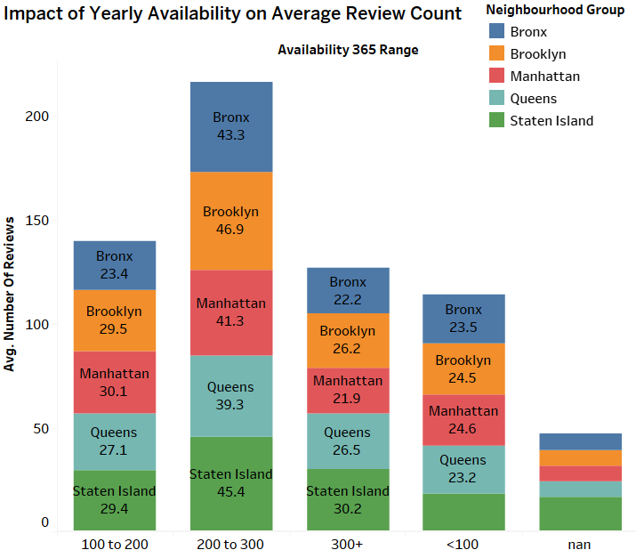
IMPROVING AIRBNB LISTINGS IN STATEN ISLAND FOR INCREASED OCCUPANCY AND CUSTOMER SATISFACTION
Brooklyn has the highest number of reviews due to its availability to stay open for more than 200 days a year.
Some sites in Staten Island have not been open for a single day, resulting in low reviews from end consumers.
We need to identify the sites in Staten Island that have not been open and determine the issues they are facing.

Slide 8
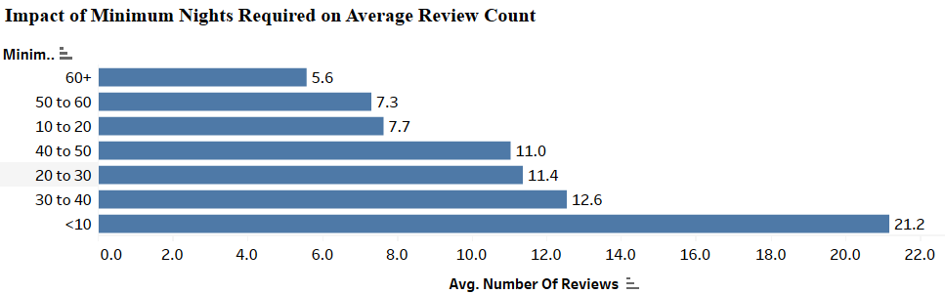
ENTIRE HOME/APT IS THE MOST PREFERRED ROOM TYPE ON AIRBNB DUE TO HIGHER AVAILABILITY OF MINIMUM NIGHTS STAY BOOKING WINDOWS
The preferred room types on Airbnb are Entire home/apt, followed by Private rooms and then Shared rooms. This is likely due to the availability of a higher number of minimum nights stay booking windows for Entire home/apt types compared to Private and Shared rooms.
The top neighborhoods for maximum minimum night stay bookings are "Brooklyn-Williamsburg", "Brooklyn-Bedford-Stuyvesant", "Manhattan-Harlem", "Brooklyn-Bushwick", and "Manhattan-Upper West Side". These areas are contributing to the high demand for properties in Manhattan and Brooklyn.
The two most important factors that influence a customer's preference for a property and the likelihood of leaving a review are the availability of a maximum or minimum night stay booking window and the property's openness for a greater number of days in a year.

Slide 9
RECOMMENDATIONS
Increase the availability of properties for booking by ensuring that hosts offer their properties for a maximum number of minimum night stays and for a greater number of days in a year, which can improve review ratings and revenue.
Focus on the top performing hosts, locations, and listings identified in the data to improve property acquisition and increase traction in low-priced neighborhoods like Staten Island and Brooklyn, where there is a higher number of reviews and demand for properties.
Consider offering competitive pricing options for popular neighborhoods like Manhattan and Brooklyn, where the average price range preferred by customers is higher than the actual price range offered, to attract more bookings and increase revenue.

Slide 10
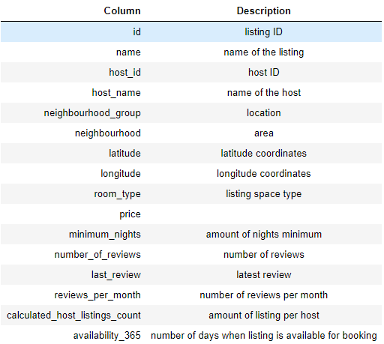
Appendix – Data Source The Columns In The Dataset Are Self-explanatory. You Can Refer To The Diagram Given Below To Get A Better Idea Of What Each Column Signifies.

Slide 11
Appendix – Data Methodology
Methodology Approach
Research Problem
Business Understanding
Types of Data Require
Data Source
Who are we presenting?
Analysis Done
Recommendations
Method of Analysis along with code
Data Understanding and Preparation
Variables Overview
Handling missing values and outliers
Feature selection/engineering
Analysing methods
Matrix used Analysis
Evaluation of Methods
Findings and Insights

Slide 12
Appendix: Data Assumptions
Reviews per Listing was used as a measure of popularity to gather insights on customer preferences.
The number of reviews was assumed to be a valid measure to determine customer preferences.
Null values were assumed to have no significant impact on the analysis.

Slide 13

Thank you!

