Slide 1

UNLOCKING INSIGHTS FOR REVENUE GROWTH: AIRBNB DATA ANALYSIS IN NEW YORK
For Lead Data Analyst & Data Analysis Manager
Presented By,
Sudheer N Poojari, Jyothi Kappala, Hemant Kondhalkar

Slide 2
AGENDA
Objective Background Data Life Cycle & Analysis Method
Key Findings
Recommendations Appendix Data Source Data Methodology Data Model Assumptions
1
2
3
4
5
6

Slide 3
OBJECTIVES
Analyze the impact of Covid-19 on Airbnb's economic and market conditions.
Evaluate the current state of Airbnb revenue in New York and identify key factors that influence revenue growth.
Assess the challenges and gaps in the research and data preparation phases and propose solutions.

Slide 4
Background
The top three neighborhoods account for 40% of all Airbnb rentals in NYC.
The average price per night for the top three neighborhoods is $186, which is 22% higher than the citywide average.
The three most common types of rentals in NYC are private rooms (45%), entire apartments (43%), and shared rooms (9%).

Slide 5
DATA LIFE CYCLE & ANALYSIS METHOD
Collected and cleaned relevant data on Airbnb's revenue in New York and conduct exploratory data analysis to identify key factors that impact revenue growth.
Used regression analysis to identify the relationship between revenue and other variables such as occupancy rates, seasonality, and location, and create new features from the existing data to extract more meaningful insights.
Prepared the data for analysis by standardizing variables, encoding categorical variables, and using data visualization techniques to present the findings in a clear and concise manner to facilitate understanding and decision-making.

Slide 6
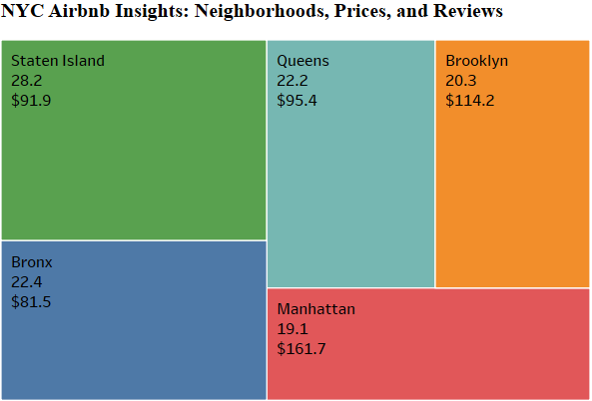
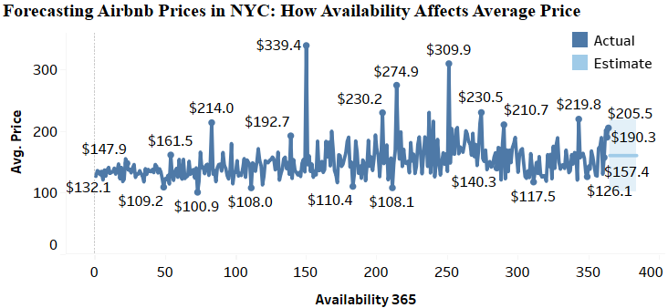
Decoding Airbnb Growth in NY: Property, Customer, & Host Insights
Manhattan offers the highest priced properties on the Airbnb platform, with an average price of $161, followed by Brooklyn with an average price of $114.
Majority of customers prefer a price range between $81 to $160, as reflected in their reviews, and it is forecasted to stay around $160 in the future.
Hosts typically list less than 2 properties on average, with an average price range between $80 to $170, with the exception of Manhattan where some hosts list more than 10 properties.

Slide 7
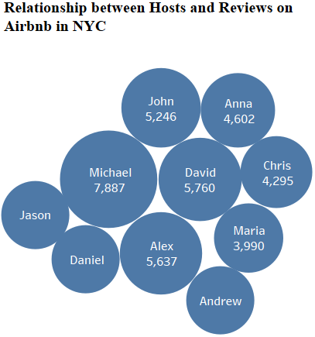
NYC Airbnb Top Performers: Insights on Hosts, Locations, and Listings
Top 5 hosts: Michael, David, Alex, John, and Anna have the highest number of reviews for their high-priced listings.
Top 5 locations: Staten Island - Silver Lake, Staten Island - Richmondtown, Staten Island - Eltingville, Staten Island - Huguenot, and Brooklyn - Manhattan Beach have the lowest price range and the highest number of reviews.
Top 5 high-priced listings: "NYC LUXURY3 BEDROOMS IN MIDTOWN EAST & GYM& BALCONY" in Manhattan-Murray Hill, "Modern Duplex - Central Chelsea!!!" in Manhattan-Chelsea, "Upper West Side elegance. Riverside" in Manhattan-Upper West Side, "Spacious & Bright 3BRs NearSubways, Parks, Shops" in Brooklyn-Cobble Hill, and "An Artist's Inspiration: Sun-Soaked Chelsea Loft" in Manhattan-Chelsea have the highest price offerings.

Slide 8
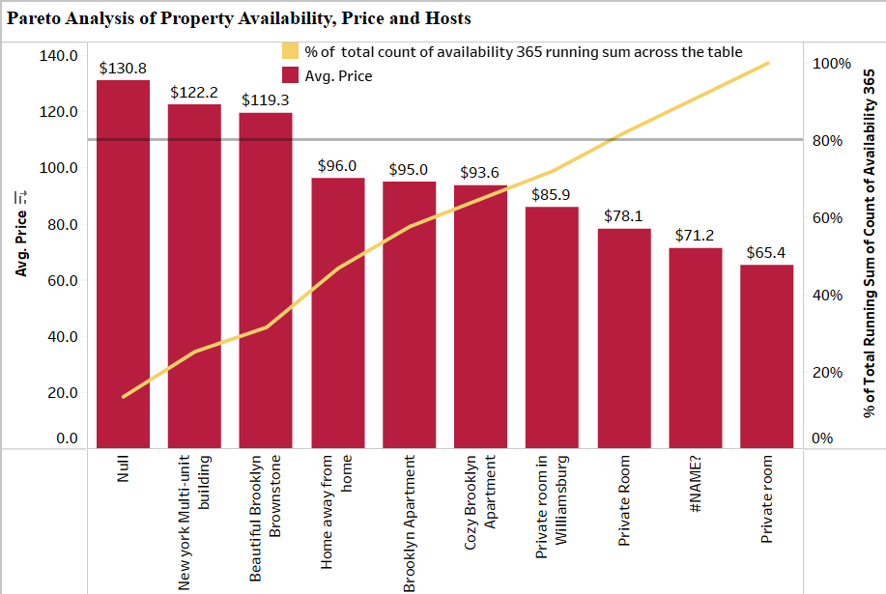
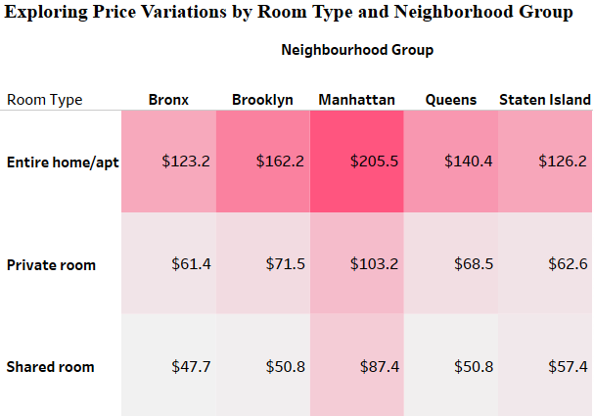
Manhattan's Priciest Accommodations and Affordable Options in Williamsburg, Cozy Brooklyn with High Availability
The 'Entire home/apt' room type in Manhattan is the most expensive at $205, while 'Private rooms' in Manhattan and Brooklyn have the highest average prices.
The cheapest room type is 'Shared room', with the lowest average price of $50.5 in Brooklyn.
Williamsburg, Cozy Brooklyn, and Home Away from Home have the highest availability and lower prices ($85 & $93), making them great choices for customers.

Slide 9
RECOMMENDATIONS
Increase the focus on high-priced listings in Manhattan, which is the most lucrative area on the platform, and prioritize marketing efforts toward the properties of the top 5 hosts with the highest number of reviews.
Capitalize on the majority of customers' preference for a price range between $81 to $160, as reflected in their reviews, by encouraging hosts to price their listings within this range to increase demand and revenue.
Improve the data preparation phase by standardizing data collection and cleaning processes and incorporating advanced analytics tools to automate the data cleaning and feature engineering processes, to improve the accuracy and efficiency of the analysis.

Slide 10
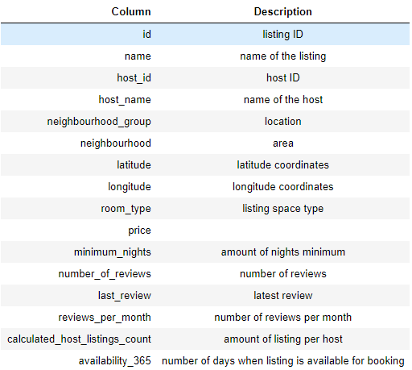
Appendix – Data Source The Columns In The Dataset Are Self-explanatory. You Can Refer To The Diagram Given Below To Get A Better Idea Of What Each Column Signifies.

Slide 11
Appendix – Data Methodology
Training Methods
Python for data understanding, pre-processing, and general univariate and multivariate analysis
Tableau used for in-depth bivariate and multivariate analysis
Methodology Approach
Research problem
Business understanding
Types of data required
Data sources
Audience
Analysis conducted
Recommendations
Method of Analysis
Data understanding and preparation
Variables overview
Handling missing values and outliers
Feature selection/engineering
Analysis methods
Matrix used in analysis
Evaluation of methods
Findings and Insights

Slide 12
DATA MODEL ASSUMPTIONS
The revenue of an Airbnb rental property is primarily determined by factors such as occupancy rates, seasonality, location, and price, as well as other variables that may impact revenue growth.
The data collected on Airbnb rentals in New York is representative of the overall market, and there are no significant biases or missing data that could impact the accuracy of the analysis.
The relationships between different variables such as occupancy rates and price are linear, and there are no significant interactions or nonlinear effects that need to be accounted for in the analysis.

Slide 13

Thank you!

