Slide 1
DOCKER

Slide 2
CONTENTS
Introduction to Docker
Docker vs. VM
Basic Docker Commands
Docker Networking
Building Custom Image
Docker Best Practices
Docker Volumes
Pushing Docker Images to Registry
Docker Compose

Slide 3
Introduction to Docker
Problem Statements
How Docker solve these problems
Docker Overview
Docker Architecture

Slide 4
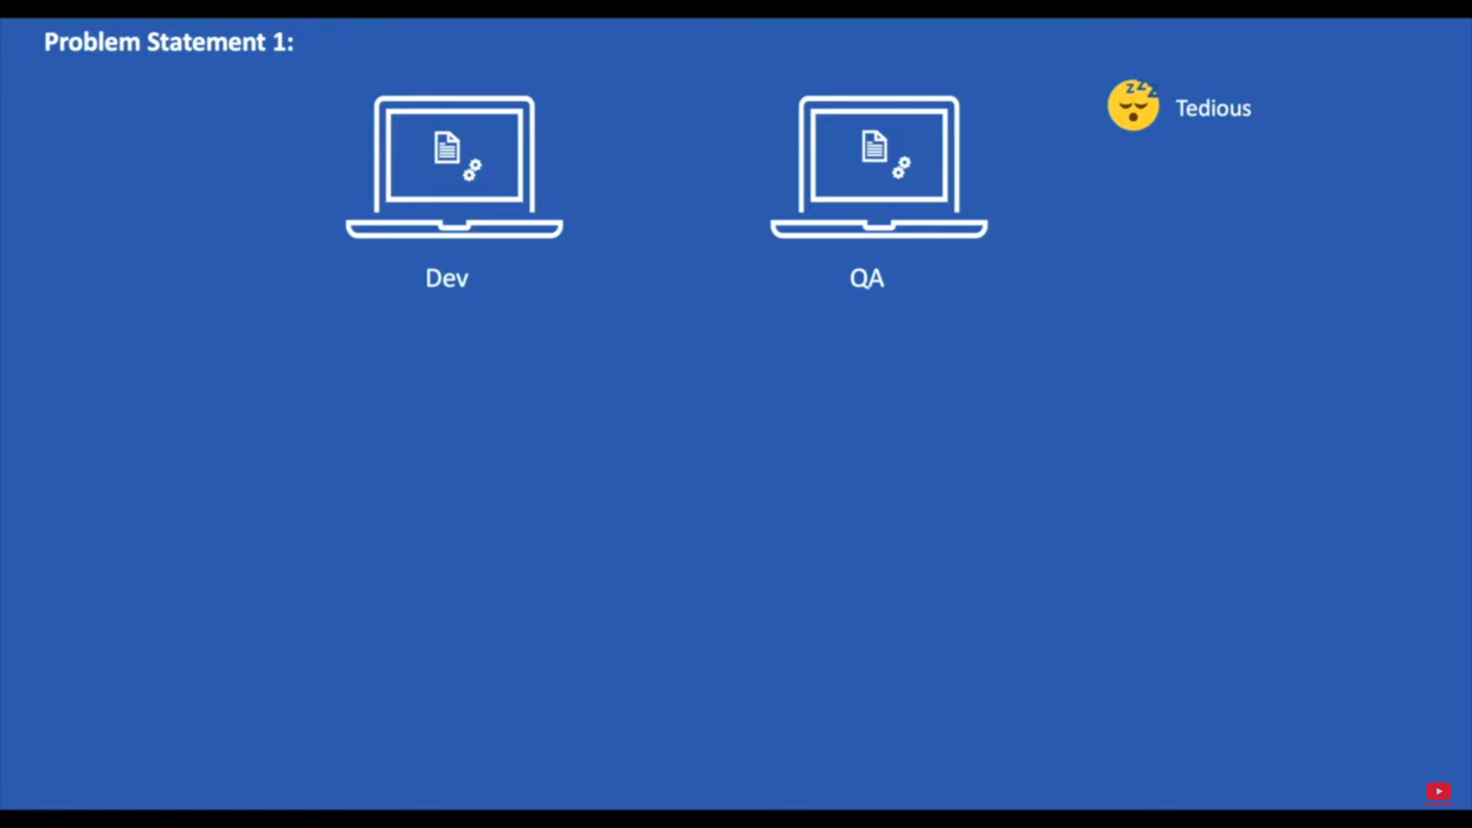

Slide 5
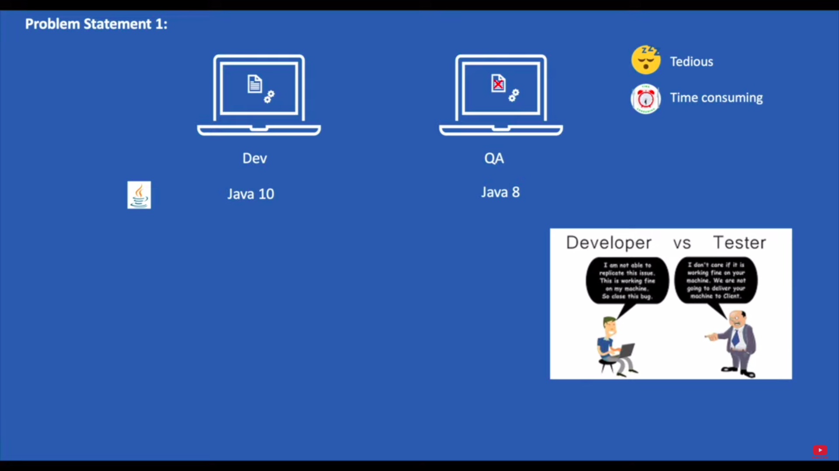

Slide 6
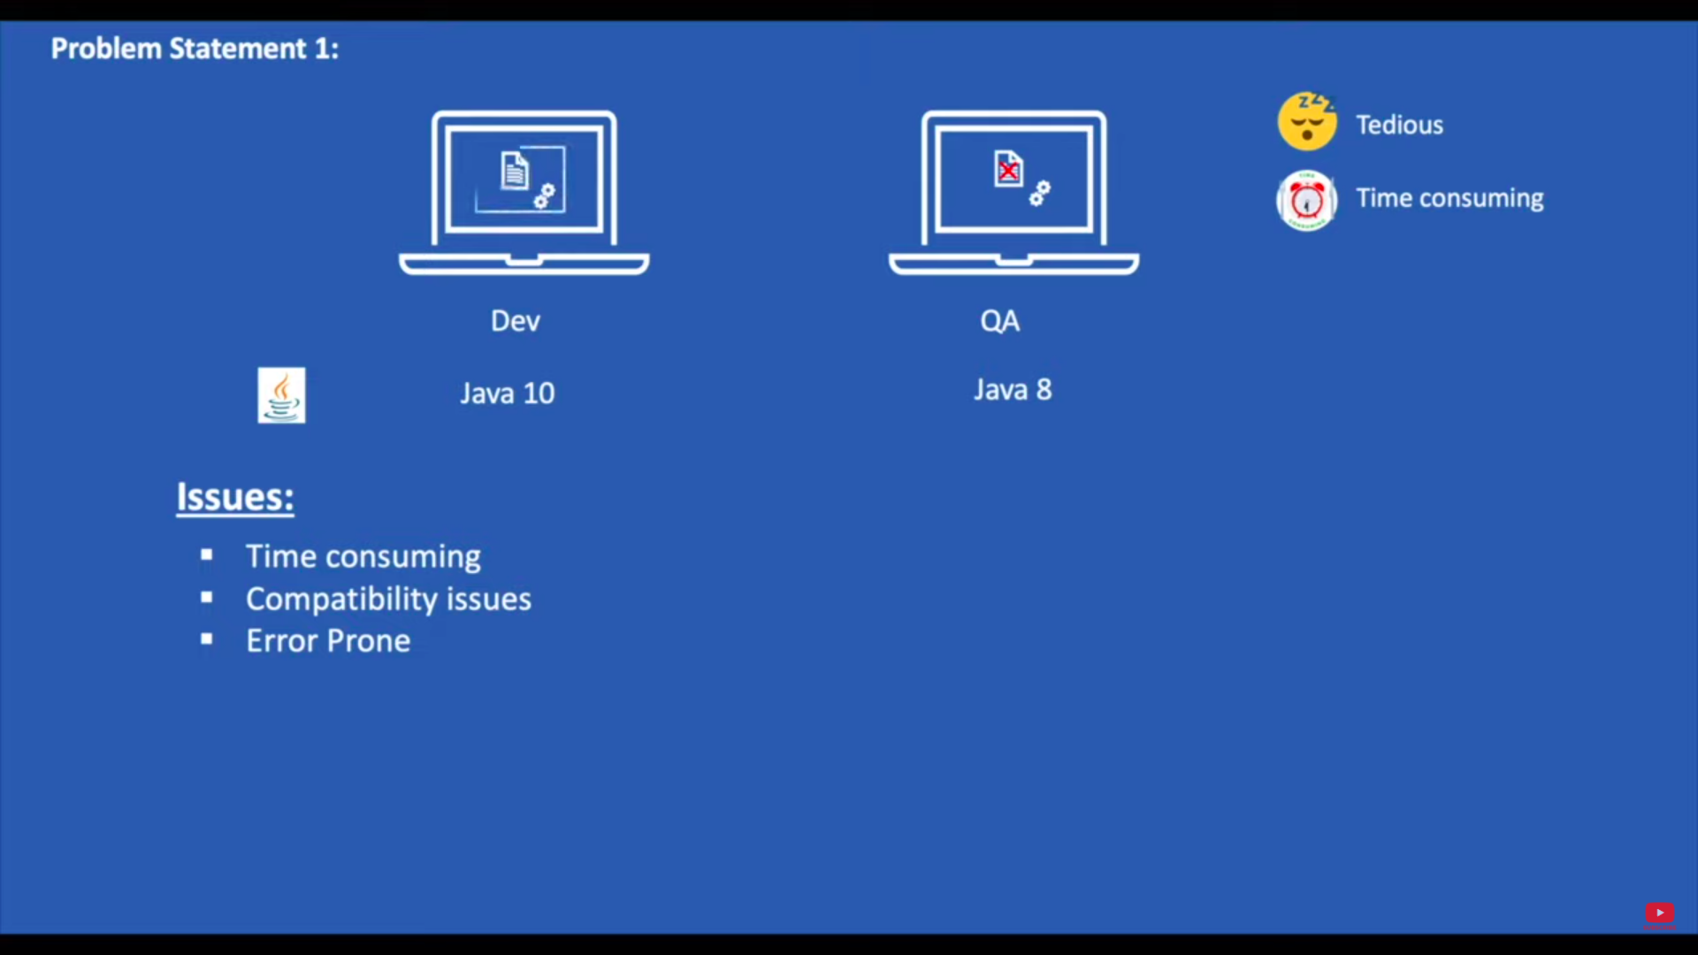

Slide 7
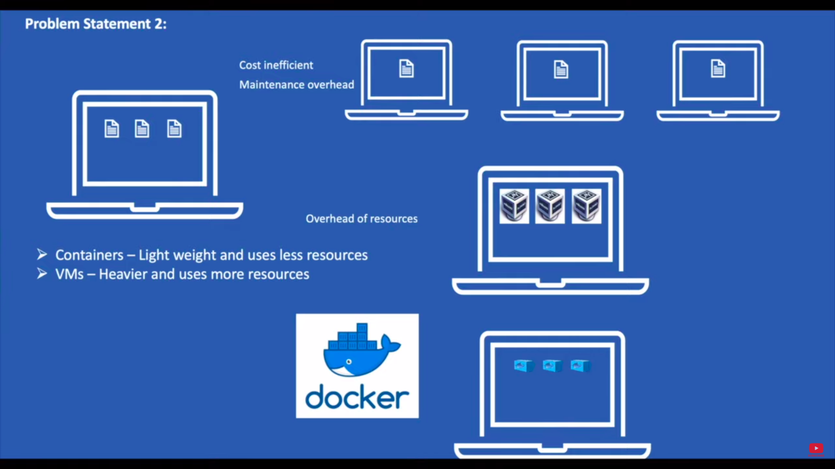

Slide 8
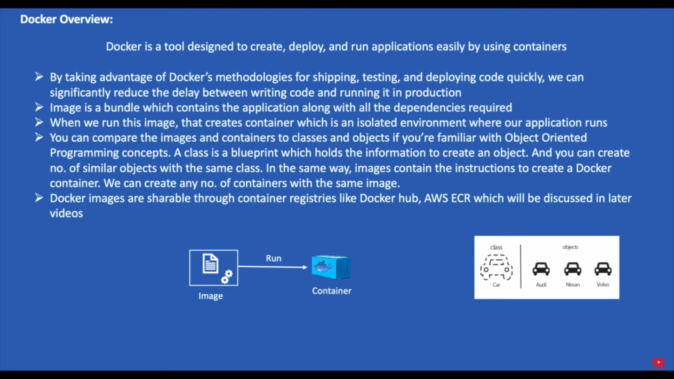

Slide 9
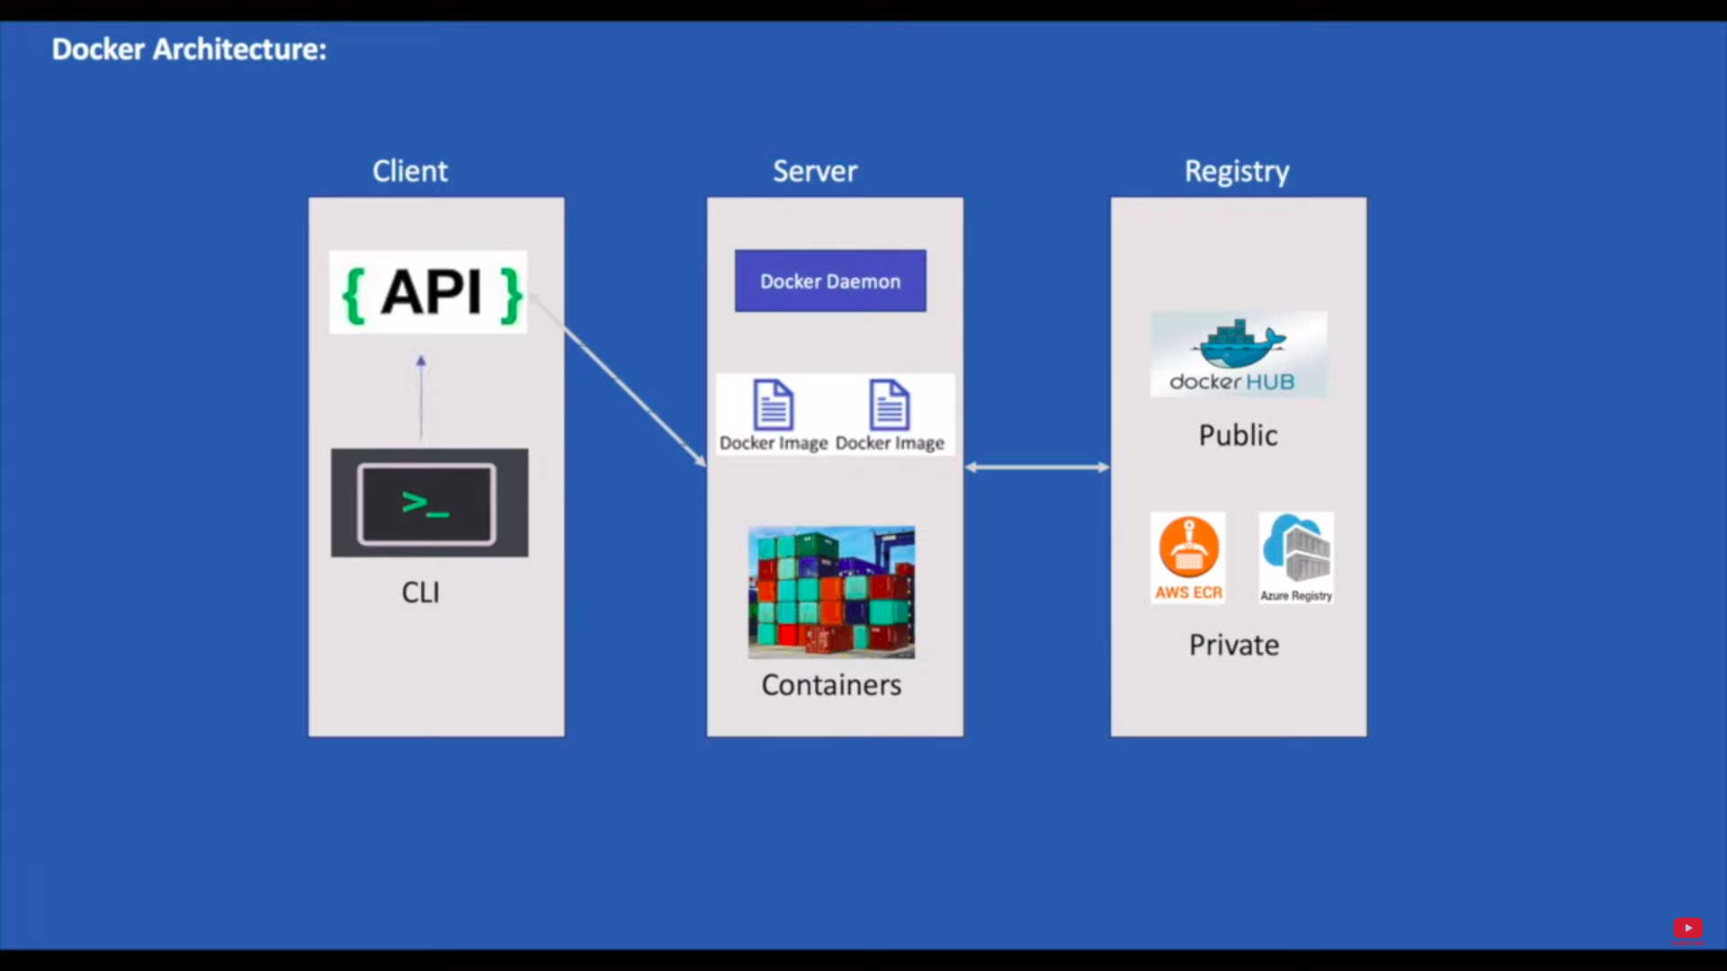

Slide 10
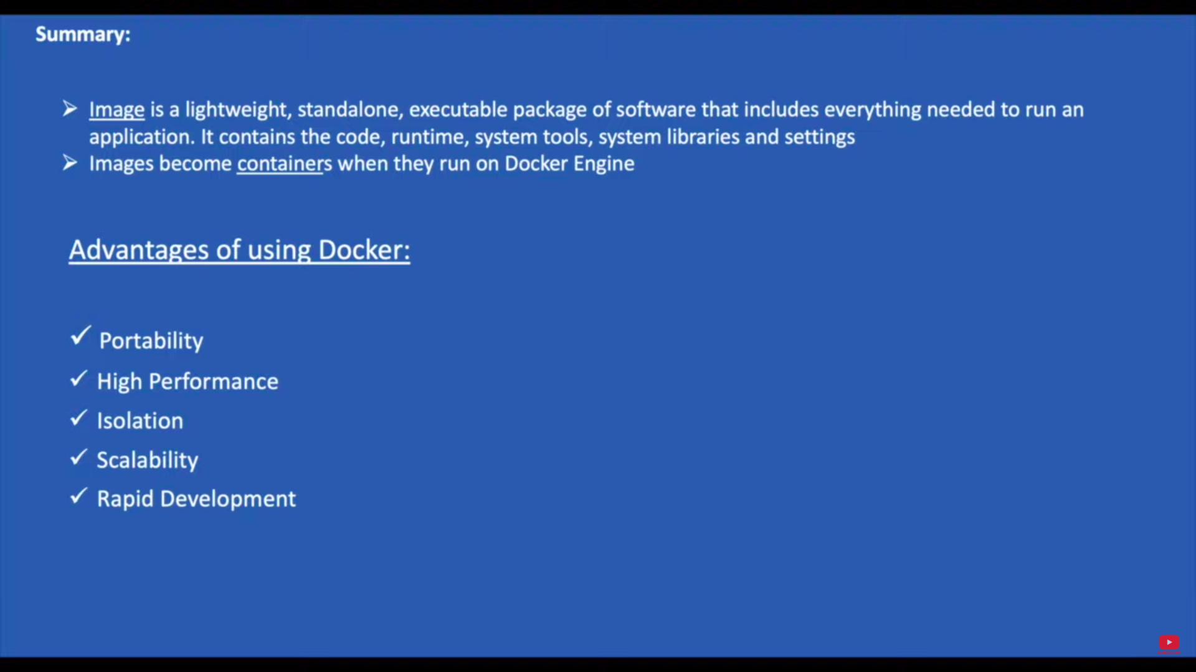

Slide 11
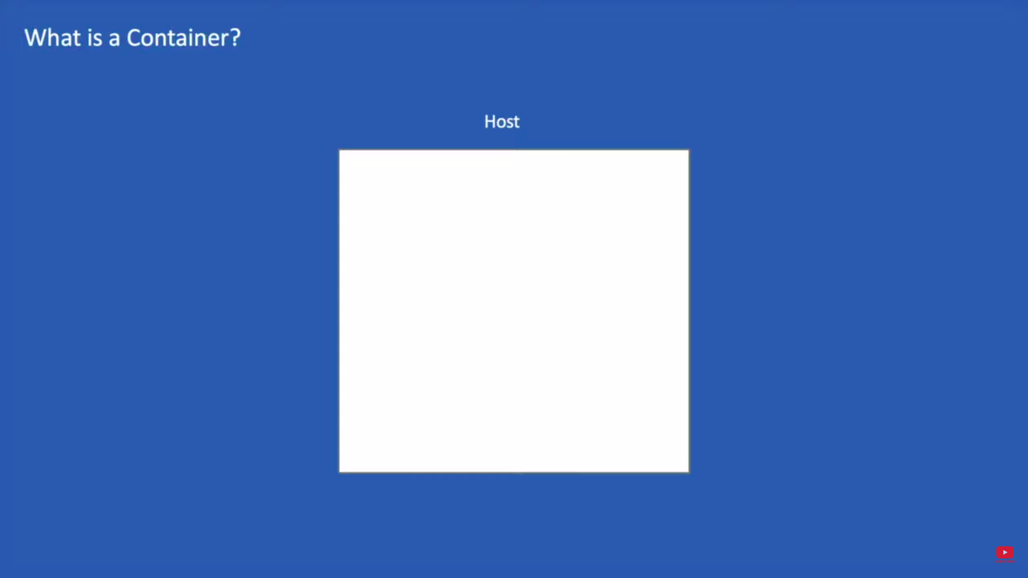

Slide 12
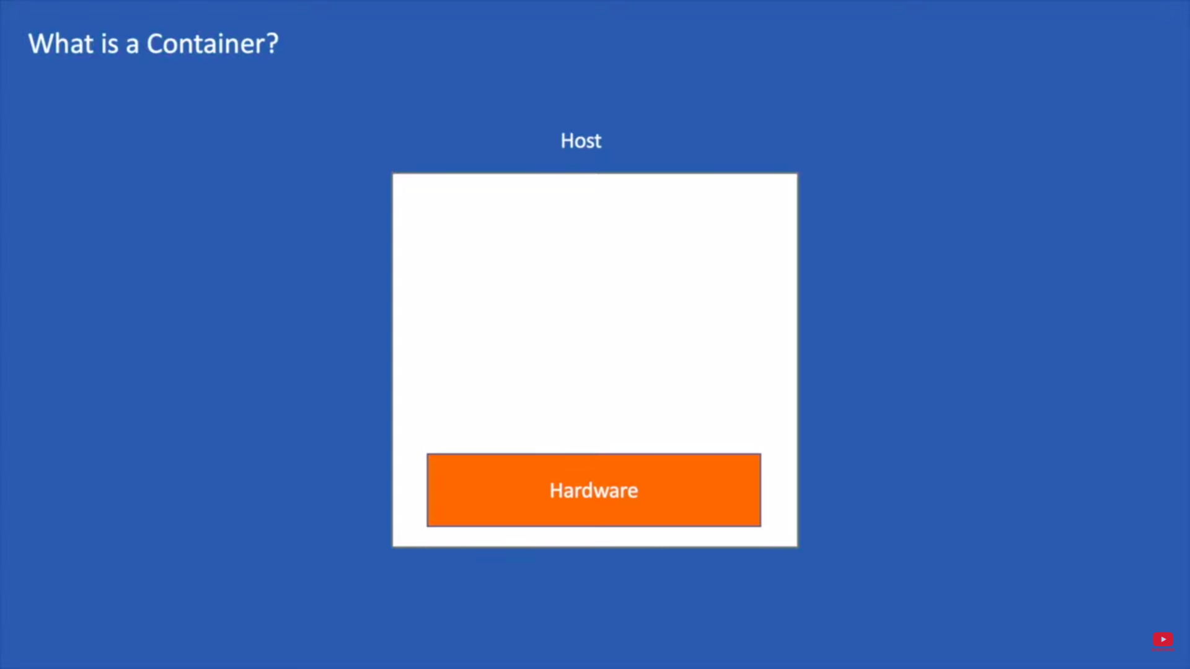

Slide 13
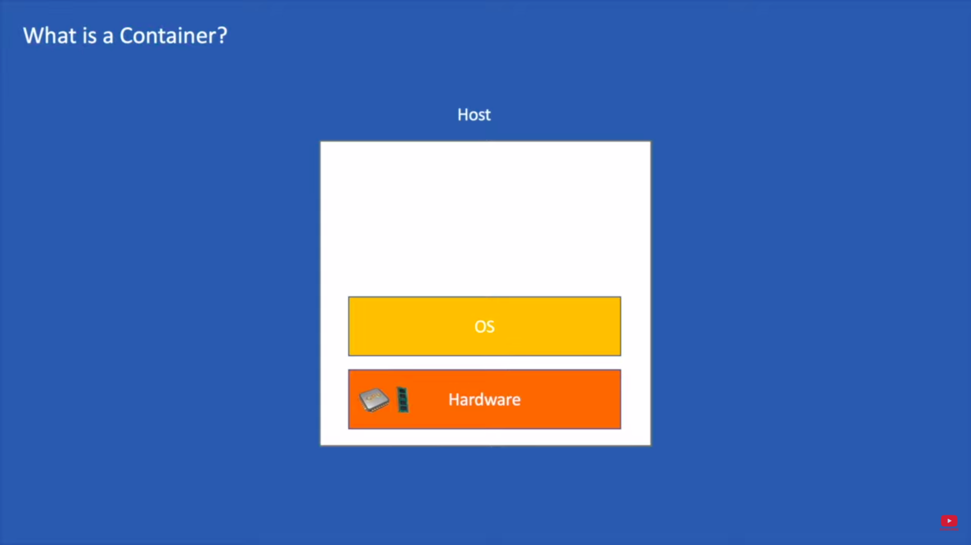

Slide 14
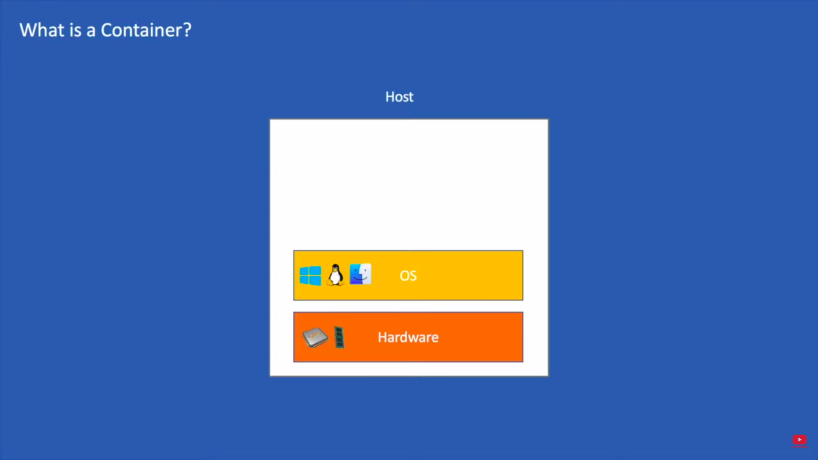

Slide 15
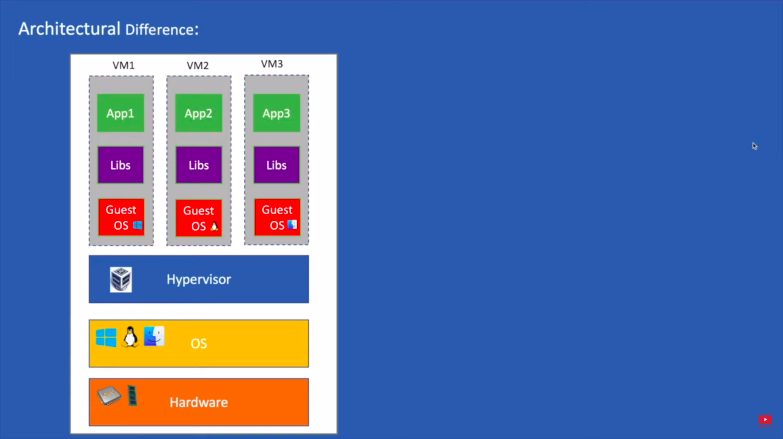

Slide 16
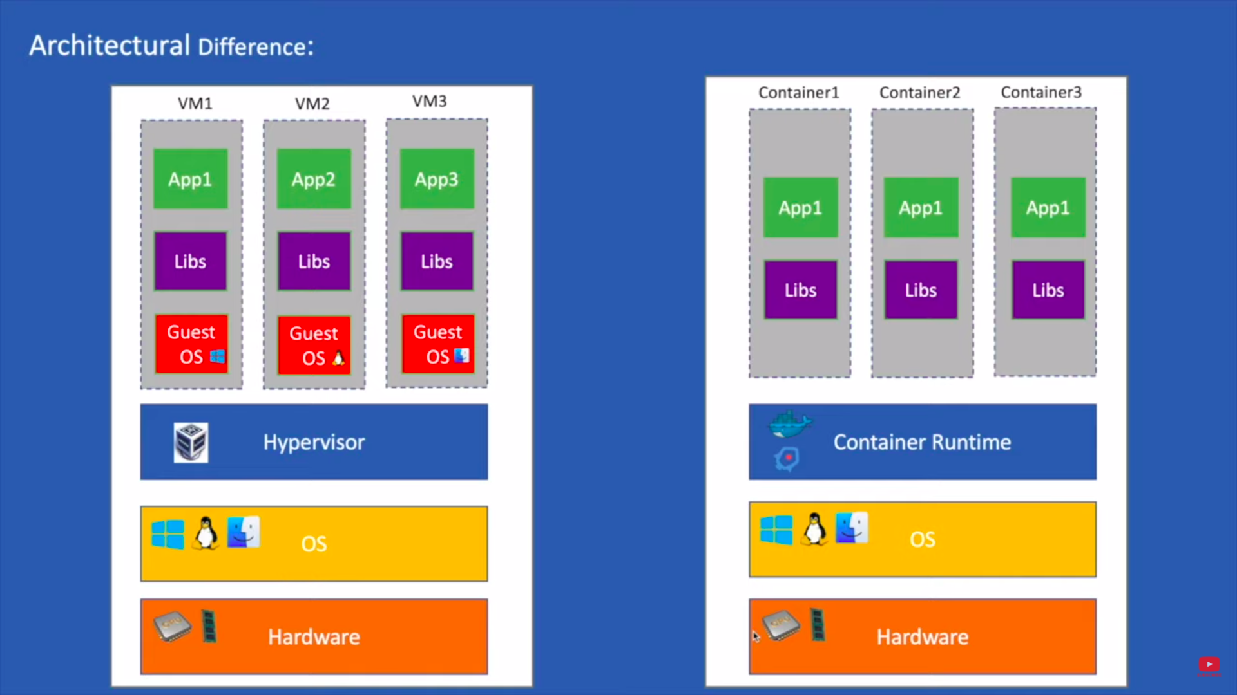

Slide 17
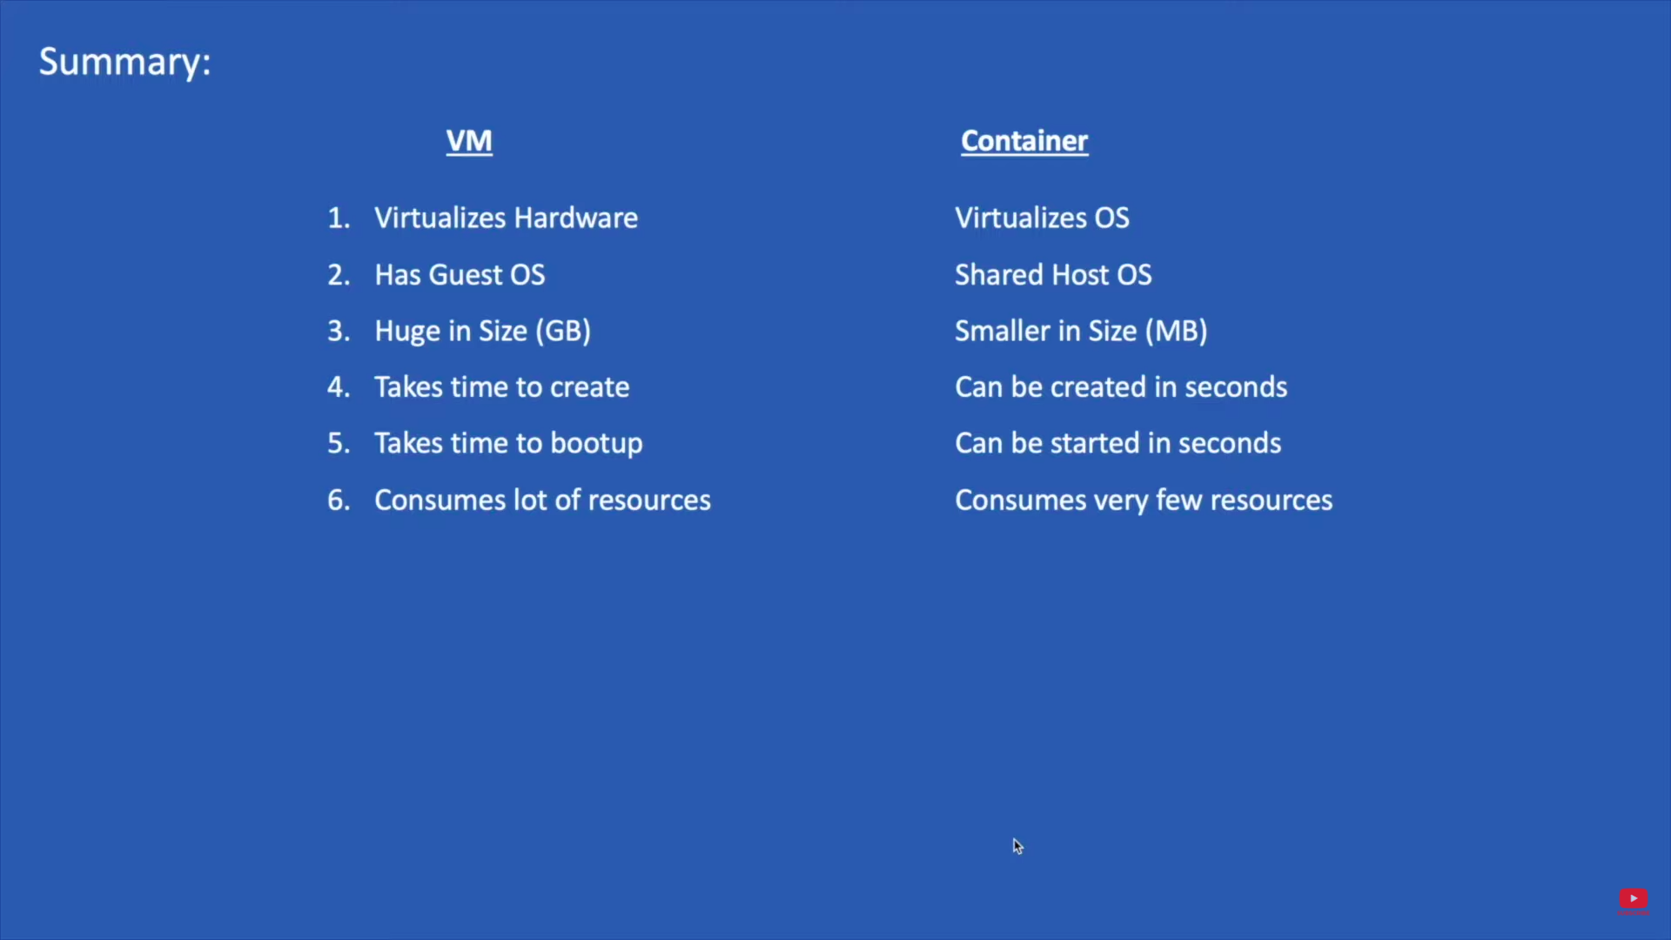

Slide 18
BASIC DOCKER COMMANDS
Pulling images from docker hub
docker pull imagename
/You can pull specified version if you want to
To display docker images
docker images
To create a container
/We need to run image inorder to create a container but it can done in both attach and detach mode

Slide 19
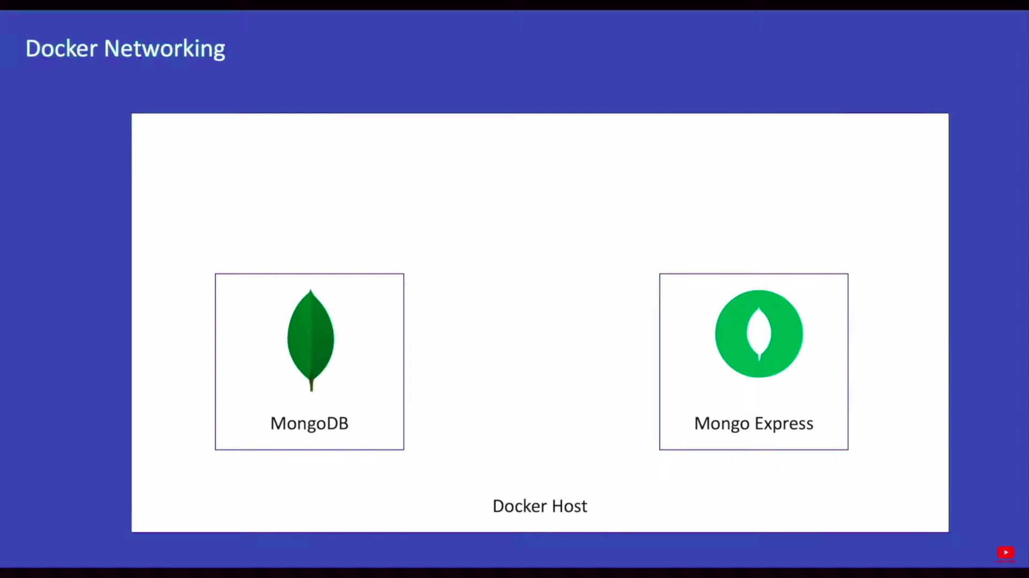
Docker Networking

Slide 20
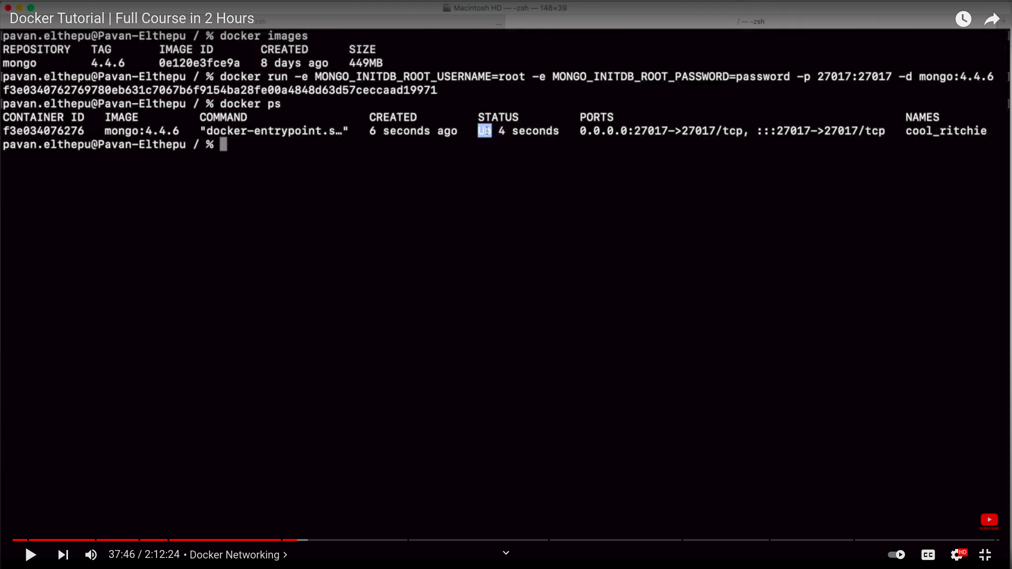

Slide 21
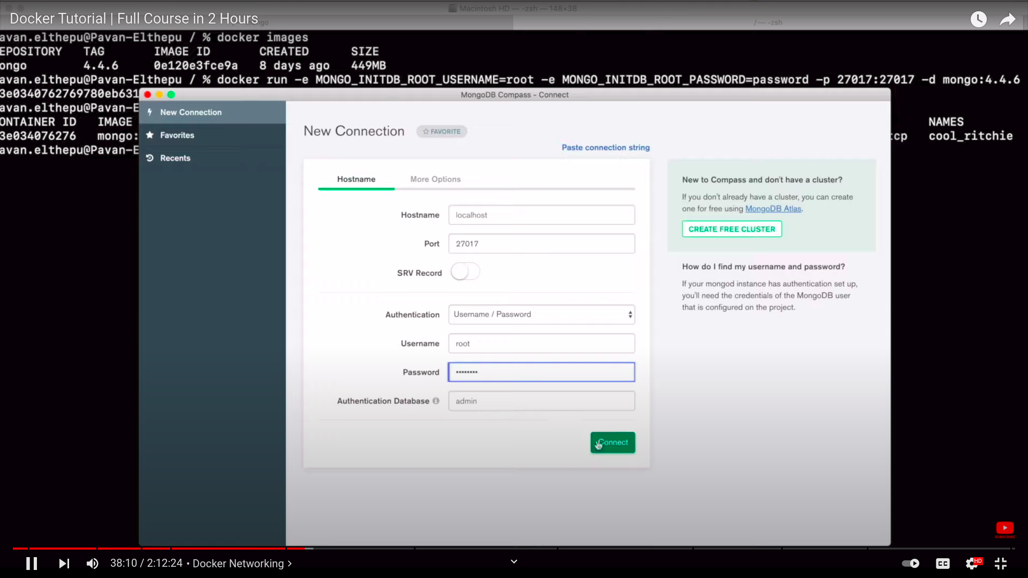

Slide 22
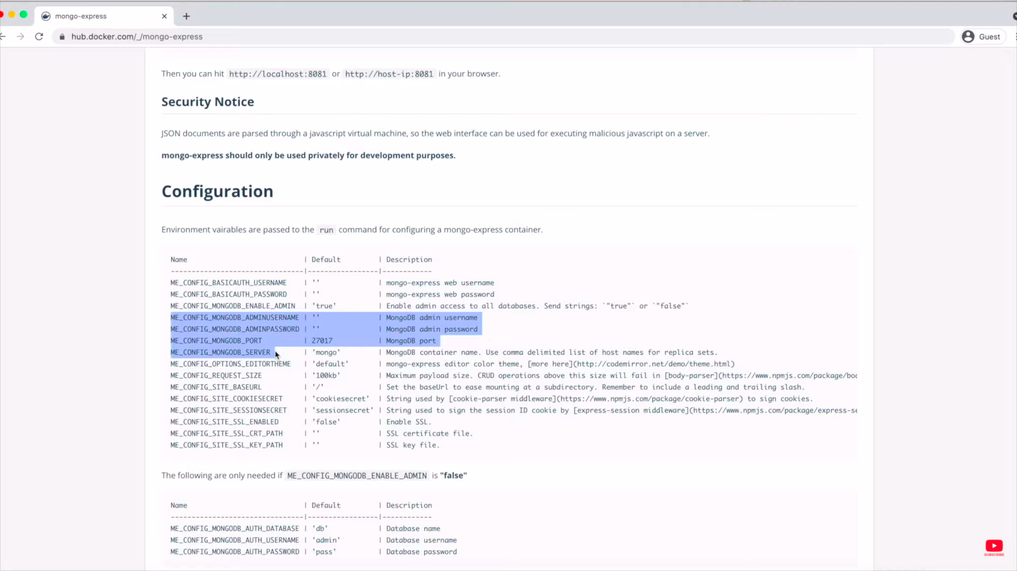

Slide 23
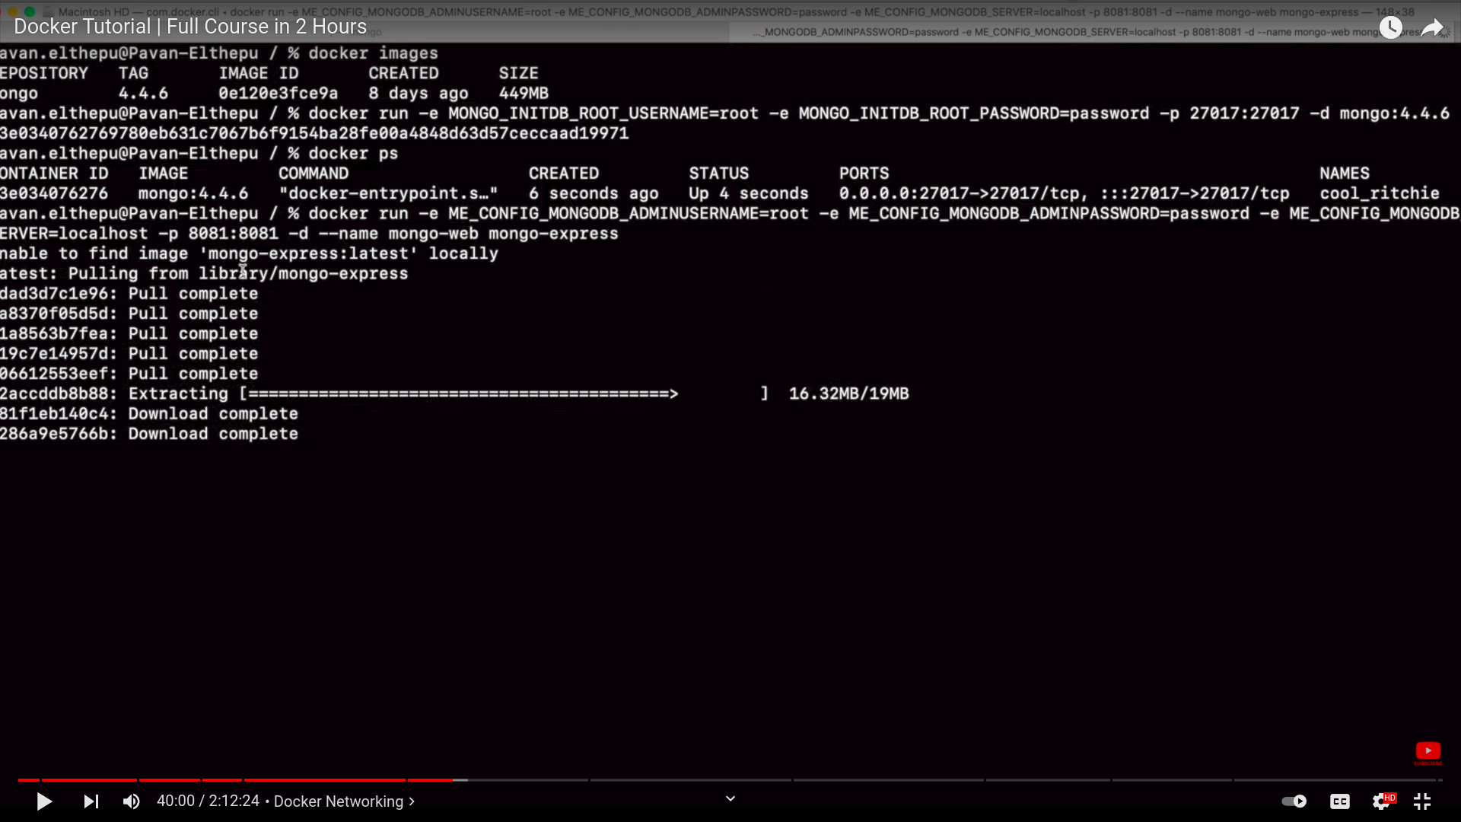

Slide 24
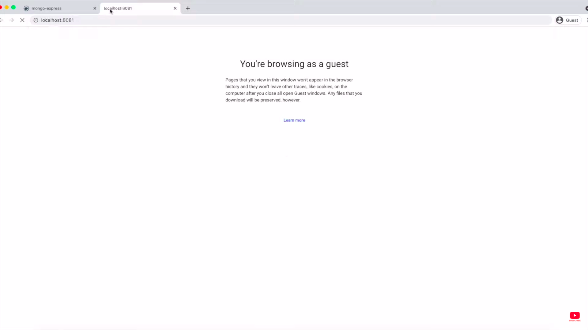

Slide 25
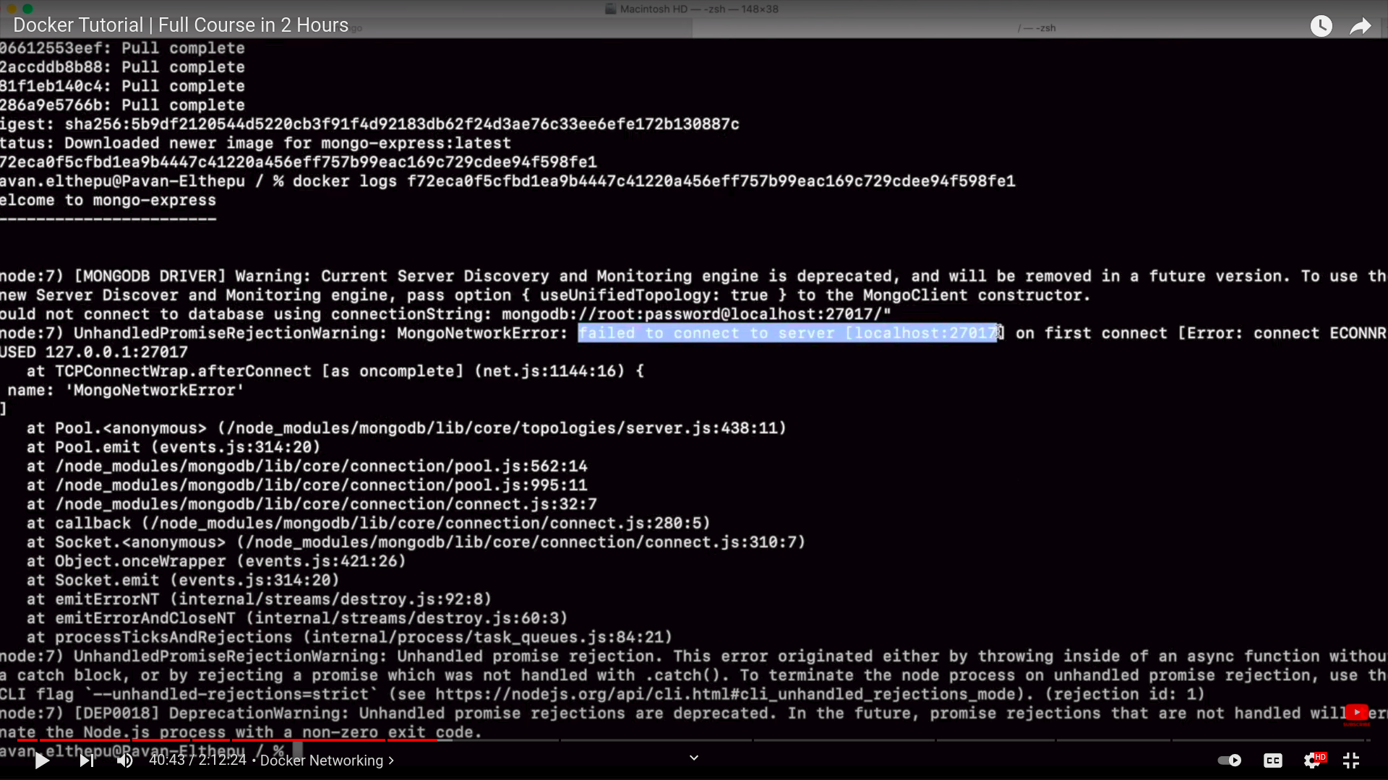

Slide 26
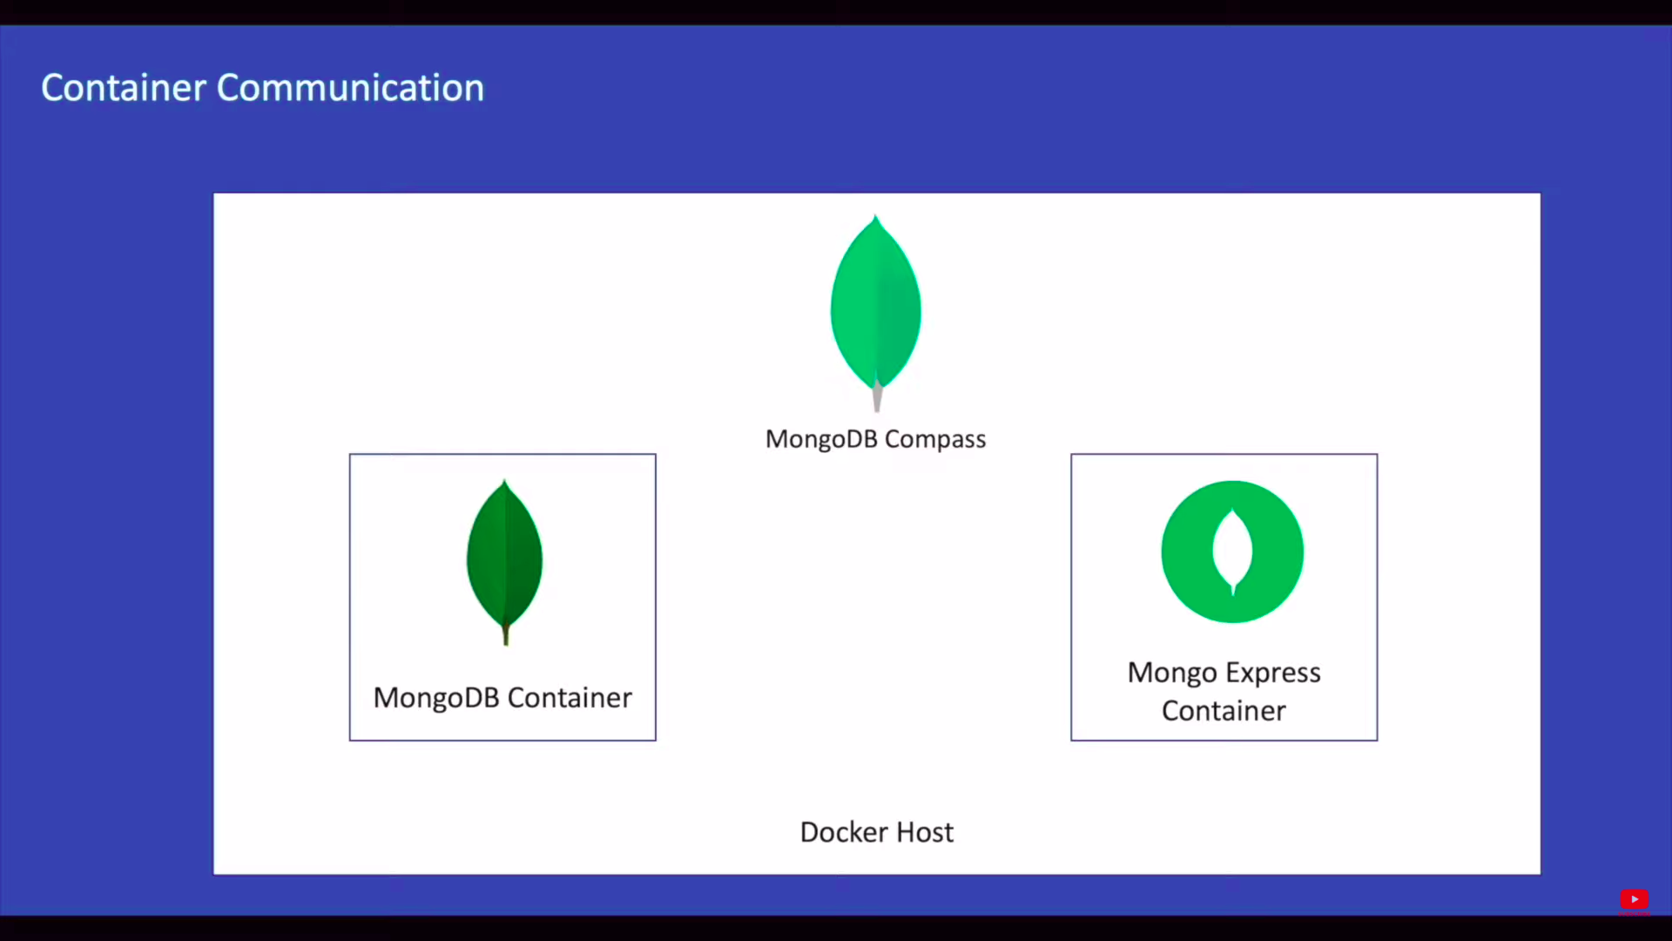
Let's see what's happening here at the moment we have two containers on our docker host one is mongodb and the other one is mango express we also have compass which is desktop application
Note that it's not containerized meaning we didn't run this with docker we tried to access mongodb with localhost using compass and it worked but the same thing with express is not working here we are trying to access mongodb container from the mango express container when you say local host from the container it's not same as local host from your host
The container doesn't have any idea of what's going on outside unless we explicitly mention it as we discussed earlier when a container is created it gets a unique ip address so instead of giving localhost let's give ip address of the container and see what happens

Slide 27
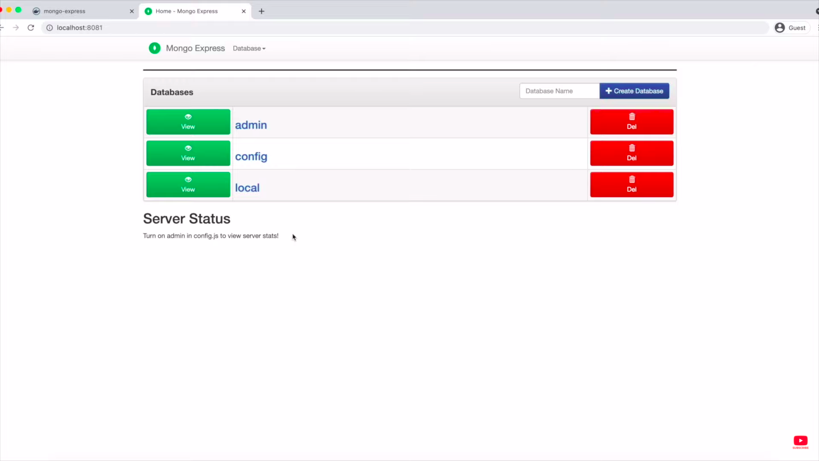
IP ADDRESS
Inorder to find the ip address of a container
docker inspect container id
docker inspect cid | grep IPaddress

Slide 28
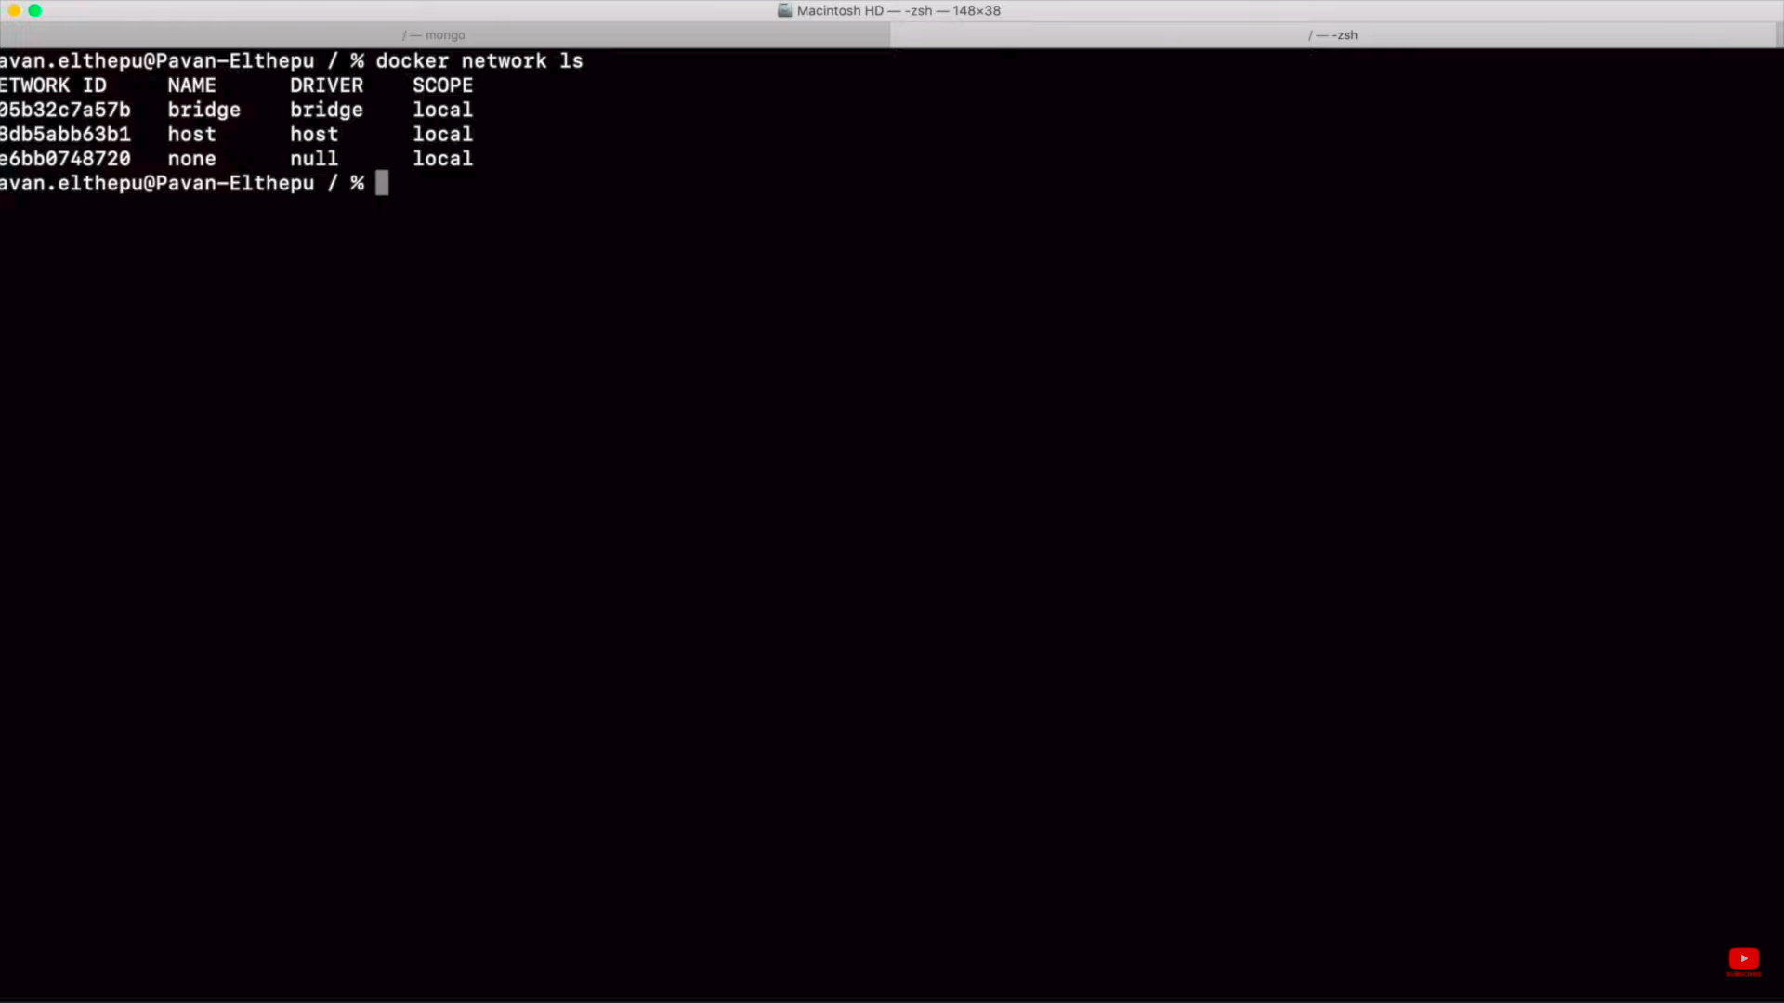
Docker Network
What If IP address changes to any reason?
Is there a way to refer mongo db on the name of the container?

Slide 29
None Network
None Network:If you have a container in this none network you will not be able to access anything outside this container except the resources of that container
The purpose of container is not to host any operating system the purpose of container is to run some service or to run some computation in the container when there is no service in the container immediately it gets exited

Slide 30
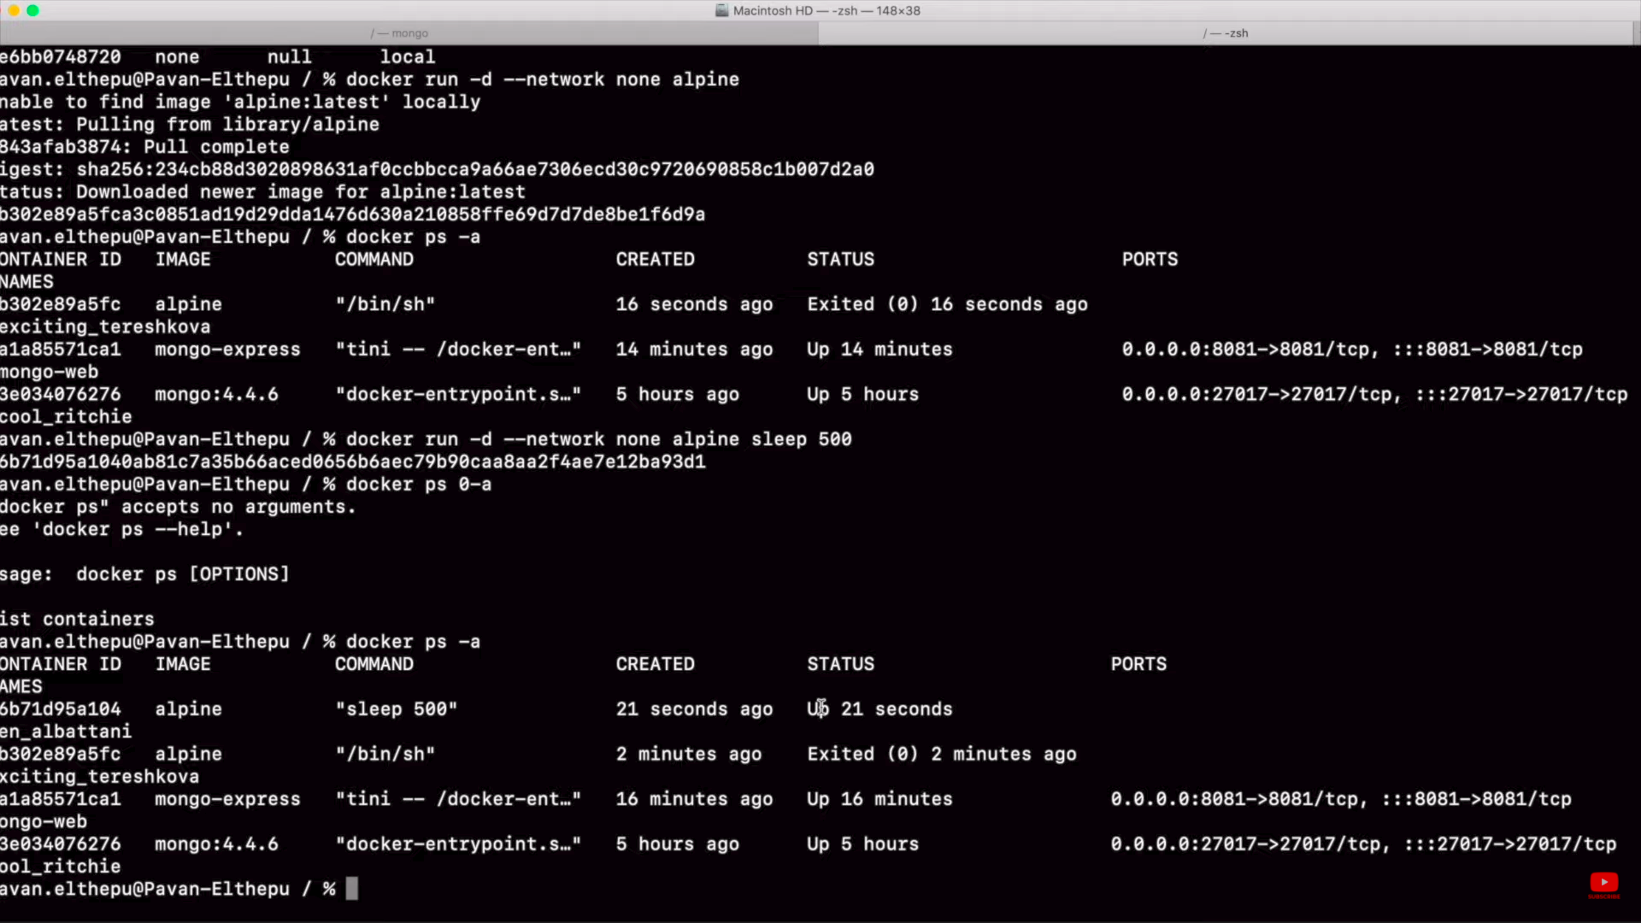

Slide 31
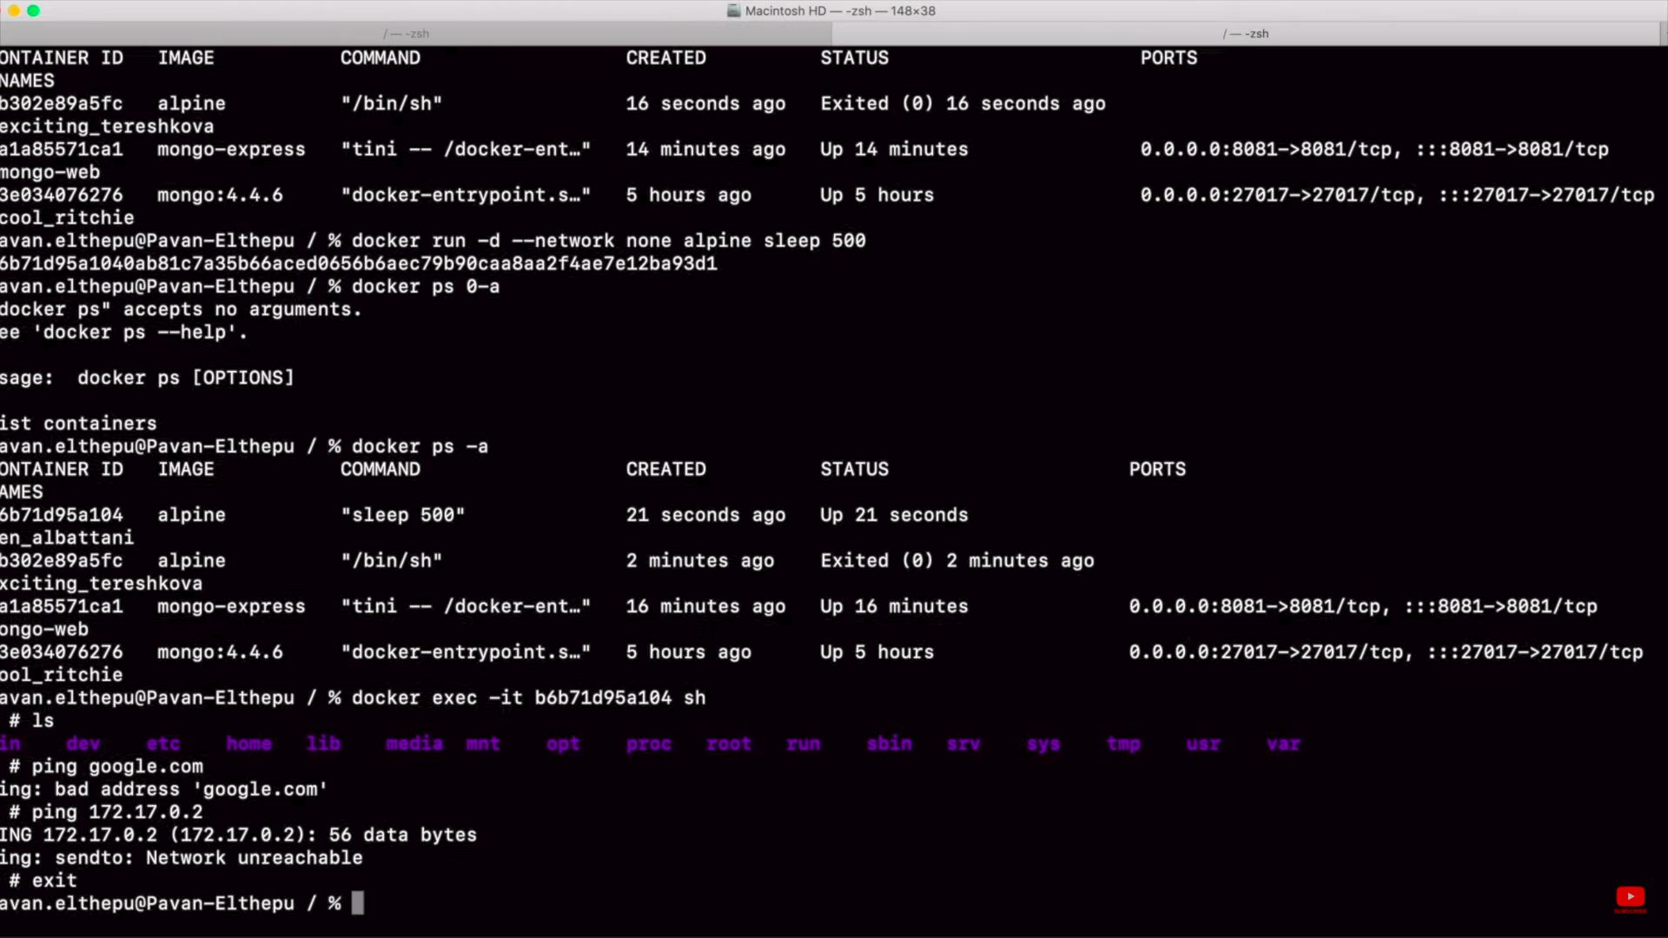

Slide 32
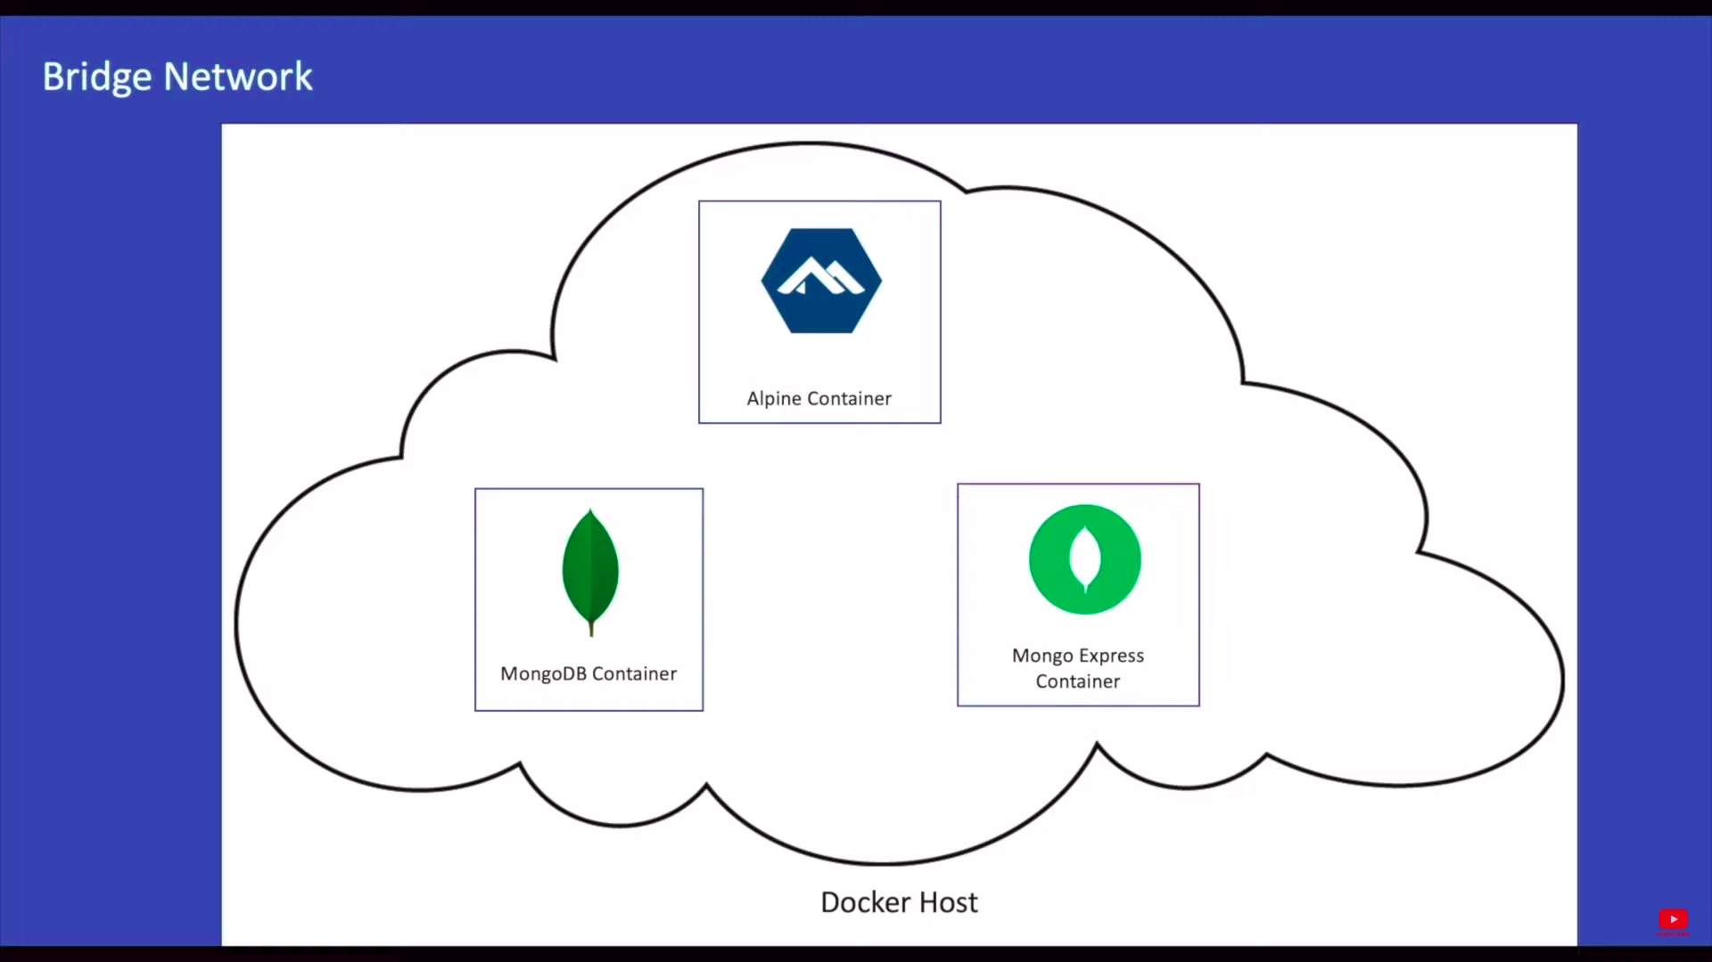
Bridge Network
Bridge networks can access external resources and containers in the same network
In the default bridge network we have alpine container running and we have db container running and also express container this running as we didn't give any network while creating this mongodb and express container by default they get added to the default bridge network now these three containers can communicate with each other that's reason we could able to access the mongodb container from the mango express container using the ip address of the mongodb container but our goal was to access the container with the name of the container

Slide 33
Bridge Network
Inorder to create docker bridge network
docker network create mongo-net –driver bridge
Inorder to delete all containers in single command
docker stop ${docker ps -a}

Slide 34
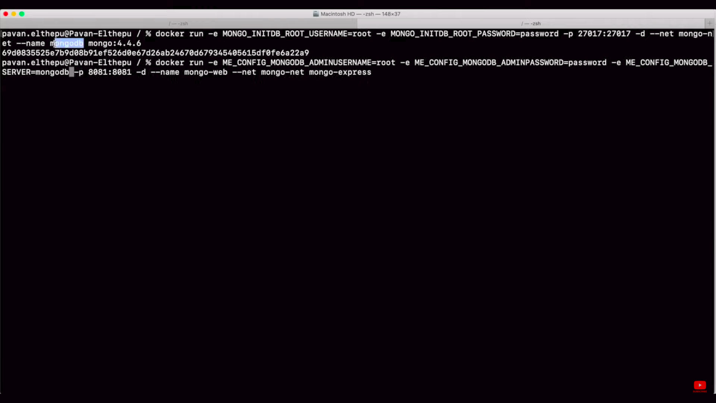

Slide 35
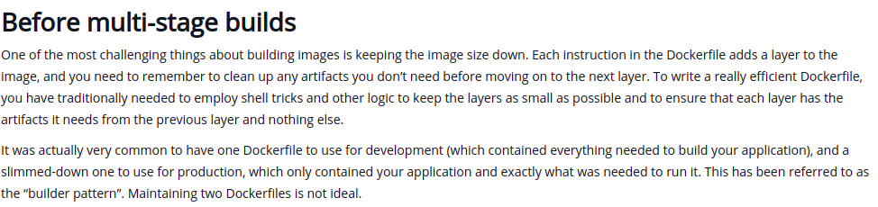
Docker Best Practices-Multi Stage Building

Slide 36
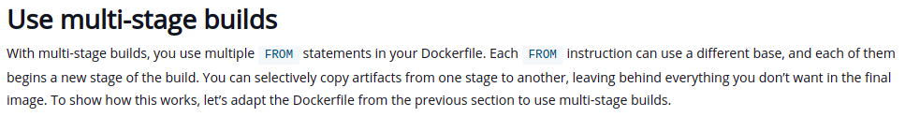
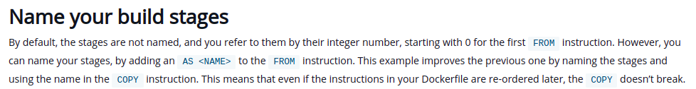
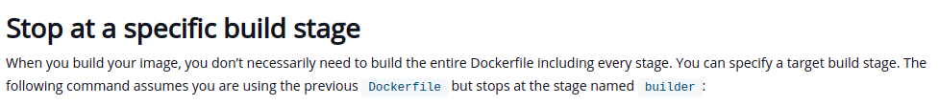
Multi Stage Building

Slide 37
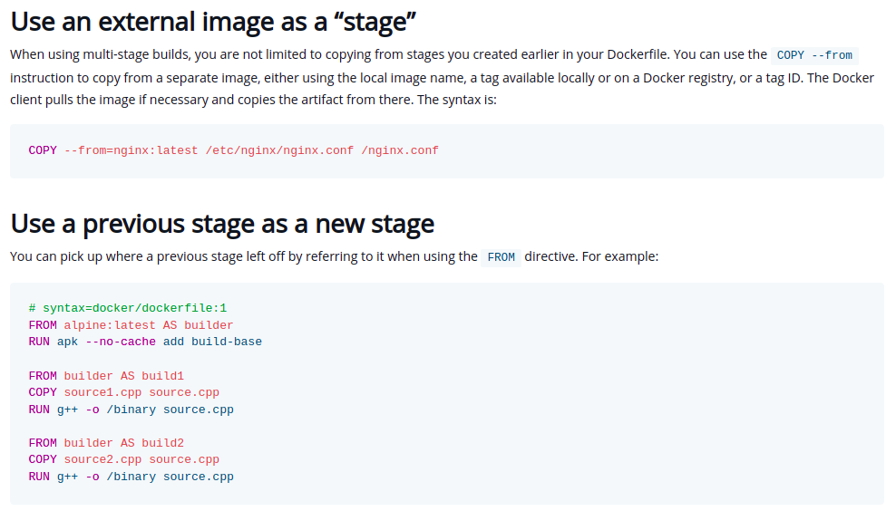
Multi Stage Building

Slide 38
Docker Layer Caching
First look at docker layer caching
Docker layers are quite handy — as they contain the state of the docker image at each milestone, and are saved on the local filesystem, layers act as a cache. If nothing is changed in a layer (or any layers preceding it), we can simply re-use the files without the need to rebuild that particular layer (e.g. no need to run the command again — which in case of long running commands can save us a lot of time).
We said already that each command from the Dockerfile descriptor will result in a layer — each command also comes with the rules corresponding to it’s caching behaviour. For the commands we used:
WORKDIR — layer is cached unless the working directory changes
COPY — layer is cached unless any of the files or directories copied have changed since. This includes renaming files, changing the contents, created timestamp pr permission changes.
RUN — layer is cached unless the command changes (different script or different arguments)

Slide 39
Docker Layer Caching
How will this setup behave in different scenarios:
Changing the source code — as the last example we run, this is the bread and butter of developer’s work — we change the code, test it, release, and so on, in circles. Because the source is copied to the docker image last, all previous layers are cached, so only last few layers need to be rebuilt and we have the updated docker image ready in seconds
Changing or adding the dependency — this involves updating the package.json file, which in turn rebuilding all layers below — we run npm install again, followed by copying the source code — this takes longer time, similar to our initial build. But that’s expected — we need to install the dependencies if they change
Changing the base image — let’s say we upgrade to the latest node version. AS we’re updating the FROM command, which is the first layer encountered by the build process, none of the subsequent layers can be reused from the cache and needs to be rebuilt. This is also common sense — if upgrading the core dependency like the node version, we’d expect to rebuild the entire image to ensure all dependencies are compatible with the change.

Slide 40
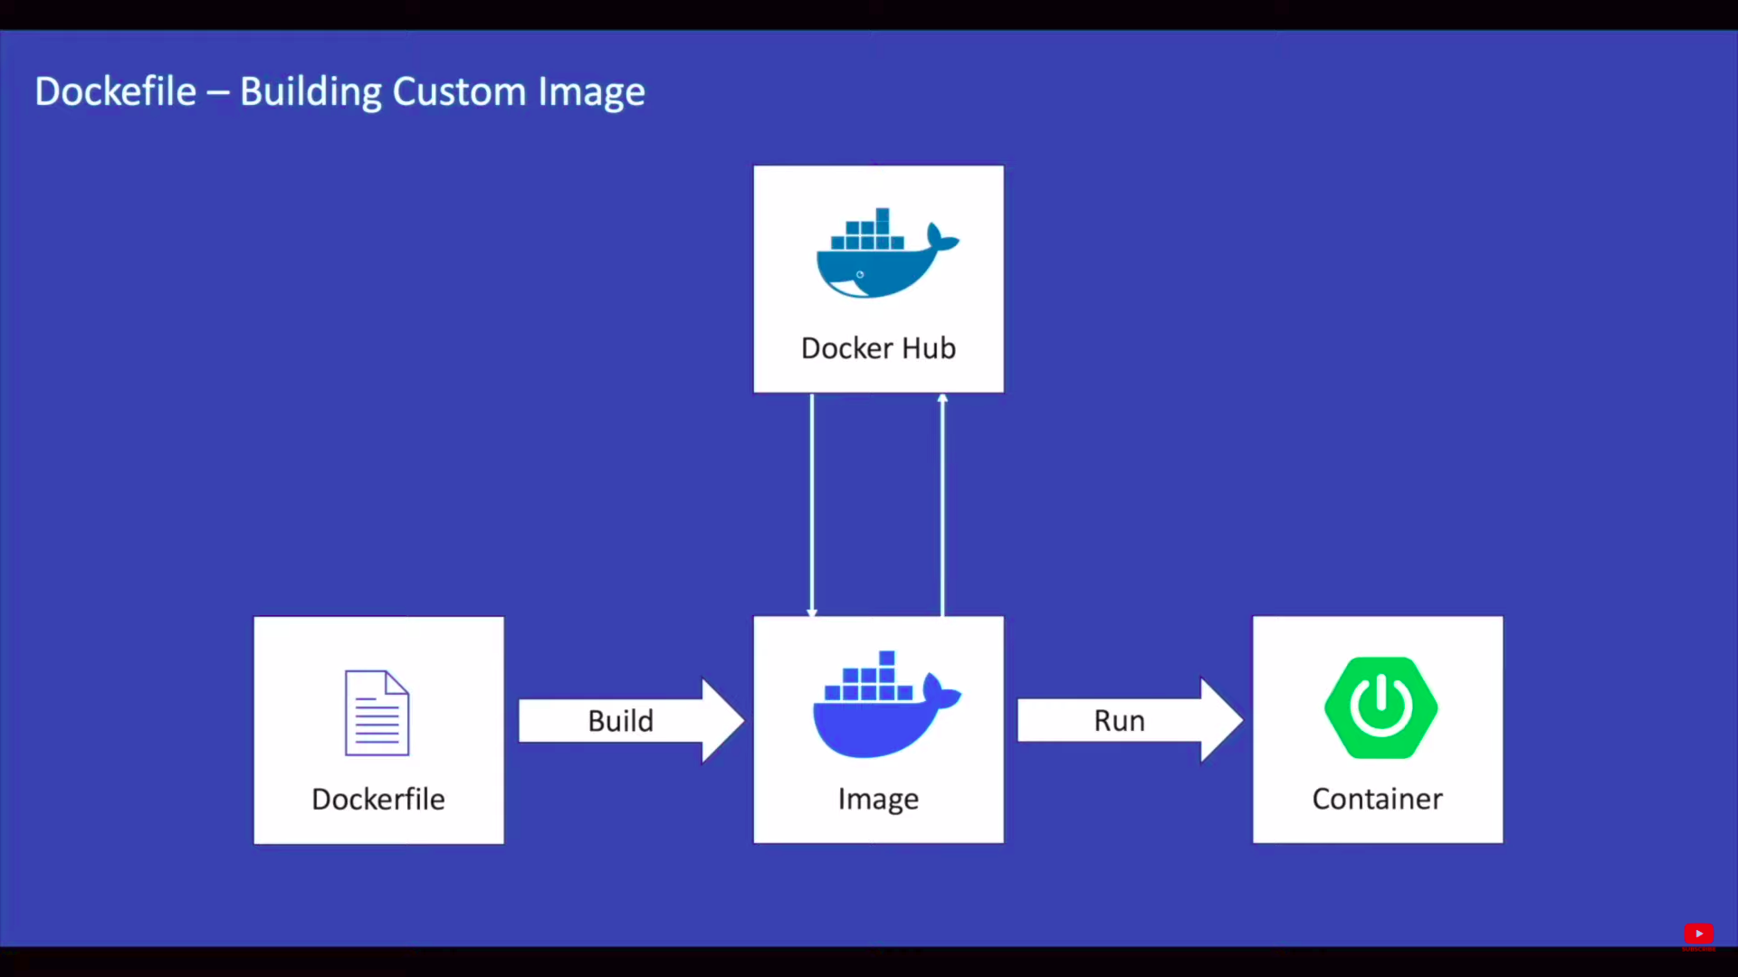
Building Custom Image

Slide 41
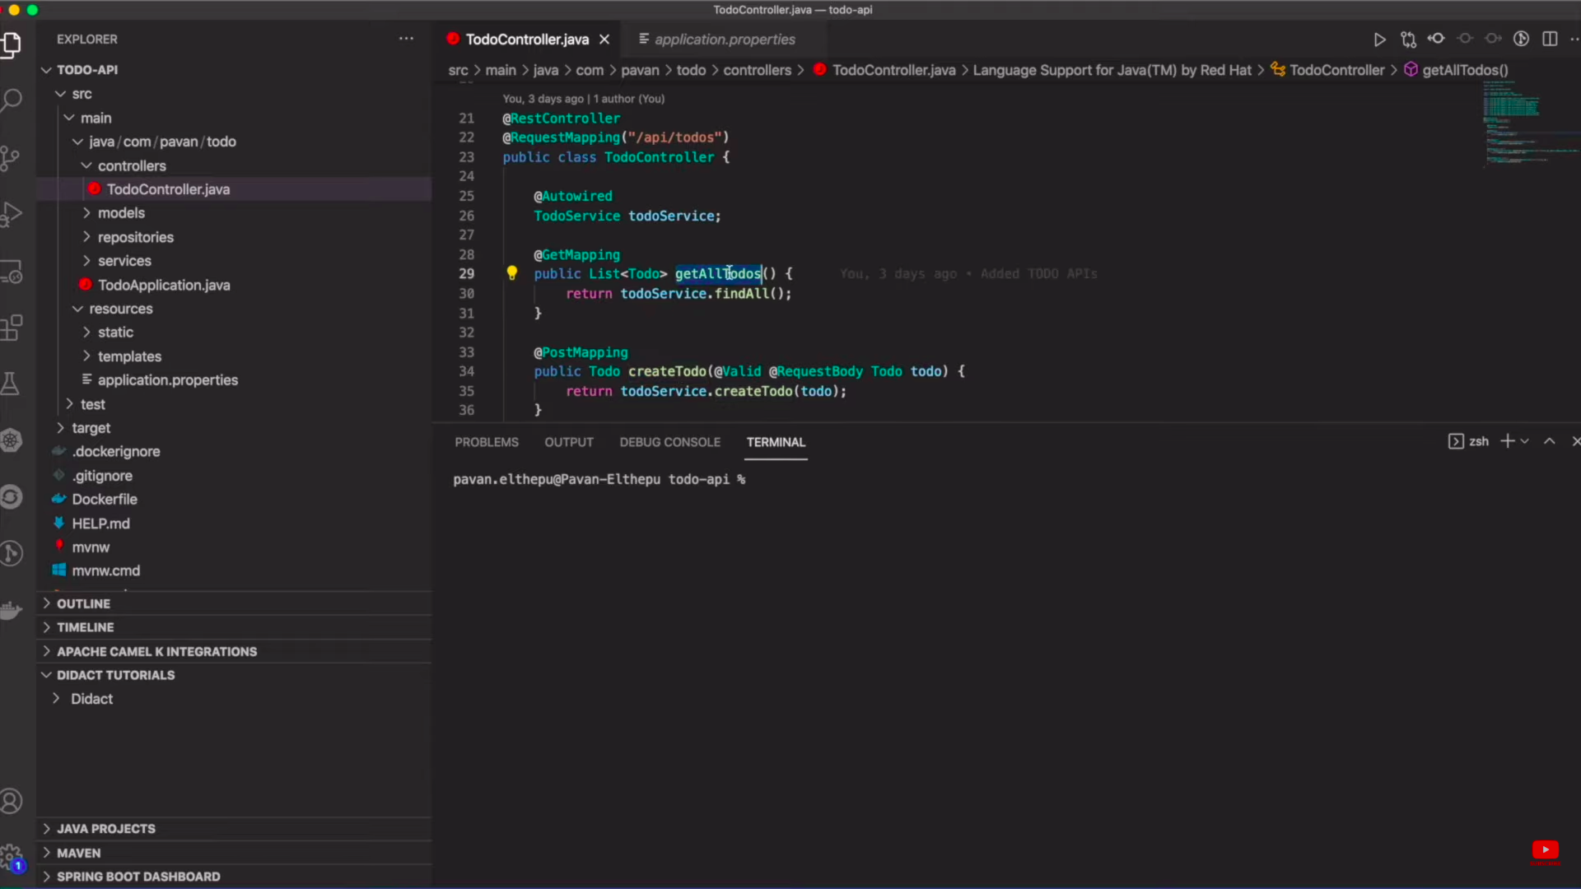

Slide 42
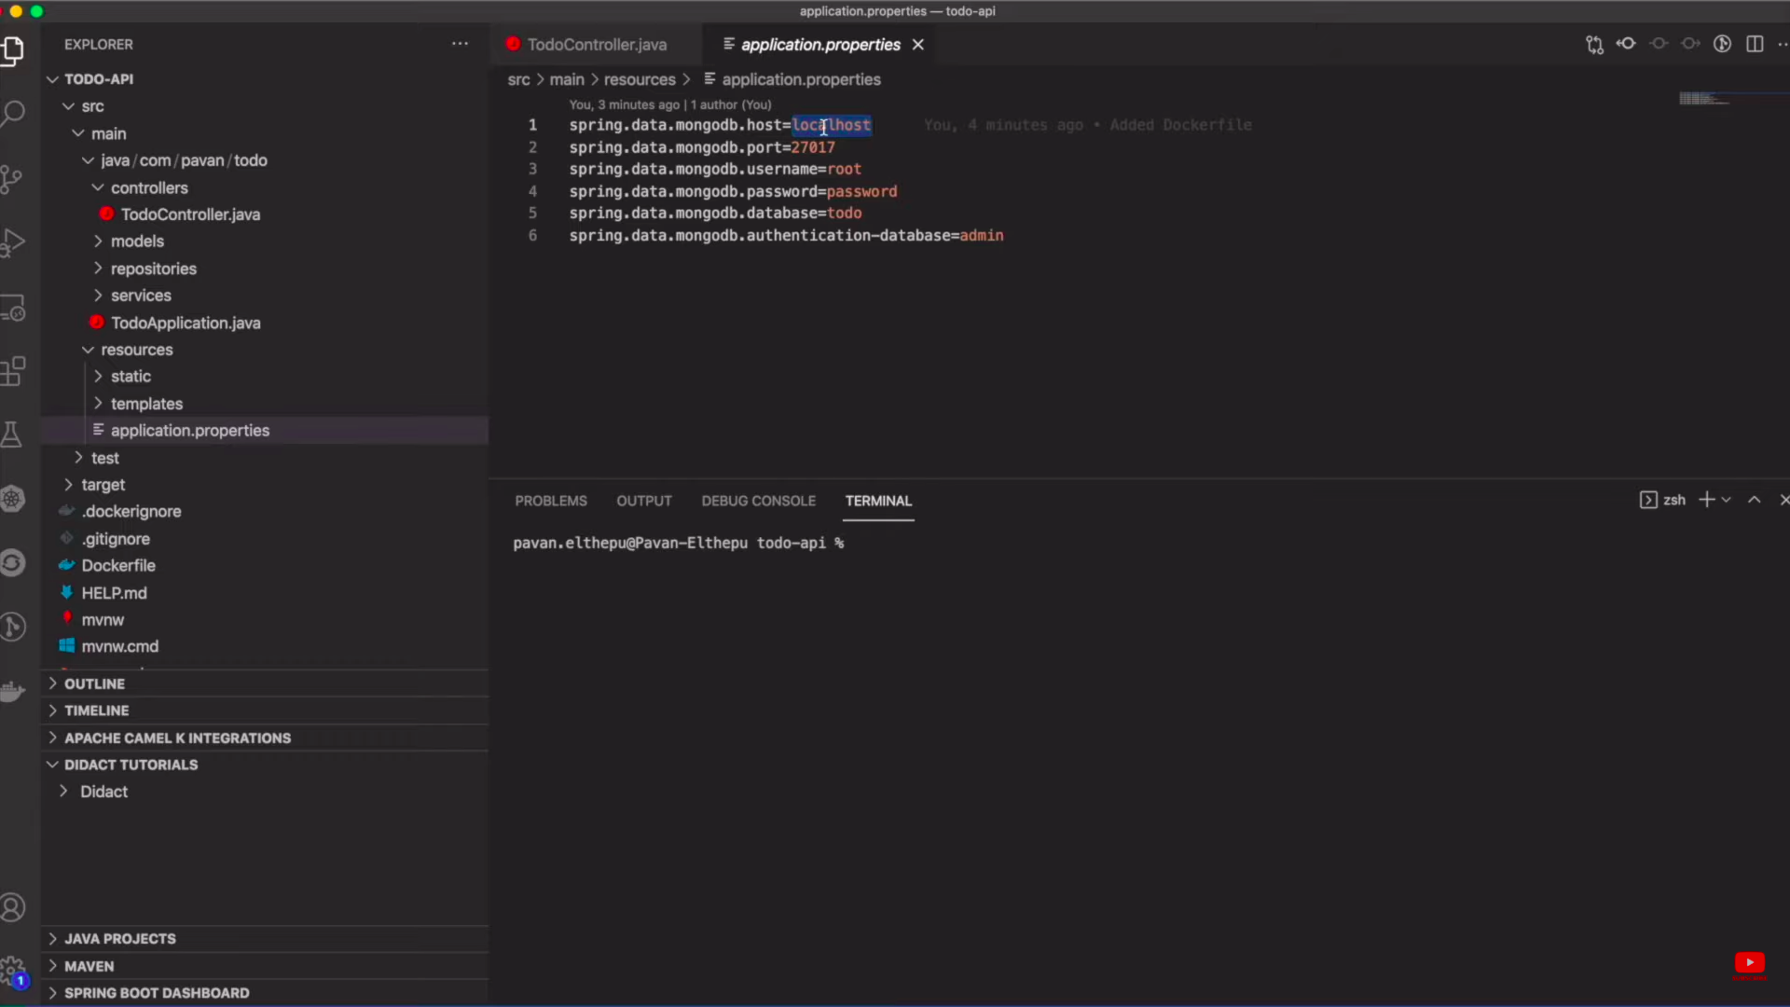

Slide 43
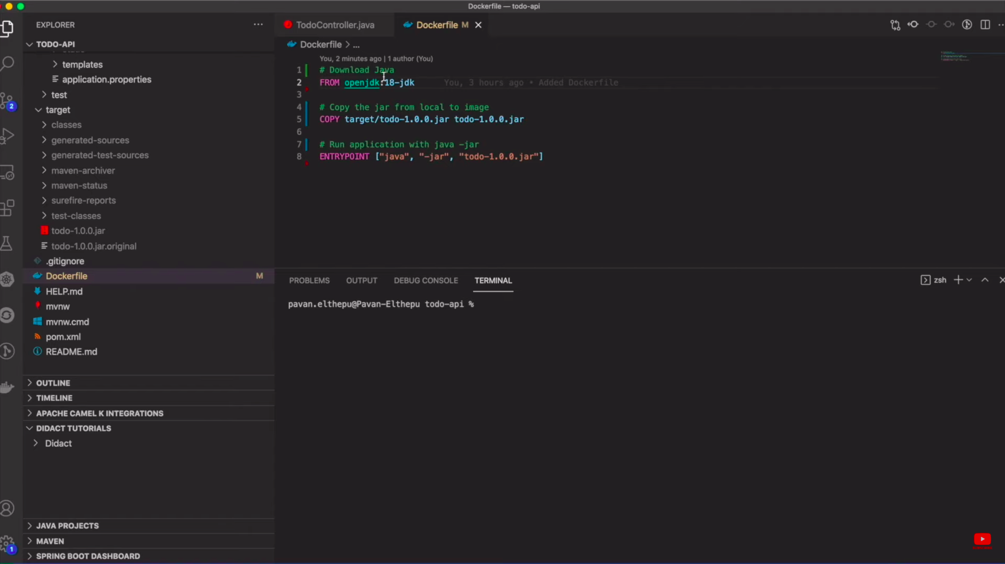

Slide 44
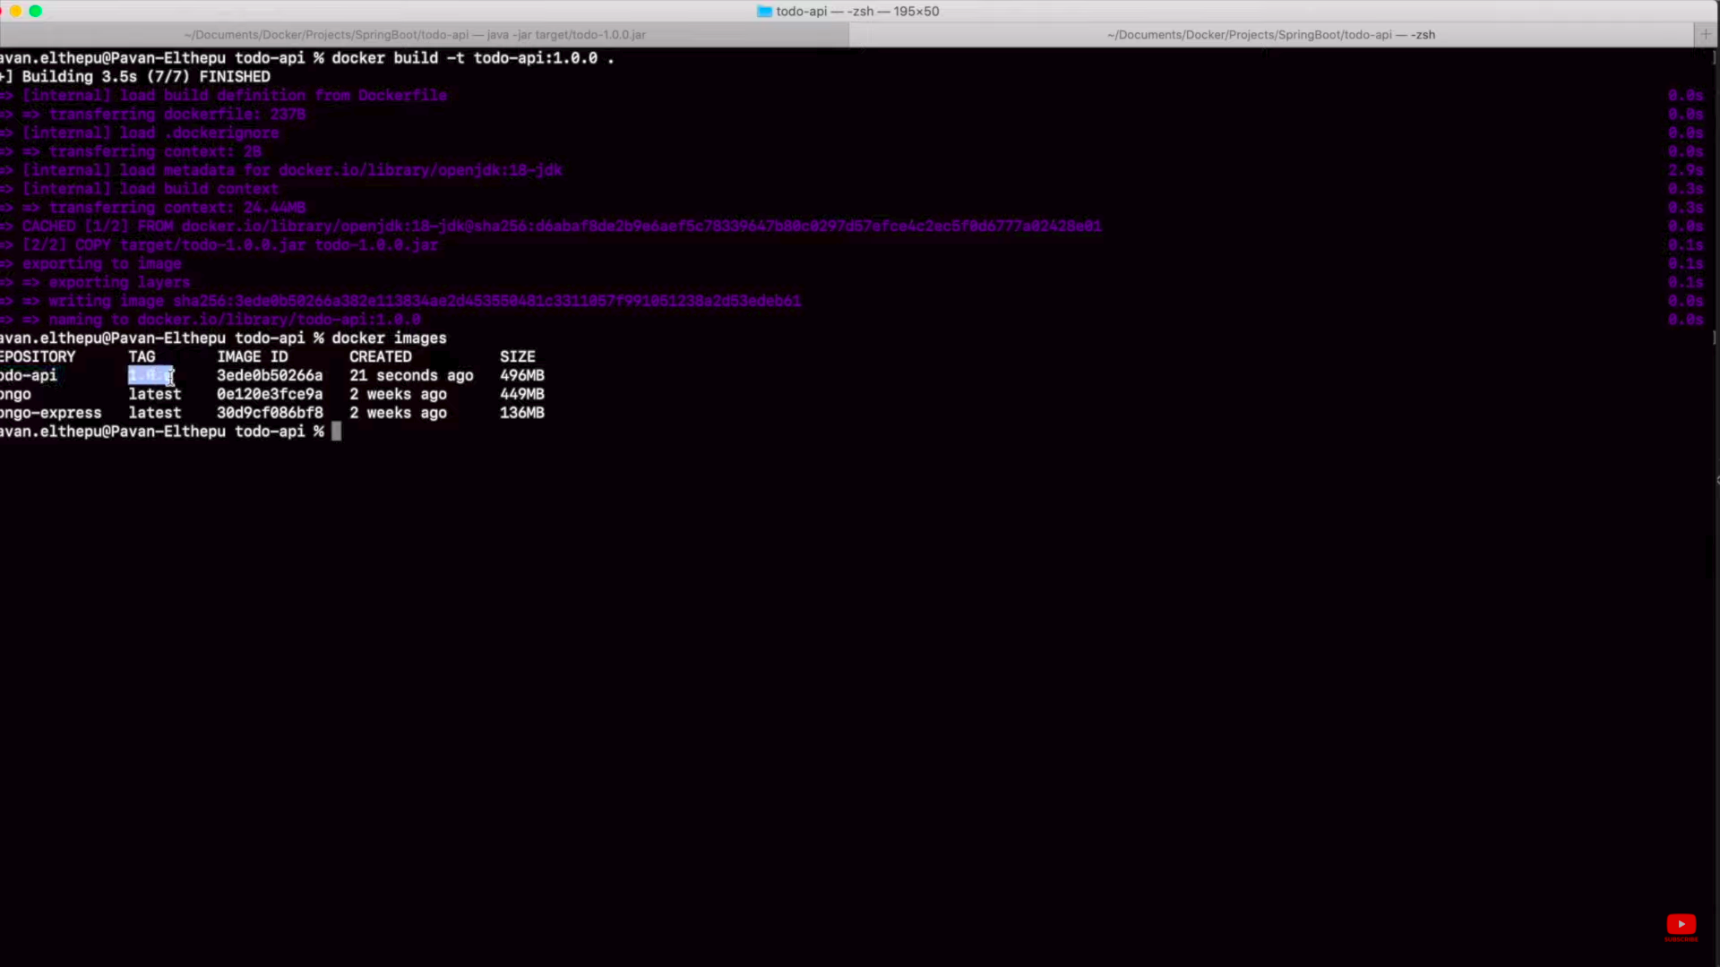

Slide 45
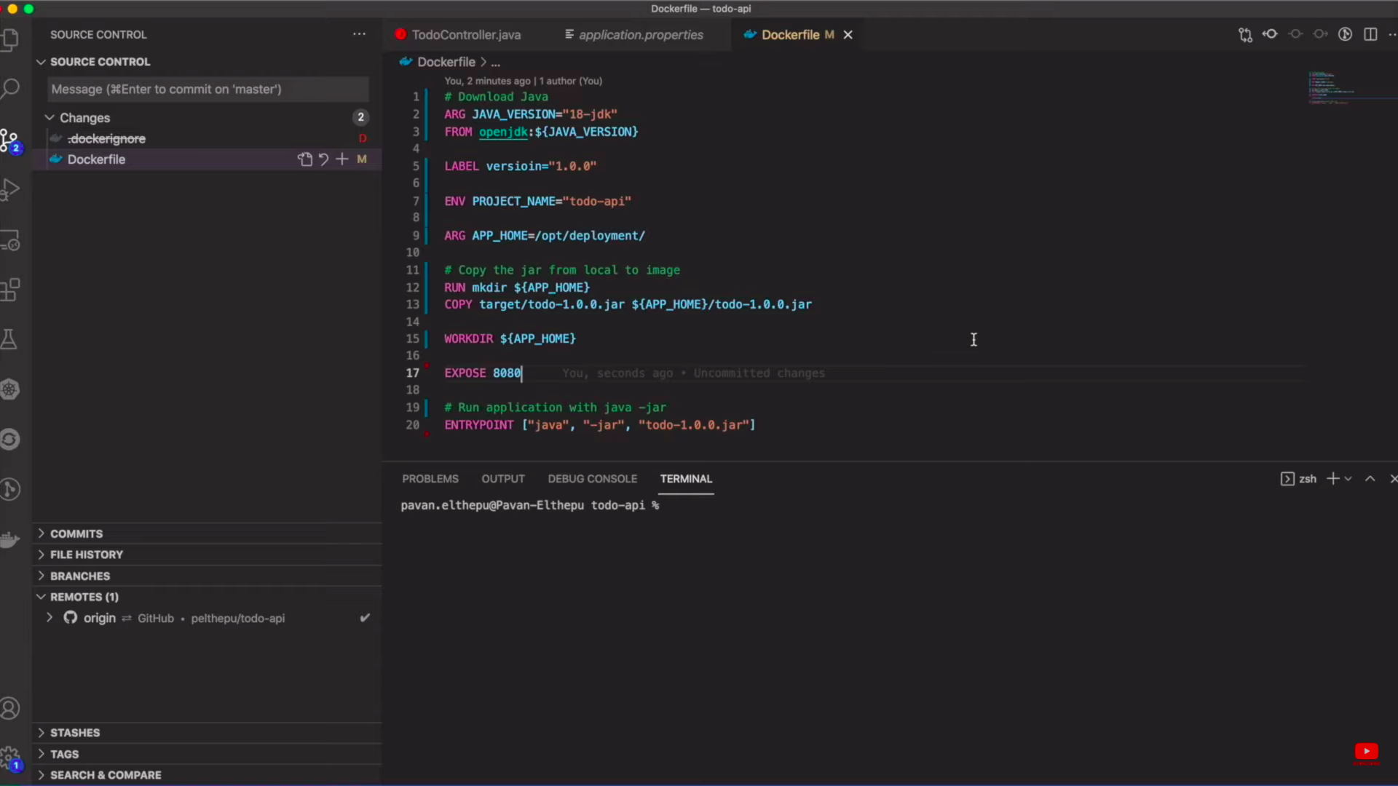

Slide 46
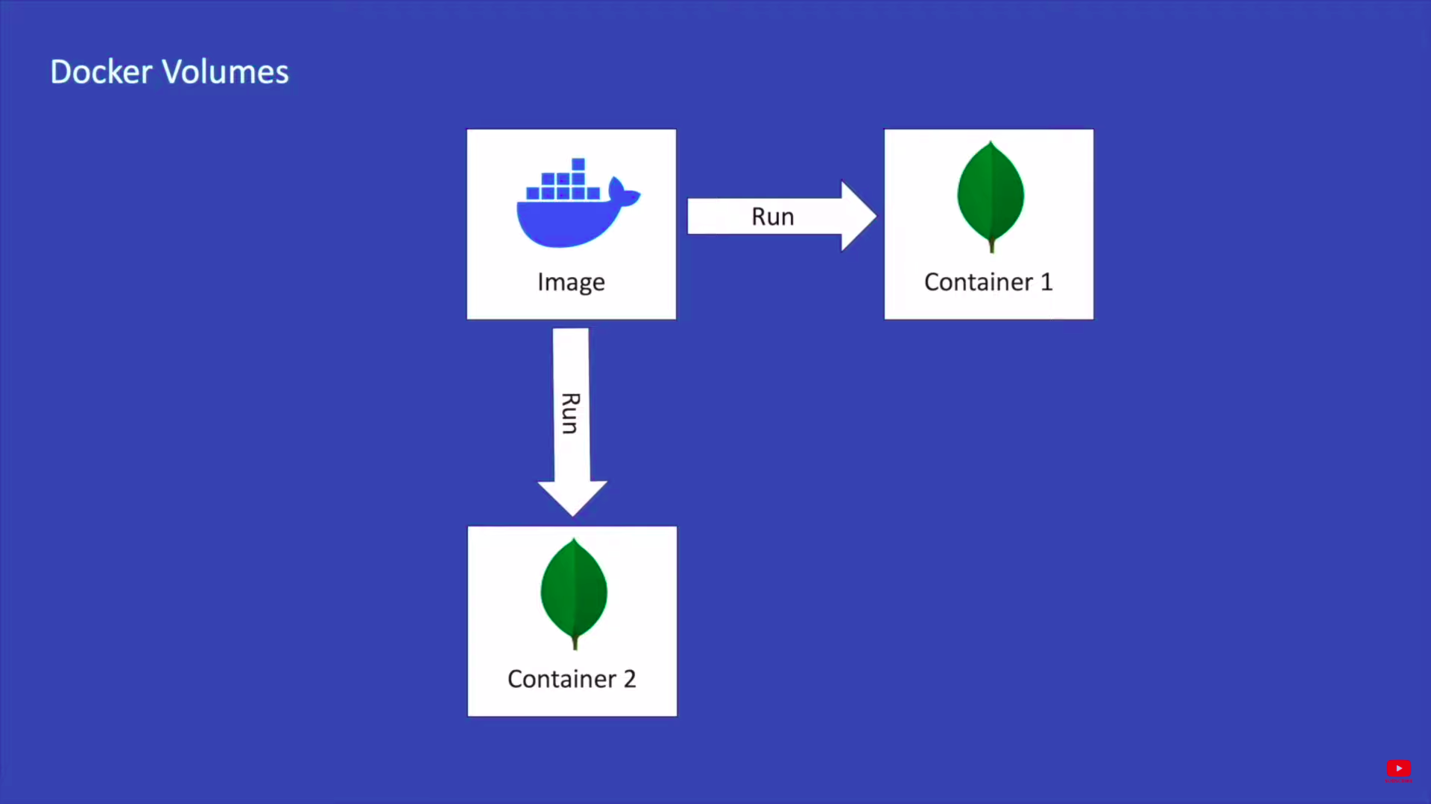
Docker Volumes

Slide 47
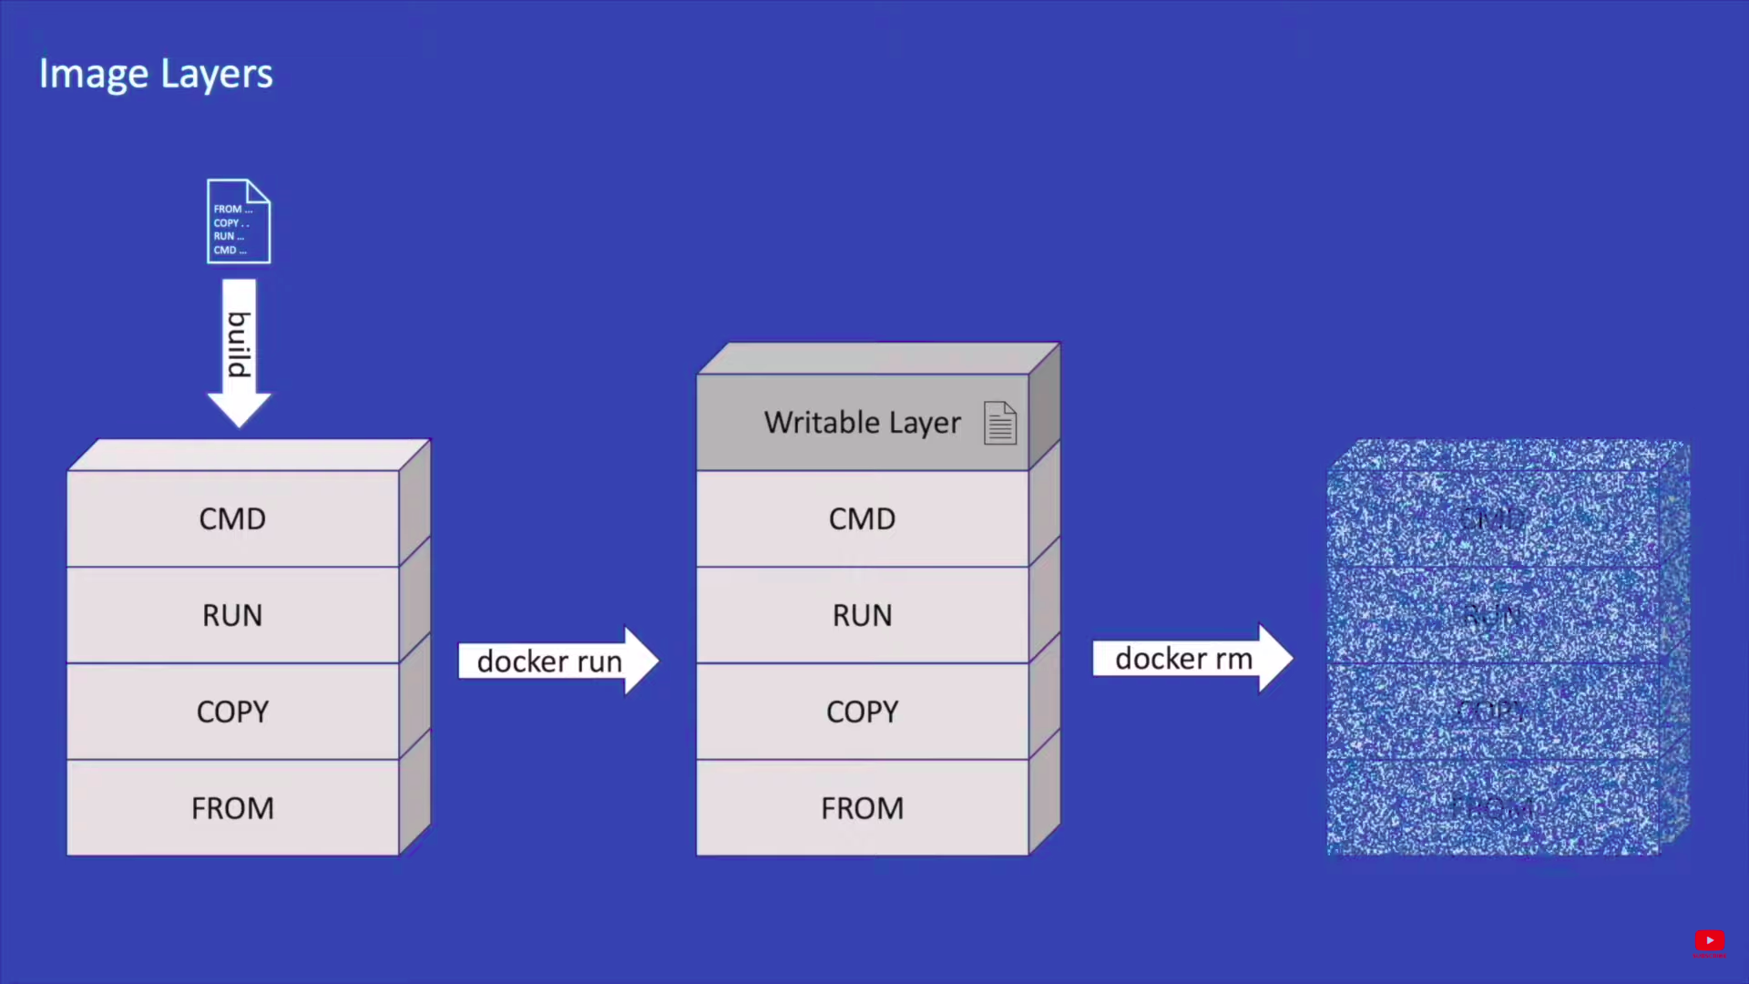
Docker Volumes

Slide 48
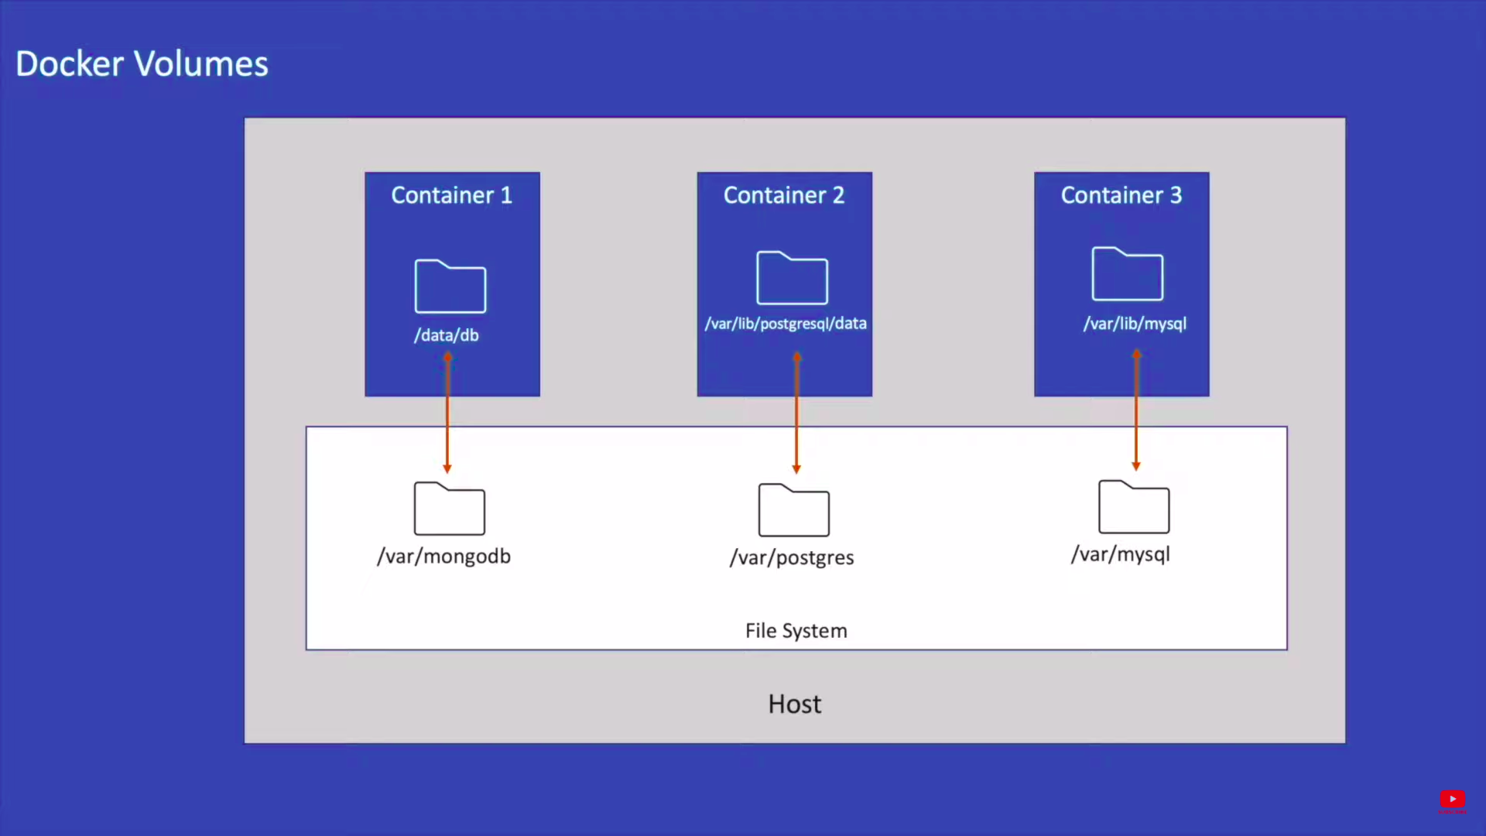

Slide 49
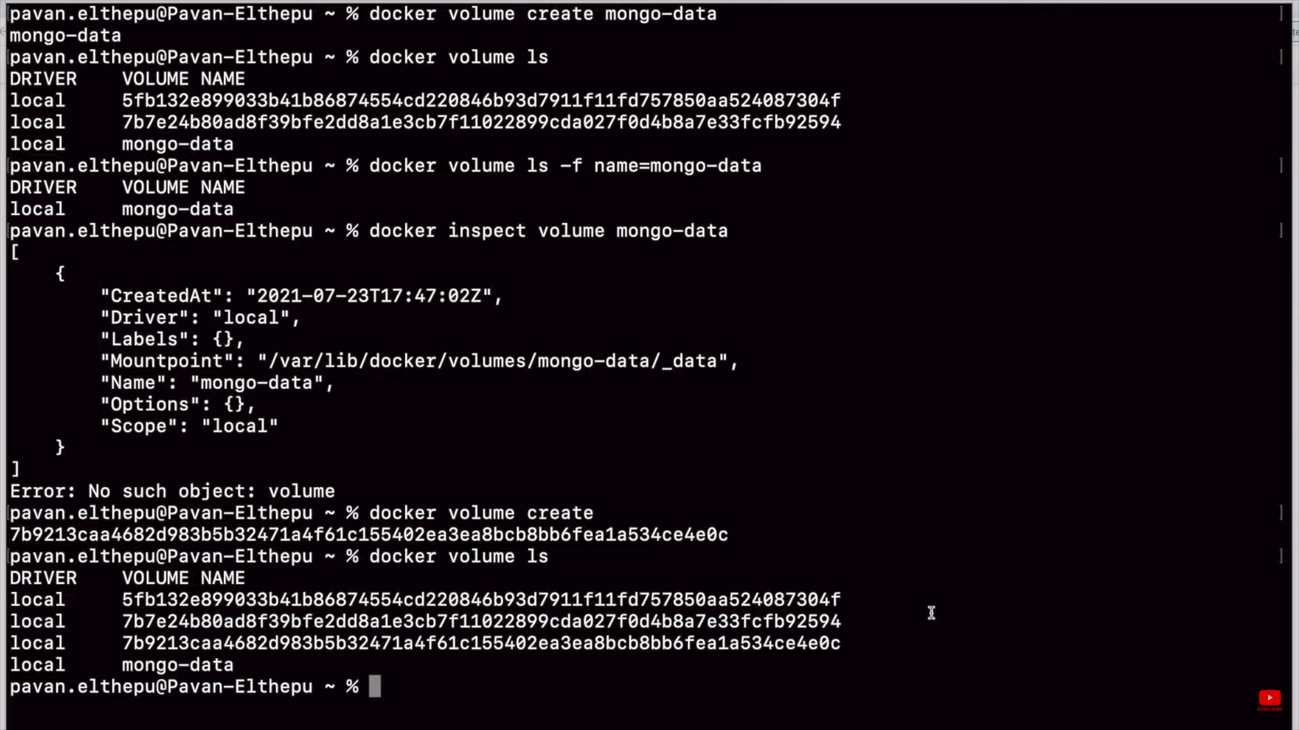

Slide 50
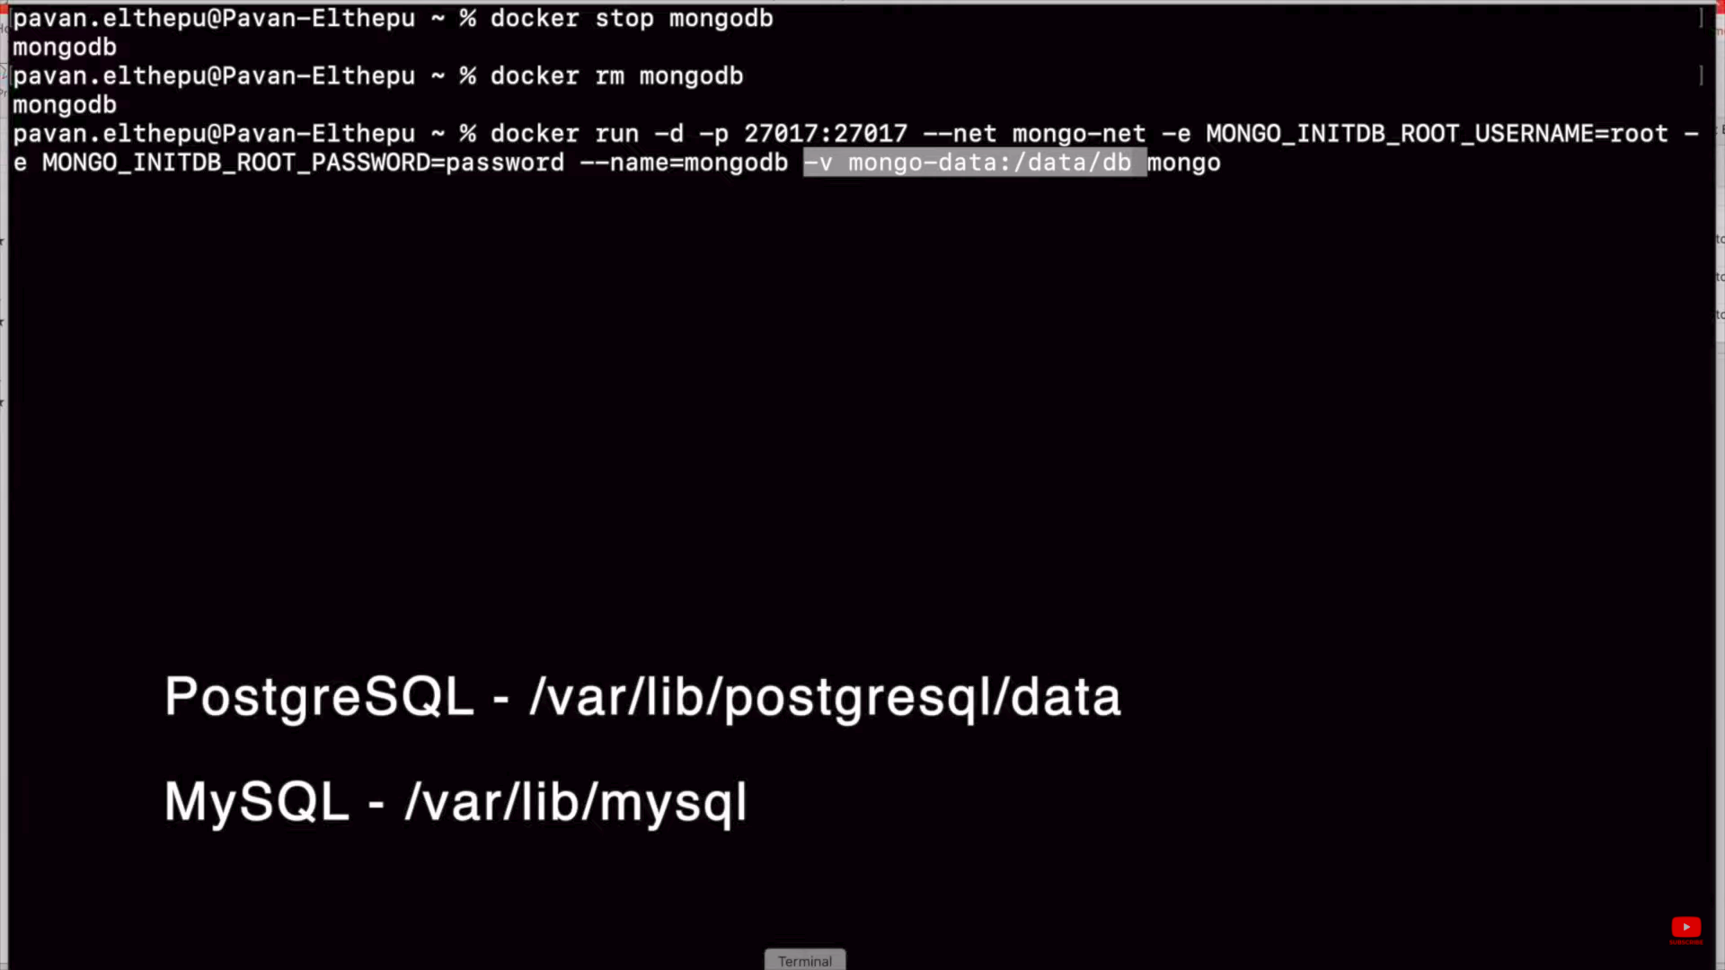

Slide 51
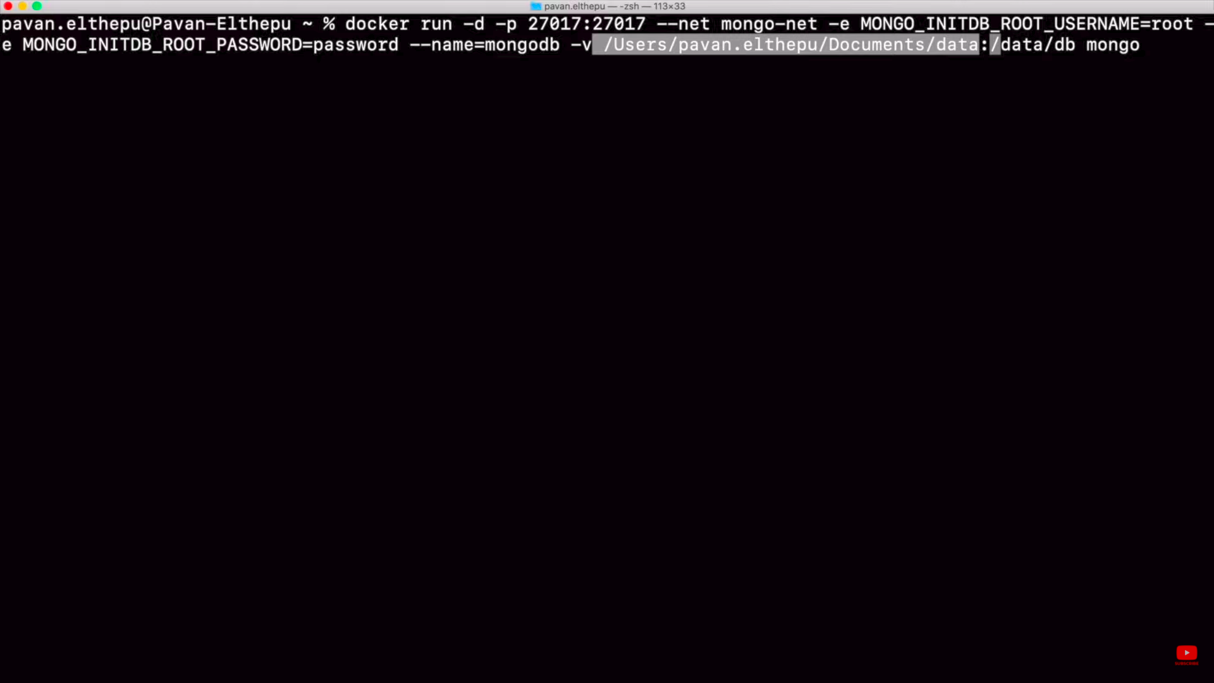
m

Slide 52
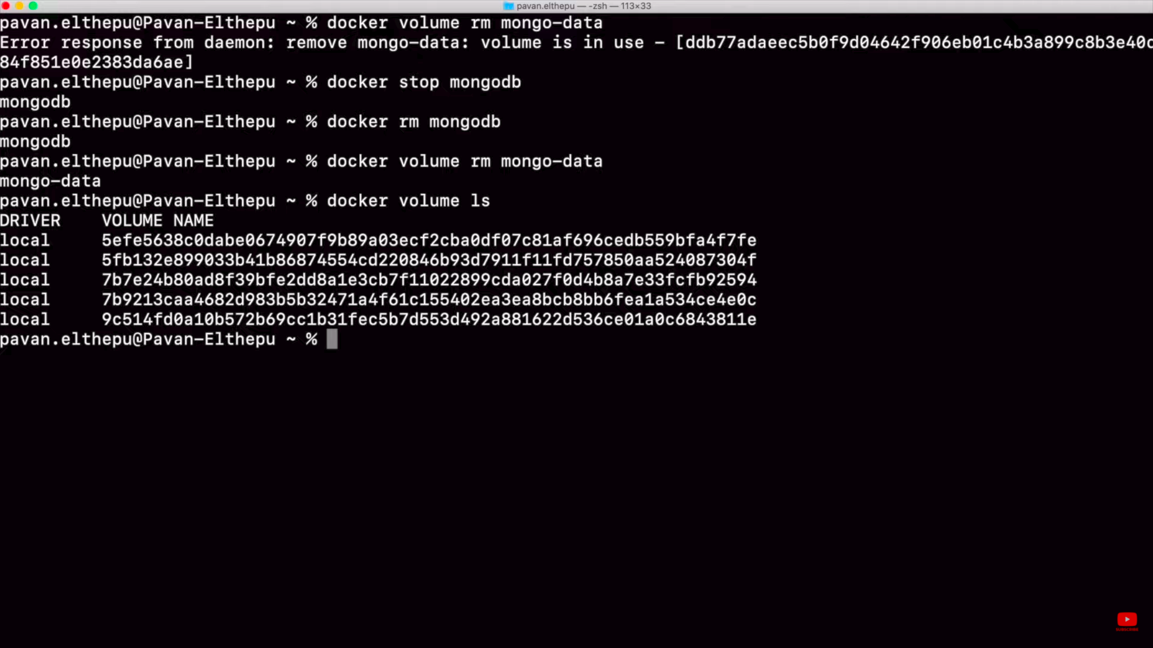

Slide 53
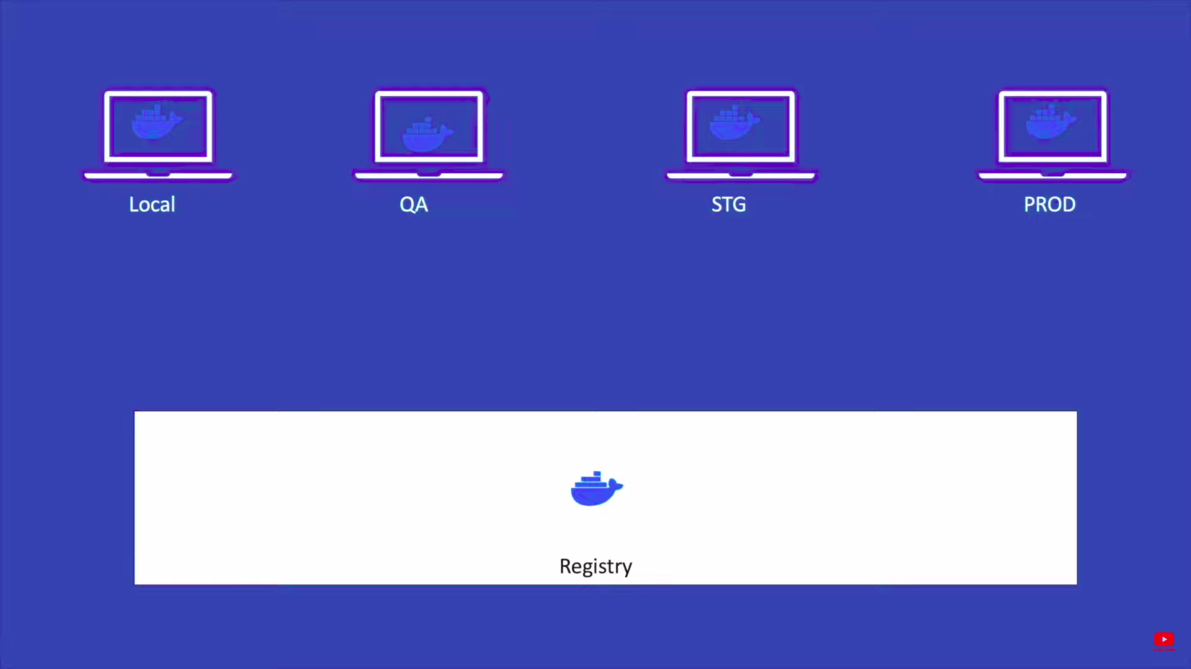

Slide 54
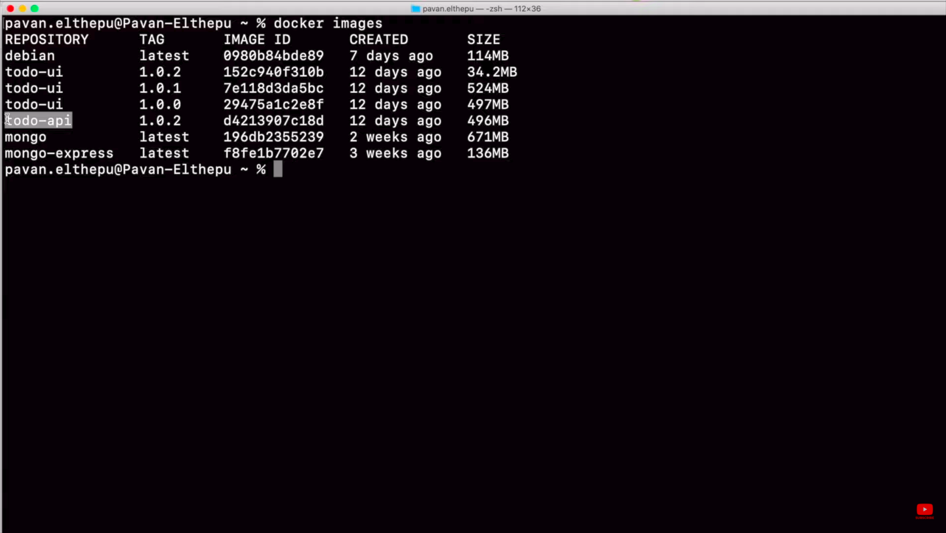

Slide 55
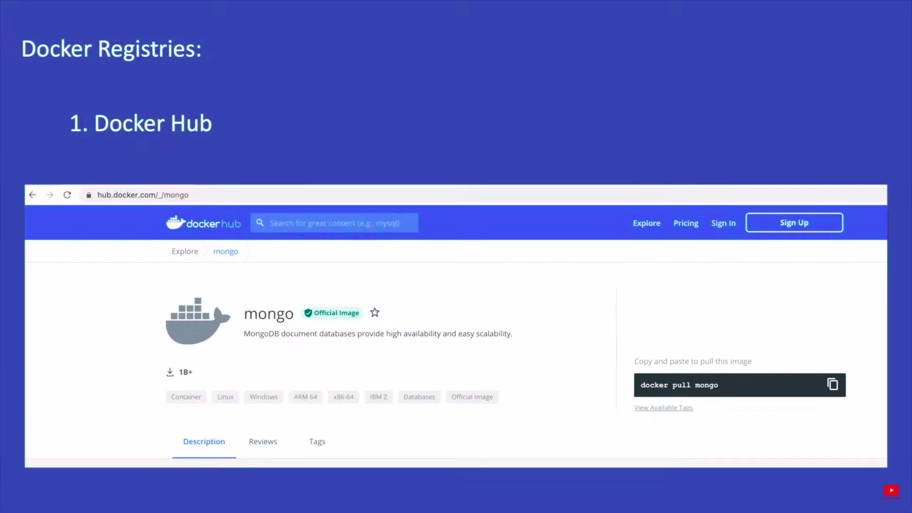

Slide 56
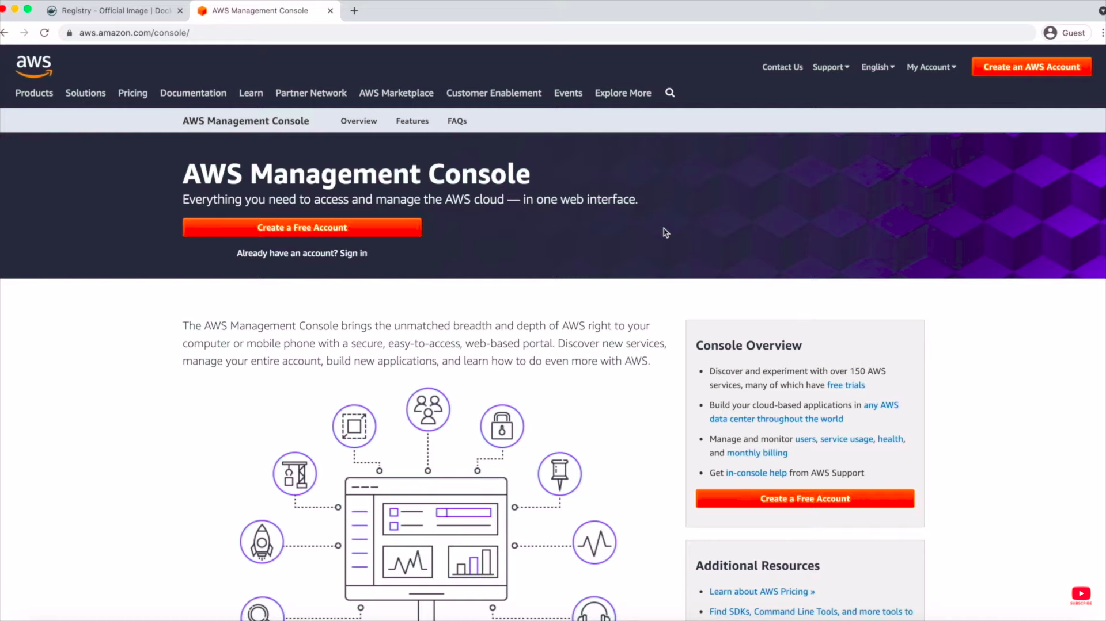

Slide 57


Slide 58


Slide 59


Slide 60


Slide 61


Slide 62


Slide 63
Docker Compose
Docker Compose is a tool that was developed to help define and share multi-container applications. With Compose, we can create a YAML file to define the services and with a single command, can spin everything up or tear it all down.

Slide 64


Slide 65


Slide 66


Slide 67


Slide 68


Slide 69


Slide 70


