Slide 1

DASHBOARD ON ANALYSED E-COMMERCE SALES DATA

Slide 2

About me
Name : S.K. Sudheer Sagar
Qualification : M.Tech (CSE)
WORK EXPERIENCE :Junior Data Service Engineer, Centific Technologies (2022-2024)
LinkedIn : www.linkedin.com/in/sudheer-sagar

Slide 3
Agenda
Objective of the Project
ER Diagram and schema explanation
Key analysis questions (use cases)
Power BI visuals with screenshots or summaries
Final business insights and recommendations
Conclusion (Key finding overall)
Q&A Slide
Your Experience/Challenges working on PowerBI – Data Analysis Project.

Slide 4
OBJECTIVE
To design interactive dashboard on Analysis of E-Commerce Sales Dataset.
To track and analyze their online sales across India.
To analyze e-commerce sales performance across segments, categories, and regions to identify growth oppurtunities and improve profitability.
To practice using DAX formulas, transform data with custom columns, measures and filtering techniques.

Slide 5
Project Key points
Data Collection (Kaggle)
Data Cleaning (Format datatypes, missing values)
Data Modelling (New columns, Grouping data, Split & Rename columns, Relationships, DAX formulas)
Data Visualization
Sharing Insights

Slide 6
Key analysis questions
KPI Overview
Segment and Category Breakdown
Monthly Trends
Sub-category performance
Regional Analysis
Customer Analysis

Slide 7
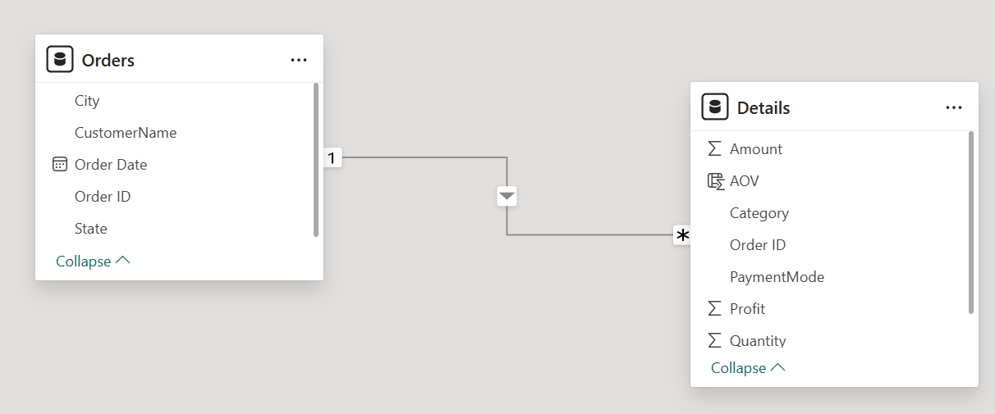
Relationship among tables
One-to-many Relationship is established among the tables where detailing of each order is stored in the details table.

Slide 8
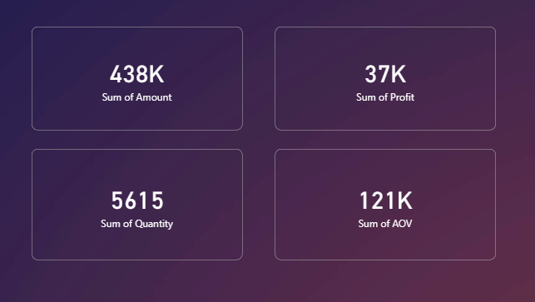
KPI Overview
We start with high-level KPIs: ₹438K in total sales and ₹121K in profit. That’s a healthy margin, but we’ll dig deeper to see where improvements can be made. Strong overall performance, but margin optimization is key.

Slide 9
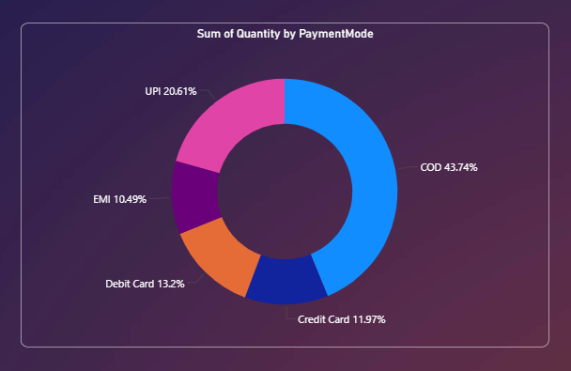
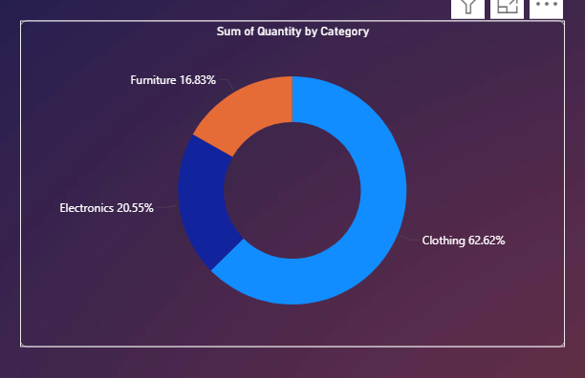
Segment & Category Breakdown
Consumer segment leads in revenue, and Technology is the top-performing category. But Furniture lags in profitability, this could be due to high discounts or shipping costs.

Slide 10
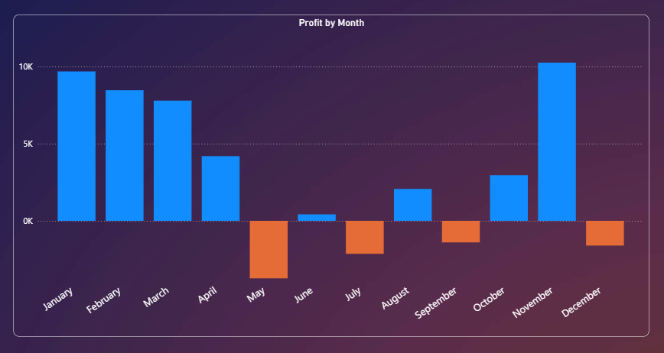
Monthly Trends
Sales peak in Q4, likely due to holiday demand. However, profit doesn’t always follow suggesting that discounts may be eroding margins during peak periods.

Slide 11
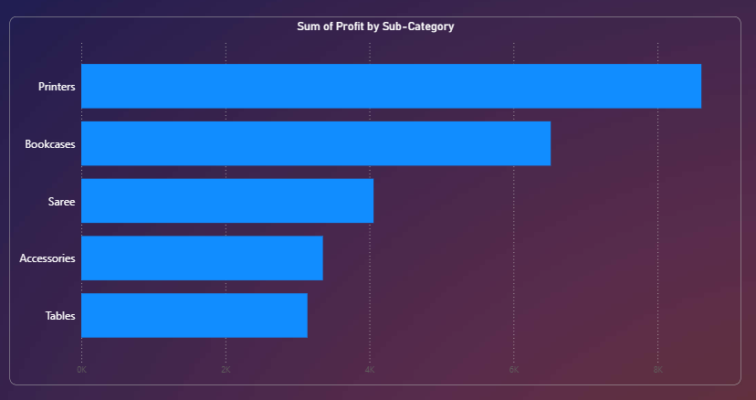
Sub-Category Performance
Printers and Bookcases are strong performers. Tables and Accessories show low profit these may need pricing review or promotional support.

Slide 12
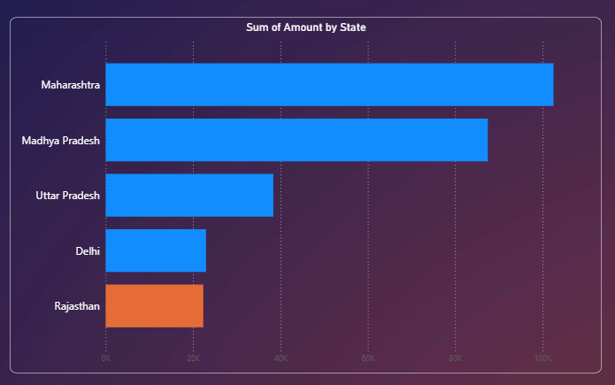
Regional Analysis
West region dominates in sales, but South shows better profitability. This insight can guide regional marketing and product focus.

Slide 13
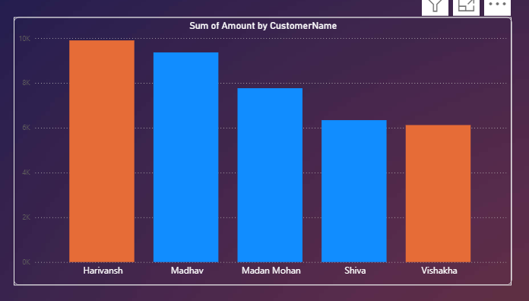
Customer Analysis
Top Contributed Customers representing the loyalty and consumer positive feedback which helps owners to extend their businesses over many regions.

Slide 14
Dashboard Features
Interactive filters: Region, Segment, Category
DAX Measures: ProfitMargin, TotalSales, AvgDiscount
Tooltips & bookmarks for enhanced user experience
This dashboard uses DAX measures, tooltips, and bookmarks to enhance interactivity. It’s designed for both analysts and decision-makers.

Slide 15
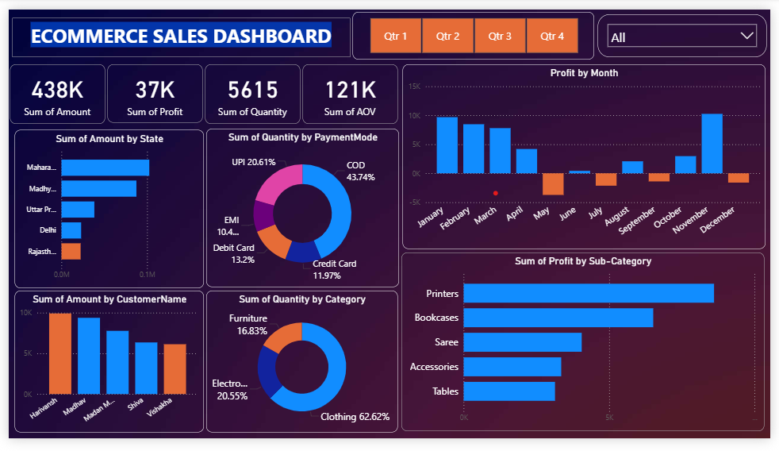
Final Dashboard
ECOMMERCE SALES DASHBOARD
This dashboard uses DAX measures, tooltips, and bookmarks to enhance interactivity. It’s designed for both analysts and decision-makers.

Slide 16
Conclusion
This project reflects my ability to turn complex datasets into clear, actionable insights that support business strategy.
Whether it's identifying high-margin opportunities, optimizing product performance, or guiding regional decisions, this dashboard is designed to empower stakeholders with data-driven clarity.
To applying these skills in a dynamic team environment and continuing to build impactful analytics solutions that drive measurable results.

Slide 17
Challenges
Complex DAX Calculations
Date Formatting Issues
Missing or Inconsistent Data
Large Dataset Performance
Dashboard responsiveness dropped with multiple slicers and visuals.
Initial dashboard had too many visuals, which overwhelmed the user.
Dashboard responsiveness dropped with multiple slicers and visuals.

Slide 18
Q&A

Slide 19

THANK YOU

