Slide 1
DBMS
Database management system (DBMS) refers to the set of tools for creating and managing databases.
General purpose software system that facilitates defining, constructing, manipulating, and sharing databases among various users and applications.
– Defining a database involves specifying the data types, structures, and constraints of the data to be stored in the database.
– Constructing the database is the process of storing the data on some storage medium
– Manipulating a database includes functions such as querying the database to retrieve specific data, updating the database etc.
– Sharing a database allows multiple users and programs to access the database simultaneously.

Slide 2
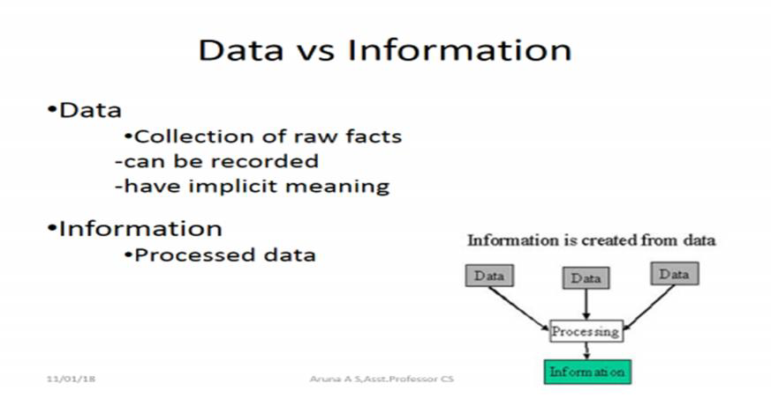
Database– Collection of Related Data
–

Slide 3
Structured data
Information stored in databases is known as structured data because it is represented in a strict format
The DBMS then checks to ensure that all data follows the structures and constraints specified in the schema
Semi structured data
Data may have a certain structure but not all information collected will have identical structure
Semi-structured data is information that doesn’t reside in a relational database but that does have some organizational properties that make it easier to analyze.
Unstructured data
Very limited indication of the type of data
Unstructured data represent around 80% of data
–

Slide 4
Characteristics of the Database Approach
Self-describing nature of a database system: the database system contains not only the database itself but also a complete definition of the database structure and constraints. This definition is stored in the DBMS catalog, which contains information such as the structure of each file, the type and storage format of each data item, and various constraints on the data. The information stored in the catalog is called meta-data.

Slide 5
Insulation between programs and data: Allows changing data storage structures and operations without having to change the DBMS access programs. It is called program-data independence.
Support of multiple views of the data: Each user may see a different view of the database, which describes only the data of interest to that user.
Sharing of data and multiuser transaction processing : allowing a set of concurrent users to access the database simultaneously. Concurrency control within the DBMS guarantees that each transaction is correctly executed

Slide 6

Schemas, Instances, and Database State
The description of a database is called the database schema, which is specified during database design and is not expected to change frequently.
The schema is represented by using schema diagram

Slide 7
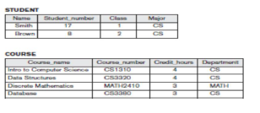
The actual data in a database may change quite frequently. The data in the database at a particular moment in time is called a database state or instance

Slide 8
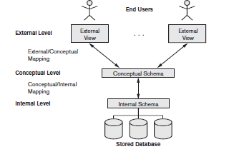
Three-Schema Architecture
The goal of the three-schema architecture is to separate the user applications from the physical database.

Slide 9
Internal level:
The internal level has an internal schema describes the physical storage structure of the database
Conceptual level
The conceptual level has a conceptual schema, which describes the structure of the whole database for a community of users.
The conceptual schema hides the details of physical storage structures and concentrates on describing entities, data types, relationships, user operations, and constraints.
External/View level
The external schema at external/view level to describe the various user views.
Each external schema describes the part of the database that a particular user group is interested in and hides the rest of the database from that user group.

Slide 10
Data Independence
Data Independence is the capacity to change the schema at one level of a database system without affecting schema at the next higher level
We can define 2 types of data independence
Logical Data Independence
Physical Data Independence
Logical Data Independence
The capacity to change the conceptual schema without having to change external schemas and the application programs
When compared to Physical Data independence, it is challenging to achieve logical data independence.
Examples include Add/Modify/Delete a new attribute, entity or relationship is possible without a rewrite of existing application programs,Merging two records into one

Slide 11
Physical Data Independence
The physical data independence is basically used to separate conceptual levels from the internal/physical levels
The capacity to change the internal schema without having to change the conceptual schema.
Compared to Logical Independence, it is easy to achieve physical data independence.
Examples includes Switching to different data structures, Changing the access method, Modifying indexes.

Slide 12
Advantages of DBMS
Controlling Redundancy: Redundancy leads to duplication of data. Using DBMS, it is possible to control redundancy.
Restricting Unauthorized Access: By defining multiple views, it is possible to restrict unauthorized access.
Providing Persistent Storage for Program objects: Databases can be used to provide persistent storage for program objects and data structures.
Providing Storage Structures and Search Techniques for Efficient Query Processing: DBMS uses techniques like indexing which help for the faster retrieval of data.
Providing Backup and Recovery : A DBMS must provide facilities for recovering from hardware or software failures. The backup and recovery subsystem of the DBMS is responsible for recovery.

Slide 13
Advantages of DBMS
Providing Multiple User Interfaces : many types of users with varying levels of technical knowledge use a database , a DBMS should provide a variety of user interfaces. These include query languages for casual users, programming language interfaces for application programmers, forms and command codes for parametric users, and menu-driven interfaces and natural language interfaces for standalone users.
Representing Complex Relationships among Data: DBMS must have the capability to represent a variety of complex relationships among the data, to define new relationships as they arise, and to retrieve and update related data easily and efficiently.

Slide 14
Advantages of DBMS
Enforcing Integrity Constraints: Most database applications have certain integrity constraints that must hold for the data. A DBMS should provide capabilities for defining and enforcing these constraints.

Slide 15
Database Languages
DBMS uses data definition language(DDL) to define internal schema , conceptual schema and the mapping between the two. DDL compiler process the DDL statements and store the schema definition in catalog.
In some DBMS where a clear separation is maintained between the conceptual and internal levels, the DDL is used to specify the conceptual schema only. Another language, the storage definition language (SDL), is used to specify the internal schema. The mappings between the two schemas may be specified in either one of these languages.
View definition language (VDL),is used to specify user views and their mappings to the conceptual schema.

Slide 16
Database Languages
DBMS uses data manipulation language(DML) to perform manipulation operations like retrieval, insertion, deletion, and modification of the data.
There are two main types of DMLs.
High level/Nonprocedural DML: High level DMLs can specify and retrieve many records in a single DML statement. A query in a high level DML specifies often specifies which data to retrieve rather than how to retrieve it.
Low level/Procedural DML:A low level or procedural DML typically retrieves individual records or objects from the database and processes each separately. A query needs to specify which data to be retrieved and how to retrieve that data

Slide 17
Database Users
Database Administrators(DBA)
• Administering database and DBMS is the responsibility of the database administrator (DBA).
• The DBA is responsible for authorizing access to the database, coordinating and monitoring its use, and acquiring software and hardware resources as needed.
• The DBA is accountable for problems such as security breaches and poor system response time.
Database Designers
• Database designers are responsible for identifying the data to be stored in the database and for choosing appropriate structures to represent and store this data.
• These tasks are mostly done before the database is actually implemented and populated with data.
• It is the responsibility of database designers to communicate with database users and understand their needs

Slide 18
Database Users
End Users
• End users are the people whose jobs require access to the database for querying, updating, and generating reports;
• There are several categories of end users:
Naive or parametric end users
Sophisticated end users
Casual end users
System Analysts and Application Programmers
Naive or parametric end users
They make up a large section of the end-user population
Their main job function is constantly querying and updating the database, using standard types of queries and updates—

Slide 19
Database Users
-Sophisticated end users
• Include engineers, scientists, business analysts, and others who thoroughly familiarize themselves with the facilities of the DBMS in order to implement their own applications
• Familiar with the structure of the database and facilities offered by DBMS
-Casual end users
occasionally access the database, but they may need different information each time.
-Standalone users
maintain personal databases by using ready-made program packages that provide easy-to use menu-based or graphics-based interfaces.

Slide 20
Data Models
Data models defines the logical structure of a database.
Data Model is the modelling of the data description, data semantics, and consistency constraints of the data.
The different data models are
Entity Relationship(ER) model
Relational Model
Hierarchical Model
Network Model
Object-Oriented Data Model

Slide 21
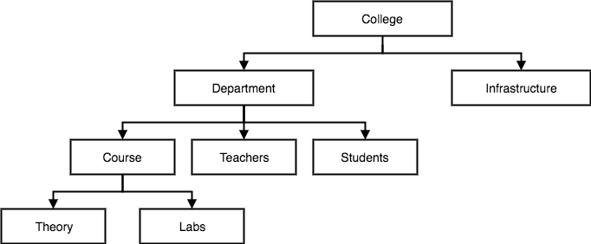
Hierarchical Model
Hierarchical Model was the first DBMS model.
This database model organises data into a tree-like-structure, with a single root, to which all the other data is linked.
The hierarchy starts from the Root data, and expands like a tree, adding child nodes to the parent nodes.
A child node will only have a single parent node.

Slide 22
Advantages of Hierarchical Model
It is very simple and fast to traverse through a tree-like structure.
Any change in the parent node is automatically reflected in the child node so, the integrity of data is maintained.
Disadvantages of Hierarchical Model
Complex relationships are not supported.
As it does not support more than one parent of the child node so complex relationships can’t be represented using this model
If a parent node is deleted then the child node is automatically deleted.

Slide 23
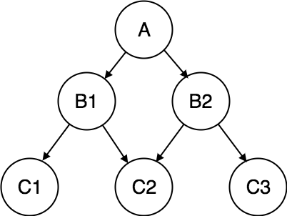
Network Model
This is an extension of the Hierarchical model.
In this model data is organised more like a graph, and are allowed to have more than one parent node.
This database model was used to map many-to-many data relationships.
This was the most widely used database model, before Relational Model was introduced.

Slide 24
Advantages of Network Model
The data can be accessed faster as compared to the hierarchical model.
Any change in the parent node is automatically reflected in the child node so, the integrity of data is maintained.
Disadvantages of Network Model
As more and more relationships need to be handled the system might get complex.

Slide 25
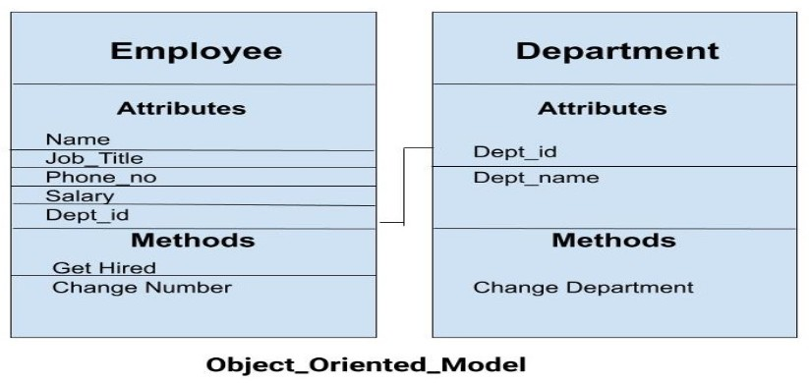
Object-Oriented Data Model
The real-world problems are more closely represented through the object-oriented data model.
In this model, both the data and relationship are present in a single structure known as an object with attributes.
Two or more objects are connected trough links

Slide 26
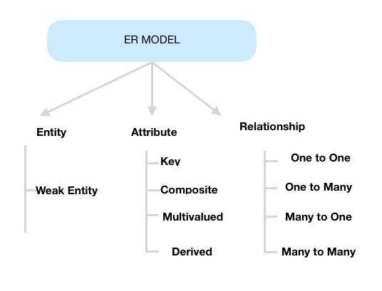
ER model
An Entity–relationship model (ER model) describes the structure of a database with the help of a diagram called ER diagram.
ER diagram is a high-level conceptual data model diagram.
ER diagrams are created based on three basic concepts: entities, attributes and relationships.

Slide 27
An entity can be a real-world object with independent existence.
An entity set is a collection of similar types of entities.
Eg: student, person, department etc.
An entity is represented by using rectangle
Entities are represented by means of their properties, called attributes. All attributes have values.
For example, a student entity may have name, class, and age as attributes
An attribute is represented by an oval

Slide 28
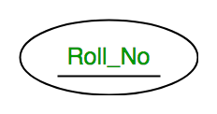
Types of Attributes
Key attributes
A key attribute can uniquely identify an entity from an entity set.
For example, student roll number can uniquely identify a student from a set of students.
Key attribute is represented by oval with the text is underlined.
Atomic vs composite attribute
An attribute composed of many other attribute is called as composite attribute.
For example, Address attribute of student Entity type consists of Street, City, State, and Country.
In ER diagram, composite attribute is represented by an oval comprising of ovals.

Slide 29
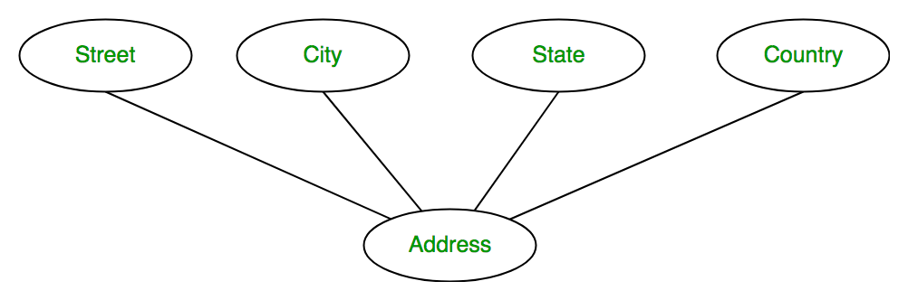
Attributes that are not divisible called atomic attributes
Single-Valued versus Multivalued Attributes.
Most attributes have a single value for a particular entity; such attributes are called single-valued.
For example, Age is a single-valued attribute of a person.
An attribute consisting more than one value is called multivalued attribute
For example, Phone_No (can be more than one for a given student).
In ER diagram, multivalued attribute is represented by double oval.

Slide 30
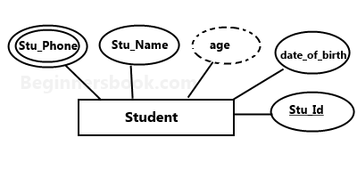
Stored versus Derived Attributes.
An attribute which can be derived from other attributes of the entity type is known as derived attribute.
e.g.; Age (can be derived from DOB).
In ER diagram, derived attribute is represented by dashed oval.
The complete entity type Student with its attributes can be represented as:

Slide 31
Relationship
A relationship is represented by diamond shape in ER diagram
It shows the relationship among entities.
There are four types of relationships:
1. One to One
2. One to Many
3. Many to One
4. Many to Many

Slide 32
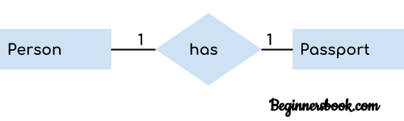
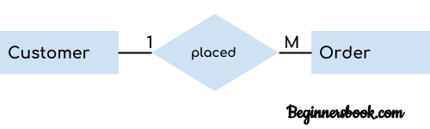
One-to-One Relationship :When only one instance of an entity is associated with the relationship, then it is known as one to one relationship.
One-to-many relationship: When only one instance of the entity on the left, and more than one instance of an entity on the right associates with the relationship then it is known as a one-to-many relationship.

Slide 33
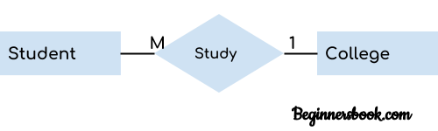

Many-to-one relationship:When more than one instance of the entity on the left, and only one instance of an entity on the right associates with the relationship then it is known as a many-to-one relationship.
Many-to-many relationship: When more than one instance of the entity on the left, and more than one instance of an entity on the right associates with the relationship then it is known as a many-to-many relationship.

Slide 34
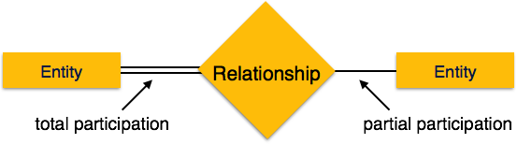
Participation constraint
Participation constraint denotes the number of entities participating in a relation.
Two Types
Total Participation: Each entity in the entity set must participate in the relationship. Represented by double line
Also known as Existence Dependency
Partial Participation – The entity in the entity set may or may NOT participate in the relationship.

Slide 35
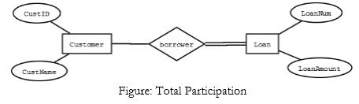
Participation constraint
For example, consider the relationship borrower between customers and loans. A double line from loan to borrower, as shown in figure below indicates that each loan must have at least one associated customer. Each entity in Loan participating in the relationship. So it is total participation.
But there may be some customers without loan. So the participation of entity set in the borrower relationship is partial.

Slide 36
Degree of relationship
The degree of a relationship is the number of entity types that participating in a relationship.
Based on the number of entity types that are connected we have the following degree of relationships:
Unary(Recursive)
Binary
Ternary
N-ary

Slide 37
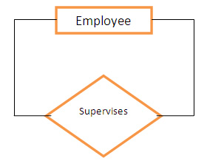
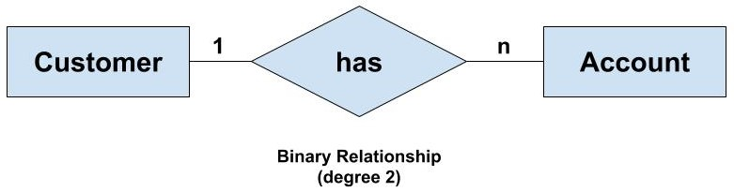
Unary (degree 1)
A unary relationship exists when both the participating entity types are the same.
For eg: employee supervises employee
Binary (degree 2)
A binary relationship exists when the two entity set participating in relation. For eg: customer has account

Slide 38
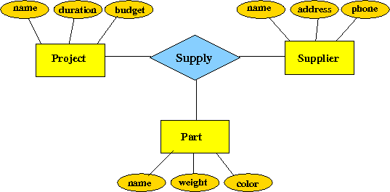
Ternary Relationship(degree 3)
When there are exactly three entity sets participating in a relationship then such type of relationship is called ternary relationship.
For example consider the statement “supplier supply parts to project”. Three entities (supplier, parts, project) are involved in the relationship supply

Slide 39
Weak Entity set vs Strong Entity set
An entity set with a key attribute is called strong entity set.
Strong entity does not depends on any other entities in the schema.
Participation of strong entity set in a relationship is either total or partial.
An entity set without any key attributes is called weak entity set. It depends on strong entity in the schema.
Weak entity types have partial keys. Partial Keys are set of attributes with the help of which the tuples of the weak entities can be distinguished and identified.

Slide 40
Weak Entity set vs Strong Entity set
Weak entity always depends on a strong entity set
Weak entity is represented in ER diagram using double rectangle.
The relationship between a strong entity and weak entity is known as identifying relationship and it is represented by using double diamond in ER diagram
The participation of weak entity in identifying relationship is always total.

Slide 41
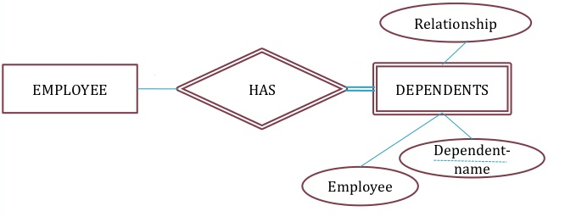
A company wants to store the details of dependents for insurance purposes. The existence of dependent entity always depends on employee entity. So Dependent is a weak entity set and the relationship has is called identifying relationship.

Slide 42
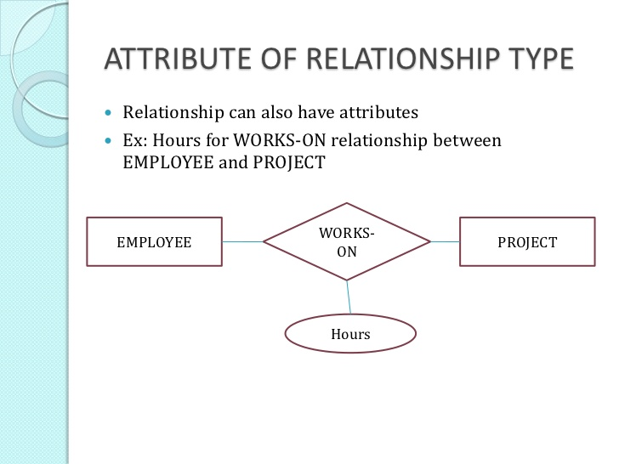

Slide 43
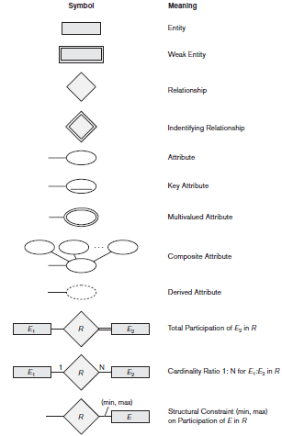

Slide 44
Design an ER diagram to represent the following scenario:
A company has many employees working on a project. An employee can be part of one or more projects. Each employee works on a project for certain amount of time. Assume suitable attributes for entities and relations. Mark the primary key(s) and the cardinality ratio of the relations.
The entity sets are employee ,project. These two entity sets are connected by a relationship working on.

Slide 45
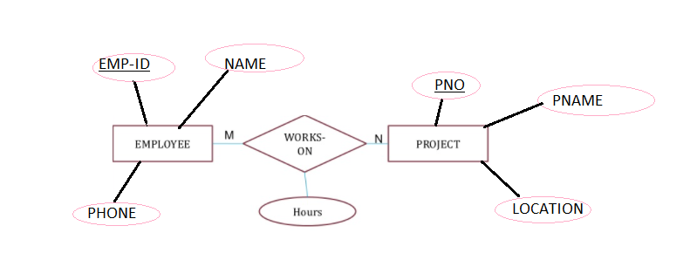
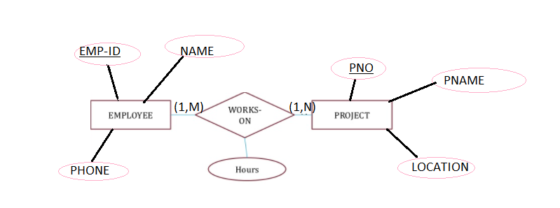
In the above ER diagram the cardinality is represented by using conventional notation.
The other representation is by using (min,max) notation

Slide 46
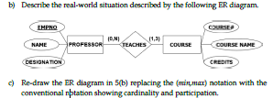

The above ER diagram consist of two entity sets.
Professor(EMPNO,NAME,DESIGNATION)
COURSE(COURSEID,COURSE_NAME,CREDITS)
These two entity sets are connected by a relationship teaches.
The professor teaches course. A professor can teach minimum 0 courses and maximum N courses. A course is taught by minimum one professor and maximum 3 professor

Slide 47
A Company has several departments.Each department may have several Location.Departments are identified by a name, D_no, Location.A Manager control a particular department. Each department is controls number of projects .Employees are identified by name, id, address, dob. An employee supervises another employees. An employee works in only one department but can work on several project .We also keep track of number of hours worked by an employee on a single project. Each employee has dependent. Dependent has name, Gender and relationship.
Draw ER diagram using conventional notation.

Slide 48
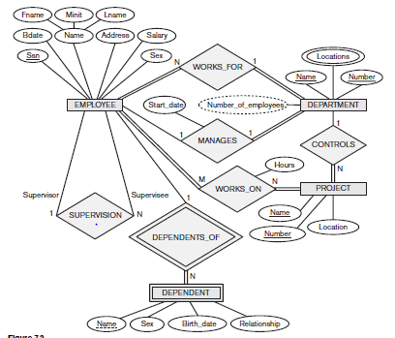

Slide 49
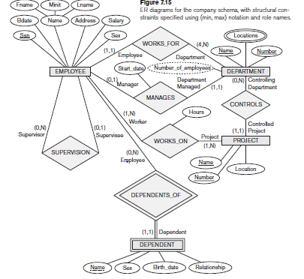

Slide 50
Design an ER diagram for the given scenario;
Suppose that you are designing a schema to record information about reality shows on TV. Your database needs to record the following information:
_ For each reality show, its name, genre, basic_info and participants name. Any reality show has at least two or more participants.
- For each producer, the company name, company country. A show is produced by exactly one producer. And one producer produces exactly one show.
- For each television, its name, start year, head office. A television may broadcasts multiple shows. Each show is broadcasted by exactly one television.
-For each user, his/her username, password, and age. A user may rate multiple shows, and a show may be rated by multiple users. Each rating has a score of 0 to 10.

Slide 51
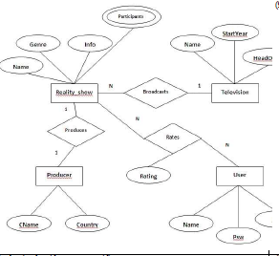

Slide 52
A cOMPANY has the following scenario: There are a set of salespersons. Some of them manage other salespersons. However, a salesperson cannot have more than one manager. A salesperson can be an agent for many customers. A customer is managed by exactly one salesperson. A customer can place any number of orders. An order can be placed by exactly one customer. Each order lists one or more items. An item may be listed in many orders. An item is assembled from different parts and parts can be common for many items. One or more employees assemble an item from parts. A supplier can supply different parts in certain quantities. A part may be supplied by different suppliers.
(i) Identify and list entities, suitable attributes, primary keys, foreign keys and relationships to represent the scenario.
(ii) Draw an ER diagram to model the scenario using min-max notation.

Slide 53
A college has the following scenario: There are a set of departments. Department offer courses. A department can offer multiple courses, but a course is offered by exactly one department. Student enroll courses. A student can enroll multiple courses. Faculty works in department . Some faculty heads other faculty. Faculty teaches one or more courses, but a course is taught by exactly one faculty,
Draw ER diagram

Slide 54
Classification of DBMS
Several criteria are used to classify DBMSs
Based on the data model used:
Relational, Network, Hierarchical, Object-oriented
Classification Based on User Numbers
single-user database system: supports one user at a time
multiuser database system: supports multiple users concurrently.
Classification Based on Database Distribution
Centralized (If data stored at a single computer site):Centralized DBMS can support multiple users, but DBMS and database reside totally at a single computer site

Slide 55
Centralized (If data stored at a single computer site):Centralized DBMS can support multiple users, but DBMS and database reside totally at a single computer site.
Distributed: the actual database and the DBMS software are distributed from various sites that are connected by a computer network.
homogeneous distributed database systems: use the same DBMS software at multiple sites.
heterogeneous distributed database system: different sites might use different DBMS software, but there is additional common software to support data exchange between these sites

