Slide 1
Relational Model
Relational Model (RM) represents the database as a collection of relations.
data in a relational database is organized into tables.
Every row in the table represents a collection of related data values. These rows in the table denote a real-world entity or relationship.
A relation R, denoted by R(A1, A2, ...,An), is made up of a relation name R and a list of attributes, A1, A2, ..., An.

Slide 2
Key Terms in the Relational Model
Attribute: A column header of a table is known as attribute of a relation.
Tuple: A row in a table represents the record of a relation and known as a tuple of a relation.
Domain: A set of possible values for a given attribute is known as domain of a relation.
Relation Schema: A relation schema represents name of the relation with its attributes.
e.g.; EMPLOYEE (EmployeeId, FirstName, LastName, Salary)

Slide 3
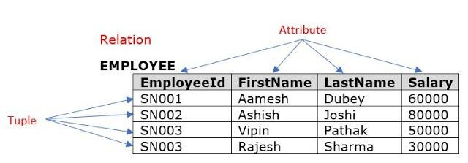
Degree: The number of attributes in the relation is known as degree of the relation. The EMPLOYEE relation defined above has degree 4.
Cardinality: The number of tuples in a relation is known as cardinality. The EMPLOYEE relation defined has cardinality 4.

Slide 4
Informal Terms | Formal Terms
Table | Relation
Column header / field | Attributes
All possible column values | Domain
Row | Tuple
Table definition | Schema of relation

Slide 5
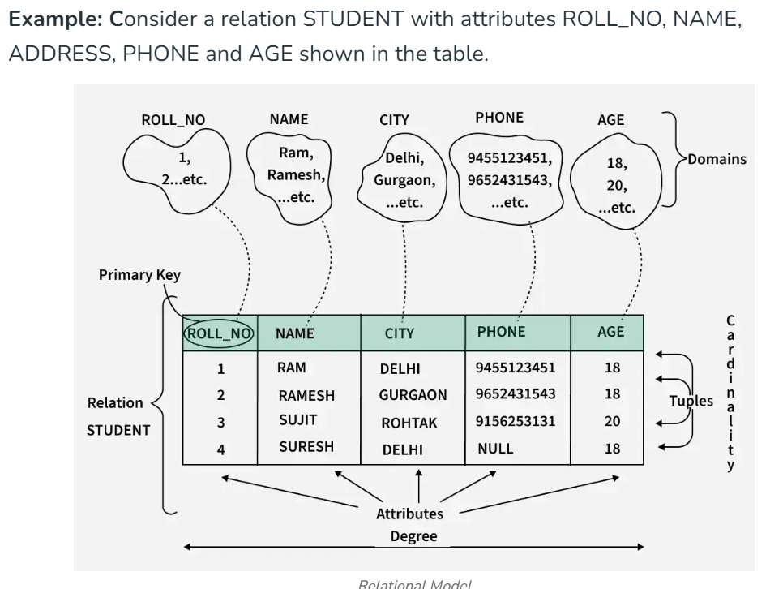
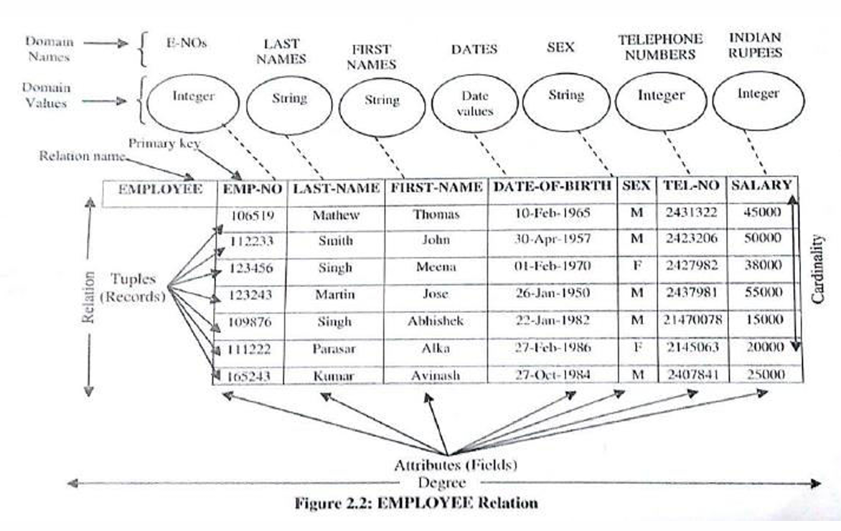

Slide 6
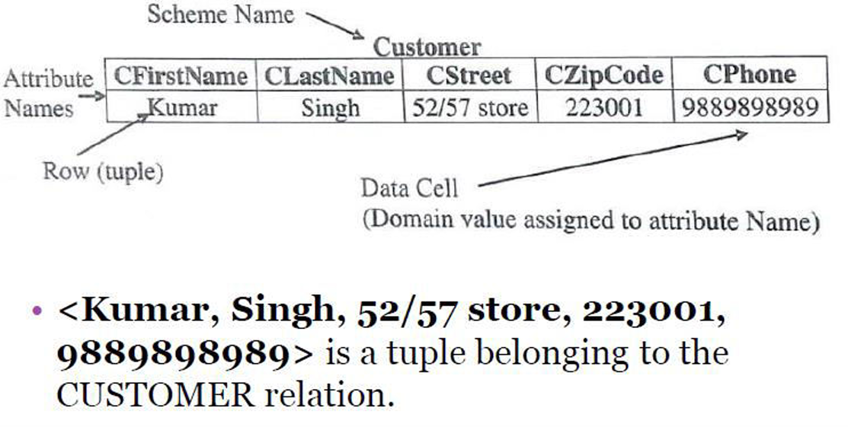

Slide 7
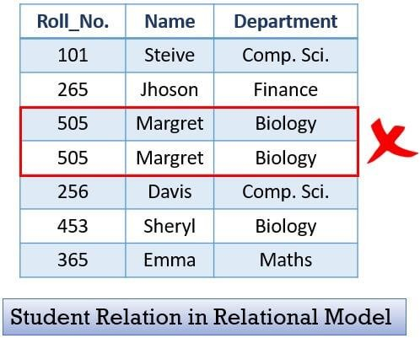
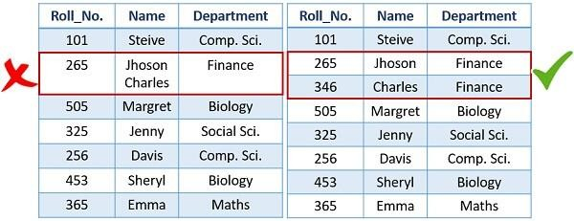
Characteristics of Relational database
Duplicate tuples are not allowed in a relation
Each tuple must have exactly one data value for an attribute.

Slide 8
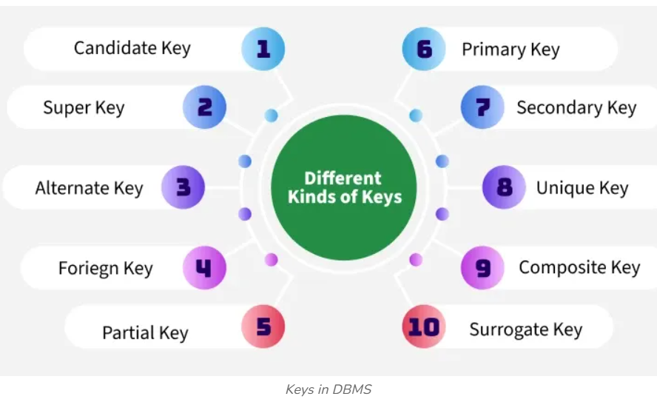
Keys in Relational Model
Keys are fundamental components that ensure data integrity, uniqueness and efficient access. It is widely used to identify the tuples(rows) uniquely in the table.
We also use keys to set up relations amongst various columns and tables of a relational database.

Slide 9
Super key in a relation: Super key is attribute or set of attributes that uniquely identifies tuple in a relation.
Consider a relation Student(Rollno,RegNo,Name,Age)
Student
The following are the some super keys of above relation
{Roll No}, {Reg.No},{Roll No,RegNo},{Roll No,Name},
{Reg. No,Name},{RollNo,Reg.no,Name},{Roll No,Reg.No,Age} ,
{Roll No,Reg.No,Name,Age}
The following are not super keys
{Name},{Age},{Name,Age}
Roll No | Reg. No | Name | Age

Slide 10
A super key is a group of single or multiple keys that uniquely identifies rows in a table. It supports NULL values in rows.
A super key can contain extra attributes that aren’t necessary for uniqueness.

Slide 11
Candidate key in a relation: The minimal set of attribute which can uniquely identify a tuple in a relation is known as candidate key.
Candidate key is a minimal super key with its proper subset is not a super key
Consider a relation Student(Rollno,RegNo,Name,Age)
Student
The candidate keys from the above relation are
{Roll No}
{Reg.No}
Roll No | Reg. No | Name | Age

Slide 12
A candidate key is a minimal super key, meaning it can uniquely identify a record but contains no extra attributes.
A candidate key must contain unique values, ensuring that no two rows have the same value in the candidate key’s columns.
Every table must have at least a single candidate key.
A table can have multiple candidate keys but only one primary key.

Slide 13
Primary key in a relation: A relation may contain multiple candidate keys. The database designer chooses one of the candidate key as primary key.
Consider a relation Student(Rollno,RegNo,Name,Age)
Student
The primary key is
{Roll No}
The primary is underlined in relation schema.
Student(Rollno,RegNo,Name,Age)
Roll No | Reg. No | Name | Age

Slide 14
It must have unique values and cannot contain any duplicate values.
A primary key cannot be NULL, as it needs to provide a valid, unique identifier for every record.
A primary key does not have to consist of a single column. In some cases, a composite primary key (made of multiple columns) can be used to uniquely identify records in a table.

Slide 15
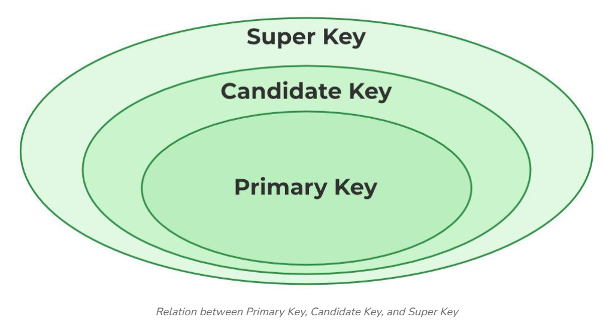
Alternate Key
An alternate key is any candidate key in a table that is not chosen as the primary key.
Eg:RegNo

Slide 16
Foreign Key
A foreign key is a key used to link two tables together via primary key. This is sometimes called as a referencing key.
A FOREIGN KEY is an attribute(or collection of attributes) in one table, that refers to the PRIMARY KEY in another table.
The table that contains the foreign key is called the referencing table(child) and the table that is referenced is called the referenced(parent) table.
Consider two relations
Department(Department_id,Department_name)
Student(Student_id,Name,Department_id).
The Department_id is a foreign key in Student relation referencing Department_id of Department.

Slide 17
Relational Integrity constraints in DBMS are referred to conditions that must be satisfied by all tupes in a relation.
The various restrictions on data that can be specified on a relational database in the form of constraints.
Constraints on the Relational database management system is mostly divided into three main categories are:
Implicit constraints: Constraints that are inherent to the data model
Explicit constraints: Constraints that can be directly expressed in schemas by using DDL.
semantic constraints: Constraints that cannot be directly expressed in the schemas and hence it must be expressed by the application programs.

Slide 18
The schema-based constraints are.
  Domain Constraints
  Entity integrity constraints
  Key Constraints
  Referential Integrity Constraints

Slide 19
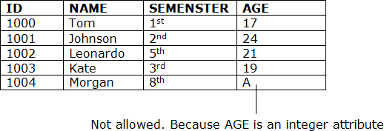
  Domain Constraints
  Domain of an attribute is the set of permitted values an attribute can take
Each attribute in a tuple is declared to be of a particular domain (for example, integer, character, Boolean, String, etc.) which specifies a constraint on the values that an attribute can take.

Slide 20
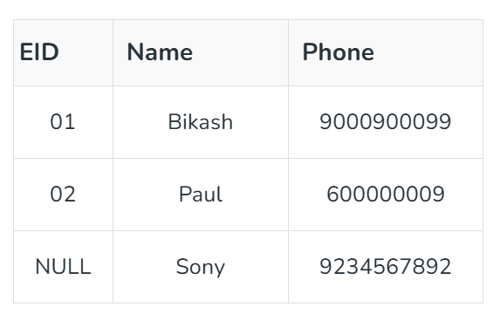

  Entity integrity constraints
The entity integrity constraint states that primary key value can't be null.
  This is because the primary key value is used to identify tuples in a relation and if the primary key has a null value, then we can't identify those tuples.
A table can contain a null value other than the primary key field.

Slide 21
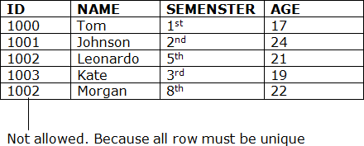
  Key Constraints or Uniqueness Constraints
Keys are the set of attributes used to uniquely identify a tuple in a relation.
The value of key attribute should be unique.
Null values are not allowed in the primary key, hence Not Null constraint is also part of the key constraint.
For any tuples t1,t2 in relation R ,we have t1[SK]≠ t2[SK] where SK is the super key of R

Slide 22
  Referential Integrity Constraints
A referential integrity constraint is specified between two tables and used to maintain the consistency among the tuples in two relations.
The referential integrity constraint states that a tuple in one relation that refers to another relation must refer to an existing tuple in that relation.
  In the Referential integrity constraints, if a foreign key in Table 1 refers to the Primary Key of Table 2, then every value of the Foreign Key in Table 1 must be null or be present in table 2

Slide 23
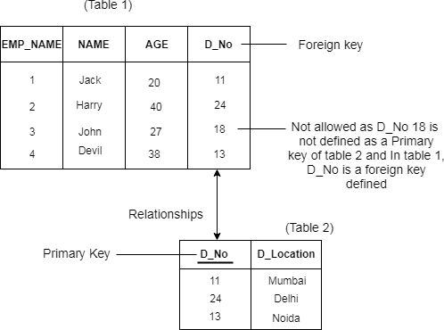

Slide 24
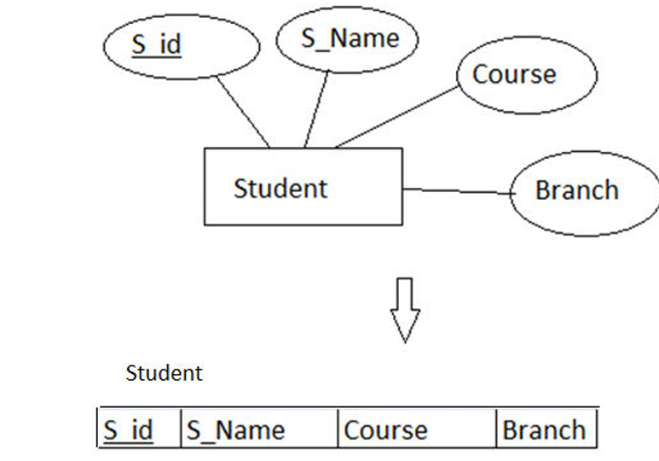
Synthesizing ER diagram to relational schema
Step1 :Mapping Strong Entities
For each regular (strong) entity type E in the ER schema, create a relation R that includes all the simple attributes of E.
The key attribute of the entity is the primary key of the table which is usually underlined.

Slide 25
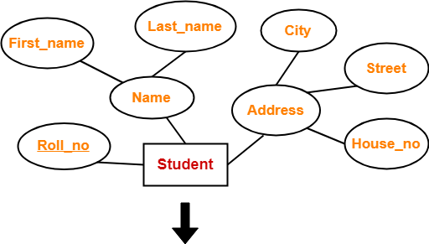
Composite Attributes to Relational schema
Include only the simple component attributes of a composite attribute.
Student ( Roll_no , First_name , Last_name , House_no , Street , City )

Slide 26
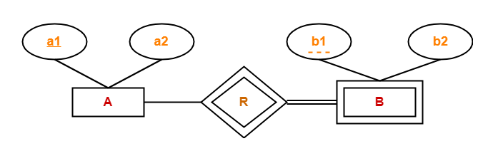
Step 2:Mapping Weak Entities
For each weak entity type W in the ER diagram with owner entity type E, create a relation R and include all simple attributes of W as attributes of R.
Include the primary key of owner relation as foreign key of R.
The primary key of R is the combination of the primary key(s) of the owner(s) and the partial key of the weak entity type W, if any.
The tables are: A(a1,a2)
B(a1,b1,b2)

Slide 27

Step 3:Mapping of Strong entity with multi-valued attributes
Requires two tables in relational model.
One table will contain all the simple attributes with the primary key.
Other table will contain the primary key and all the multi valued attributes.
Student(Roll_No,city)
Student_ph(Roll_No,Mobile_no)

Slide 28
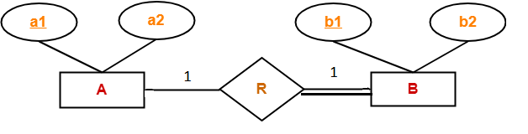
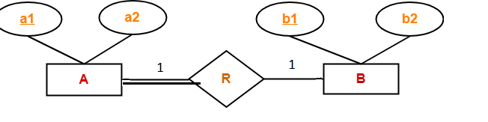
Step 4:Mapping of one-one relationship
There are three approaches for handing 1-1 relationship
Foreign key approach:
Choose the relation with total participation, include primary key of second relation as foreign key.
Two Tables :
A(a1,a2)
B(a1,b1,b2)
Two Tables :
A(a1,a2,b1)
B(b1,b2)

Slide 29
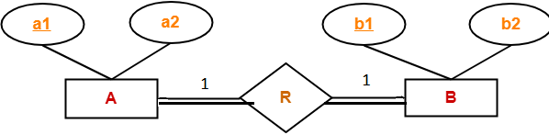
Step 4:Mapping of one-one relationship
Merged Relation Approach-total participation at both ends
Merge two entities to form a single relation
One table AB(a1,b1,a2,b2)
Cross Relation Approach(rarely used)
Set up a new relation by including the primary keys of both participating entity.

Slide 30
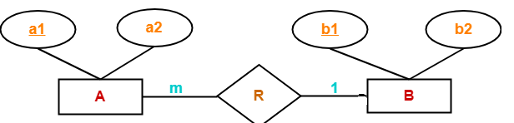
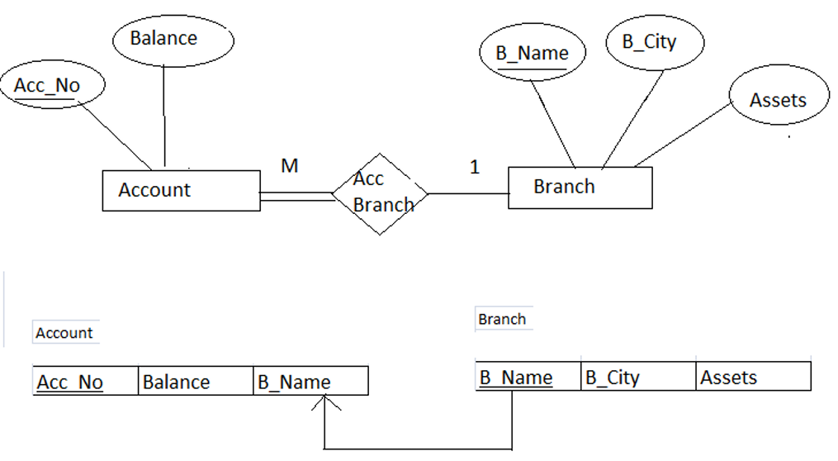
Step 5:Mapping of 1-m or m-1 relationship
Identify the relation on the n side of the relationship, add primary key of other relation as foreign key
Two Tables :
A(a1,a2,b1)
B(b1,b2)
with total participation

Slide 31
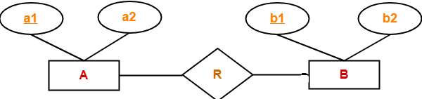
Two Tables : A(a1,a2)
B(b1,b2,a1)

Slide 32
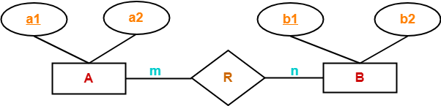
Step 6:Mapping of m-n relationship
Create third relation for the relationship by including primary keys of both participating entities and attributes of relationship if any.
Three tables:
A ( a1 , a2 )
R ( a1 , b1 )
B ( b1 , b2 )

Slide 33
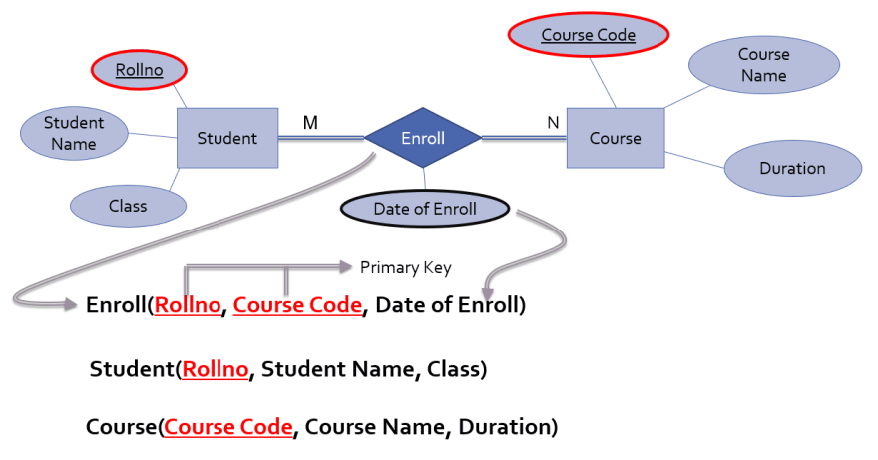

Slide 34
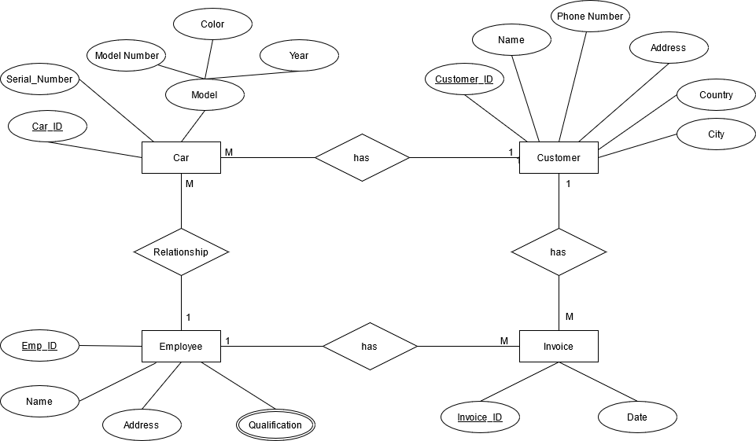

Slide 35
The ER diagram has four regular entities and each of them are converted into four tables. The attributes of the tables are the simple attributes of entities.
The entity employee contains a multi valued attribute qualification, so we create a new table EMPLOYEE_QUALIFICATION by including qualification, and the key attribute.
The ‘has’

Slide 36
CAR(Car_ID,Serial_Number,Model_Number,Color,Year,Customer_ID,Emp_ID)
CUSTOMER(Customer_ID,Name, PhoneNumber, Address, Country, City)
EMPLOYEE(Emp_ID, Name, Address)
EMPLOYEE_QUALIFICATION(Emp_ID,Qualification)
INVOICE(Invoice_ID,Date,Emp_ID,Customer_ID)

Slide 37
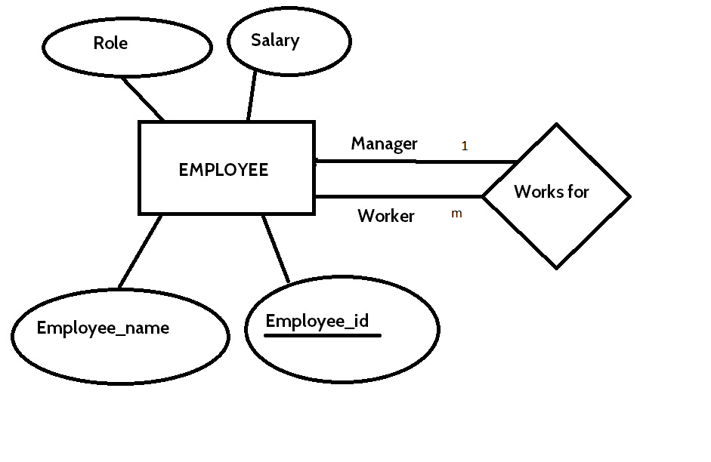
Rule for Recursive Relationship
Add a foreign key in the same table referencing the primary key of the same table.
Employee(Emp-id,name,role,salary,emp-id1) where emp-id1 is a foreign key referencing emp-id of Employee

Slide 38
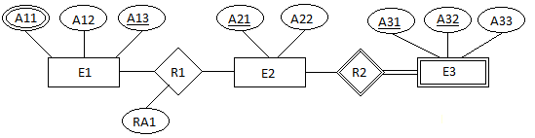
Here A11 is multi-valued attribute.
E3(A31,A32,A322,A21)
E2(A21,A22)
E1(A12,A13)
E12(A11,A13)
R1(A13,A21,RA1)-Assume that R1 is many to many relationship.

Slide 39
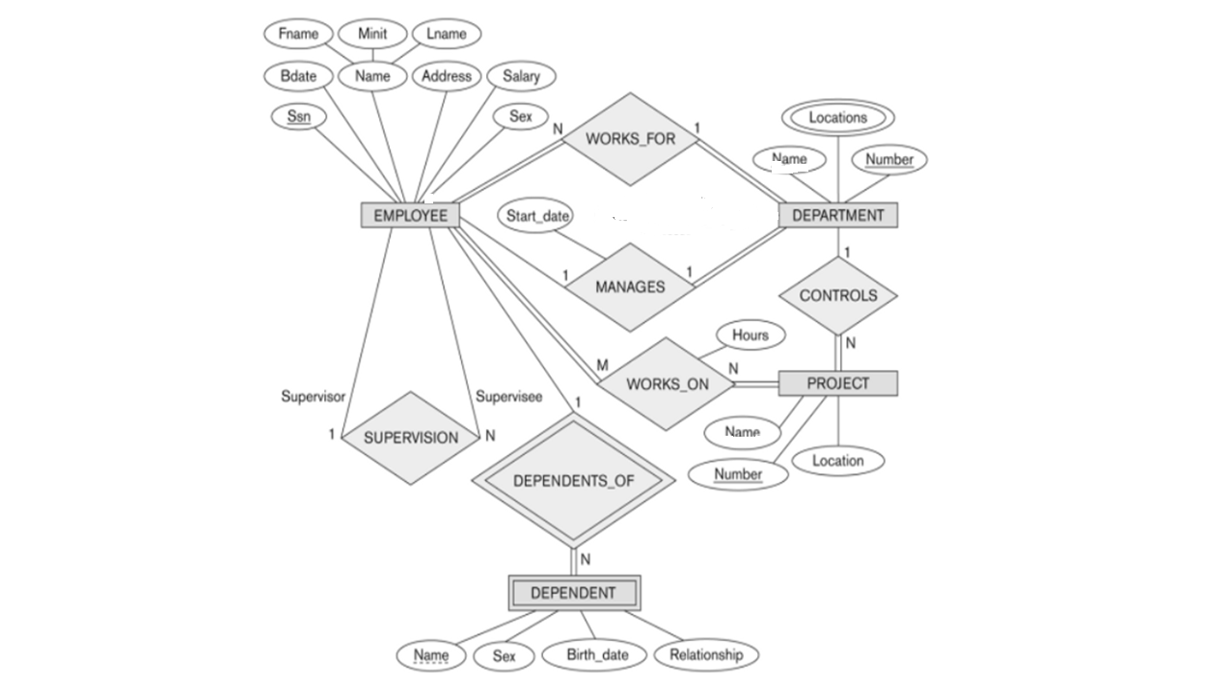

Slide 40
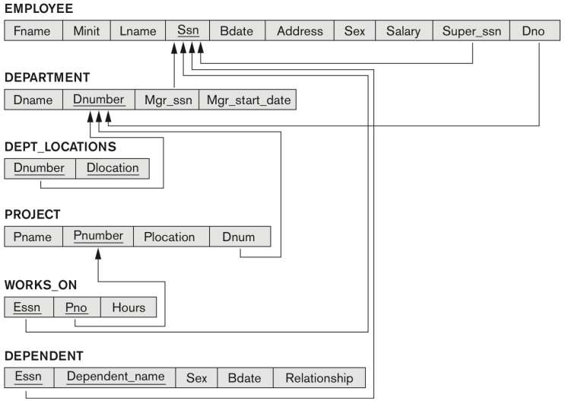
Here, the foreign keys are represented by arrows to its referenced primary key

Slide 41
Relational Algebra
Relational Algebra is a procedural query language used to access relational database.
The purpose of a query language is to retrieve data from database or perform various operations such as insert, update, delete on the data.
In relational algebra, input is a relation and output is also a relation(a temporary table holding the data asked for by the user).

Slide 42
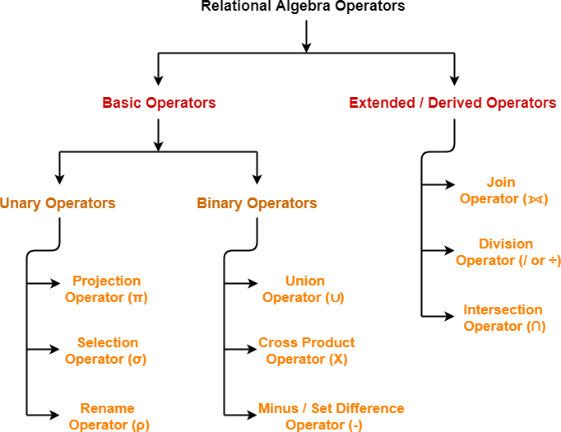

Slide 43
Select Operation (σ)
Select is used to fetch rows(tuples) from table(relation) which satisfies a given condition.
Syntax: σ_{p}(r)
Where, σ represents the Select Predicate, r is the name of relation and p represents the condition.
We can use unary and binary operators like =, <, > etc, to specify the conditions.

Slide 44
Consider a relation STUDENT(ROLLNO,NAME,AGE,GENDER)
σ_{age > 17} (Student) returns tuples from table Student, whose age is greater than 17.
σ_{age > 17 and gender = 'Male'} (Student)-return details of all male students whose age is greater than 17.
σ _{rollno=1} (Student)-Return the details of student with rollno 1.

Slide 45
Project Operation (∏)
Project operation is used to project only a certain set of attributes of a relation.
Syntax: ∏_{A1, A2...}(r)
-where A1, A2 etc are attribute names(column names).
∏_{Name, Age}(Student)-Returns Name, age from student.
∏_{Name,gender}(Student)- Returns Name, gender from student.

Slide 46
Consider a relation STUDENT(ROLLNO,NAME,AGE,GENDER)
Get the Name of student with RollNo 1.
∏_{Name} (σ_{RollNo=1} (Student))
Get the RollNo of all male students whose age is >17
∏_{RollNo} (σ_{gender=‘male’ and age>17} (Student))
Get the Name all students whose age>17 or gender=female
∏_{Name} (σ_{gender=‘female’ or age>17} (Student))

Slide 47
Rename(ρ) operator
Used to give different name to the result of any operation.
Syntax ρ_{h}(E)
where E denotes the expression and h be the name given to the result.
The query ρ_{result1}(∏_{Name} (σ_{gender=‘male’} (Student))) –gives the names of all male students and stored as result1.
It is equivalent to
Result1 (∏_{Name} (σ_{gender=‘male’} (Student)))

Slide 48
Union(U), Intersection(∩), Set difference(-) operator
These relational algebra operations are the standard mathematical operations on sets.
These are binary operators-its is operated on two relations.
To perform set operation the relation must be union compatible,
UNION: The result of this operation, denoted by R ∪ S, is a relation that includes all tuples that are either in R or in S or in both R and S. Duplicate tuples are eliminated.
INTERSECTION: The result of this operation, denoted by R ∩ S, is a relation that includes all tuples that are in both R and S.
SET DIFFERENCE : The result of this operation, denoted by R – S, is a relation that includes all tuples that are in R but not in S.

Slide 49
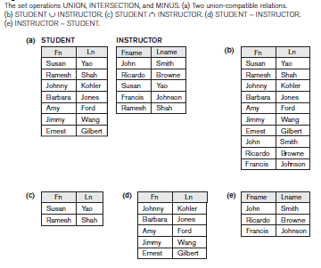

Slide 50
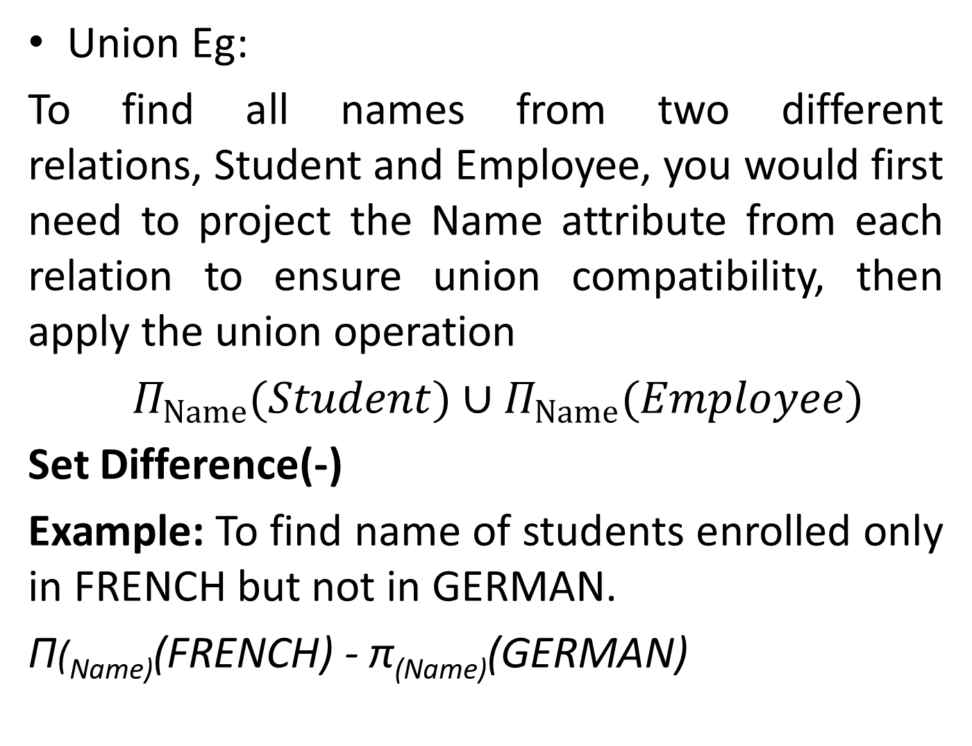
Union Eg:
To find all names from two different relations, Student and Employee, you would first need to project the Name attribute from each relation to ensure union compatibility, then apply the union operation
$Π_{Name}(Student)∪Π_{Name}(Employee)$
Set Difference(-)
Example: To find name of students enrolled only in FRENCH but not in GERMAN.
Π(_{Name)}(FRENCH) - π_{(Name)}(GERMAN)

Slide 51
CARTESIAN PRODUCT(X)
Cartesian Product(X) is a binary operator and it can also be applied to relations which are not union compatible.
The Cartesian product operation produces a new element by combining every tuple from one relation with every tuple from the other relation.
Syntax: R X S
where R and S are two relations such that the cross product will result in a table which has all the attributes of the table R followed by the attributes of the S
  If R has m attributes and S has n attributes RXS has m+n attributes.
  If R has nR tuples and S has nS tuples, the RXS has nR * nS tuples

Slide 52
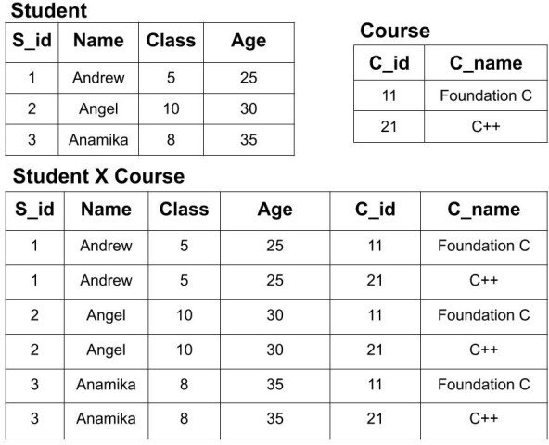
We have two tables of Student(S_id, Name, Class, Age) and Course(C_id, C_name).
Now, we will perform the cross product of both tables i.e Student X Courses

Slide 53
JOIN OPERATION
The JOIN operation, denoted by ⋈ , is used to combine related tuples from two relations into single “longer” tuples.
It is basically a cross product followed by a select operation
There are mainly two categories of join operation
Inner Join:
Theta join
EQUI join
Natural join
Outer join:
Left Outer Join
Right Outer Join
Full Outer Join

Slide 54
Inner Join:
In an inner join, only those tuples that satisfy the matching criteria are included, while the rest are excluded.
Theta Join:
The general case of JOIN operation is called a Theta join.
Theta join combines tuples from two relation that satisfies a condition
The general form of a JOIN operation on two relation R and S is
R ⋈ _{<join condition>}S
Each condition is of the form A θ B. where A is an attribute of R and B is attribute of S. and θ will <,>,=,<=,>=

Slide 55
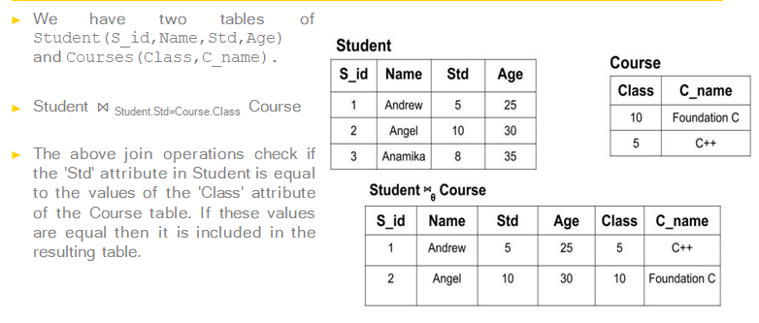
Theta join example

Slide 56
Equi Join:
When a theta join uses only equivalence condition, it becomes a equi join.
Natural join:
Natural Join is a join which is performed if there is a common attribute between the relations.
The name & type of the attribute must be same

Slide 57
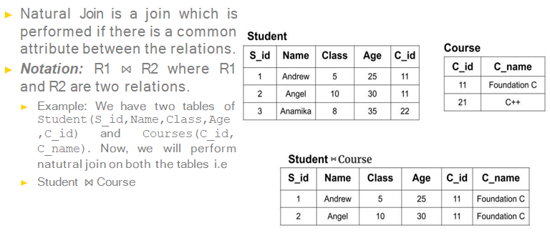

Slide 58
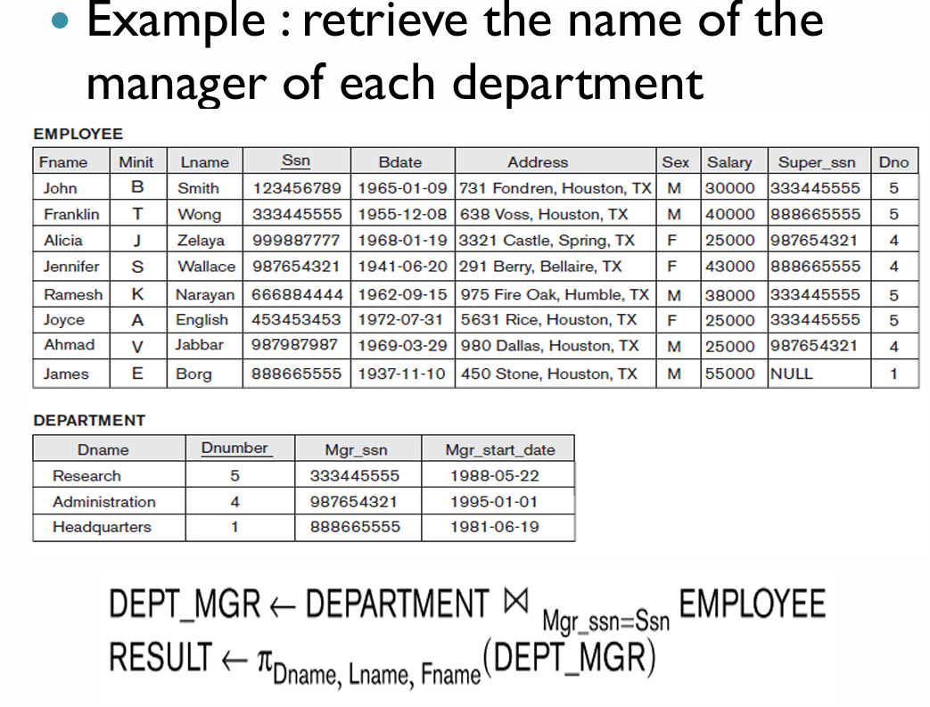

Slide 59
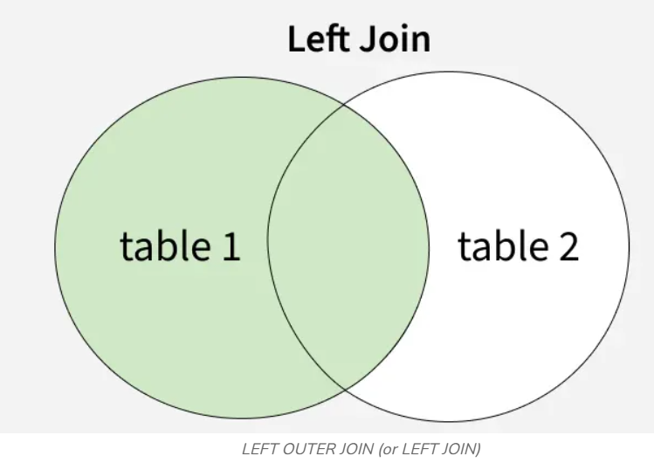
OUTER JOIN
In an outer join, along with tuples that satisfy the matching criteria, we also include some or all tuples that do not match the criteria.
Left Outer Join(A⟕ B)
Left outer join keeps all tuple in the left relation.
if there is no matching tuple is found in right relation, then the attributes of right relation are filled with null values.

Slide 60
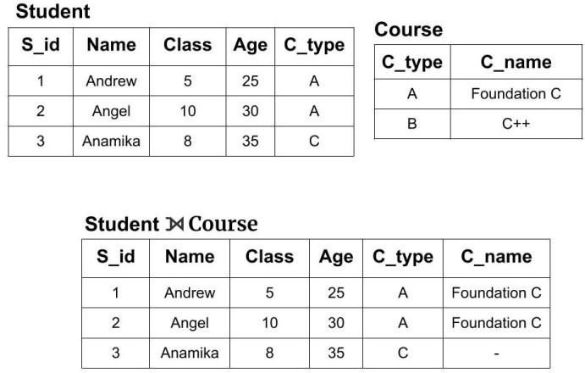

Slide 61
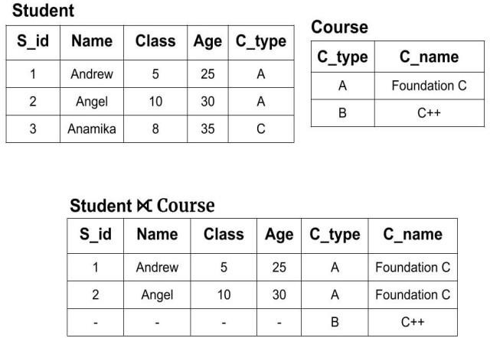
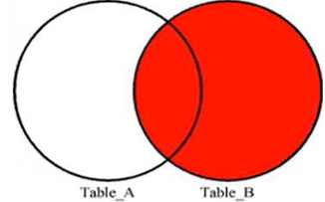
Right Outer Join(A⟖ B)
Right outer join keeps all tuple in the Right relation.
if there is no matching tuple is found in left relation, then the attributes of left relation are filled with null values.

Slide 62
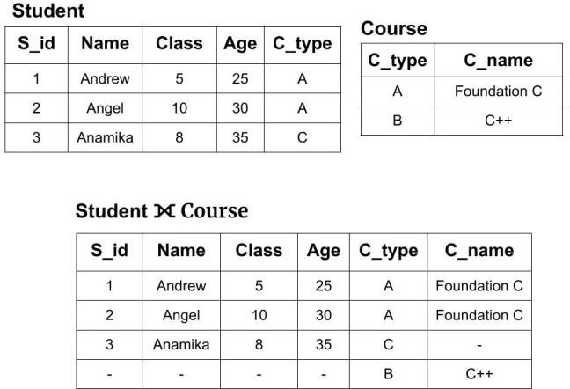
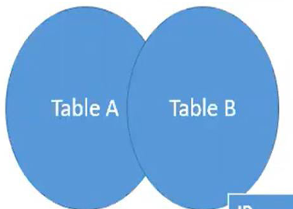
Full Outer Join(A⟗ B)
In a full outer join, all tuples from both relations are included in the result, irrespective of the matching condition.

Slide 63
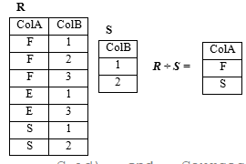
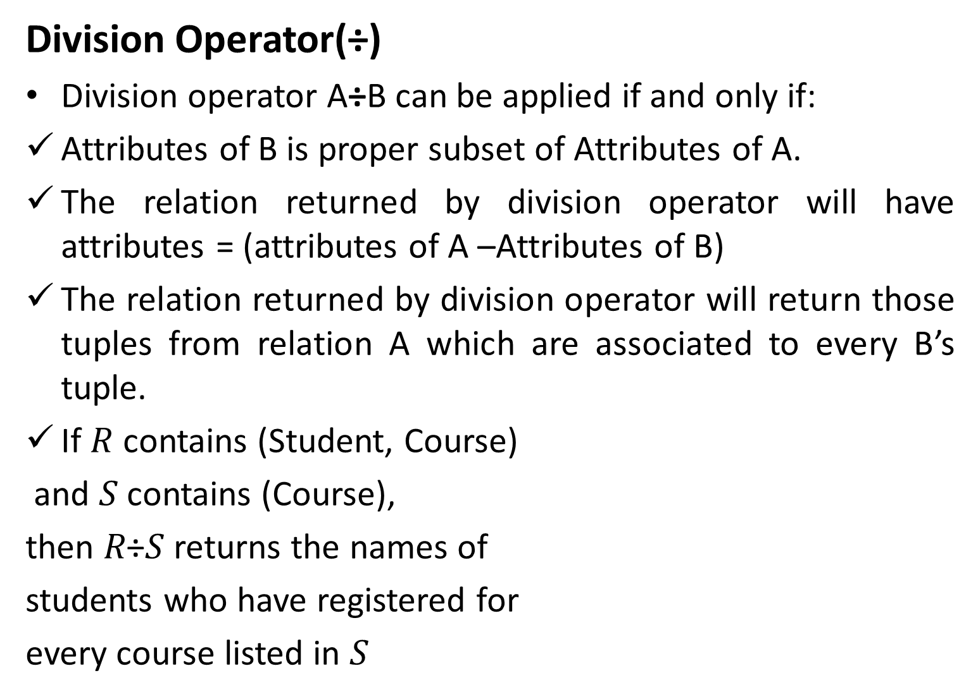
Division Operator(÷)
Division operator A÷B can be applied if and only if:
Attributes of B is proper subset of Attributes of A.
The relation returned by division operator will have attributes = (attributes of A –Attributes of B)
The relation returned by division operator will return those tuples from relation A which are associated to every B’s tuple.
If $R$ contains (Student, Course)
and 𝑆 contains (Course),
then 𝑅÷𝑆 returns the names of
students who have registered for
every course listed in $S$

Slide 64
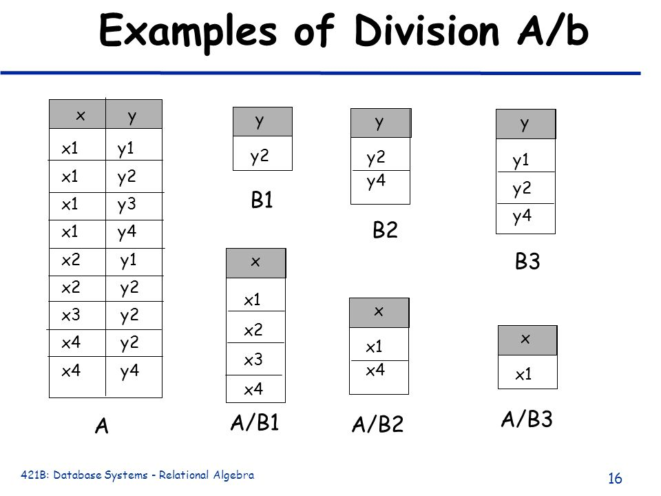

Slide 65
write relational algebra expressions for the queries that follow.
STUDENT(ROLLNO, NAME, AGE, GENDER, ADDRESS, ADVISOR)
COURSE(COURSEID, CNAME, CREDITS)
PROFESSOR(PROFID,PNAME, PHONE)
ENROLLMENT(ROLLNO, COURSEID,PROFID GRADE)
Primary keys are underlined. ADVISOR is a foreign key referring to PROFESSOR table..
Names of female students
∏_{Name} (σ_{gender=‘female’} (Student))
Names of professor and phone
∏pname,phone (Professor)

Slide 66
Give the credit of course with name dbms
∏_{credit} (σ_{cname=‘dbms’} (Course))
Names of male students along with adviser name.
∏_{name,pname} (σ_{gender=‘male’} (Student ⋈STUDENT.ADVISOR=PROFESSOR.PROFID PROFESSOR))
OR
∏_{name,pname} (σgender=‘male’ and STUDENT.ADVISOR=PROFESSOR.PROFID (Student XPROFESSOR))
Name all students whose adviser is Prof.Raju.
∏_{name} (σ_{PNAME=‘RAJU’} (Student ⋈STUDENT.ADVISOR=PROFESSOR.PROFID PROFESSOR))
Name of courses taught by Prof.raju.
∏_{CName}(σ_{PNAME=‘RAJU’}((PROFESSOR ⋈_{PROFESSOR.PROFID=} _{ENROLLMENT.PROFID}ENROLLMENT) ⋈ ENROLLMENT.COURSEID=COURSE.COURSED COURSE)))

Slide 67
RollNo, Name, Gender of students who enrolled for chemistry.
∏_{rollno,name,gender}(σ_{CNAME=‘chemistry’}((student ⋈student.rollno=ENROLLMENT.rollnoENROLLMENT) ⋈ ENROLLMENT.COURSEID=COURSE.COURSED COURSE)))
Names of students who have enrolled for any course taught by ‘Prof.Ganapathy’.
∏_{name}(σ_{PNAME=‘GANAPATHY’}((student ⋈student.rollno=ENROLLMENT.rollnoENROLLMENT) ⋈ ENROLLMENT.PROFID=PROFESSOR.PROFID PROFESSOR)))
Name of the professor who taught Mathematics
∏_{pname}(σ_{CNAME=‘MATHS’}((COURSE ⋈course.courseid=ENROLLMENT.courseidENROLLMENT) ⋈ ENROLLMENT.PROFID=PROFESSOR.PROFID PROFESSOR)))

Slide 68
Name,Roll no of students enrolled for atleast one course.
∏_{rollno,name} (student⋈student.rollno=ENROLLMENT.rollnoENROLLMENT)
Roll Number and name of students who have not enrolled for any course.(all students-enrolled students)
∏_{rollno,name} (student)-∏_{rollno,name} (student⋈student.rollno=ENROLLMENT.rollnoENROLLMENT)
Names of students who have not enrolled for any course taught by ‘Prof.Ganapathy’.(all students name-students name enrolled for courses of ganapathy)
∏_{name} (student)- ∏_{name}(σ_{PNAME=‘GANAPATHY’}((student ⋈student.rollno=ENROLLMENT.rollnoENROLLMENT) ⋈ ENROLLMENT.PROFID=PROFESSOR.PROFID PROFESSOR)))

Slide 69
Name,Phone of professor who taught at least one course.
∏_{pname,phone} (PROFESSOR⋈professor.profid=ENROLLMENT.profidENROLLMENT)
Name,Roll no of students enrolled for all courses.
∏_{rollno,name,courseid} (student ⋈student.rollno=ENROLLMENT.rollnoENROLLMENT) / ∏_{courseid} (course)

