Slide 1



TEAM
7
FILE SHARING
SYSTEM
A file-sharing system implemented in C++ allows users to upload, download, and manage files across a network using client-server architecture. It typically involves socket programming for communication, with protocols for secure and efficient data transfer.
Page 01

Slide 2

TEAM
7
TEAM DETAILS
TEAM LEADER: ADITYA CHOUDHURY (22CS8064)
TEAM DETAILS:
SIVA SANKARA VARAPRASAD(22CS8061)
RISHAV DAS (22CS8062)
DUVVU SAI SAHIL (22CS8063)
KALIVARAPU MANOJ (22CS8065)
PARIMI MANOHAR (22CS8066)
PRIYANKA TAMANG (22CS8067)
SUDHI SUNDAR DUTTA (22CS8068)
ARCHITA DAS (22CS8069)
SAYAN PAUL (22CS8070)
Page 02

Slide 3

TEAM
7
WHAT WE IMPLEMENTED
Client-Server Communication:
Establishes TCP connections using control and data sockets for command and file transfers.
File Upload and Download:
Supports sending and receiving files between client and server.
Command Execution and Status Codes:
Processes commands like `download` and ‘list’.
Multi Threading System
Connect to multiple clients at once
Page 03

Slide 4
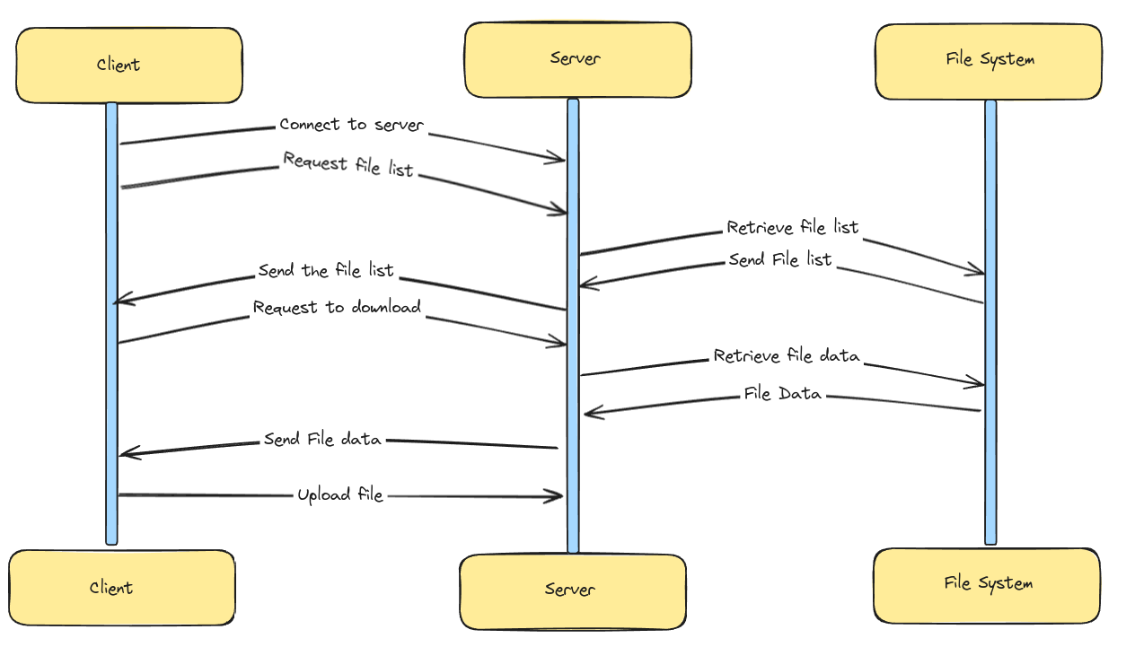
FLOW DIAGRAM
TEAM
7
Page 04

Slide 5




OS
TEAM
7
LEVEL FEATURES
SOCKET PROGRAMMING (NETWORKING)
BIG FILE HANDLING
Utilizes fopen(), fread(), fwrite(), and fclose() to read from and write to files for file transfer between client and server.
Uses multiple buffers to transfer the file in chunks
Uses socket(), connect(), bind(), listen(), accept(), recv(), and send() for establishing TCP connections for client-server communication with a centralized server.
PROCESS AND THREADING CONTROL
HASH FUNCTION
Implements a hash function to ensure deduplication. If identical files are uploaded, only one copy is stored on the server by hashing the file's bytestream.
Using multi thread implementation to handle more than one clients at a time
Page 05

Slide 6



TEAM
7
WHAT WE
USED
Page 07

Slide 7
TEAM
7
FUTURE PROSPECTS
Password-based Authentication
Multiple Client Connections with ThreadPools on Server
Contribution Based Stoage Allocation For Clients
Pause and Retry Uploads On Failure
Chunk-based Uploads for Increased Transfer Speed
Hash Verification and Redundancy Prevention
Proper Metadata Handing and File Storage With Backup system
Ensuring same file does not get uploaded multiple times
Page 08

Slide 8

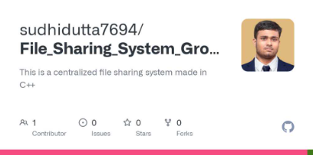

TEAM
7
FILE SHARING
SYSTEM
Link to our repository
Page 09

Slide 9


TEAM
7
THANK YOU
Page 10

