Slide 1
Segment and Score customers based on the purchase patterns for a retail client

Slide 2
Objective
To develop an engine which segments and provides the score for customers based on their behaviour and analyse their purchasing pattern which helps in designing various customer specific promotions.
Segmentation
Scoring
Association Rules

Slide 3
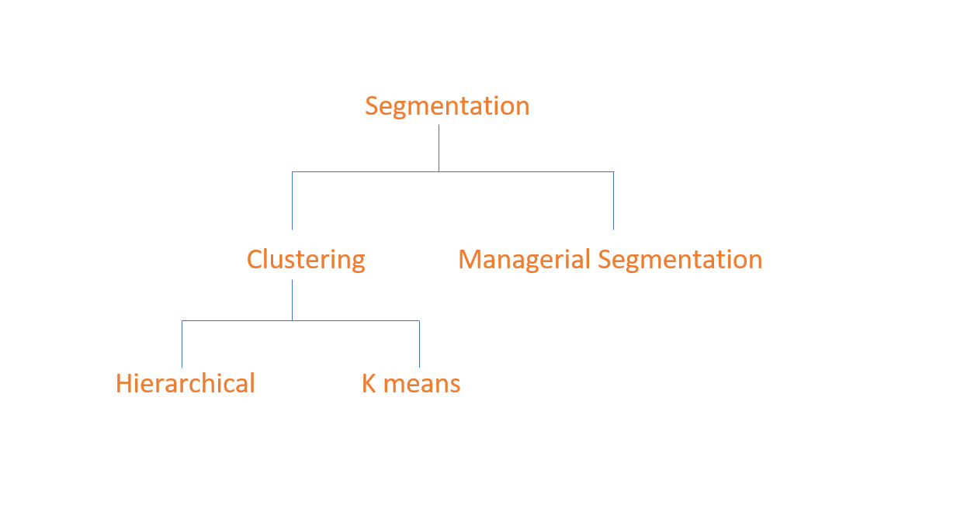
Notes:
Segmentation

Slide 4
Features generated
Frequency
Average cost
Recency
Tenure
Notes:
houdeijjjns

Slide 5
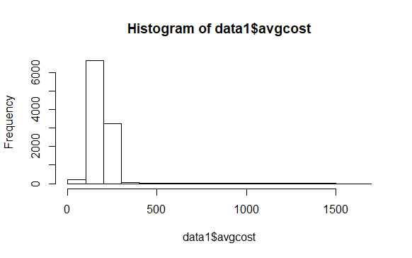
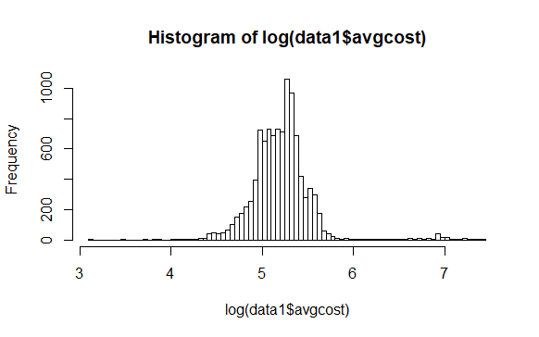
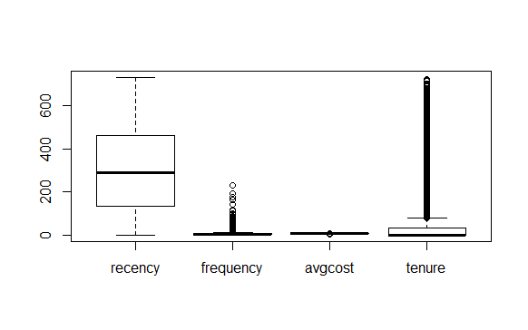
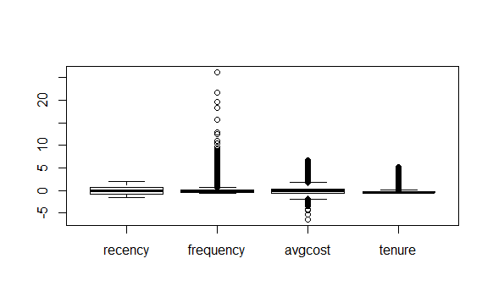
Transformations

Slide 6
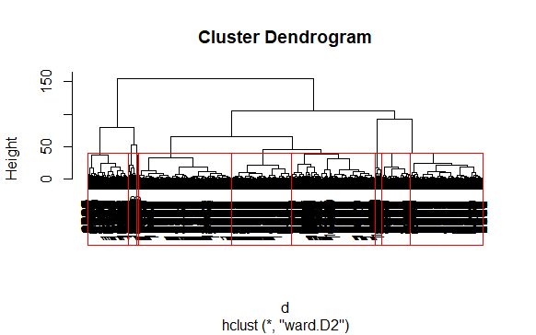

Slide 7
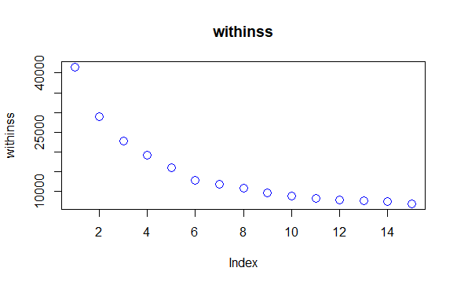

Slide 8
Hierarchical Cluster
Group.1 | recency | frequency | avgcost | tenure
1 | 577.0025 | 3.522787 | 185.8179 | 15.936500
2 | 117.1511 | 10.730916 | 182.8135 | 344.681261
3 | 140.3223 | 43.010989 | 166.1782 | 348.847240
4 | 340.8215 | 3.543353 | 990.1764 | 38.752645
5 | 235.1828 | 4.658898 | 154.9316 | 25.298783
6 | 212.4579 | 2.567556 | 225.5396 | 3.801082
K-means Cluster
Group.1 | recency | frequency | avgcost | tenure
1 | 344.04518 | 3.360465 | 993.7658 | 34.23324
2 | 91.00579 | 60.834711 | 165.0812 | 409.63642
3 | 574.46613 | 4.315152 | 138.9564 | 13.54933
4 | 591.21533 | 2.951412 | 208.1254 | 13.21109
5 | 88.46404 | 3.873122 | 191.9218 | 19.18949
6 | 315.24403 | 4.334884 | 163.9459 | 15.54770
7 | 192.36603 | 5.102117 | 117.1360 | 15.63030
8 | 282.36240 | 2.376631 | 233.0544 | 6.94279
9 | 130.00768 | 12.769525 | 180.4249 | 331.56186

Slide 9
Managerial segmentation
Active
  New active
  Active high value
  Active low value
Warm
  New warm
  Warm high value
  Warm low value
Cold
Inactive

Slide 10
Scoring
Probability Model
The likelihood that a customer we'd be active in 2016 or not
Revenue Model
how much the customer going to spend with that specific retailer over the year 2016
Score
Output of Probability Model * Output of Revenue Model

Slide 11
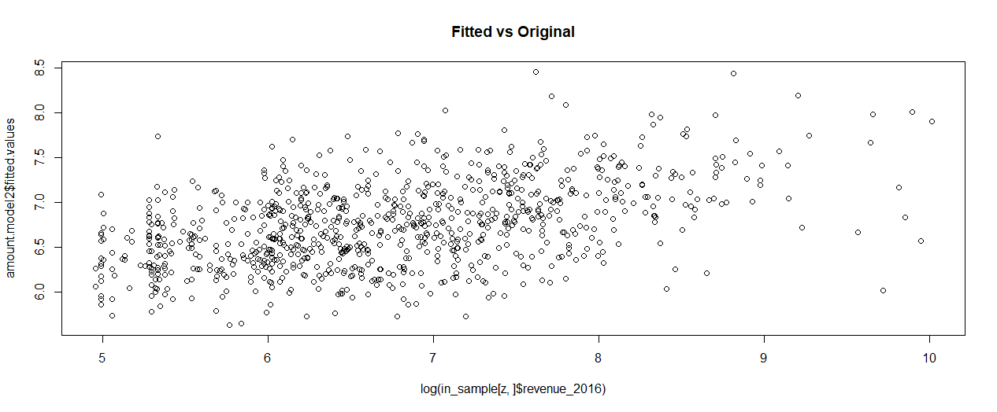

Slide 12
Association rules
Rule support Confidence Lift
1 | {53} => {31} | 0.0008742465 | 0.6551724 | 89.552592
2 | {18,47} => {15} | 0.0005521557 | 0.5000000 | 4.492146
3 | {32,39} => {65} | 0.0009202595 | 0.5555556 | 12.370788
4 | {32,39,65} => {6} | 0.0005521557 | 0.6000000 | 10.259481
5 | {32,39,6} => {65} | 0.0005521557 | 1.0000000 | 22.267418
6 | {39,6,65} => {32} | 0.0005521557 | 0.8571429 | 23.373006
7 | {32,6,65} => {39} | 0.0005521557 | 0.5714286 | 32.007364
8 | {14,16,4} => {26} | 0.0005061427 | 0.5500000 | 6.193342
9 | {14,16,26} => {4} | 0.0005061427 | 0.7857143 | 8.940277
10 | {16,20,25} => {26} | 0.0005521557 | 0.5217391 | 5.875107

