Slide 1


FusionPay- Finance Management System
Using Spring Boot Microservices & Angular
Team: Pallikonda Hannsika
Sai Kirthana Konduru
Dongeshwar Sudhiksha
Guide: Rajshekhar G.S

Slide 2
Presentation Outline
01
02
03
Introduction & Problem Statement
Project Objectives & Scope
Existing vs. Proposed System
04
05
06
System Architecture
Technologies & Requirements
Modules, UML & Database Design
07
08
Project Screenshots
Advantages, Future Scope & Conclusion

Slide 3


What is EMI & The Problem
EMI Defined
Equated Monthly Installment — a fixed payment schedule that allows customers to purchase products over time without full upfront cost.
Traditional Issues
Credit card dependency, high interest charges, and manual verification delays create friction for millions of users seeking affordable finance options.
Our Solution
A zero-cost EMI platform with automated verification, real-time tracking, and a robust microservices architecture — removing barriers to digital finance.

Slide 4


Problem Statement
Credit Card Dependency
Limits accessibility — many users are excluded from EMI schemes without a credit card.
High Interest Charges
Traditional finance charges inflate product costs significantly for end consumers.
Manual Verification
Time-consuming, error-prone processes delay approvals and frustrate applicants.
No Centralized System
Lack of real-time payment tracking and unified credit limit management for users and admins.

Slide 5

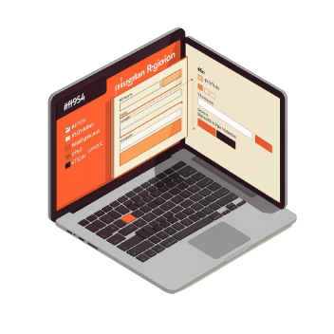


Project Aim & Objectives
Scalable EMI Platform
Digital Registration & Auth
Payment Tracking
Product & Admin Control
Real-time transaction history, intelligent credit limit management, and flexible EMI calculation engine.
Build a secure, zero-cost EMI management system that eliminates traditional finance barriers through digital innovation.
Seamless user onboarding with secure authentication, automated card activation, and role-based access control.
Efficient admin verification workflows, real-time product management, and inventory control for administrators.

Slide 6
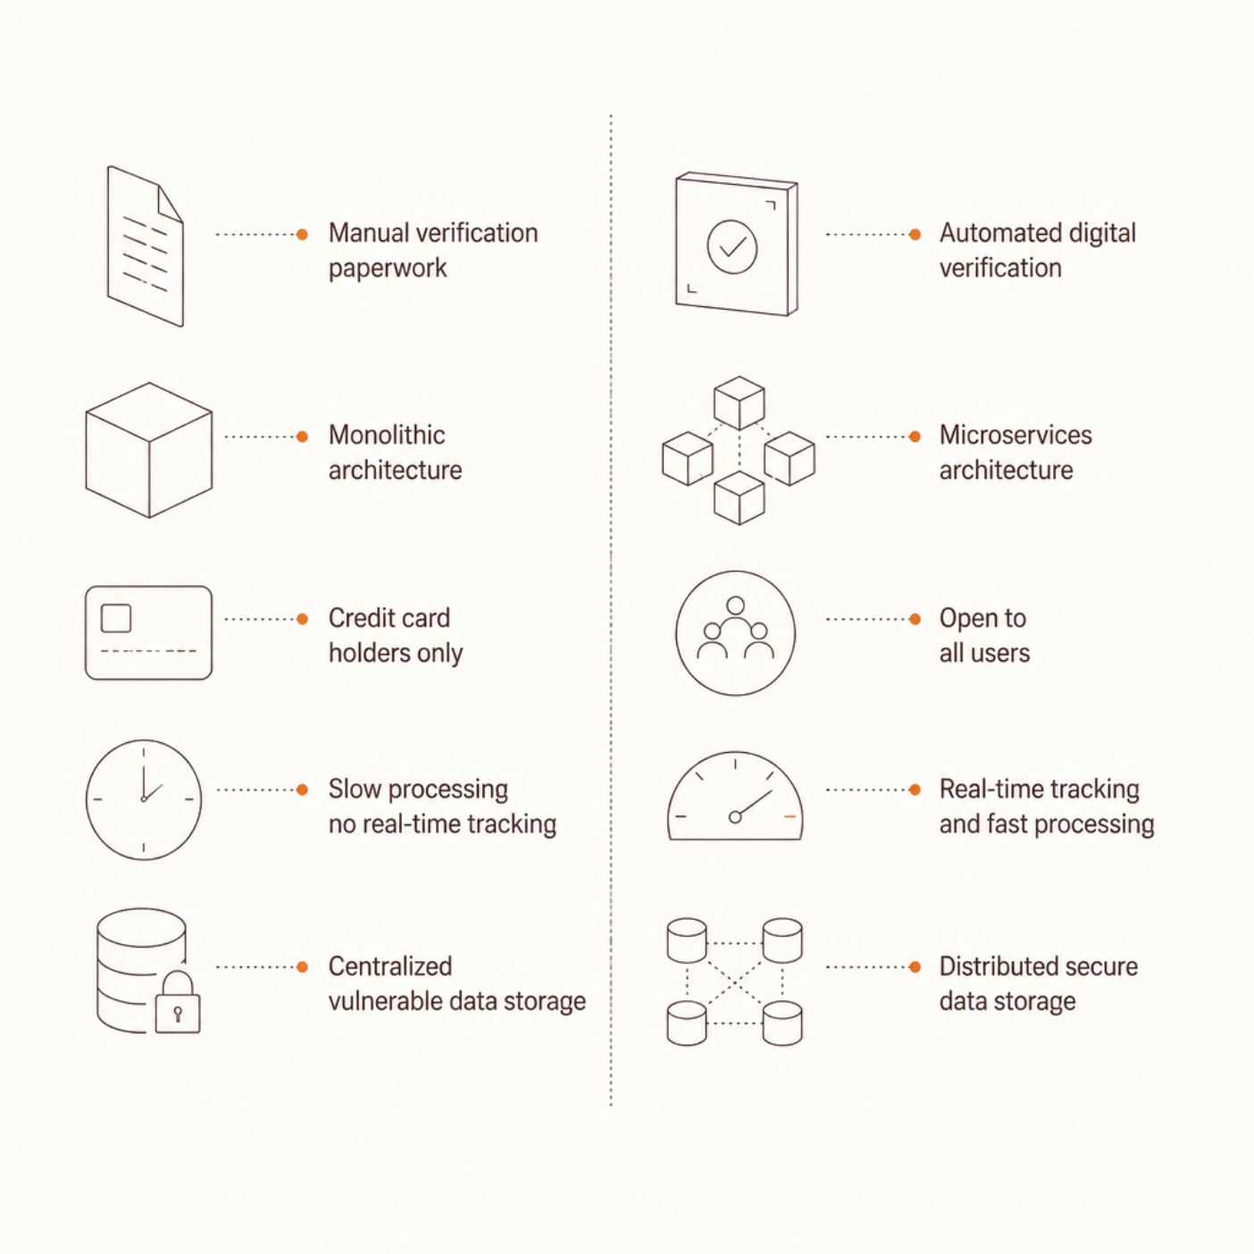

Existing System vs. Proposed System
Why Microservices?
The proposed architecture decomposes the monolith into independent, scalable services — each business function (User, Product, EMI, Admin) operates autonomously, enabling faster deployments and fault isolation.
Each microservice can be scaled independently based on real-time demand — a key advantage over legacy monolithic systems.

Slide 7
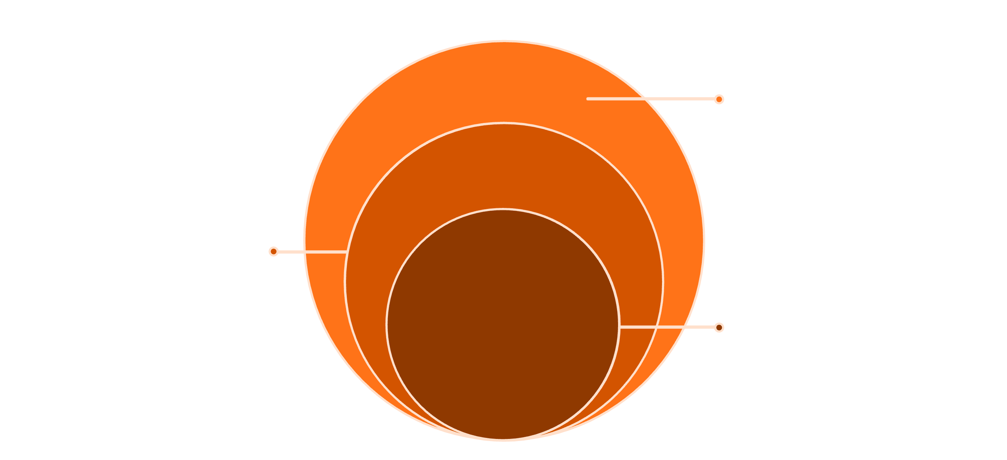
System Architecture Diagram
Microservices & Data
User, Product, EMI, Admin, MySQL, Eureka
API Gateway
Request router and single entry point
Frontend UI
Angular web client
The API Gateway acts as the single entry point, routing client requests to the appropriate microservice. Eureka Discovery Server enables dynamic service registration and load balancing across all backend services.

Slide 8
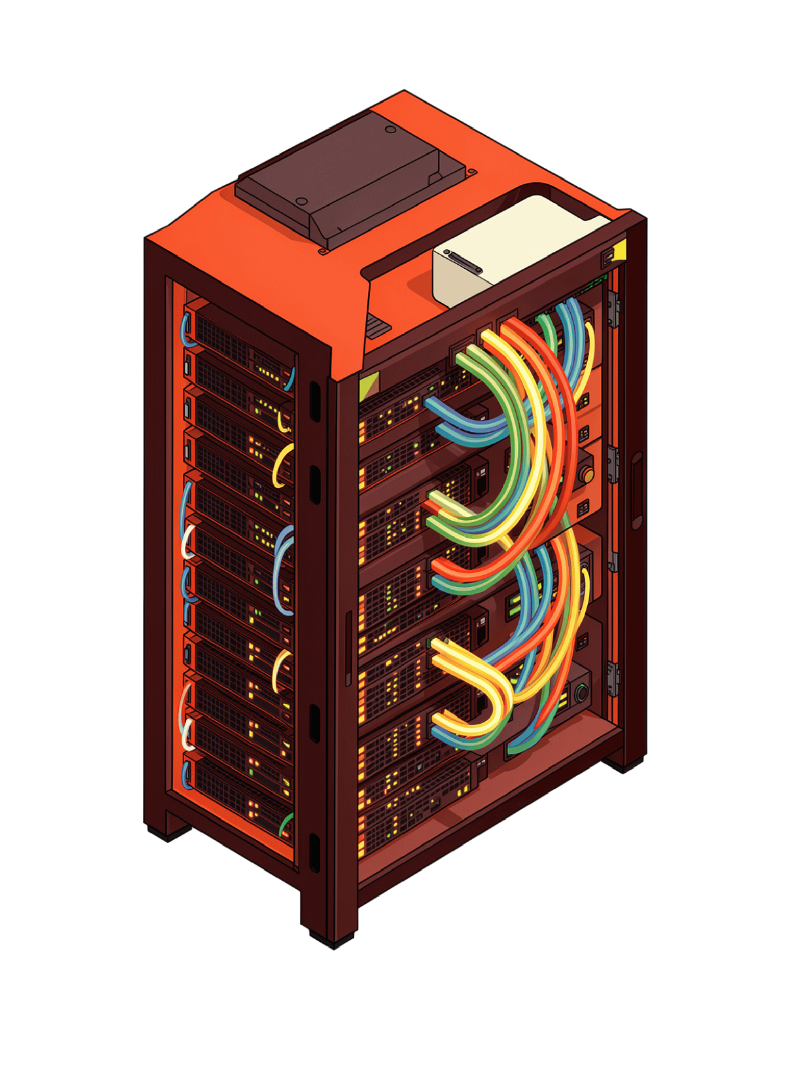
Technologies & Requirements
Backend
Frontend
Java 17 (LTS)
Spring Boot 3
Spring Data JPA & Hibernate
Spring MVC & REST APIs
Lombok & Validation
Angular Framework
HTML, CSS & Bootstrap
Responsive UI Design
Database & Tools
MySQL (Relational DB)
HeidiSQL (DB Manager)
Postman (API Testing)
Maven & Git/GitHub

Slide 9

Project Modules & Key Functionalities
1
2
User Module
Product Module
Digital registration, secure login, profile management, and EMI card application with document upload.
Browse product catalog, real-time inventory control, product categorization, and purchase initiation.
3
4
Finance Module
Admin Module
Zero-cost EMI calculation, flexible tenure selection, payment scheduling, and transaction history tracking.
Verify user applications, activate/deactivate EMI cards, manage credit limits, and oversee all transactions.
5
6
Eureka Server Module
API Gateway Module
Dynamic service registration, service discovery, and load balancing across microservices.
Single entry point for all client requests, request routing, authentication, and rate limiting.

Slide 10
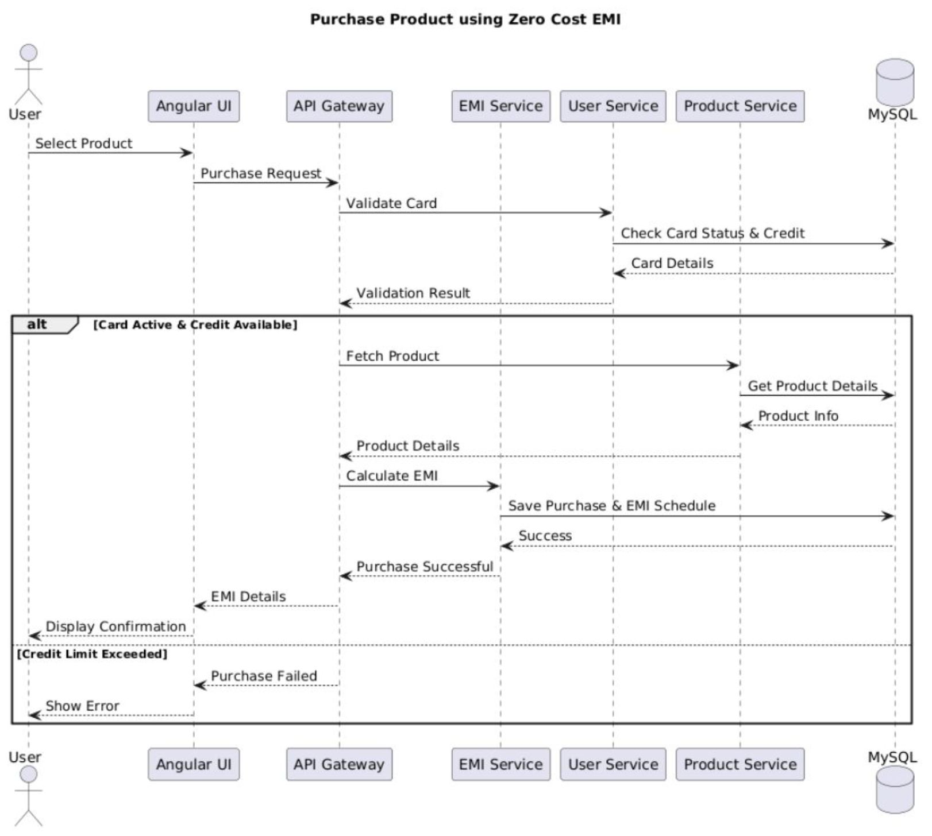
UML - Sequence Diagram

Slide 11
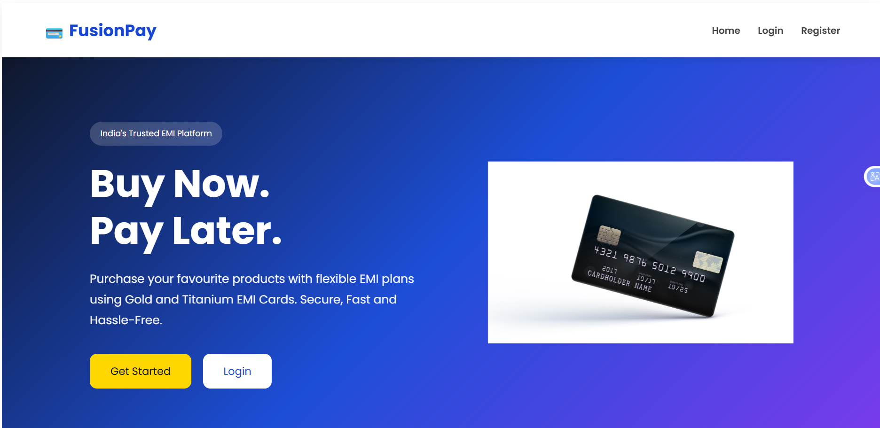
Project Screenshots

Slide 12
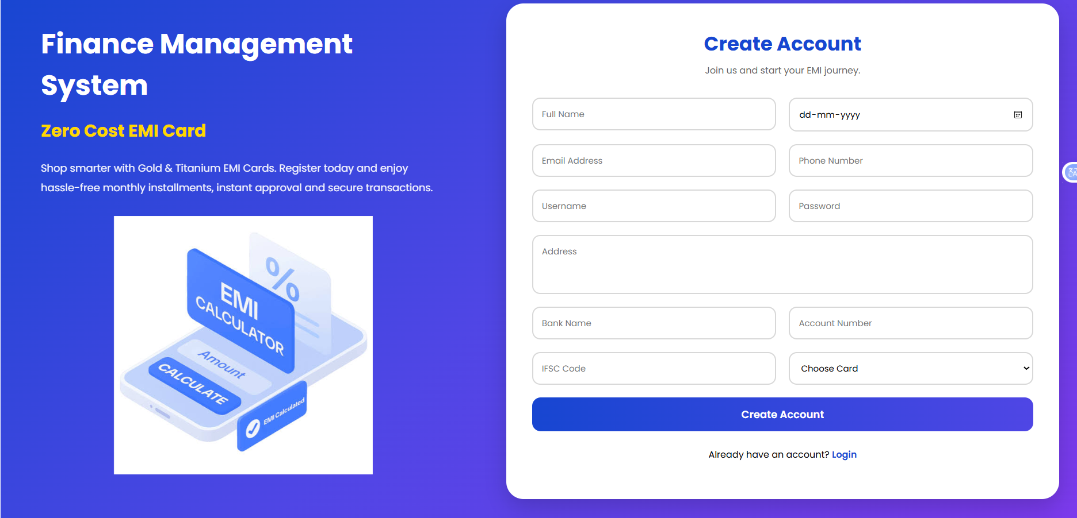

Slide 13
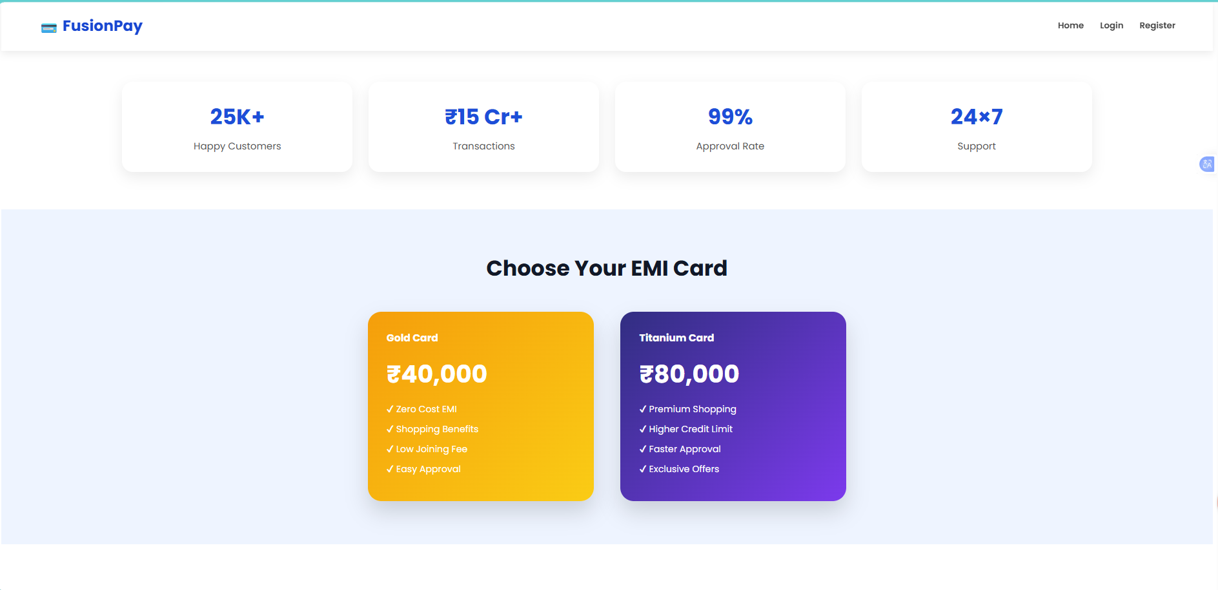

Slide 14
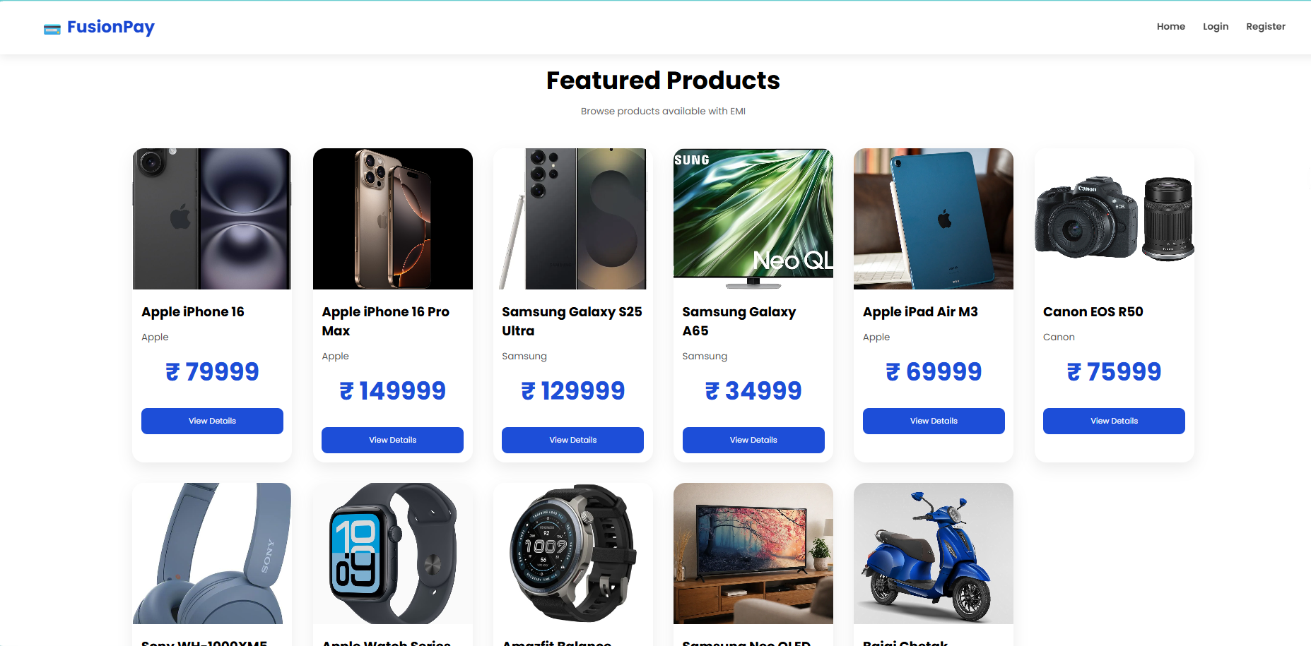

Slide 15
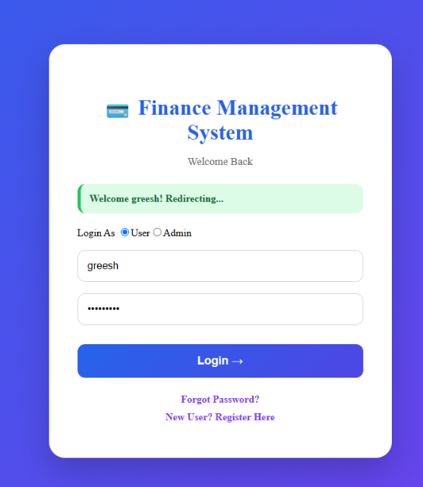
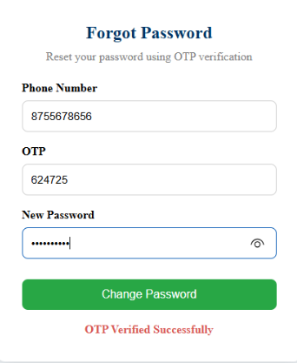
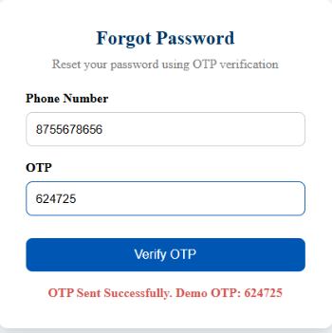

Slide 16
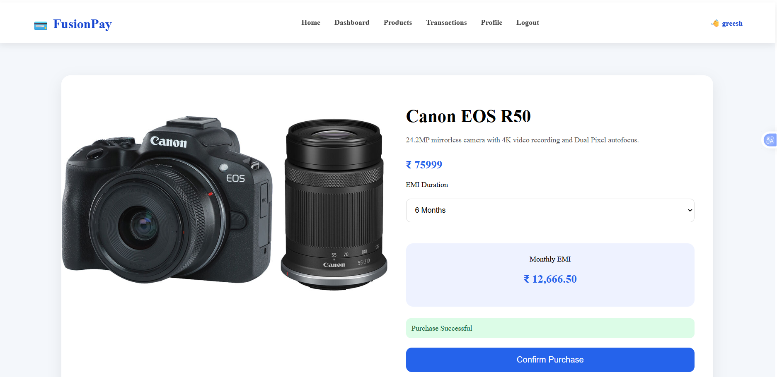

Slide 17
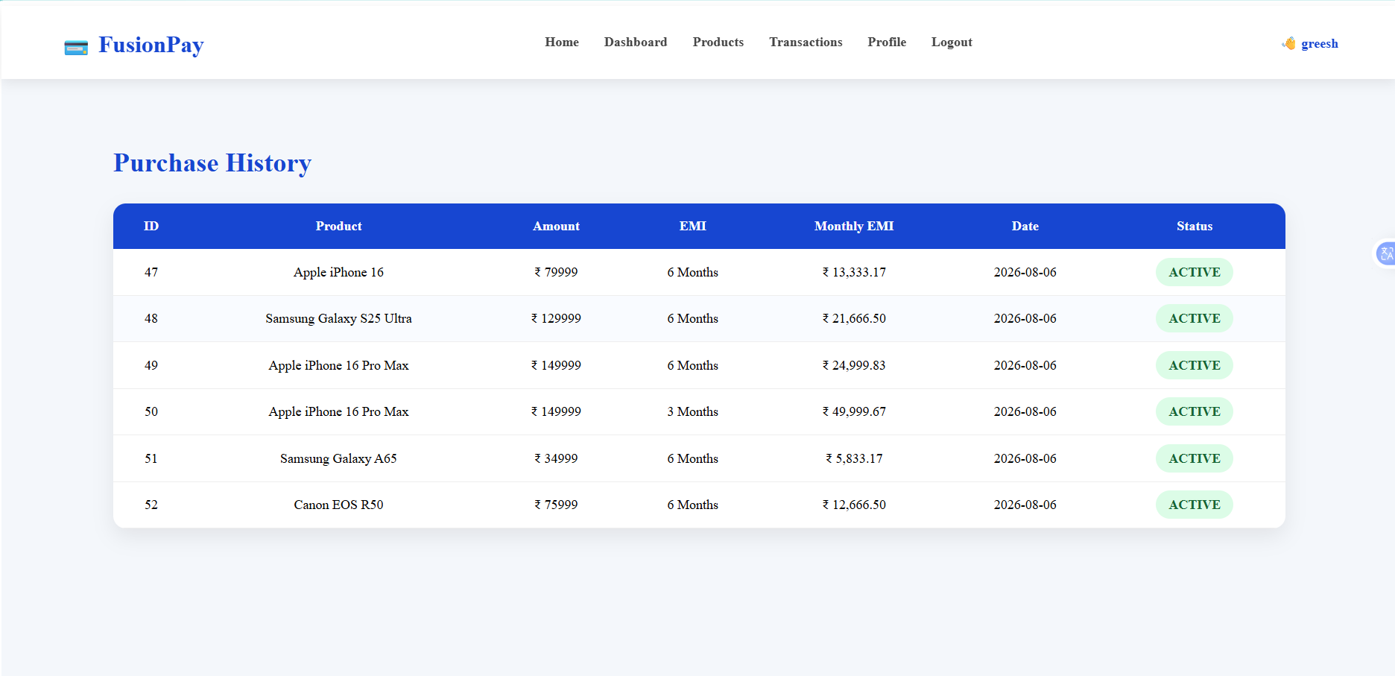

Slide 18
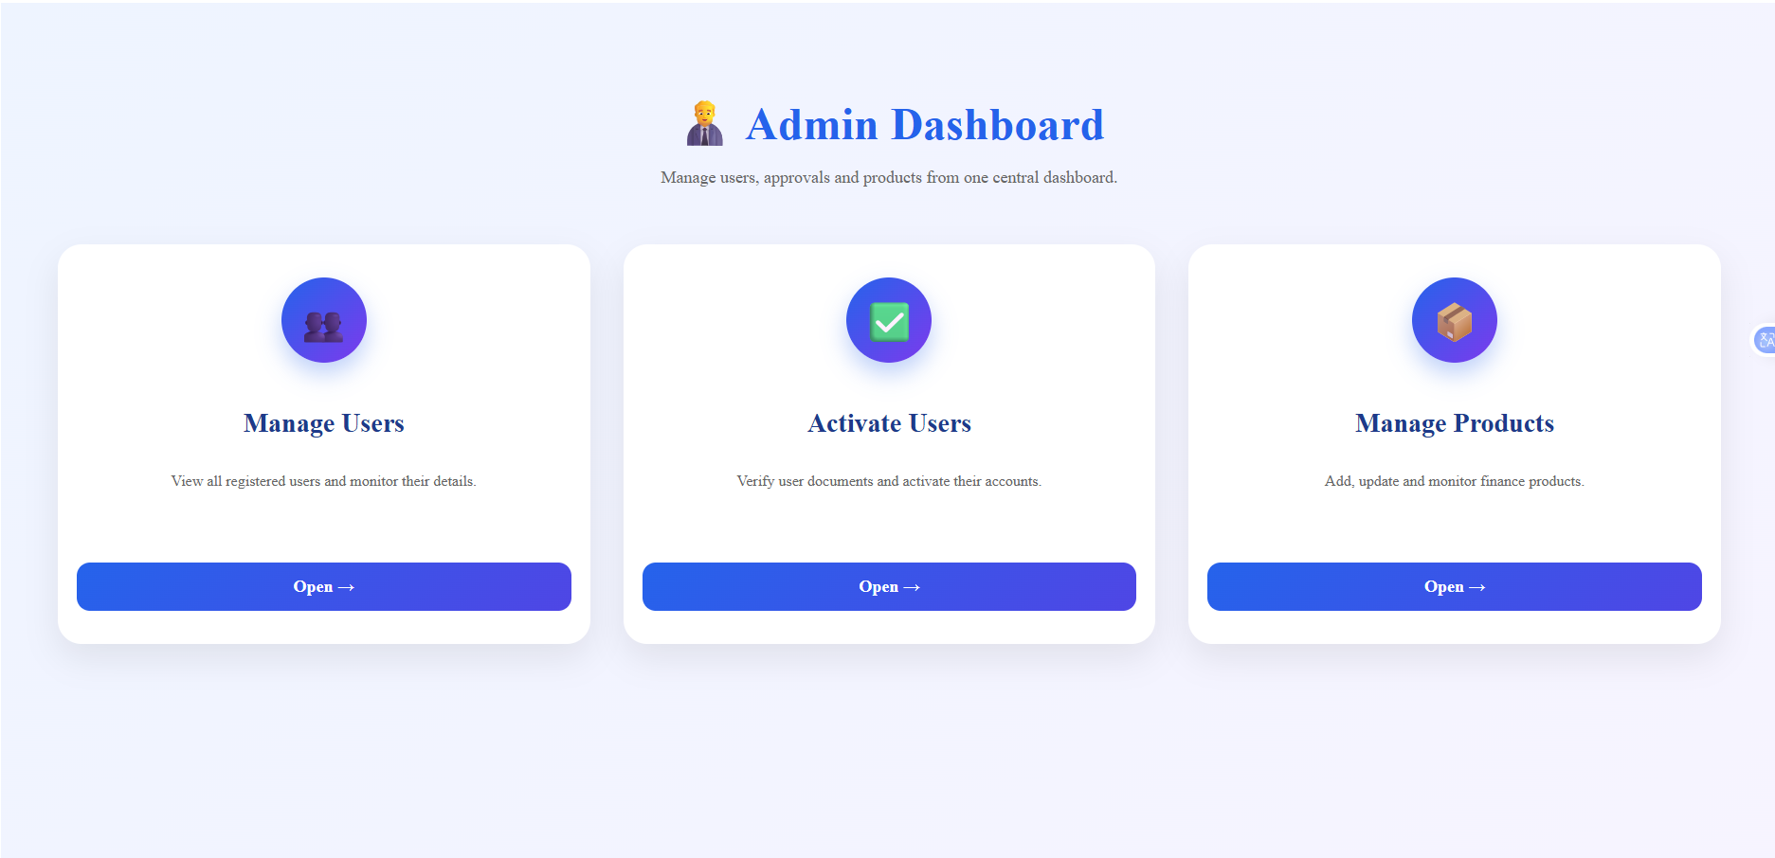

Slide 19



Advantages, Future Scope & Conclusion
Key Advantages
Future Scope
Zero-Cost EMI
AI-powered credit scoring & risk assessment
Mobile app (Android & iOS) integration
Multi-bank partnership & payment gateway support
Advanced analytics dashboard for admins
No hidden charges — genuine zero-interest installment plans for all eligible users.
High Scalability
Microservices architecture scales each component independently under load.
Conclusion
The Finance Management System delivers a modern, scalable, and accessible EMI platform — bridging the gap between traditional finance limitations and the digital needs of today's users.
Automated Workflows
Eliminates manual paperwork; approvals and notifications are fully automated.
CAPSTONE PROJECT
SPRING BOOT & ANGULAR

