Slide 1

EVENTORA : Professional Event Management
A full-stack web application for managing events, staff, and customers — powered by role-based dashboards and real-time collaboration.

Slide 2

The Problem
Fragmented Tools
Organizers juggle spreadsheets, WhatsApp, and email — with no single source of truth.
No Staff Visibility
Staff lack a clear way to track tasks or communicate in real time during events.
Broken Customer Experience
Customers struggle to discover, register, and track events across disconnected systems.
No Access Control
Without role-based permissions, everyone sees everything — creating chaos and security gaps.

Slide 3
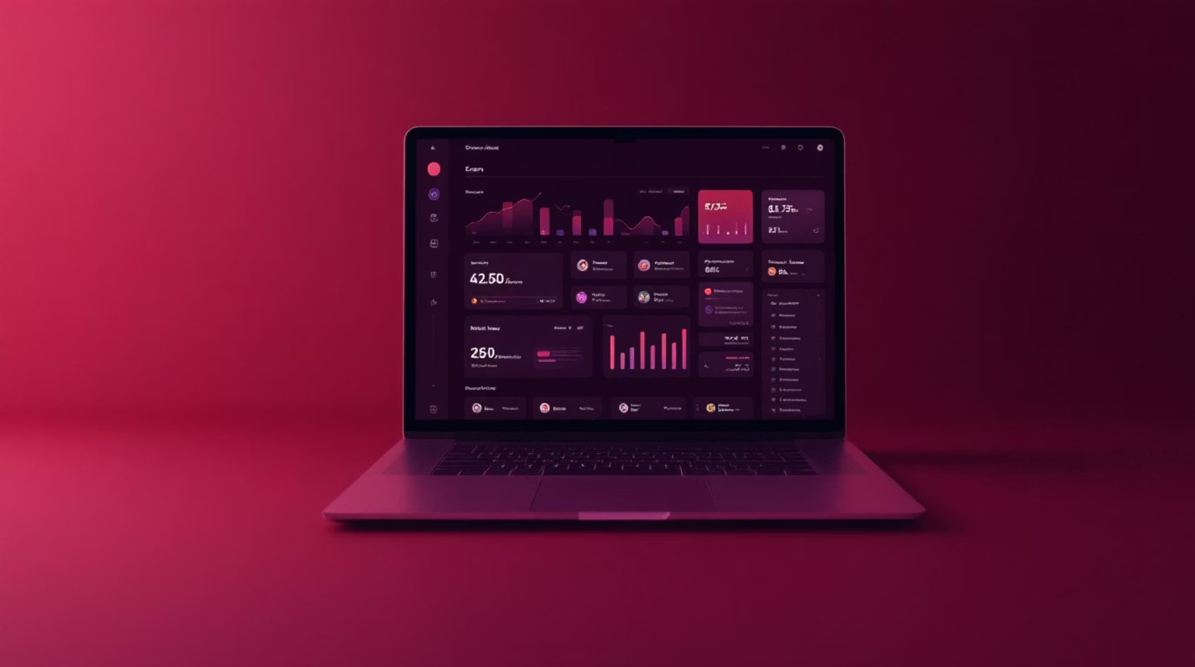
Introducing EVENTORA
One platform. Three roles. Complete control.
Each role gets a fully tailored dashboard with dedicated features. MySQL-backed authentication ensures secure, role-specific access for every user.
Manager
Staff
Customer
Full event oversight, budget tracking, and staff delegation
Task management, priority badges, and team chat
Event discovery, registration, and whishlist

Slide 4
Technology Used
Evently is built on a modern, production-ready stack designed for performance, security, and scalability.
Frontend
React 19, TypeScript, Vite
Styling
Tailwind CSS v4
Animations
Framer Motion
State Management
Zustand
Icons
Lucide React
Backend
Node.js + Express
Database
MySQL 8+
Password Security
bcryptjs

Slide 5

How It Works
Role Authentication
Login / Signup
Role Selection
Landing
Dashboard
Every user begins at a unified entry point, then branches into a tailored experience based on their role — ensuring the right tools reach the right people from the moment they log in.

Slide 6

Manager — Full Control
Event Management
Create, edit, and delete events with full details, timelines, and seating charts.
Budget Tracker
Monitor expenses, revenues, and totals in real time with event health scores.
Guest & Staff
Manage RSVPs, assign staff, delegate tasks, and oversee vendor relationships.
Analytics Overview
Calendar view, task completion %, seat fill %, and performance insights at a glance.

Slide 7
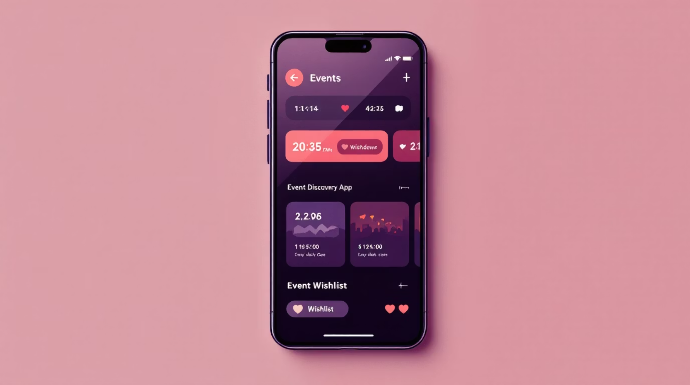
CUSTOMER EXPERIENCE
Customer — Discover & Register
Browse & Register
Search events by title or location, filter by category, and register in seconds.
Smart Pricing
Early bird and late registration pricing displayed clearly on every event card.
Ticket Countdown
Live countdown timers on registered tickets keep customers informed and engaged.
Wishlist
Save favorite events with a single tap for quick access later.

Slide 8

Staff — Stay On Track
Task Management
Personal Stats
View all assigned tasks across events with clear priority badges: High, Medium, or Low. Mark tasks complete or incomplete in one tap.
Track assigned vs. completed tasks, high-priority items, and total events involved — all in one personal overview.
Real-Time Team Chat
Communicate instantly with managers and fellow staff members without leaving the platform.

Slide 9
What Makes EVENTORA Stand Out
Built for reliability, security, and a polished user experience at every level.
Secure Authentication
Dark / Light Mode
MySQL-backed auth with bcrypt-hashed passwords and enforced signup-before-login flow.
Theme toggle persisted across sessions for a personalized experience.
Role-Based Notifications
Fully Responsive
Smart alerts tailored to each user's role and context.
Flawless experience across desktop, tablet, and mobile.
Smooth Animations
Persistent State
Polished transitions powered by Framer Motion throughout.
Zustand ensures app state is maintained reliably across sessions.

Slide 10
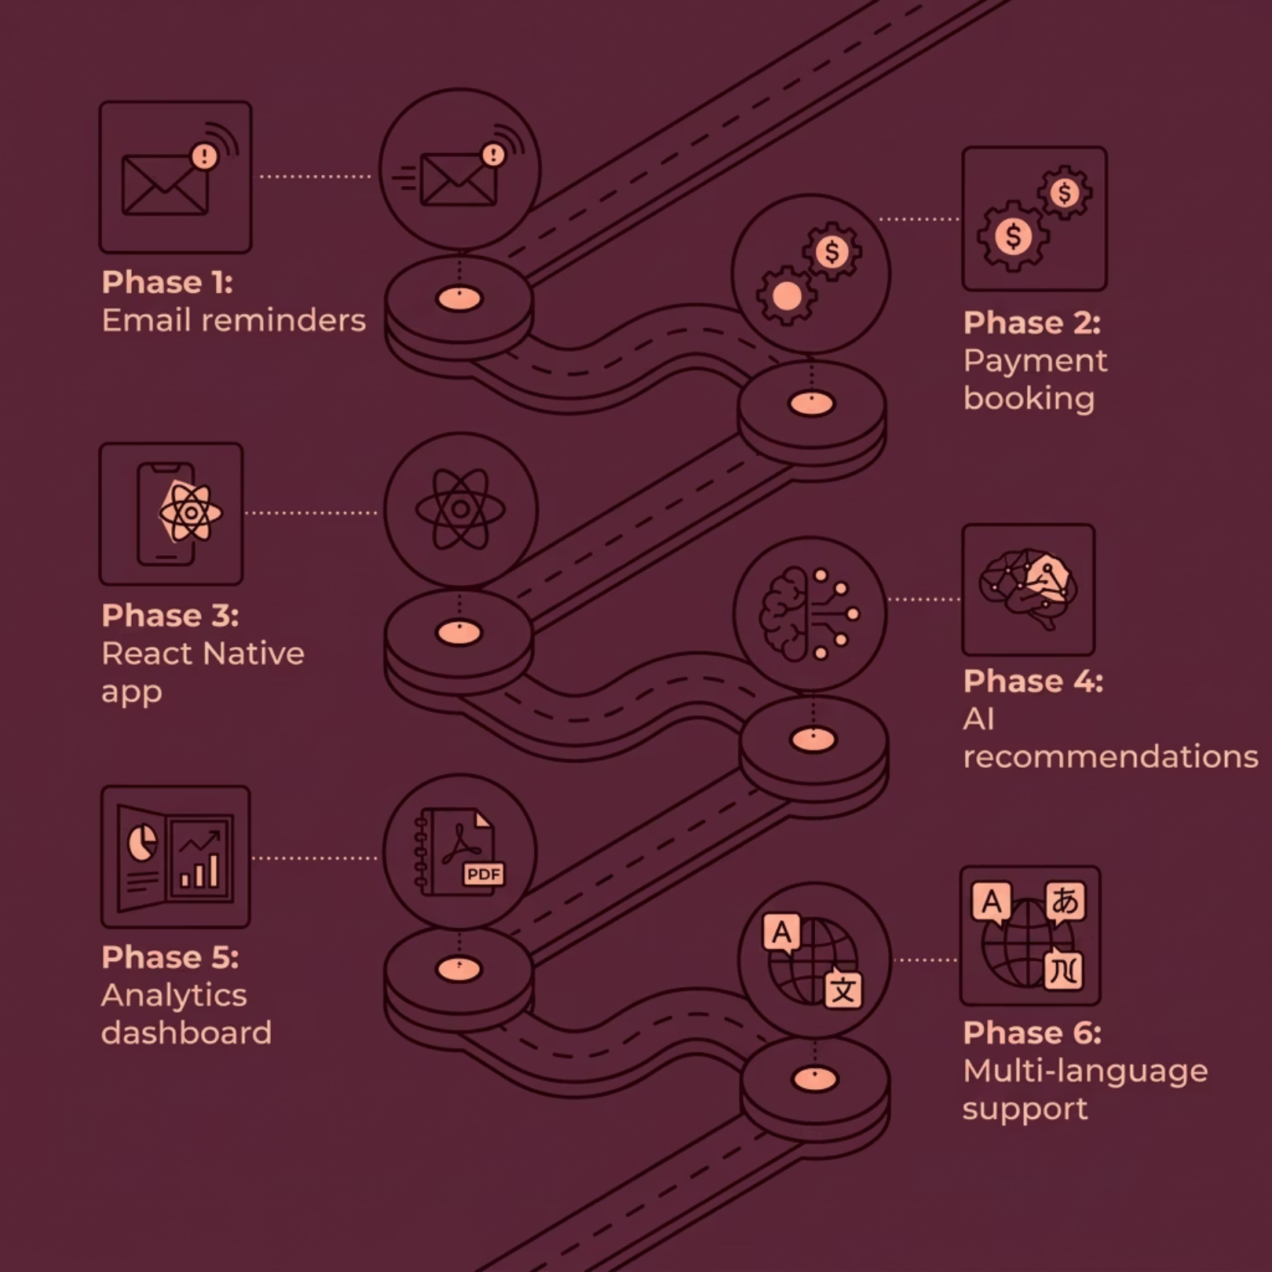


What's Next for EVENTORA
Evently is a fully functional, role-based event management platform — and the roadmap ahead is ambitious.
Currently Live: Full role-based dashboards, MySQL authentication, real-time chat, budget tracking, and responsive design.

Slide 11



Transforming Event Management
EVENTORA redefines how events are planned, executed, and experienced. By providing dedicated tools for every role, we empower organizers, streamline operations, and delight attendees, ensuring every event is a resounding success from start to finish.
Thank you for your time and interest in EVENTORA.

