Slide 1
File IO Buffering
In the interests of speed and efficiency, I/O system calls (i.e., the kernel) and the I/O
functions of the standard C library (i.e., the stdio functions) buffer data when oper-
ating on disk files

Slide 2
Kernel Buffering of File I/O: The Buffer Cache
When working with disk files, the read() and write() system calls don’t directly initiate disk access. Instead, they simply copy data between a user-space buffer and a buffer in the kernel buffer cache. For example, the following call transfers 3 bytes of data from a buffer in user-space memory to a buffer in kernel space:
write(fd, "abc", 3);
write(fd, "def", 3);
write(fd, "ghi", 3);

Slide 3
Buffer Cache
At this point, write() returns. At some later point, the kernel writes (flushes) its buffer to the disk. (Hence, we say that the system call is not synchronized with the disk operation.)
If, in the interim, another process attempts to read these bytes of the file, then the kernel automatically supplies the data from the buffer cache, rather than from the file

Slide 4
Buffer Cache
The aim of this design is to allow read() and write() to be fast, since they don’t need to wait on a (slow) disk operation. This design is also efficient, since it reduces the number of disk transfers that the kernel must perform.

Slide 5
Buffering in the stdio Library
Buffering of data into large blocks to reduce system calls is exactly what is done by the C library I/O functions (e.g., fprintf(), fscanf(), fgets(), fputs(), fputc(), fgetc()) when operating on disk files. Thus, using the stdio library relieves us of the task of buffering data for output with write() or input via read().

Slide 6
Setting the buffering mode of a stdio stream
#include <stdio.h>
int setvbuf(FILE * stream , char * buf , int mode , size_t size );
Returns 0 on success, or nonzero on error
#include <stdio.h>
void setbuf(FILE * fp , char * buf );

Slide 7
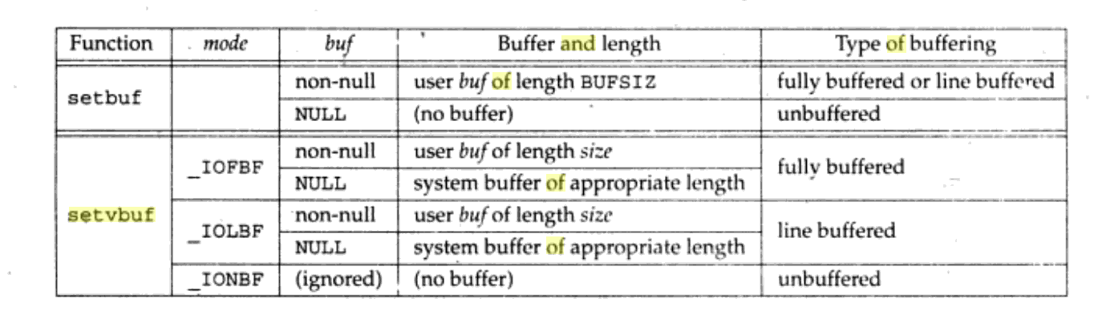
Setbuf, setvbuf

Slide 8
Flushing a stdio buffer
Regardless of the current buffering mode, at any time, we can force the data in a stdio output stream to be written (i.e., flushed to a kernel buffer via write()) using the fflush() library function. This function flushes the output buffer for the specified stream.
#include <stdio.h>
int fflush(FILE * stream );
Returns 0 on success, EOF on error

Slide 9
Controlling Kernel Buffering of File I/O
It is possible to force flushing of kernel buffers for output files. Sometimes, this is necessary if an application must ensure that output really has been written to the disk (or at least to the disk’s hardware cache) before continuing.

Slide 10
System calls for controlling kernel buffering of file I/O
The fsync() system call causes the buffered data and all metadata associated with the open file descriptor fd to be flushed to disk. Calling fsync() forces the file to the synchronized I/O file integrity completion state.
#include <unistd.h>
int fsync(int fd );
Returns 0 on success, or –1 on error

Slide 11
The sync() system call causes all kernel buffers containing updated file information (i.e., data blocks, pointer blocks, metadata, and so on) to be flushed to disk.
#include <unistd.h>
void sync(void);

Slide 12
Making all writes synchronous: O_SYNC
Specifying the O_SYNC flag when calling open() makes all subsequent output synchronous:
fd = open(pathname, O_WRONLY | O_SYNC);
After this open() call, every write() to the file automatically flushes the file data and
metadata to the disk (i.e., writes are performed according to synchronized I/O file integrity completion).

Slide 13
