Slide 1
Inter-Process Communication
Intoduction to IPC

Slide 2
IPC - background
There are 3 basic types of IPC
Communication based - These facilities are concerned with exchanging data between processes.
Synchronization: These facilities are concerned with synchronizing the actions of processes or threads.
Signals: Although signals are intended primarily for other purposes, they can be used as a synchronization technique in certain circumstances.

Slide 3
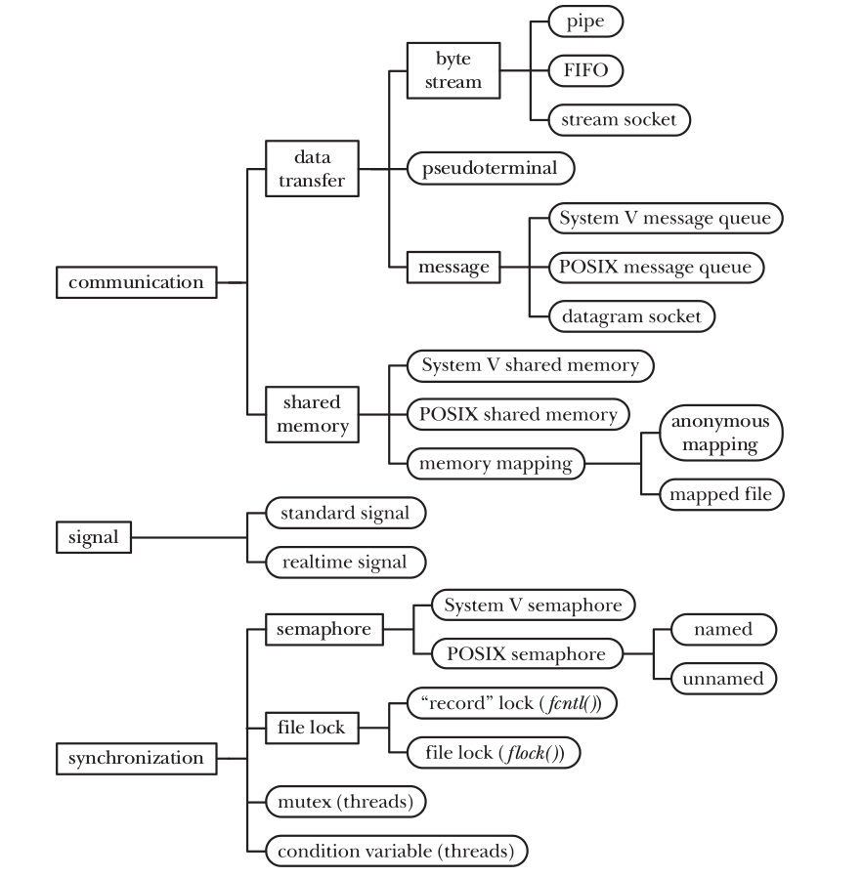

Slide 4
Communication Facilities
Data-transfer facilities - one process writes data to the IPC facility, and another process reads the data.
These facilities require two data transfers between user memory and kernel memory: one transfer from user memory to kernel memory during writing, and another transfer from kernel memory to user memory during reading.

Slide 5
Shared memory
Shared memory allows processes to exchange information by placing it in a region of memory that is shared between the processes.
A process can make data available to other processes by placing it in the shared memory region.
communication doesn’t require system calls or data transfer between user memory and kernel memory, shared memory can provide very fast communication.

Slide 6
Data transfer
Byte stream - The data exchanged via pipes, FIFOs is an undelimited byte stream.
Each read operation may read an arbitrary number of bytes from the IPC facility, regardless of the size of blocks written by the writer.

Slide 7
Data Transfer
Message: The data exchanged via Posix Message queues.
queues takes the form of delimited messages. Each read operation reads a whole message, as written by the writer process. It is not possible to read part of a message, leaving the remainder on the IPC facility; nor is it possible to read multiple messages in a single read operation.

Slide 8
Synchronisation
Semaphores - Semaphores are used for process and thread synchronization. Semaphores are clubbed with message queues and shared memory.
Mutexes and condition variables – They are usually used between Posix-threads to synchronise the data.

