Slide 1
Library Functions
and System Calls

Slide 2
NOTE :
All programs explained during this course are in C.
Ubuntu PC is used to run the C program(User can use any Linux distribution).
GCC compiler is used to compile the code.

Slide 3
The Linux library functions are the C standard library.
The C standard library is also called as libc.
The C standard library provides header files that needs to be included in user’s application program, in order to use the standard library function calls.

Slide 4
Library function
A library is a collection of pre-compiled code.
The library contains several functions together and they form a package or library. The library help to reuse the code by avoiding writing same code again and again.
For example, the standard C library provide ‘stdio.h’ header file, and this header file has to be included in user program inorder to use the library function ‘printf’.
Some Library functions are designed over the system calls, inorder to provide more additional functionality in the library functions(We will discuss this after learning system calls)

Slide 5
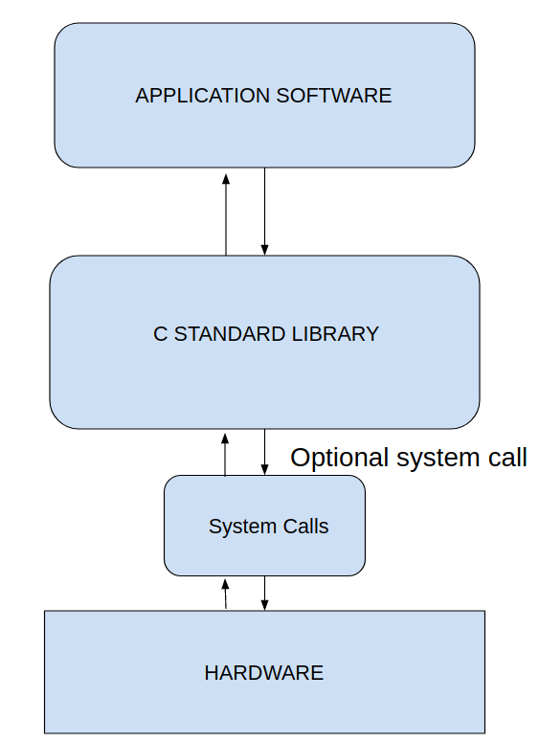
Library function Interface

Slide 6
Demo Program and C code Compilation
The open source compiler we use to compile the code is GCC.
We will look into a First demo ‘C’ program to write a simple program, and make use of standard Librabry and call library functions.
The Terminal is used to compile the code using gcc
The command used to compile code is
eg: If the source code is ‘lib_ex.c’ and required out file is ‘lib_ex.out’ then below command is used to compile the C code.
gcc lib_ex.c -o lib_ex
-o is used to create out file by name lib_ex.out
For more details on usage on gcc type ‘man gcc’ on terminal

Slide 7
System Calls
A system call can be considered as a interface through which the User application code enters Kernel mode.
Thus the system runs in kernel mode on behalf of the user program during system call execution.

Slide 8
System Calls
System calls can be invoked from user application in 2 ways.
A) Directly calling the system call
B) The user code calls the library function, and this inturn calls system calls when required.

Slide 9
Few examples of system calls are
open(), close(), read(), write() etc.
The system calls called through library functions are example
printf(), inturn calls the write() system call

Slide 10
