Slide 1
Memory Allocations
In the session of Memeory Allocation, we will discuss the below topics
a. Malloc()
b. Calloc()
c. Realloc()
d. Alloca() - Stack level memory allocation.
e. Brk()
f. Sbrk()
g. Free()
Note – brk() and sbrk() are the ‘system call’ for memory allocation which are used in implementation of ‘library functions’ malloc(), calloc() and realloc().

Slide 2
Memory allocation
A process can allocate dynamic memory by increasing the size of the heap, memory allocated is contiguous virtual memory that begins after the uninitialized data segment of a process in a virtual memory map. It grows and shrinks as memory is allocated and freed.

Slide 3
Program Break
The current limit of the heap is referred to as the ‘program break’.
When dynamic memory is allocated ‘Program Break’ increases.
After the program break is increased, the process may access any address in the newly allocated area.

Slide 4
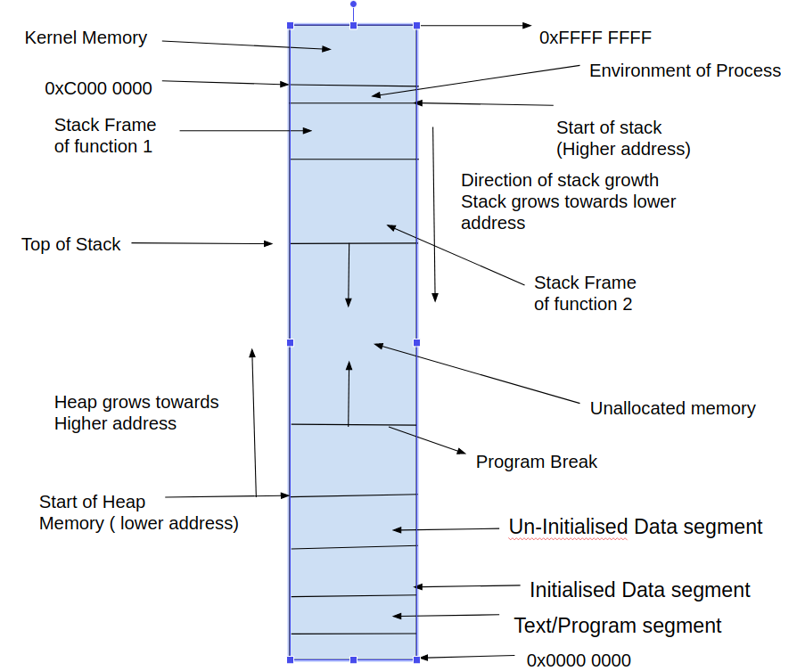
Program Break

Slide 5
Brk() and sbrk() - System Call
brk()
#include <unistd.h>
int brk(void * mem_loc );
brk() on success, sets ‘Program Break’ to new memory location specified by brk().
success: Returns 0 on success,
Fail: –1 on error
sbrk()
#include <unistd.h>
void *sbrk(intptr_t increment );
success: Returns ‘program break’ which is a virtual memory location on success,
Fail : (void *) –1 on error, and ‘errno’ is set to ENOMEM (Out of memory).
intptr_t : integer data type

Slide 6
Allocating Memory on the Heap: malloc()
In general, C programs use the malloc family of functions to allocate and deallocate memory on the heap. These functions are built over brk() and sbrk().
#include <stdlib.h>
void *malloc(size_t size );
Returns pointer to allocated memory on success, or NULL on error

Slide 7
calloc()
When process terminates, by default the memory of a process is freed. By good practise when the memory is utilised, it must be explicitly freed by programmer.
The calloc() function allocates memory for an array of identical items
#include <stdlib.h>
void *calloc(size_t numitems , size_t size );
Returns pointer to allocated memory on success, or NULL on error

Slide 8
realloc()
#include <stdlib.h>
void *realloc(void * ptr , size_t size );
Returns pointer to allocated memory on success, or NULL on error
When we are increasing the size of the block of memory, realloc() attempts to form a single block.
If the block lies at the end of the heap, then realloc() expands the heap.
If the block of memory lies in the middle of the heap, and there is insufficient free space immediately following it, realloc() allocates a new block of memory and copies all existing data from the old block to the new block.
Care must be taken in above case as the old memory location and newly allocated memory location may not both be same, hence storing memory address before realloc() and later using same memory after realloc for memory access may give wrong results.

Slide 9
Free()
Free() - function is used to free the dynamically allocated memory from the heap. This needs to be called only when memory is allocated using
malloc() or calloc or realloc(). The syntax is.
#include <stdlib.h>
void free(void * ptr );

Slide 10
free()
free() doesn’t lower the program break, it adds the freed block of memory to a list of free blocks that can be used by future calls to malloc().
The block of memory being freed can be in the middle of the heap, rather than at the end of heap, so that lowering the program break is not done during free().

Slide 11
Allocating Memory on the Stack: alloca()
Like the functions in the malloc, alloca() allocates memory dynamically, but this memory is not allocated from heap, alloca() obtains memory from the stack by increasing the size of the stack frame of current executing function.
#include <alloca.h>
void *alloca(size_t size );
Returns pointer to allocated block of memory which is in stack virtual address.

Slide 12
Please refer to below ‘MAN’ pages for further details of discussed functions
man 2 brk
man 2 sbrk
man malloc
man calloc
man realloc
Man alloc

