Slide 1
Pipes and Fifo
Pipes and FIFO for IPC

Slide 2
PIPES
A pipe is a byte stream.
There is no concept of messages or message boundaries when using a pipe.
A PIPE has 2 ends.
A read end.
A write end.
Refer to diagram below.

Slide 3
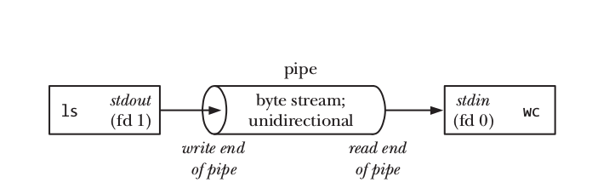
Pipes

Slide 4
Pipes
Pipes are unidirectional.
Pipes have limited capacity(usually 64 K bytes). A pipe is simply a buffer maintained in kernel memory.
This means a PIPE when data is produced and without consuming it, the pipe becomes full.
And new data cannot be written, until the other end of pipe is read through the data.

Slide 5
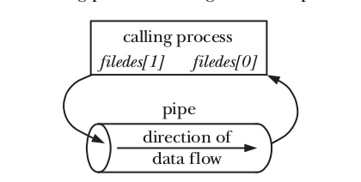
Pipe creation
#include <unistd.h>
int pipe(int filedes [2]);
Returns 0 on success, or –1 on error

Slide 6
Application of Pipes
Pipes are used to communicate across related process, ex – Parent , child process.
After fork() - the child process inherits copies of its parent’s file descriptors.

Slide 7
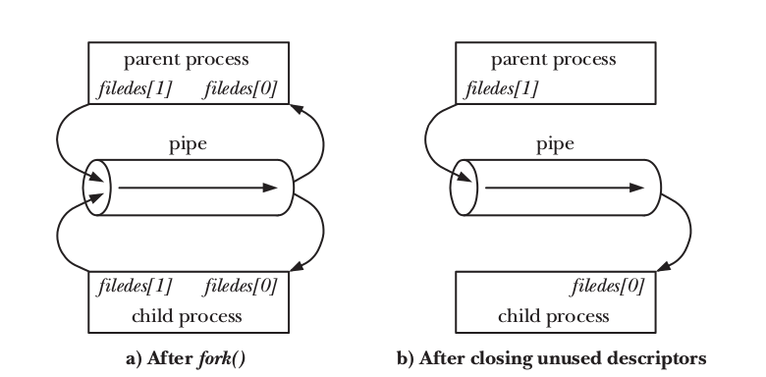
Pipe after fork()

Slide 8
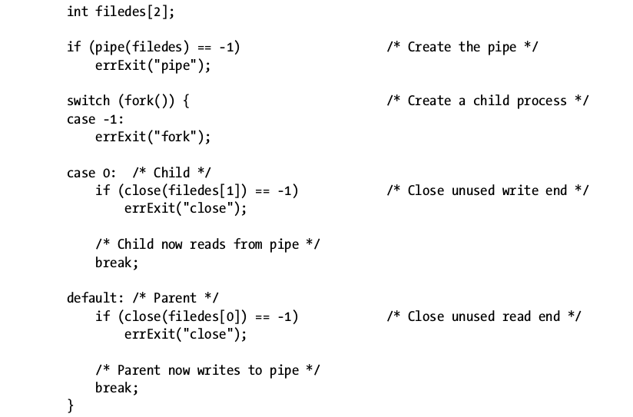
Pipe code prototype
Steps in creating a pipe to transfer data from a parent to a child Process.

Slide 9
SIGPIPE signal in Pipes
SIGPIPE signal(broken pipe signal) is sent to write end process when read end is closed.

Slide 10
Using Pipes to Connect Filters
Pipes are used to pass output from one shell command to other shell command.
[IMPORTANT NOTE] - By default, all file descriptors opened by a program that calls exec() remain open across the exec() and are available for use by the new program
Eg: ls | wc -l
The above is implemented using the C code. Refer to the C Program.

Slide 11
Using Pipes to Connect Filters
Parent Process
Child process 1
Exec’s ls
Pfd1-open(write end)
Pipe
Pfd0-open (read end)
Child process 2
Exec’s wc -l

Slide 12
FIFO - first in, first out.
Semantically, a FIFO is similar to a pipe.
Also called name Pipes.
The principal difference is that a FIFO has a name within the file system and is opened in the same way as a regular file.
This allows a FIFO to be used for communication between unrelated processes (e.g., a client and server).

Slide 13
Once a FIFO has been opened, we use the same I/O system calls as are used with pipes and other files (i.e., read(), write(), and close()).
Just as with pipes, a FIFO has a write end and a read end, and data is read from the pipe in the same order as it is written.

Slide 14
Create a fifo
#include <sys/stat.h>
int mkfifo(const char * pathname , mode_t mode );
Returns 0 on success, or –1 on error

