Slide 1
Fork() - system call
Overview of fork()
Parent and child process.
Memory segment of parent and child process

Slide 2
Process creation
Creating new process: fork()
In many applications, creating multiple processes can be a useful way of dividing up a task.
Dividing tasks up in this way often makes application design simpler. It also permits greater concurrency (i.e., more tasks or requests can be handled simultaneously).
The fork() system call creates a new process(the child), which is an almost exact duplicate of the calling process (parent).

Slide 3
Fork() - syntax
#include <unistd.h>
pid_t fork(void);
Note: Unlike other function calls, fork() return twice(on success), one in parent process, and other in child process.
a. In parent: returns process ID of child
on success, or –1 on error;
b. In successfully created child: always returns 0

Slide 4
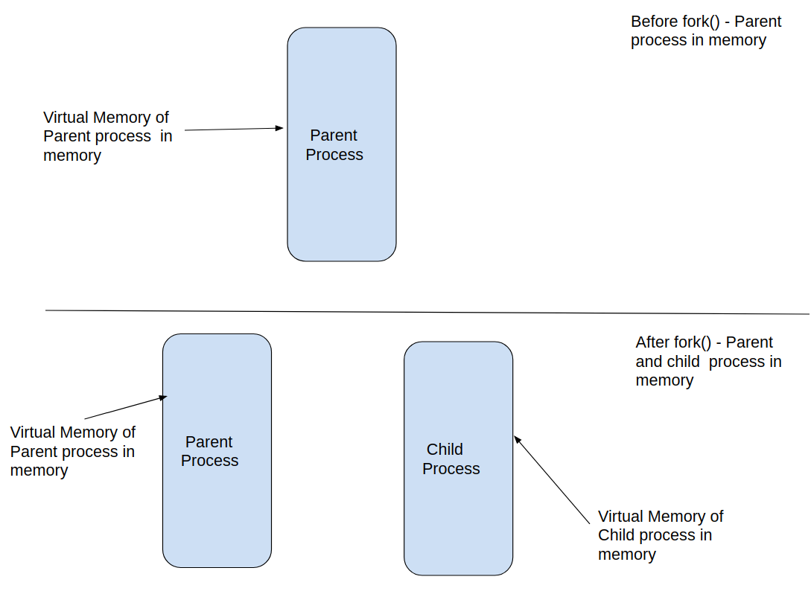
Before and After Fork()

Slide 5
Fork()
An important point wrt fork() is - After fork() is executed successfully, two processes exist in memory, and each process, execution continues from the point where fork() returns.
The child process has a “seperate copy” of all the memory segment like, text, data, stack and heap, hence Child process executes the same program as parent process.
The child’s memory contents are initially exact duplicates of the corresponding parts the parent’s memory.
After the fork(), each process can modify the variables in its stack, data, and heap segments without affecting the other process.

Slide 6
Fork() - return values
Fork() return ‘0’ in child process
Fork() returns child process ID in parent process ID.
Let us see some example programs of fork(), and the parent-child process creation.

Slide 7
Orphan Process
The orphan process, is created when the parent of the child dies/exits before the child exits/dies.
In a Unix-like operating system any orphaned process will be immediately adopted by the special init system process. This operation is called re-parenting and occurs automatically.
Even though technically the orphan process has the init process as its parent, it is still called an orphan process since the process that originally created it no longer exists

Slide 8
Zombie Process
A Zombie process (or defunct process) is a process that has completed execution but hasn’t been reaped by its parent process. As result it holds a process entry in the process table and the PID
Also, unlike normal processes, the kill command has no effect on a zombie process.

Slide 9
Sleeping process
The process has been kept on sleep(time), the process state changes to sleep state, when the process sleep is done, it changes its state accordingly

Slide 10
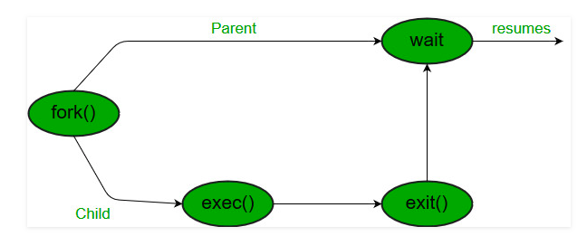
wait()

Slide 11
Wait() and Exit()
Wait() - system call – used to synchronise parent and child process and get exit status of child process.
Exit() - system call – to terminate the process.

Slide 12
Wait()
Each process has a entry in process table.
When a process ends, all of the memory and is deallocated(but a entry of exited process is still maintained in process table). The parent can read the child’s exit status by executing the wait system call.
The parent process receives signal SIGCHLD when child process dies.

Slide 13
wait()
Wait() - system call also gives information on how the child process exited.
#include <sys/wait.h>
pid_t wait(int * status );

Slide 14
waitpid()
Waitpid() - system call also gives information on how the child process exited.
#include <sys/wait.h>
pid_t waitpid(pid_t pid, int *status, int options);

Slide 15
Process Table
Process Table is a registry of all running processes (or exited before being reaped) in the system. Each process is represented by an process entry

Slide 16
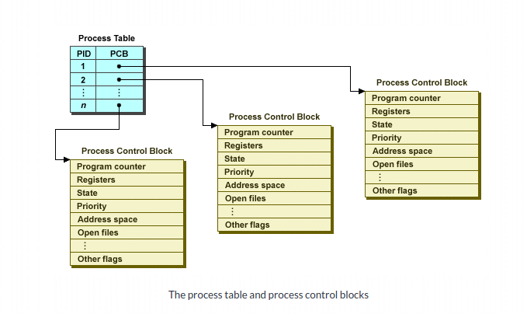
Process table and Process Control Block

Slide 17
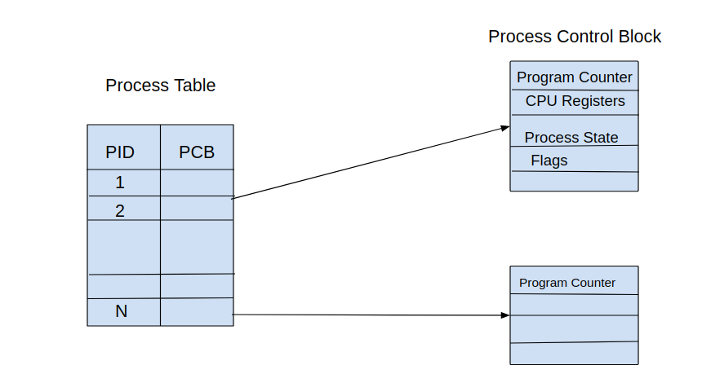
Process table and Process Control Block

Slide 18
PCB – Data structure of each process
There are many data members of PCB few of them are
Program Counter
Process number
Process State
CPU Registers
Process Priority
Memory management information
List of open files of the process
And many more.....
Note: the struct ‘task_struct’ represents process control block in Linux

Slide 19
File Sharing Between Parent and Child
When a fork() is performed, the child receives duplicates of all of the parent’s file descriptors.
This means that corresponding file descriptors in the parent and the child refer to the same file description.
The open file description contains the current file offset (as modified by read(), write(), and lseek())
As a result, these attributes of an open file are shared between the parent and child.

Slide 20
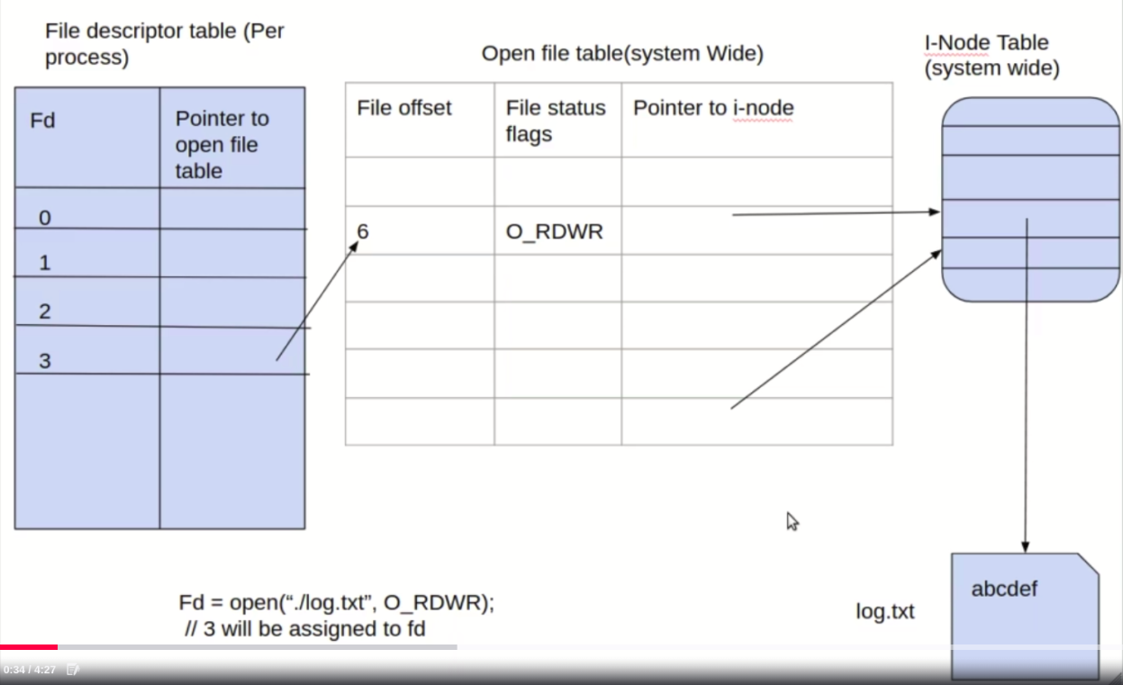

Slide 21
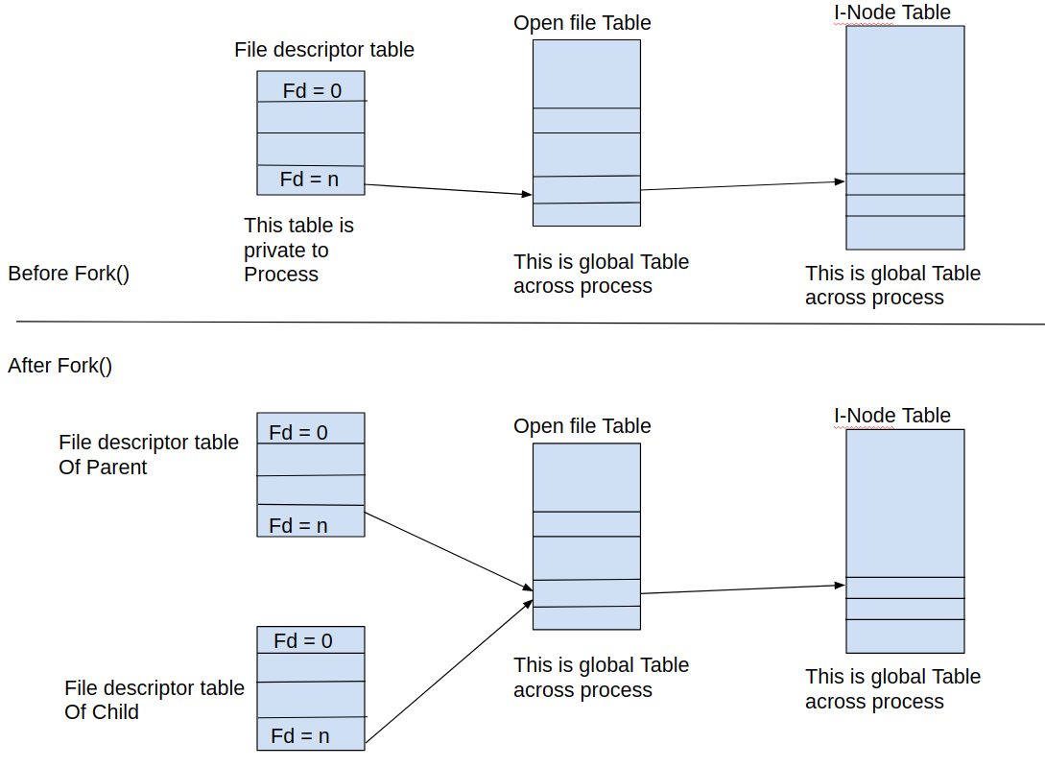

Slide 22
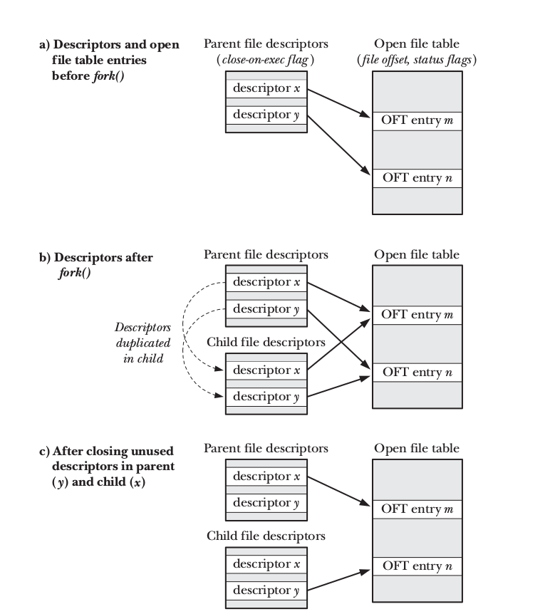

Slide 23
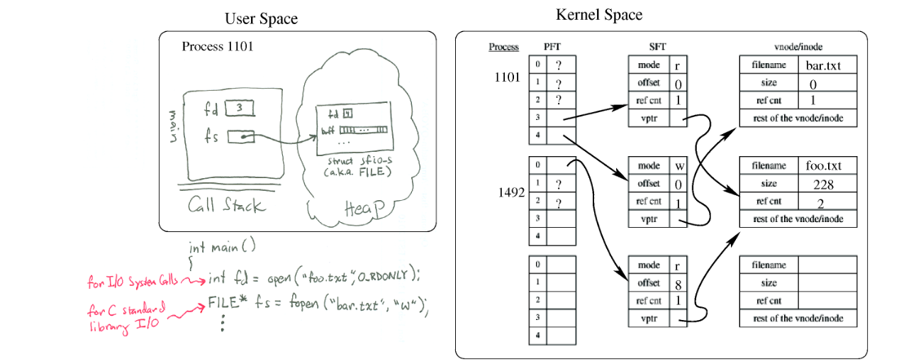
Process and files (user and kernel space)

Slide 24
miscellaneous
waitpid(pid_t pid, int *status, int options) – Can be used in multiple options, one main use is to wait for a particular process specified by pid, if parent has more than one child process.

Slide 25
Exec() - Running New program
Execve() - system call loads a new program into a process’s memory, During this operation, the old program is discarded.
The process’s stack, data, and heap are replaced by those of the new program.
The new program commences execution at its main() function.

Slide 26
#include <unistd.h>
int execve(const char * pathname , char *const argv [], char *const envp []);
Never returns on success; returns –1 on error

Slide 27
The exec() Library Functions
#include <unistd.h>
int execle(const char * pathname , const char * arg , ...
/* , (char *) NULL, char *const envp [] */ );
int execlp(const char * filename , const char * arg , ...
/* , (char *) NULL */);
int execvp(const char * filename , char *const argv []);
int execv(const char * pathname , char *const argv []);
int execl(const char * pathname , const char * arg , ...
/* , (char *) NULL */);
None of the above returns on success; all return –1 on error

Slide 28
Fork() - Exec()
The fork() - exec() combination is used to create new child process have its own virtual memory.
Refer to Examples

