Slide 1
PROCESS
Processes and Programs
Process ID and Parent Process ID
Memory Layout of a Process.
Examples of different memory section of Process using C Code.

Slide 2
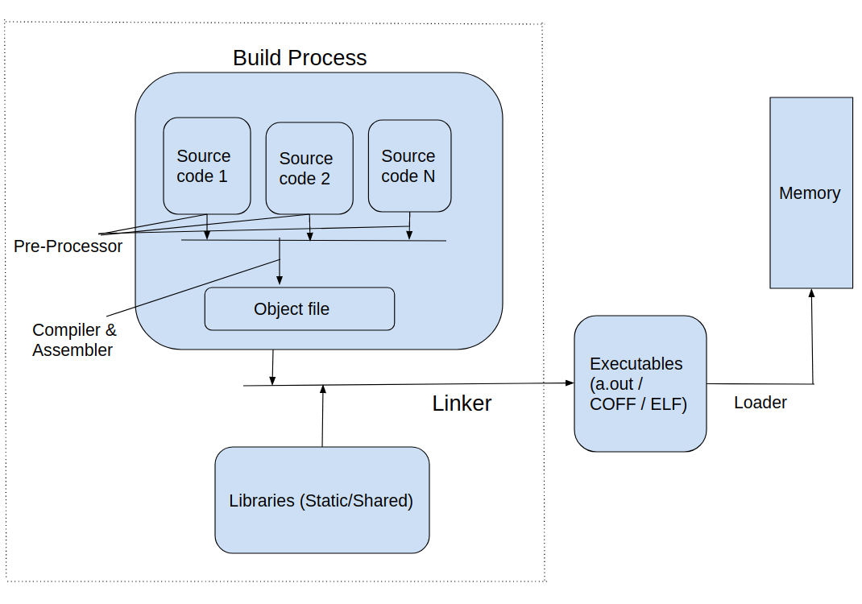
Program and Process

Slide 3
Processes and Programs
A process is an instance of an executing program.
A program is a file containing a range of information that describes how to construct a process at run time.

Slide 4
Child and Parent Process
In Linux Processes have a Parent-child relation.
A Process is created by its parent
In Linux startup sequence
Process ‘0’ is first process – called ‘swapper’ process
Process ‘1’ is ‘Init’ Process – Init process plays an important role. It creates and monitors set of other process.
Init process becomes the parent of any ‘Orphan’ Process.
Man 8 init – for manual page on ‘init’ process.

Slide 5
Process ID
#include <unistd.h>
pid_t getpid(void);
Always successfully returns process ID of caller
The Linux kernel limits process IDs to being less than or equal to 32,767(default on 32 bit).
/proc/sys/kernel/pid_max – contains 1 greter than actual max number of process allowed in system.
‘Ps -ef’ – get running process and PID

Slide 6
Parent Process ID
#include <unistd.h>
pid_t getppid(void);
Always successfully returns process ID of parent of caller process.

Slide 7
Process States
A process is “created” state using fork() system call.
‘Running’ state – Process is running in main memory.
‘Ready to Run’ in ‘Main Memory’
‘Ready to Run’ in ‘Swap Memory’
‘Sleep’ state in ‘Main Memory’
‘Sleep’ state in ‘Swap memory’
‘Blocked’ state in ‘Main Memory’
‘Blocked’ state in ‘Swap Memory’
‘Terminated’ state

Slide 8
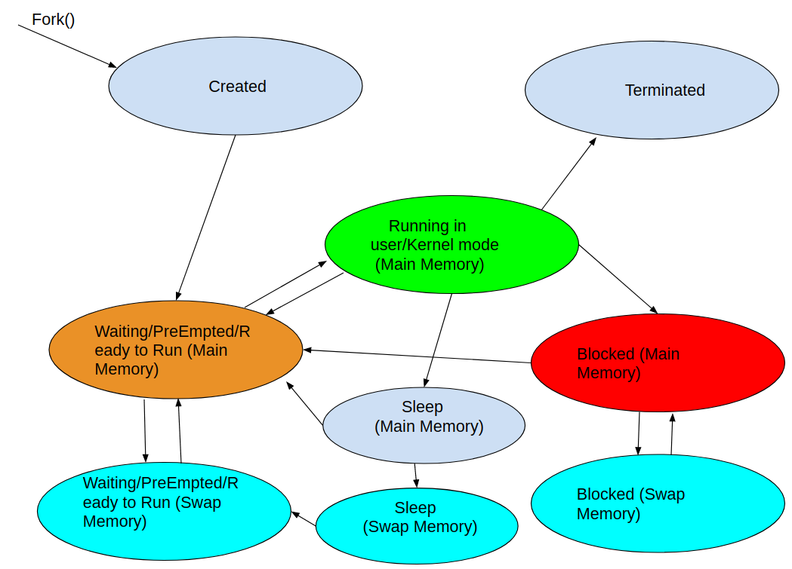

Slide 9
Memory Layout of a Process
The different segments of a process are..
1. Text segment – The code resides here
2. Data Segment – for data variables during compile time.
A. Initialised data segment
B. Un-Initialised data segment (BSS)
3. Stack segment – for local variables
4. Heap segment – for dynamic memory data’s.

Slide 10
Text Segment of a Process
The ‘text segment’ contains the code of the program that is ran. This segment of memory cannot be written, so that the code is not altered by any pointers. This means ‘Text segment’ is Read only.

Slide 11
‘Initialized data segment’ of a Process
The ‘initialized data segment’ contains global and static variables that are ‘explicitly initialized’ with value in the code.

Slide 12
Memory Layout of a Process
The uninitialized data segment contains global and static variables that are not explicitly initialized in the code. The system initializes all value’s of this segment to ‘0’.

Slide 13
‘Stack’ segment of a Process
The stack is a dynamically growing and shrinking segment containing local data’s(stack frames) of functions. One stack frame is allocated for each function that are called. A frame stores the function’s local variables, function arguments.

Slide 14
‘Heap’ segment of a Process
The heap is an area from which memory (for variables) can be dynamically allocated at run time.

Slide 15
Virtual Memory Management
Similar to other modern kernels, Linux has a technique known as virtual memory management. The aim of this technique is to make efficient use of both the CPU and RAM (physical memory/Main Memory)
Each Process has its own memory space(4GB) on a 32 bit system.
Each process has a private user space memory. This means one process cannot access memory of other process directly.
Each process has below seperate Memory segments(the size of each memory segemnt is configurable)
a. Text segment
b. Data segment(Initialised and uninitialised)
c. Stack segment
d. Heap segment
The Process virtual memory has a user space, and a Kernel space. This memory region is configurable, but it is usually 3GB user space and 1GB Kernel space.

Slide 16
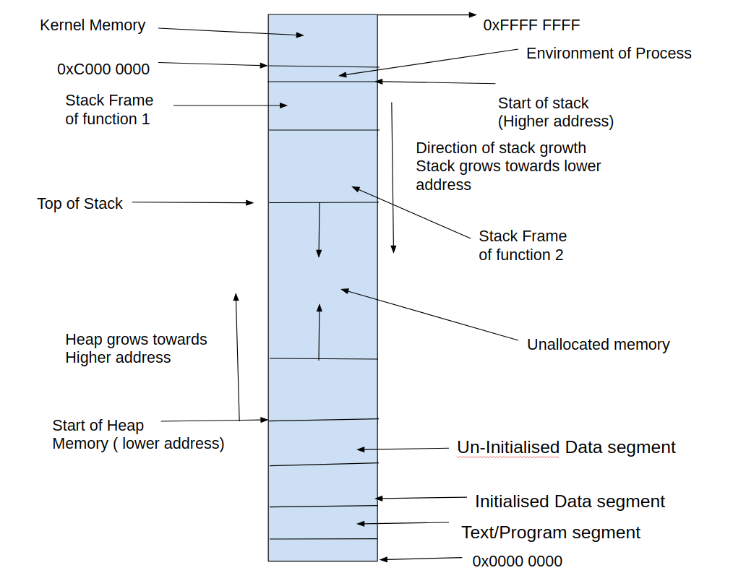
Virtual Memory of process

Slide 17
Page Frame
A virtual memory of each process, is split into small, fixed size units called ‘pages’ (default page size usually is 4096 Bytes, but configurable to different size).
Similarly, RAM(Physical memory) is divided into a series of page frames of the same size.
At any given point of time, only some of the ‘pages’ of a process are present in physical memory (RAM), these pages are called ‘Resident Set’.
Copies of the unused pages(whose entry is not present in page table) of a process are maintained in the swap area ( usually disk space) and loaded into physical memory, when required.
Frame size varies – generally 4K, 8K or 16K and is configurable.

Slide 18
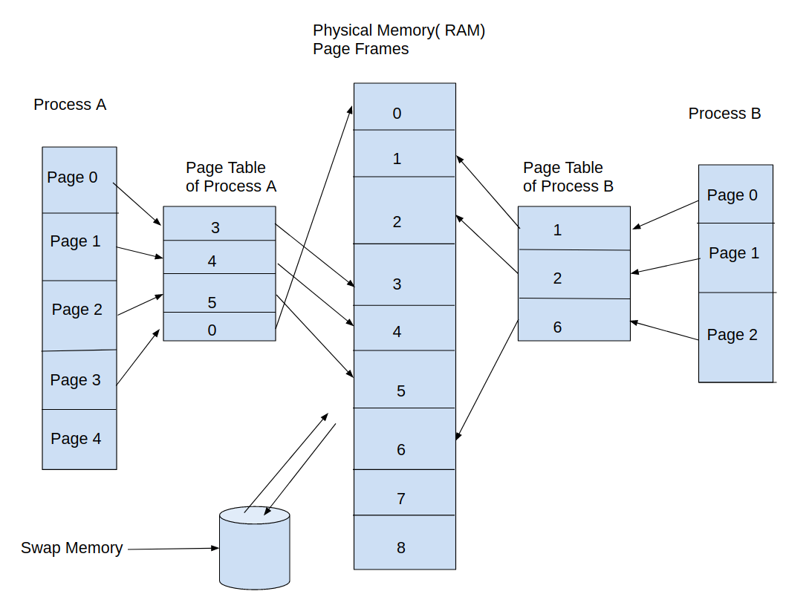
Page Table

Slide 19
Page Table
Two or more processes can share memory. This is possible by having page-table entries of different processes refer to the same pages of RAM. Memory sharing occurs below circumstances:
a. Multiple processes executing the same program can share a single (read-only) copy of the program code.
b. Processes can use the shared memory with other processes to exchange data’s.

Slide 20
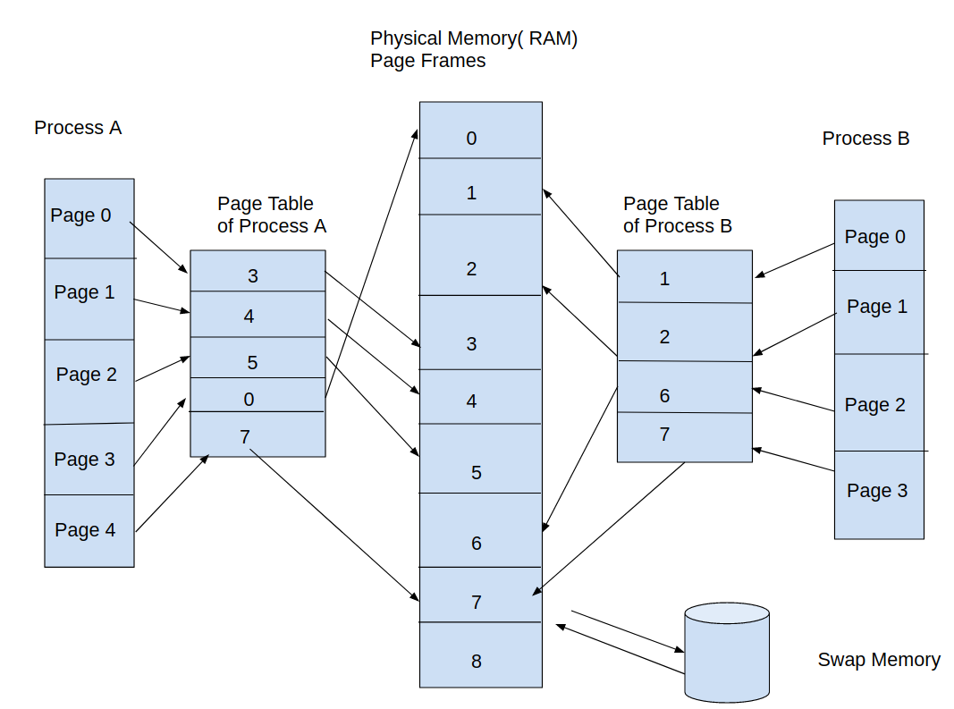
Memory Sharing between Process

Slide 21
Page Fault
When a process tries to access a page that is not currently present in physical memory(and page table), a page fault occurs, at this point the kernel suspends execution of the process while the page is loaded from swap memory into Main memory(RAM).

Slide 22
Environment List
Each process set of strings called the environment list, or simply the environment. Each of these strings is a definition of the form ‘name=value’.
Thus, the environment represents a set of ‘name-value’ pairs that can be used to hold arbitrary information. The names in the list are referred to as environment variables.

