Slide 1
Signals
Signals are software interrupts that provide a mechanism for handling asynchronous events.
These events can originate from outside the system, such as when the user generates the interrupt character by pressing Ctrl-C, or from activities within the system.
In Linux there are different signals, and have a unique numbers, by which they are identified.

Slide 2
signals
Signals have a very precise lifecycle.First, a signal is raised, The kernel then stores the signal until it is able to deliver it. Finally the signals are delivered to corresponding process.

Slide 3
The kernel can perform one of three actions, depending on what the process asked it to do
“Ignore the signal” - No action is taken.
There are two signals that cannot be ignored: SIGKILL and SIGSTOP.
“Catch and handle the signal” - The kernel will suspend execution of the process’s current code path and jump to a previously registered function The process will then execute this function Once the process returns from this function, it will jump back to wherever it was when it caught the signal

Slide 4
Signals
“Perform the default action” - This action depends on the signal being sent. The default action is often to terminate the process.
Every signal will have its default behaviour incase the process has not handled it.

Slide 5
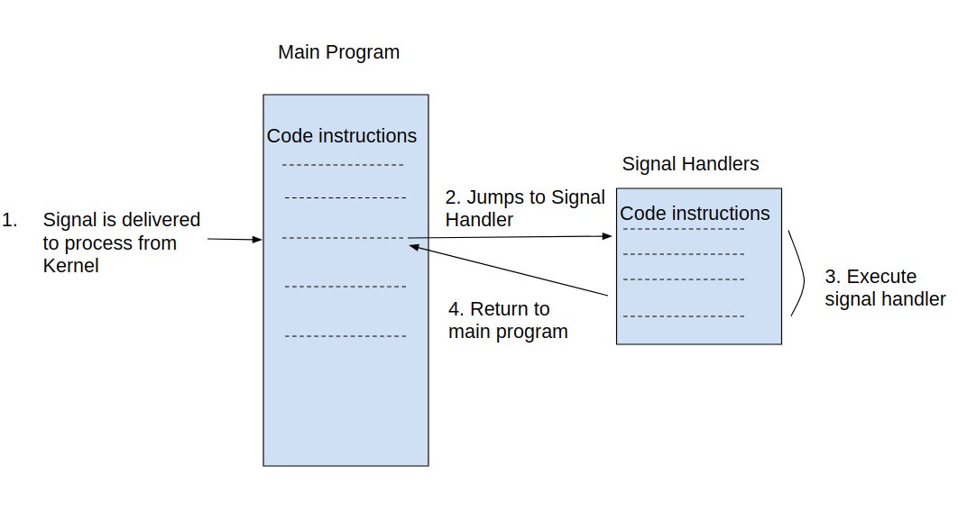
How Signal handler work

Slide 6
Signal Identifiers - Every signal has a symbolic name that starts with the prefix ‘SIG’. For example, SIGINT is the signal sent when the user presses Ctrl-C.
SIGKILL is the signal sent when a process is forcefully terminated.
These signals are all defined in a header file included from <signal.h>

Slide 7
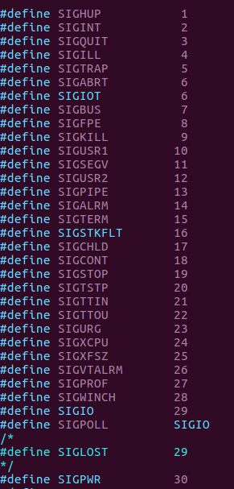
Signals list
Signals are defined in
signal.h header file

Slide 8
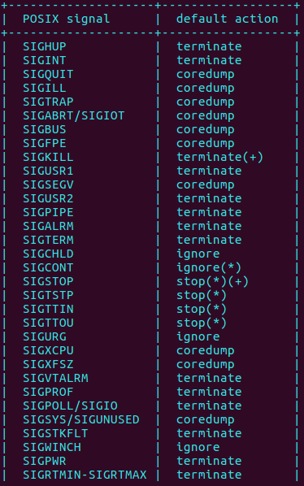
Default actions of signals

Slide 9
Signal explanantions
SIGABRT - The abort() function sends this signal to the process that invokes it. The process then terminates and generates a core dump file.
SIGALRM - The alarm() and setitimer(), functions send this signal to the process that invoked them when an alarm expires

Slide 10
SIGBUS – (Bus Error)This signal is raised when process has a memory access error .
SIGCHLD - Whenever a process terminates or stops, the kernel sends this signal to the process’s parent.

Slide 11
SIGCONT - The kernel sends this signal to a process when the process needs to be resumed which is in a stopped state.
SIGFPE - This signal represents any arithmetic exception.
SIGILL - The kernel sends this signal when a process attempts to execute an illegal machine instruction.
SIGINT - This is a interrupt signal. This occurs when users presses Ctrl-C from keyboard.
SIGKILL - This signal is sent from the kill() system call.

Slide 12
SIGPIPE - If a process writes to a pipe but the reader has terminated, the kernel raises this signal.
SIGSEGV - This signal, whose name derives from segmentation violation, is sent to a process when it attempts an invalid memory access.
SIGUSR1 and SIGUSR2 - These signals are available for user-defined purposes; the kernel never raises them.
These are few most used signals, there are few other signals also

Slide 13
Basic Signal Management
#include <signal.h>
sighandler_t signal (int signo, sighandler_t my_handler);
void my_handler (int signo);
When a signal is delivered to a process, using signal(), the signal can either perform default action or ignore the particular signal.
SIG_DFL - Set the behavior of the signal given by signo to its default. For example, in the case of SIGPIPE , the process will terminate.
SIG_IGN - Ignore the signal given by signo
Refer to examples.

Slide 14
Sending a Signal
The kill() system call, the basis of the common kill utility, sends a signal from one process to another:
#include <sys/types.h>
#include <signal.h>
int kill (pid_t pid, int signo);

Slide 15
In its normal use (i.e., if pid is greater than 0 ), kill() sends the signal signo to the process identified by pid .
On success, kill() returns 0.
On failure (no signals sent), the call returns −1 and sets errno to one of the following:
EINVAL
The signal specified by signo is invalid.
EPERM
The invoking process lacks sufficient permissions to send a signal to any of the requested processes.
ESRCH
The process or process group denoted by pid does not exist or, in the case of a process, is a zombie.

Slide 16
Signal Permissions
In order to send a signal to another process, the sending process needs proper permissions.
A user can send a signal only to a process that he or she owns.
If signo is 0 (the aforementioned null signal) the call does not send a signal, but it still performs error checking.
This is useful to test whether a process has suitable permissions to send the provided process or processes a signal

Slide 17
Example
int ret;
ret = kill (1722, 0);
if (ret); /* we lack permission */
else; /* we have permission */

