Slide 1
Thread Synchronisation

Slide 2
Overview
One of the principal advantages of threads is that they can share information via global variables.
we must take care that multiple threads do not attempt to modify/read the same variable at the same time.
The term critical section is used to refer to a section of code that accesses a shared resource and whose execution should be atomic.
It means the execution should not be interrupted by another thread that simultaneously accesses the same shared resource.

Slide 3
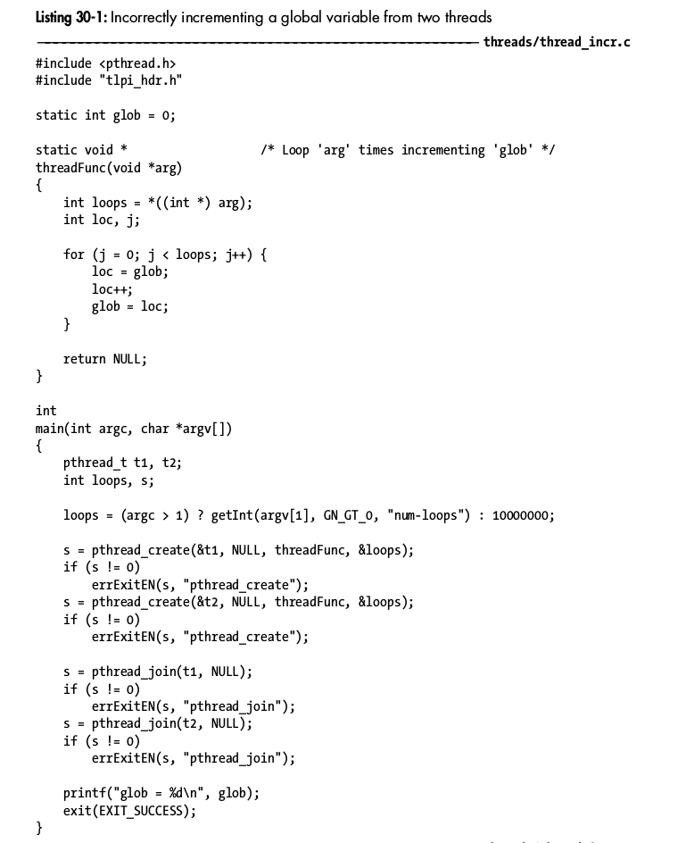
Incorrect method

Slide 4
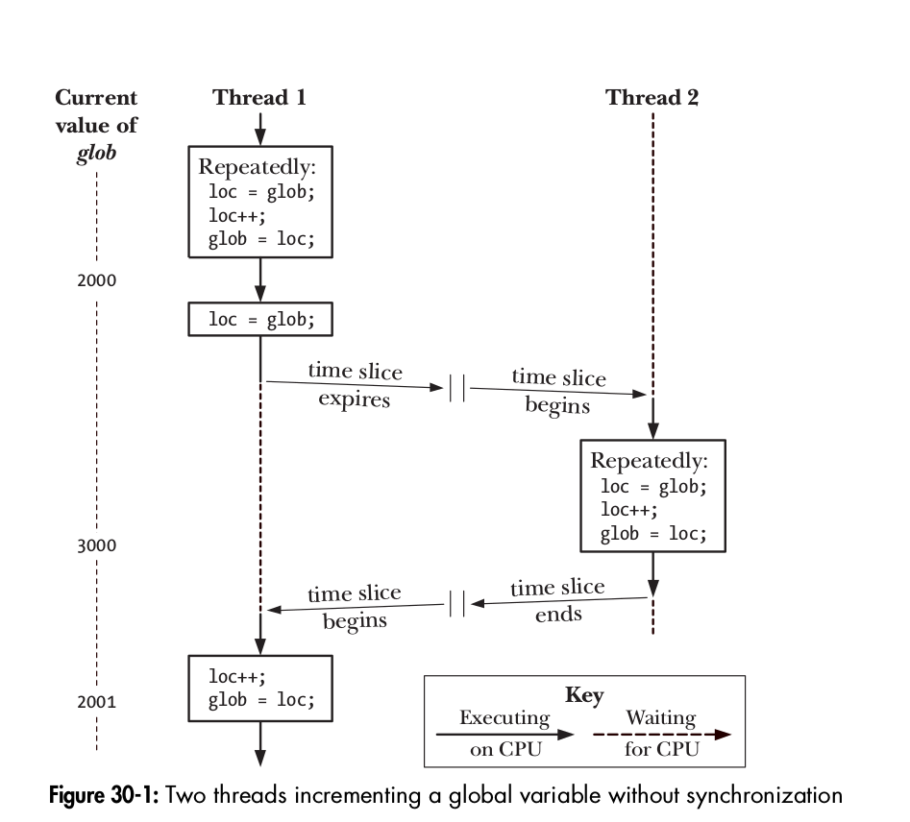

Slide 5
Mutex
To avoid the problems that can occur when threads try to update a shared variable, we must use a mutex (short for mutual exclusion)
More generally, mutexes can be used to ensure atomic access to any shared resource.
A mutex has two states: locked and unlocked.
At any moment, at most one thread may hold the lock on a mutex.
When a thread locks a mutex, it becomes the owner of that mutex. Only the mutex owner can unlock the mutex

Slide 6
Each thread employs the following protocol for accessing a resource.
Lock the mutex for the shared resource;
Access the shared resource; and
Unlock the mutex.

Slide 7
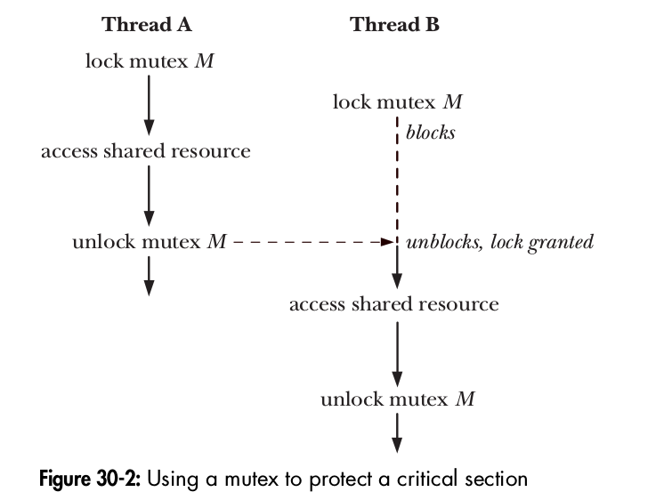

Slide 8
Statically Allocated Mutexes
A mutex can either be allocated as a static variable or be created dynamically at run time.
pthread_mutex_t mtx = PTHREAD_MUTEX_INITIALIZER;

Slide 9
#include <pthread.h>
int pthread_mutex_lock(pthread_mutex_t * mutex );
int pthread_mutex_unlock(pthread_mutex_t * mutex );
Both return 0 on success, or a positive error number on error

Slide 10
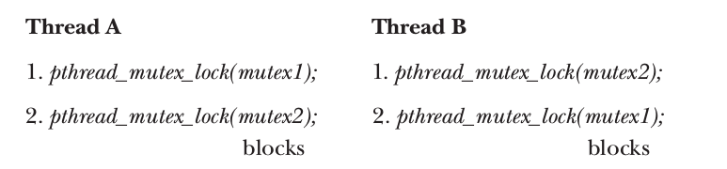
Dead lock
Sometimes, a thread needs to simultaneously access two or more different shared resources, each of which is governed by a separate mutex

Slide 11
Avoiding Dead locks
The simplest way to avoid such deadlocks is to define a mutex hierarchy
Threads can lock the same set of mutexes, they should always lock them in the same order.
For example, in before scenario, the deadlock could be avoided if the two threads always lock the mutexes in the order mutex1 followed by mutex2.

Slide 12
pthread_mutex_trylock and pthread_mutex_timedlock
The Pthreads API provides two variants of the pthread_mutex_lock() function:
pthread_mutex_trylock() and pthread_mutex_timedlock().
The pthread_mutex_trylock() function is the same as pthread_mutex_lock(), except that if the mutex is currently locked, pthread_mutex_trylock() fails, returning the error EBUSY .

Slide 13
pthread_mutex_trylock and pthread_mutex_timedlock
The pthread_mutex_timedlock() function is the same as pthread_mutex_lock()
Except that the caller can specify an additional argument, abstime, that places a limit on the time that the thread will sleep while waiting to acquire the mutex.
If the time interval specified by its abstime argument expires without the caller becoming the owner of the mutex, pthread_mutex_timedlock() returns the error ETIMEDOUT.
Assignment to use/code ‘pthread_mutex_trylock’ and ‘pthread_mutex_timedlock’.

Slide 14
Signaling Changes of State: Condition Variables
A mutex prevents multiple threads from accessing a shared variable at the same time.
A condition variable allows one thread to inform other threads about changes in the state of a shared variable and allows the other threads to wait (block) for such notification.

Slide 15
Condition variable
In condition variable the thread waiting for resource will be made to sleep, and as soon as the it gets signal from other thread, the thread wakes up and performs to consume the share variable.
A condition variable is always used in conjunction with a mutex.

Slide 16
Statically Allocated Condition Variables
condition variables can be allocated statically or dynamically.
pthread_cond_t cond = PTHREAD_COND_INITIALIZER;

Slide 17
Signaling and Waiting on Condition Variables
The principal condition variable operations are signal and wait.
The signal operation is a notification to one or more waiting threads that a shared variable’s state has changed.
The wait operation is the means of blocking until such a notification is received.

Slide 18
The pthread_cond_signal() and pthread_cond_broadcast() functions both signal the condition variable specified by cond.
The pthread_cond_wait() function blocks thread until the condition variable cond is signaled.
#include <pthread.h>
int pthread_cond_signal(pthread_cond_t * cond );
int pthread_cond_broadcast(pthread_cond_t * cond );
int pthread_cond_wait(pthread_cond_t * cond , pthread_mutex_t * mutex );
All return 0 on success, or a positive error number on error

Slide 19
Using a condition variable in the producer-consumer example.
The program below explains the concept of Condition variables.

Slide 20
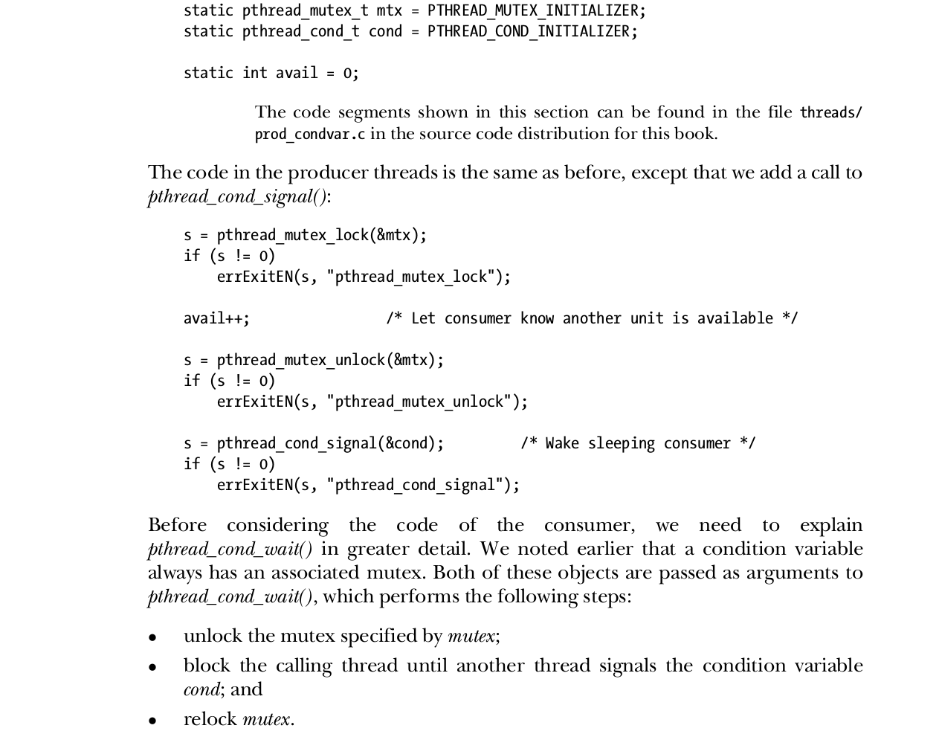
Producer code
Used in Condition variable.

Slide 21
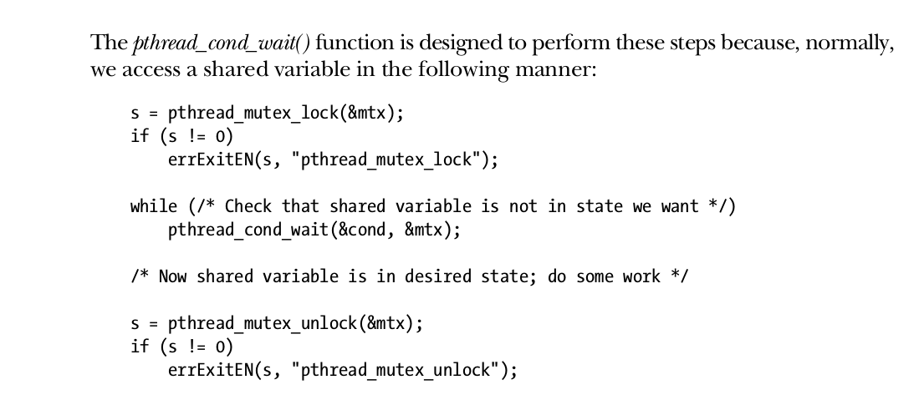
Consumer code

Slide 22
Thread Safe
A function is said to be thread-safe if it can safely be invoked by multiple threads at the same time.
In other words - If a function is not thread-safe, then we can’t call it from one thread while it is being executed in another thread.

Slide 23
static int glob = 0;
static void
incr(int loops)
{
int loc, j;for (j = 0; j < loops; j++) {
loc = glob;
loc++;
glob = loc;
}
}

