Slide 1
Thread Synchronisation

Slide 2
Thread synchronisation
MUTEX (Mutual Exclusion)
Condition variables

Slide 3
Overview
One of the main advantages of threads are that they can share information through global variables.(data segement, heap segment)
Programmer has to take care that multi-threads do not attempt to modify/read the same global variable at the same time.
“critical section” is used to refer to a section of code that accesses a shared resource and whose execution should be atomic, else synchronisation issues arise.
It means that the shared resources have to be used in protected manner, to overcome synchronisation issues, we will discuss different methods to overcome synchronisation issues.

Slide 4
Incorrect method
Lets see a Example program of incorrect way of multi-thread programming, which causes synchronisation issue while accessing global resource.

Slide 5
Mutex
Mutex is a type of lock(its data type is pthread_mutex_t).
To avoid the problems that can occur when multiple threads try to access/modify a shared variable, we must use a mutex (short for mutual exclusion)
More generally, mutexes can be used to ensure atomic access to any shared resource.
A mutex has two states: locked and unlocked.
At any moment, at most one thread may hold the lock on a mutex, and hence only that thread can execute the critical section.
When a thread locks a mutex, it becomes the owner of that mutex. Only the mutex owner can unlock the mutex.

Slide 6
Mutex operation
Steps of Mutex operations
Lock the mutex for the shared resource;
Access the shared resource, perform operations on shared resource as required, and
Unlock the mutex.

Slide 7
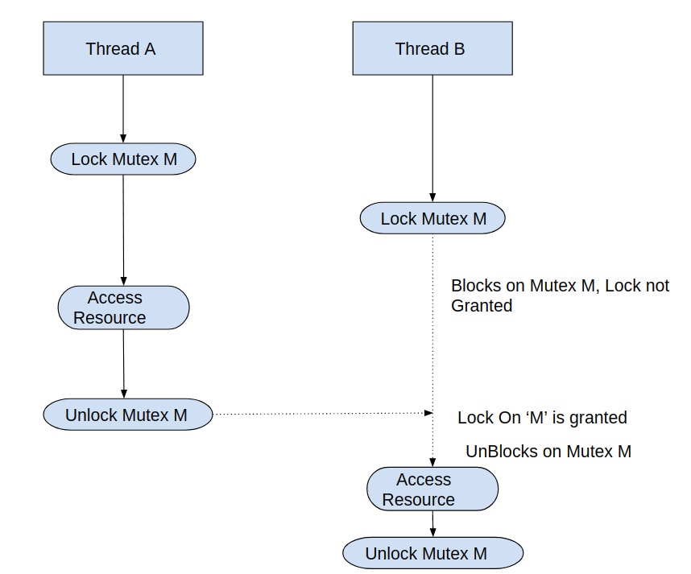

Slide 8
Statically Allocated Mutexes
A mutex can either be allocated as a static variable or be created dynamically at run time.
pthread_mutex_t mtx = PTHREAD_MUTEX_INITIALIZER;

Slide 9
Mutex syntax
#include <pthread.h>
int pthread_mutex_lock(pthread_mutex_t * mutex );
int pthread_mutex_unlock(pthread_mutex_t * mutex );
Both return 0 on success, or a positive error number on error

Slide 10
Statically Allocated Mutexes
A mutex can either be allocated as a static variable or be created dynamically at run time.
pthread_mutex_t mtx = PTHREAD_MUTEX_INITIALIZER;

Slide 11
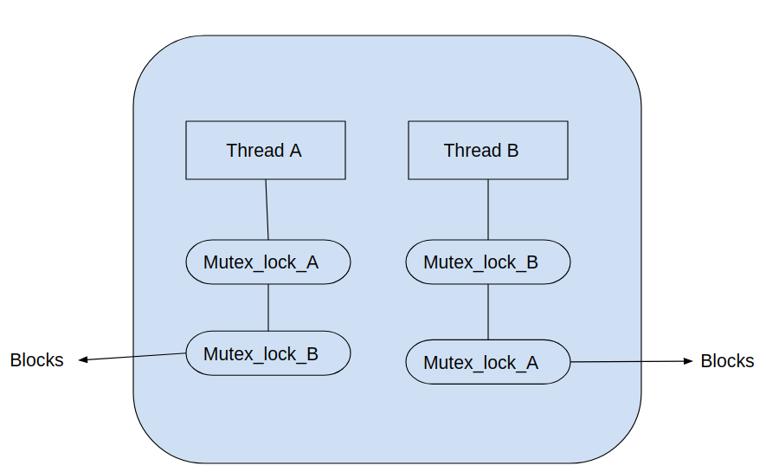
Dead lock
Sometimes, a thread needs to simultaneously access two or more different shared resources, each of which is governed by a separate mutex
Dead lock can also be caused, if a thread has already locked a mutex, and same thread is trying to lock the same mutex again.

Slide 12
Avoiding Dead locks
The simplest way to avoid such deadlocks is to define a mutex hierarchy
Threads can lock the same set of mutexes, they should always lock them in the same order.
For example, in before scenario, the deadlock could be avoided if the two threads always lock the mutexes in the order mutex1 followed by mutex2.

Slide 13
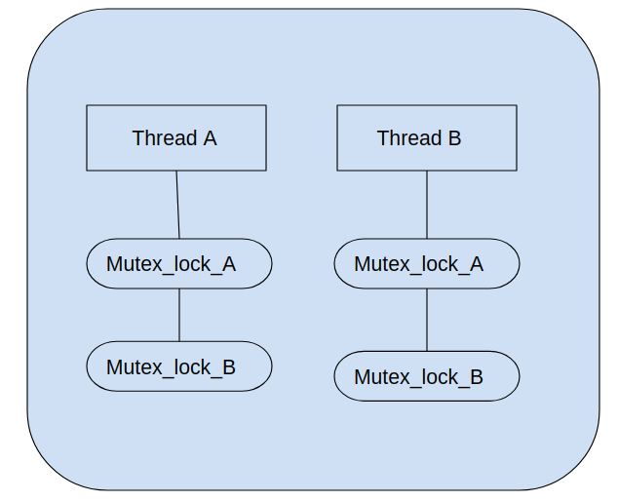

Slide 14
pthread_mutex_trylock and pthread_mutex_timedlock
The Pthreads API provides two variants of the pthread_mutex_lock() function:
pthread_mutex_trylock() and pthread_mutex_timedlock().
The pthread_mutex_trylock() function is the same as pthread_mutex_lock(), except that if the mutex is currently locked, pthread_mutex_trylock() fails, returning the error EBUSY .

Slide 15
pthread_mutex_trylock and pthread_mutex_timedlock
The pthread_mutex_timedlock() function is the same as pthread_mutex_lock()
Except that the caller can specify an additional argument, abstime, that places a limit on the time that the thread will sleep while waiting to acquire the mutex.
If the time interval specified by its abstime argument expires without the caller becoming the owner of the mutex, pthread_mutex_timedlock() returns the error ETIMEDOUT.

Slide 16
Signaling Changes of State: Condition Variables
A condition variable allows signalling from one thread to other thread, about changes in the state of a shared variable.
Condition variables help to define the sequence of thread execution, for eg: In case of producer and consumer application, first the producer thread runs, and then the producer thread signals the consumer thread for further execution.

Slide 17
Condition variable
In condition variable the thread waiting for shared resource will be made to sleep, and as soon as it gets signal from other thread, the thread wakes up and executes(like accessing/modifying shared resource).
A condition variable is always used in conjunction with a mutex.

Slide 18
Statically Allocated Condition Variables
condition variables can be allocated statically or dynamically.
pthread_cond_t cond = PTHREAD_COND_INITIALIZER;

Slide 19
Signaling and Waiting on Condition Variables
The principal of condition variable is ‘signal and wait’.
The ‘signal’ operation is a notification to one or more waiting threads that a shared variable’s state has changed.
The ‘wait’ operation is the method of blocking until such a notification is received from other Thread.

Slide 20
Syntax
The pthread_cond_signal() functions signal’s the condition variable specified by cond.
The pthread_cond_wait() function blocks thread until the condition variable cond is signaled.
#include <pthread.h>
int pthread_cond_signal(pthread_cond_t * cond );
int pthread_cond_wait(pthread_cond_t * cond , pthread_mutex_t * mutex );
All return 0 on success, or a positive error number on error

Slide 21
Working principle of Condiation Variable
pthread_cond_wait(pthread_cond_t * cond , pthread_mutex_t * M)
Step1 – The thread calling pthread_cond_wait unlocks Mutex – M.
Step2 – Blocks on the condition variable ‘cond’ to receive the signal from other thread
Step3 – As soon as it receives required signal, it further locks Mutex – M.
Note: Step1 & Step 2 is executed as a atomic operation.

