Slide 1
Overview of Threads
Like processes, threads are a mechanism that permits an application to perform multiple tasks concurrently.
A single process can contain multiple threads.
Threads share the same global memory, including the initialized data, uninitialized data, and heap segments.
The Threads in process can execute concurrently.

Slide 2
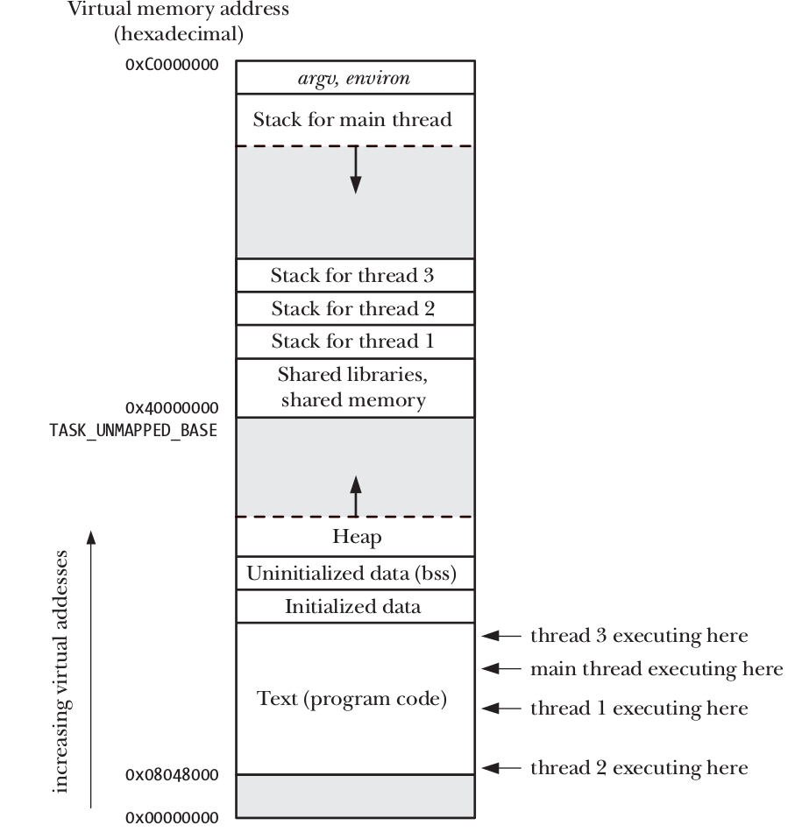
Memory layout of Threads(Four threads executing in a process)

Slide 3
Advantages of Threads over Process
Threads offer advantages over processes in certain applications.
It is difficult to share information between processes.
Process creation with fork() is relatively expensive.
Sharing information between threads is easy and fast.
It is just a matter of copying data into shared (global or heap) variables.
Thread creation is faster than process creation.
Disadvantage of thread - Threads must take care of race around and synchronisation of global data that is shared by threads.

Slide 4
Attributes shared by threads of a process
process ID and parent process ID
process group ID and session ID
open file descriptors
signal dispositions – process behaviour when signal is delivered.
file system–related information: umask, current working directory, and root directory
interval timers (setitimer()) and POSIX timers (timer_create())
resource limits

Slide 5
Attributes Unique to threads
thread ID
signal mask;
thread-specific data.
the errno variable;
realtime scheduling policy and priority
CPU affinity
stack

Slide 6
Threads in Linux
Introduction to Threads(POSIX).
Creating Thread.
Thread ID
Terminating Thread.

Slide 7
pthread_create
When a program is started, the resulting process consists of a single thread, called the initial or main thread.
The pthread_create() function creates a new thread.
#include <pthread.h>
int pthread_create(pthread_t * thread , const pthread_attr_t * attr , void *(* start )(void *), void * arg );
Returns 0 on success, or a positive error number on error

Slide 8
pthread creation
pthread_t *thread;
int s;
s = pthread_create(&thread, NULL, func, &arg);
if (s != 0){
Error creating thread.
}

Slide 9
Compiling Pthreads programs
The program is linked with the libpthread library (the equivalent of –lpthread).
Eg: gcc *.c -lpthread

Slide 10
Thread IDs
Each thread within a process is uniquely identified by a thread ID.
This ID is returned to the caller of pthread_create().
thread can obtain its own ID using pthread_self().
#include <pthread.h>
pthread_t pthread_self(void);
A thread can get its own thread ID by calling pthread_self().
Applications of thread ID will be discussed next.

Slide 11
Thread Termination
The execution of thread terminates in one of the below ways:
The thread’s start function calls a return with return value for the thread.
The thread calls pthread_exit()
The thread is canceled using pthread_cancel().
Main thread performs a return from main() function, this causes all threads in the process to terminate immediately.

Slide 12
pthread_exit()
The pthread_exit() function terminates the calling thread, and specifies a return value, this value can be obtained in main thread by calling pthread_join().
include <pthread.h>
void pthread_exit(void * retval );
The retval argument specifies the return value for the thread.
If the main thread calls pthread_exit() instead of calling exit() or return() , then the other threads continue to execute.

Slide 13
Thread IDs
Each thread within a process is uniquely identified by a thread ID.
This ID is returned to the caller of pthread_create().
thread can obtain its own ID using pthread_self().
#include <pthread.h>
pthread_t pthread_self(void);
A thread can get its own thread ID by calling pthread_self().
Applications of thread ID will be discussed next.

Slide 14
Thread Id and pthread_equal()
Below functions use the thread ID.
pthread_join()
pthread_detach()
pthread_cancel()
pthread_kill()
include <pthread.h>
int pthread_equal(pthread_t t1 , pthread_t t2 );
Returns nonzero value if t1 and t2 are equal, otherwise 0
Example
if (pthread_equal(tid, pthread_self())
printf("tid matches self\n");

Slide 15
pthread_join()
The pthread_join() function when called from main thread, waits for the specified thread to terminate.
If that thread has already terminated, pthread_join() returns immediately.
Syntax:
int pthread_join(pthread_t thread , void ** retval );
Returns 0 on success, or a positive error number on error

Slide 16
pthread_join()
The task that pthread_join() performs for threads is similar to that performed by waitpid() for processes.
The main use case of using pthread_join is that the main thread should wait for all the threads it has created, and then only should terminate itself in the end.

Slide 17
Detaching a Thread
By default, a thread is joinable, this means that when it terminates, another thread can obtain its return value using pthread_join().
pthread_detach() - The system automatically cleans up terminated thread, no need of calling pthread_join.
#include <pthread.h>
int pthread_detach(pthread_t thread );
Returns 0 on success, or a positive error number on error

Slide 18
Pthread_cancel
#include <pthread.h>
int pthread_cancel(pthread_t thread );
Returns 0 on success, or a positive error number on error
Used to cancel/terminate a specified thread.

