Slide 1
User mode and Kernel mode

Slide 2
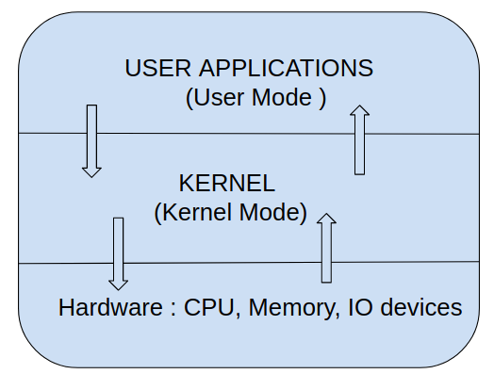
The main feature of Linux is to provide security/Accesiblity of the underlying hardware .
Linux Layered Architecture overview

