Slide 1
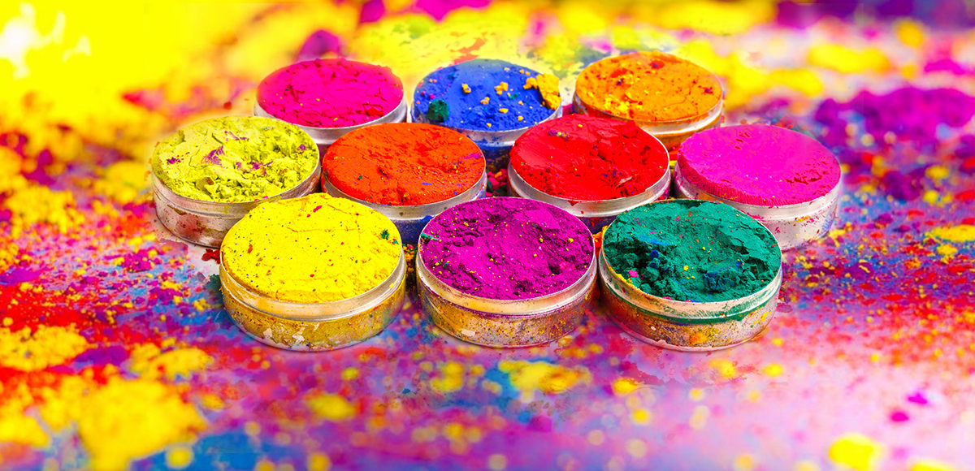
Holi
Festival of Colors
Bonfires
New colorful beginning

