Slide 1



Computational Modelling
of Real World Problems Using Digital Research Infrastructure and Community Outreach
Sudhi Sharma Padillath Vasudevan
Post-Doctoral Research Scholar,
Carleton University,
Ottawa, Canada

Slide 2
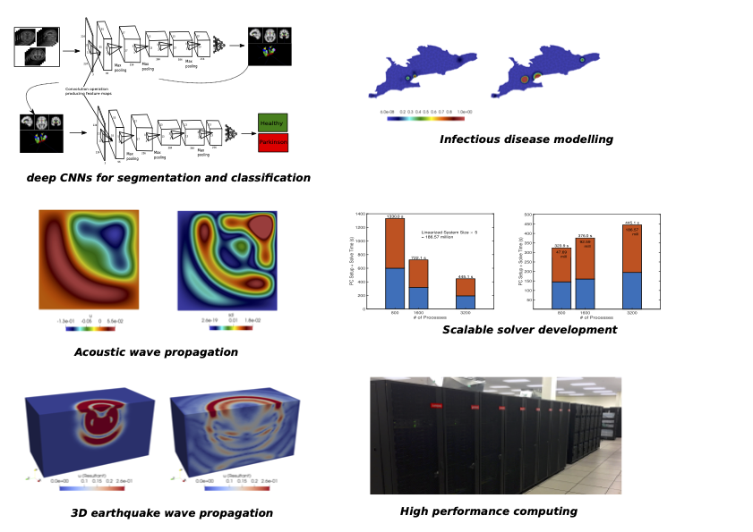

Technical Challenges
openseeds
mentoring & training program

Slide 3
Towards an Open Science Leader
Challenge
Designing and building for understanding
Designing and building for participation and inclusion
Learning
Incorporating feedback loops from users
Designing and creating new ideas with contributors and users and allowing contributors to share governance on the project
Building project documents, workflows and contribution guidelines
Conducting webinars and orientation calls for contributors and users
Mentoring and guiding others to being an open science leader
open seeds
mentoring & training program

Slide 4
Progress
Conducted a DRAC resource awareness webinar to fellow researchers from different university and disciplines and collected feedback
Developed an open canvas Canvas
Updated my open source project resource page with detailed README, License and contributor guidelines : Github
Created OSF account for generating DOI and sharing project documents to larger audience : OSF
open seeds
mentoring & training program

Slide 5
Future Work and Open Questions
Engaging wider audience through university wide programs and social media outreach
How to engage decision makers to create a positive impact on improved accessibility to E-D-I-A groups ?
How to create an inclusive collaboration in design and building state of the art digital tools useful for the community ?
How to mobilize financial and other resources for successful completion of the project
How to effectively create a community of world class science educators and leaders

Slide 6
THANK YOU
Questions/ Feedbacks ?
Connect with me : sudhisharmapadillath@gmail.com
open seeds
mentoring & training program

