Slide 1
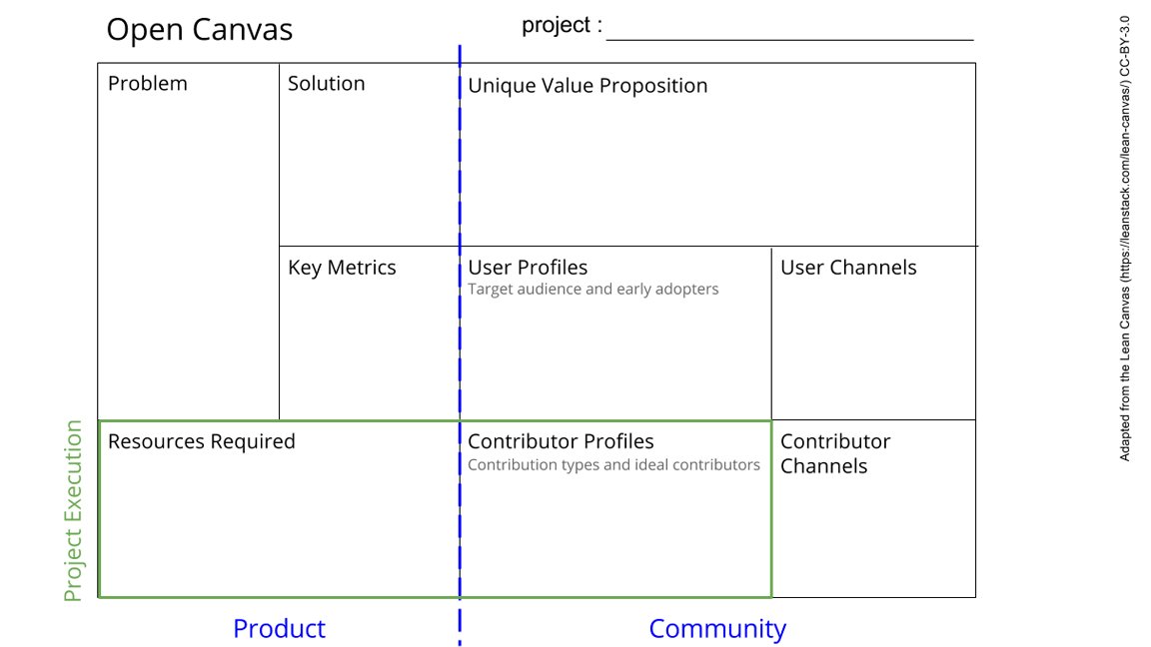
Segmentation of special regions from MRI scans
Classification of PD patients from healthy with these segments
Improve accuracy of model with respect to PD-mimics and different sexes
Utilize a 3D CNN model for seg
Utilize a 3D CNN model for classification
Generative model/data augmentation/other methods ?
Metrics : dice, IoU, sensitivity etc
Sensitivity, specificity, F1Score etc
Independent test set
Clinicians
Pharmaceutical industries
GPUs
Open source packages for preprocessing
Input MRI data and labels
Machine learning expert with experience running in GPUs
Neuroscience expert
See next slide for instructions!
Notes:
Go to File > Make a Copy… to make your own canvas
See next slide for instructions

Slide 2
