Slide 1
AWS CloudFormation
Kalyan Reddy Daida

Slide 2
Course Objectives
AWS CloudFormation
Continuous Integration
AWS Code Commit
AWS Code Build
Continuous Delivery
AWS CodeDeploy
AWS CodePipeline
Infrastructure as Code with CI/CD Tools.

Slide 3

Template Anatomy
Resources
5 Examples and 18 resources overall
Parameters
4 Examples
Mappings
2 Examples
Conditions
6 Examples
AWS CloudFormation
Outputs
7 Examples
Metadata
Designer & Interface
cfn-init
Metadata

Slide 4
Resources
EC2 Instance
CodeBuild
Security Group
CodeBuild IAM Role
Elastic IP
CodeDeploy Application
VPC
CodeDeploy DeploymentGro
Resources
Subnet
CodeDeploy Deploymnet
Route Table
CodeDeploy IAM Role
AWS CloudFormation
SubnetRoute TableAssociation
CodePipeline
IAM Role
InternetGateway
CodePipeline Pipeline
VPCGatewayAttachment
SNS Topic

Slide 5
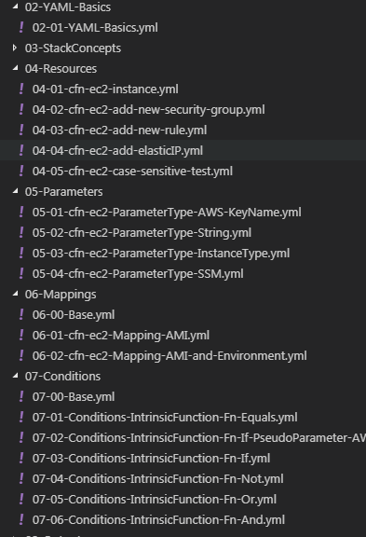
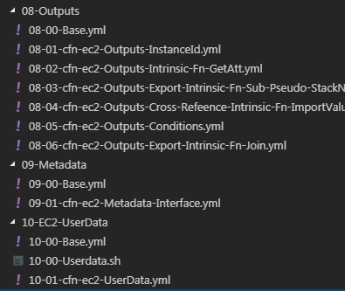
Templates Written

Slide 6
Metadata - cfn-init
Base Template
Metadata Format
services
packages
aws-cfn-bootstrap
groups
cfn-init
users
cfn-signal
sources
outputs
Create Stack & Test
files
Creation Policy
Create Stack & Test
commands
cfn-hup
Update Stack – Deploy v2 App

Slide 7
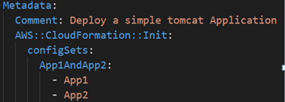
Config Sets
configSets (Single)
Sample:
App1AndApp2
App1
App2

Slide 8
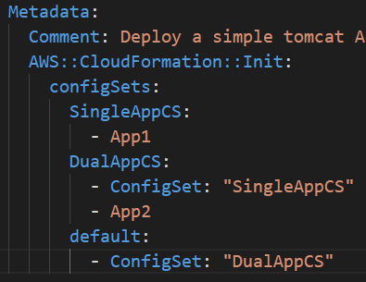
configSets (Multiple)
SingleAppCS
DualAppCS
default
App1
SingleAppCS
App2
DualAppCS
App1
SingleAppCS
App2
Sample:
App1

Slide 9

Nested Stacks
Root Stack
VPC Nested Stack
Security Group Nested Stack

Slide 10
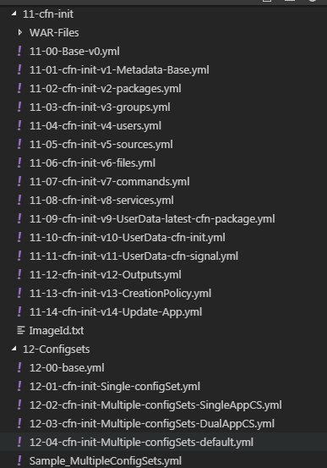
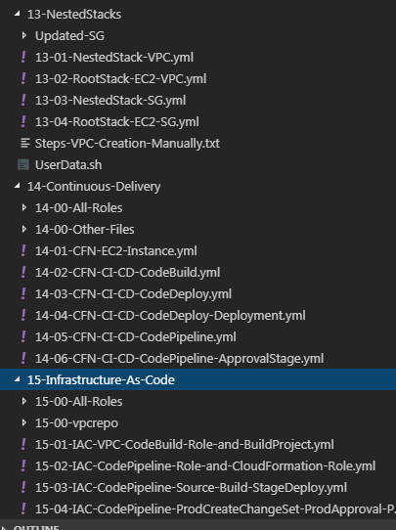
Templates Written

Slide 11
Intrinsic Functions & Pseudo Parameters
Intrinsic Functions
Fn::Ref
Fn::Base64
Fn::FindInMap
Fn::GetAtt
Fn::GetAzs
Fn::ImportValue
Fn::Join
Fn::Select
Fn::Sub
Condition Functions
Fn::And
Fn::Equals
Fn::If
Fn::Not
Fn::Or
Pseudo Parameters
AWS::Region
AWS::AccountId
AWS::StackName
AWS::NoValue (very important when using conditions)

Slide 12


Stages in Release Process
Source
Build
Test
Production

Slide 13
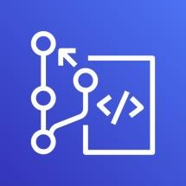
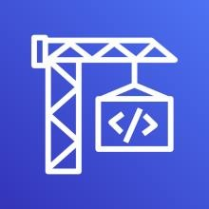

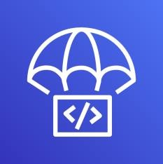


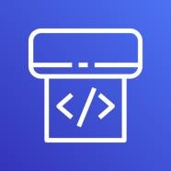
AWS Developer Tools or Code Services
Source
Build
Test
Deploy
Monitor
AWS CodeCommit
AWS CodeBuild
AWS CodeBuild + Third Party
AWS CodeDeploy
AWS X-Ray
Amazon CloudWatch
AWS CodePipeline

Slide 14
AWS Developer Tools or Code Services
Source
Build
Test
Deploy
Monitor
AWS CodeCommit
AWS CodeBuild
AWS CodeBuild + Third Party
AWS CodeDeploy
AWS X-Ray
Amazon CloudWatch
AWS CodePipeline

Slide 15
AWS Developer Tools or AWS Code Services
Source
Build
Test
Deploy
Monitor
CodeCommit
CodeBuild
CodeBuild + Third Party
CodeDeploy
AWS X-Ray
CloudWatch
Version control
service
We can privately
store and manage
source code
Secure & highly
available
Fully managed build service, Compiles source code, Runs tests and produces software packages
Scales continuously and processes multiple builds concurrently.
No build servers to manage.
Pay by minute, only for compute resources we use.
Monitor builds through CloudWatch events.
Supports following programming language runtimes Ruby, Python, PHP, Node, Java, Golang, .Net Core, Docker and Android
Automates code deployments
to any instance and Lambda
Avoids downtime during
application deployment
Roll back automatically if
failure detected
Deploy to Amazon EC2,
Lambda, or on-premises servers
Monitors Source
check-ins and triggers
builds
Monitors builds
Monitors
Infrastructure
Collects logs
Continuous delivery service for fast and reliable application updates
Model and visualize your software release process
Builds, tests, and deploys your code every time there is a code change
Integrates with third-party tools and AWS
CodePipeline

Slide 16


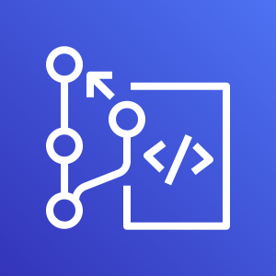
CodeCommit
Build a simple rest service using Java Spring Boot.
Check-in code to Local Repo and push to CodeCommit.
Developer
Local Git Repo
push
AWS Cloud
AWS CodeCommit

Slide 17



CodeBuild – AWS Web Console
CodeBuild – AWS CloudFormation
Developer
Developer
Local Git Repo
Local Git Repo
push
push
AWS Cloud
CodeBuild Stack
AWS Cloud
CodeCommit
CodeCommit
CodeBuild
Service Role
CodeBuild
Simple Storage
Service (S3)
CodeBuild
Simple Storage
Service (S3)

Slide 18


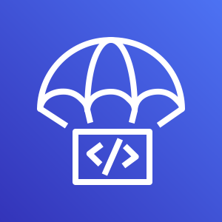
CodeDeploy – AWS Web Console
CodeDeploy – AWS CloudFormation
User
accessing
Rest service
Developer
User
accessing
Rest service
Developer
Local Git Repo
Local Git Repo
Internet
push
Internet
push
AWS Cloud
CodeDeploy Stack
EC2 Apps Stack
AWS Cloud
CodeCommit
CodeCommit
CodeBuild
Service Role
CodeDeploy
Service Role
Role for EC2 Instance Profile
Staging EC2 Instance
CodeBuild
Simple Storage
Service (S3)
CodeDeploy
EC2 Instance
CodeBuild
Simple Storage
Service (S3)
CodeDeploy
Production EC2 Instance

Slide 19
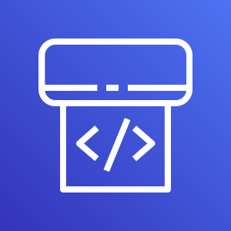

CodePipeline – AWS Web Console
AWS Cloud
CodePipeline
Developer
CloudWatch
Local Git Repo
push
CodeCommit
CodeBuild
Simple Storage
Service (S3)
CodeDeploy
EC2
Instance

Slide 20



CodePipeline – AWS CloudFormation
AWS Cloud
CodePipeline
CI CD CloudFormation Stack
Developer
Local Git Repo
push
CodeCommit
CodeBuild
Simple Storage
Service (S3)
CodeDeploy
Simple Notification
Service
CodeDeploy
Staging EC2 Instance
Role for EC2 Instance Profile
Production EC2 Instance
Authorized
Approver
EC2 Apps CloudFormation Stack

Slide 21
Infrastructure as Code
Source
Build
Test
Production
Source Stage
Build Stage
Test Stage
Prod Stage
AWS CodeCommit
AWS CodeBuild
AWS CodePipeline
AWS CodePipeline

Slide 22


Infrastructure as Code
Source
Build
Test
Production
Source Stage
Build Stage
Test Stage
Prod Stage
Master Branch
Prepare or Validate
Template
Create & Execute
Change set
Create & Execute
Change set

Slide 23


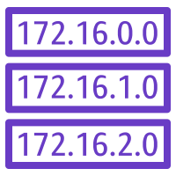

Infrastructure as Code – Manual AWS Web Console
AWS Cloud
Staging VPC Stack
CodePipeline
Action-1:
Test Stage
Create
Stack
VPC
Subnet
Developer
Internet gateway
Prod Stage
Route table
Source Stage
Prod VPC Stack
Build Stage
Action-1:
Create Change set
Local Git Repo
push
Action-2:
Prod
Approval
CodeCommit
CodeBuild
Simple Storage
Service (S3)
Simple Notification
Service
Authorized
Approver
Action-3:
Execute
Change set
VPC
Subnet
CodeBuild
Service Role
CodePipeline
Role
CloudFormation
Role
Internet gateway
Route table

Slide 24
Infrastructure as Code – CFN Template creation Flow
AWS Cloud
CI CD IAC Pipeline Stack
Staging VPC Stack
CodePipeline
Action-1:
Test Stage
Create
Stack
VPC
Subnet
Developer
Internet gateway
Prod Stage
Route table
Source Stage
Prod VPC Stack
Build Stage
Action-1:
Create Change set
Local Git Repo
push
Action-2:
Prod
Approval
CodeCommit
CodeBuild
Simple Storage
Service (S3)
Simple Notification
Service
Authorized
Approver
Action-3:
Subnet
Execute
Change set
VPC
CodeBuild
Service Role
CodePipeline
Role
CloudFormation
Role
Internet gateway
Route table

Slide 25
Infrastructure as Code – Execution Flow
AWS Cloud
CI CD IAC Pipeline Stack
Staging VPC Stack
CodePipeline
Action-1:
Subnet
Test Stage
Create
Stack
VPC
Developer
Internet gateway
Prod Stage
Route table
Source Stage
Prod VPC Stack
Build Stage
Action-1:
Create Change set
Local Git Repo
push
Action-2:
Prod
Approval
CodeCommit
CodeBuild
Simple Storage
Service (S3)
Simple Notification
Service
Authorized
Approver
Action-3:
Subnet
Execute
Change set
VPC
CodeBuild
Service Role
CodePipeline
Role
CloudFormation
Role
Internet gateway
Route table

Slide 26
Templates Written

Slide 27
YAML

Slide 28
YAML
YAML Key Value pairs
YAML Lists
YAML Dictionary
YAML Lists containing Dictionaries
YAML Lists containing Dictionaries containing Lists
YAML Pipe
YAML Greater than Sign
YAML Comments

Slide 29
YAML – Key Value Pairs
YAML documents will be full of key value pairs.
Key and Value are separated by colon.
We must have a space after colon differentiating the value.
YAML Supports different data types.
Integer
Floating point Numbers
Strings
Boolean
Dates - Format: ISO 8601
Null values
Important Note for Strings: Quote strings when they have special characters like colons :, braces {}, pipes |, brackets []
Key Value Pairs
Name: Dave
Age: 29
Gpa: 4.2
Occupation: Engineer
State: 'New Jersey'
AboutMe: "I am a software engineer"
Male: true
DateOfBith: 1990-09-15T15:53:00
PoliceCases: null

Slide 30
YAML – List / Array
YAML List indented with opening dash.
Dash indicates that it’s a element of an array.
All members of a list are lines beginning at the same indentation level starting with a ”-” (a dash and a space)
Block Sequence indicate each entry with a dash and space
Flow Sequence is written as a comma separated list within square brackets.
List / Array
Block Sequence
Persons:
- Dave
- John
- Mike
- Sam
Flow Sequence
Persons: [Dave, John, Mike, Sam]

Slide 31
YAML Dictionary / Map
YAML Dictionaries are set of properties grouped together under an item.
YAML Dictionaries contain key value pairs.
Dictionary
Dave:
Age: 25
Occupation: Engineer
State: New Jersey
gpa: 4.5
male: true

Slide 32
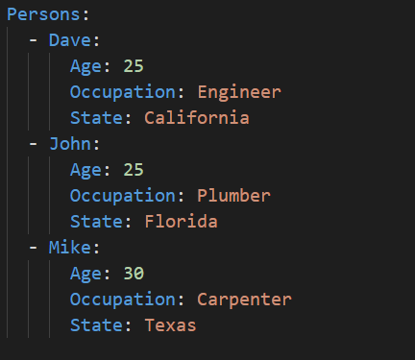
YAML Lists containing Dictionaries

Slide 33
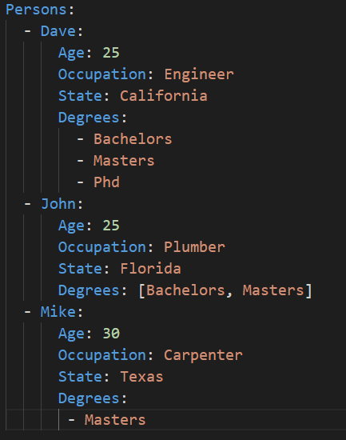
YAML Lists containing Dictionaries containing Lists

Slide 34
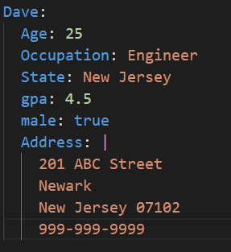
YAML Pipe
The pipe notation, also referred to as literal block
All new lines, indentation, extra spaces everything preserved as is.

Slide 35
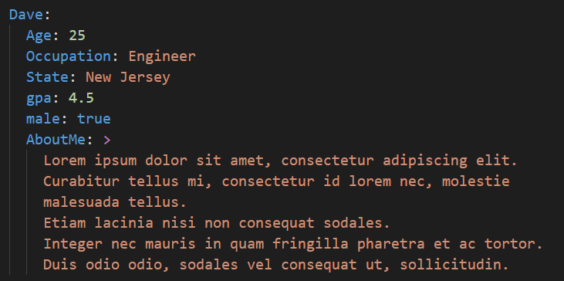
YAML Greater than Sign
The greater than sign notation, also referred to as folded block.
Renders the text as a single line.
All new lines will be replaced with a single space.
Blank lines are converted to new line character.

Slide 36
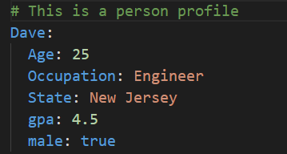
YAML Comments
We can have comments in YAML with # sign. Below is an example.

Slide 37
Stack Features

Slide 38
AWS CloudFormation
Simplifies our Infrastructure Management.
Quickly replicates our infrastructure.
Easily controls and tracks changes to our infrastructure.

Slide 39
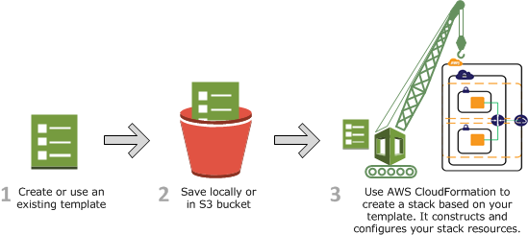
How does CloudFormation works?

Slide 40
AWS CloudFormation
Stack Core Features
Create Stack
Update Stack
Create Change Set
Roll back
Stack
Managing collection of AWS resources as a single unit is called stack.
We can create, update, delete the collection of AWS resources by creating, updating and deleting stacks.
To create AWS resources, we create a stack by submitting the template that we created, AWS CloudFormation provisions all those resources automatically for us.

Slide 41
AWS CloudFormation
Change Set
If we want to make changes to our stack, we can update the stack.
Before making changes to resources, we can generate a change set, which is summary of proposed changes.
Change sets allow us to see how our changes might impact current running resources in a stack especially for critical resources, before implementing them we get an idea about the impact.
For example: If we associate a new keypair to ec2 instance, AWS will delete the current ec2 instance and replaces it with new ec2 instance by adding new keypair to it.

Slide 42
Stack Features
Step 00: Pre-requisites
Create Default VPC (if not present)
Create Key pairs
cfn-key-1
cfn-key-2
Gather AMI ID
Step 01: Stack Features
Create Stack
Update Stack
Create Change Sets
Rollback

Slide 43
Resources

Slide 44
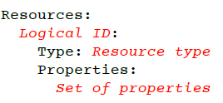
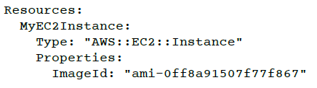
Resources
Resources are key components of a stack.
Resources section is a required section that need to be defined in cloud formation template.
Syntax
Resources Documentation: https://docs.aws.amazon.com/AWSCloudFormation/latest/UserGuide/aws-template-resource-type-ref.html

Slide 45
Resources
Step 01: Create resource - EC2 Instance
Step 02: Add Second Resource - New security group and Intrinsic Function Ref
Step 03: Update Resource Properties - Add new rule to Security group
Step 04: Add third Resource - Elastic IP
Step 05: Perform case sensitive test with resource properties

Slide 46

Intrinsic Function: Ref
The intrinsic function Ref returns the value of the specified parameter or resource.
Resource Case: When we specify a resource logical name, it returns a value that we can typically use to refer to that resource.
Parameter Case: When we specify a parameter logical name, it returns the value of that parameter.
Syntax:
Long Form
Ref: logicalName
Short Form
!Ref logicalName

Slide 47
Parameters

Slide 48
Parameters
Parameters: Parameters enable us to input custom values to our template each time when we create or update stack.
We can have maximum of 60 parameters in a cfn template.
Each parameter must be given a logical name (logical id) which must be alphanumeric and unique among all logical names within the template.
Each parameter must be assigned a parameter type that is supported by AWS CloudFormation.
Each parameter must be assigned a value at runtime for AWS CloudFormation to successfully provision the stack. We can optionally specify a default value for AWS CloudFormation to use unless another value is provided.

Slide 49
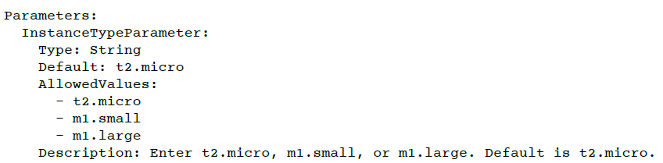

Parameters
Parameters must be declared and referenced within the same template.
We can reference parameters from the Resources and Outputs sections of the template.
Syntax

Slide 50
Parameter Properties
Parameter Types
AllowedPattern
AllowedValues
ConstraintDescription
Default
Description
MaxLength
MaxValue
MinLength
MinValue
NoEcho
Type (Mandatory)
String
Number
List<Number>
CommaDelimitedList
AWS Specific
AWS::EC2::Instance::Id
AWS::EC2::VPC::Id
List<AWS::EC2::Subnet::Id>
Type (Mandatory)
SSM Parameter Type
AWS::SSM::Parameter::Name
AWS::SSM::Parameter::Value<String>
AWS::SSM::Parameter::Value<List<String>>

Slide 51
Parameters - Practice
Step 01: Create a parameter type of AWS for KeyName property of ec2 instance.
Step 02: Create a parameter type of string for AvailabilityZone property of ec2 instance.
Step 03: Create a parameter type of string for InstanceType property of ec2 instance.
Step 04: Create a parameter type of SSM for InstanceType property of ec2 instance.
Pre-requisite: Create a SSM Parameter in parameter store.

Slide 52
Mappings

Slide 53
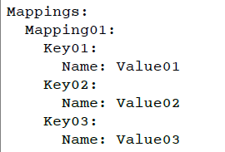
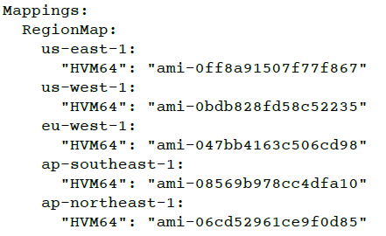
Mappings
Mappings section matches a key to a corresponding set of named values.
For example, if we want to set values based on a region, we can create a mapping that uses region name as a key and contains the values we want to specify for each region
We can use Fn::FindInMap intrinsic function to retrieve values in map.

Slide 54
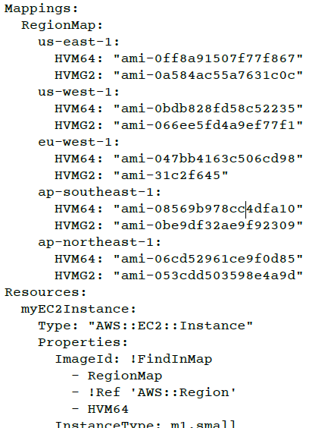
Intrinsic Function: FindInMap
The intrinsic function FindInMap returns the value corresponding to keys in a two-level map that is declared in Mappings section.
Parameters
Map Name
Top Level Key
Second Level Key
Return Value

Slide 55
Mappings - Practice
Step 01: Create a Mapping to select the AMI ID for ec2 instance property – ImageId based on region.
Top Level Key: Region (us-east-2, us-west-1)
Second Level Key: HVM64
Step 02: Create a Mapping to select the instance type based on environments (dev or prod) for ec2 instance property - InstanceType
Top Level Key: Environment (dev, prod)
Second Level Key: Instance Type

Slide 56

Pseudo Parameters
Pseudo parameters are parameters that are predefined by AWS CloudFormation.
We don’t need to declare them in our template.
We can use them the same way as we use parameters as an argument for Ref function.
Usage:
AWS::AccountId
AWS::NotificationARNs
AWS::NoValue
AWS::Partition
AWS::Region
AWS::StackId
AWS::StackName
AWS::URLSuffix

Slide 57
Conditions

Slide 58
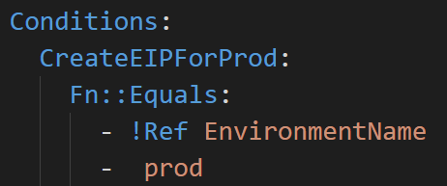

Conditions
Conditions section contains statements that define the circumstances under which entities are created or configured.
Example: 1 - We can create a condition and then associate it with a resource or output so that AWS CloudFormation only creates the resource or output if the condition is true.
Example:2 - We can associate the condition with a property so that AWS CloudFormation only sets the property to a specific value if the condition is true, if the condition is false, AWS CloudFormation sets the property to a different value that we specify.
We will use conditions, when we want to re-use the template in different contexts like dev and prod environments.
Synatx:

Slide 59
Conditions
Conditions are evaluated based on predefined Psuedo parameters or input parameter values that we specify when we create or update stack.
Within each condition we can reference the other condition.
We can associate these conditions in three places.
Resources
Resource Properties
Outputs
At stack creation or stack update, AWS CloudFormation evaluates all conditions in our template. During stack update, Resources that are now associated with a false condition are deleted.
Important Note: During stack update, we cannot update conditions by themselves. We can update conditions only when we include changes that add, modify or delete resources.

Slide 60
Conditions - Intrinsic Functions
We can use the below listed intrinsic functions to define conditions in cloud formation template.
Fn::And
Fn::Equals
Fn::If
Fn::Not
Fn::Or
We will be covering all these functions in our practice exercises.

Slide 61
Conditions - Practice
Step 01: Create an EIP when environment is prod, use intrinsic function Fn::Equals
Step 02: Create a security group for dev environment when condition is met and demonstrate Pseudo parameter “AWS::NoValue” for when environment is prod. Use Intrinsic function Fn::If
Step 03: Create a security group for prod env with prod related condition added. Use Intrinsic function Fn::If
Step 04: Demonstrate Intrinsic function Fn::Not
Step 05: Demonstrate Intrinsic function Fn::Or
Step 06: Demonstrate Intrinsic function Fn::And

Slide 62
Outputs

Slide 63
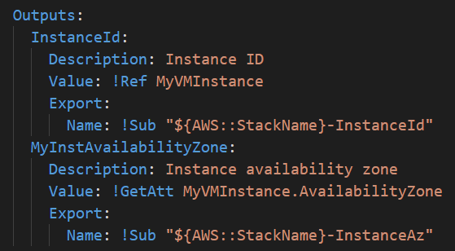
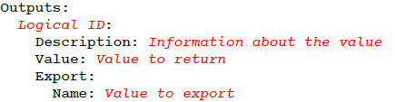
Outputs
Outputs section declares output values that we can
Import in to other stacks (to create cross-stack references)
When using Nested stacks, we can see how outputs of a nested stack are used in Root Stack.
We can view outputs on the CloudFormation console
We can declare maximum of 60 outputs in a cfn template.
Syntax:

Slide 64
Outputs
Export (Optional)
Exports contain resource output used for cross-stack reference.
For each AWS account, Export name must be unique with in the region. As it should be unique we can use the export name as “AWS::StackName”-ExportName
We can’t create cross-stack references across regions.
We can use the intrinsic function Fn::ImportValue to import values that have been exported within the same region. We will see this practically.
In simple terms, export availability zone in stack1 and use it stack2
For outputs, the value of the Name property of an Export can't use Ref or GetAtt functions that depend on a resource.
We can’t delete a stack if another stack references one of its outputs.
We can’t modify or remove an output value that is referenced by another stack.
We can use Outputs in combination with Conditions. We will see that in our practice sessions for Outputs.

Slide 65
Outputs Practice
Step 01: Create a very basic output using intrinsic function Fn::Ref - InstanceId.
Step 02: We will use Fn::GetAtt intrinsic function to create outputs.
Step 03: We will use Fn::Sub intrinsic function to create outputs and we will use Pseudo Parameter AWS::StackName. In addition, we will export the Security Group and Availability Zone.
Step 04: We will create a new stack by referencing the Security Group and Availability Zone export value from previous stack. We will use Fn::ImportValue intrinsic function to import those exports.
Step 05: We will use Conditions in Outputs section to demonstrate their combination.
Step 06: We will demonstrate Fn::Join intrinsic function.

Slide 66
Metadata

Slide 67
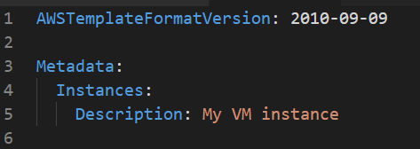
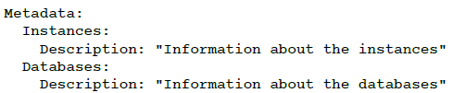
Metadata
Metadata provides details about the cfn template.
Syntax:
We have three types of metadata keys which are listed below.
Metadata Keys
AWS::CloudFormation::Designer
AWS::CloudFormation::Interface
AWS::CloudFormation::Init

Slide 68
Metadata Keys
AWS::CloudFormation::Designer
Auto generated during resources drag and drop to canvas.
AWS::CloudFormation::Interface
Used for parameter grouping.
AWS::CloudFormation::Init
Used for application installation and configurations on our aws compute (EC2 instances).
This is core and important feature of CloudFormation.
We have one complete section outlining the end to end details of init.

Slide 69
Metadata
AWS::CloudFormation::Designer

Slide 70
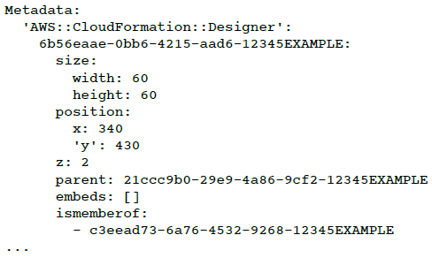
AWS::CloudFormation::Designer
Designer, Visually depicts how our resources are laid out
Designer automatically add this information when we use it to create view and update templates. Its a system generated metadata.
It defines the information about our resources such as their size and relative position in template metadata. All layout information is stored in designer metadata.

Slide 71
AWS::CloudFormation::Designer
In designer we drag and drop the resources.
When we create templates in Designer, it enforces some basic relationships between resources to help us create valid template.
Example: We cannot directly add EC2 instance in a VPC, we must add a subnet in a VPC.
We can also validate template directly in designer.
We can bring our template which we have written manually and validate in designer using validate template.

Slide 72
AWS::CloudFormation::Designer
Integrated Editor:
We can make all our template modifications with this editor.
It also provides the auto-complete feature that lists all property names for a resource so we don’t need to memorize all the properties of a resource or refer documentation.
We can use integrated editor to convert from JSON to YAML and vice versa.

Slide 73
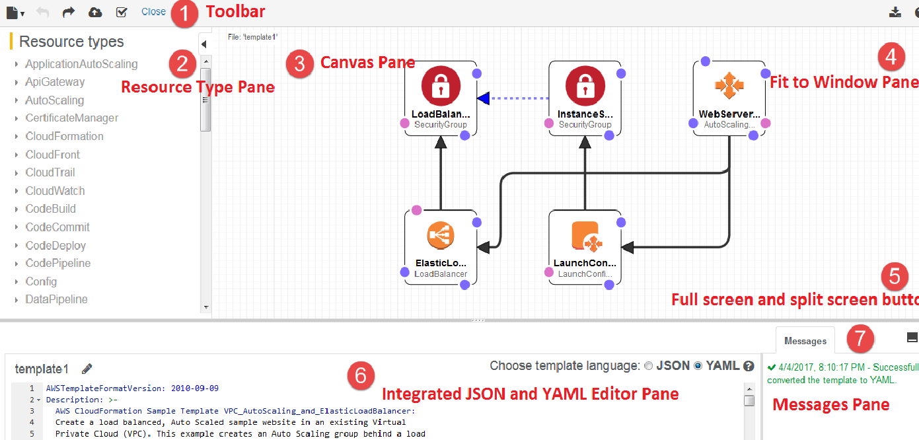


Slide 74
How I use Designer?
Firstly, I write my cfn templates manually in editor by referring documentation
Which gives me greater confidence on that particular resource for which I am writing template.
I use visual studio code as my editor due to the fact that dealing with YAML spaces is simplified in this editor. I just use tabs and VS code editor takes care of yaml spaces.
Copy template to Integrated Editor and Validate Template.
Convert template from JSON to YAML or YAML to JSON.
Drag resources to canvas and see their properties (some times).
Copy template to Integrated Editor and review template visually on canvas.

Slide 75
CloudFormation Designer - Demo

Slide 76
Metadata
AWS::CloudFormation::Interface

Slide 77
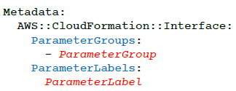
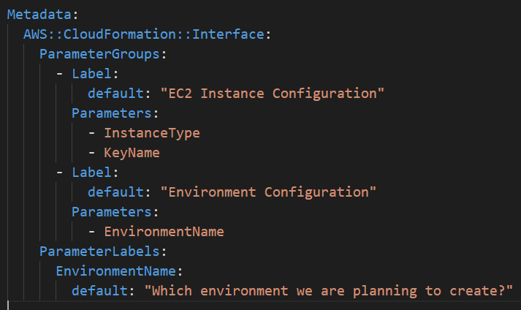
AWS::CloudFormation::Interface
Syntax:
When we create or update stacks in the console, the console lists input parameters in alphabetical order by their logical IDs.
By using this key, we can define our own parameter grouping and ordering so that users can efficiently specify parameter values.
We can also define labels for parameters.
A label is a friendly name or description that the console displays instead of a parameter's logical ID which helps users understand the values to specify for each parameter.

Slide 78
EC2 UserData

Slide 79
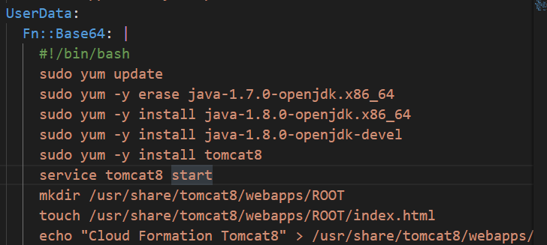
CloudFormation & UserData
We can use UserData in CloudFormation template for ec2.
We need to use a intrinsic function Fn::Base64 with UserData in CFN templates. This function returns the Base64 representation of input string. It passes encoded data to ec2 Instance.
YAML Pipe (|): Any indented text that follows should be interpreted as a multi-line scalar value which means value should be interpreted literally in such a way that preserves newlines.
UserData Cons
By default, user data scripts and cloud-init directives run only during the boot cycle when we first launch an instance.
We can update our configuration to ensure that our user data scripts and cloud-init directives run every time we restart our instance. (Reboot of server required)
Sample:

Slide 80
Helper Scripts
cfn-init, cfn-hup and cfn-signal

Slide 81
Helper Scripts
AWS CloudFormation provides the following Python helper scripts that we can use to install software and start services on Amazon EC2 that we create as part of stack.
cfn-init
cfn-signal
cfn-get-metadata
cfn-hup

Slide 82
Metadata
AWS::CloudFormation::Init

Slide 83
Base Template
Metadata Format
services
packages
aws-cfn-bootstrap
groups
cfn-init
users
cfn-signal
sources
outputs
Create Stack & Test
files
Creation Policy
Create Stack & Test
commands
cfn-hup
Update Stack – Deploy v2 App

Slide 84
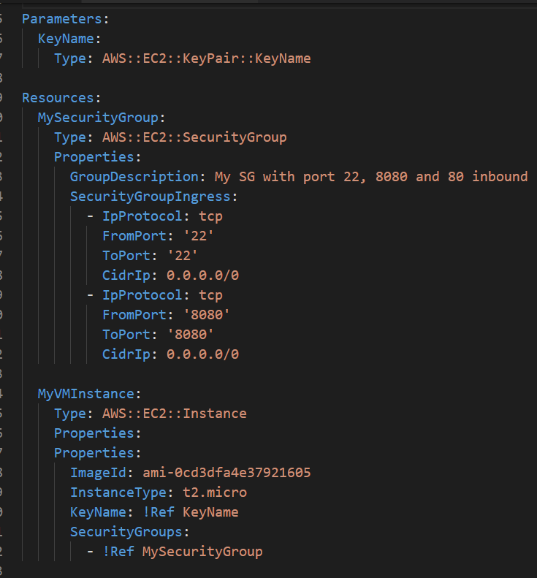
Step 00 – Base Template
Resources
Security Group
VM Instnaces
Parameters
We will Parameterize KeyName parameter

Slide 85
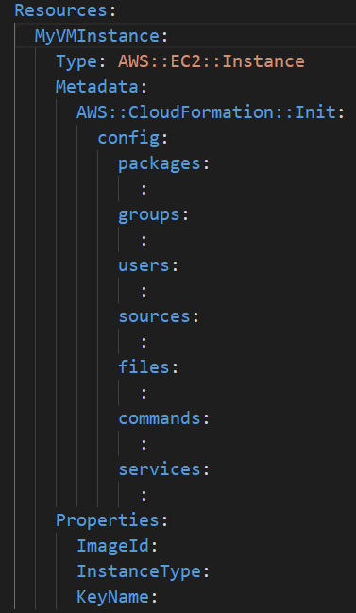
Step-01: Metadata: AWS::CloudFormation::Init
Type AWS::CloudFormation::Init will be used to include metadata section on an ec2 instance for cfn-init helper script.
Configuration is separated in to sections.
Metadata is organized in to config keys, which we can even group in configsets.
By default cfn-init calls and processes the metadata section when it has single config key (No configsets defined).
We can even specify configsets as input to cfn-init script so that it can process the entire configset with all its configkeys. We will see it in detail in configsets section.
The cfn-init helper script processes the configuration sections in the order specified in syntax section.

Slide 86
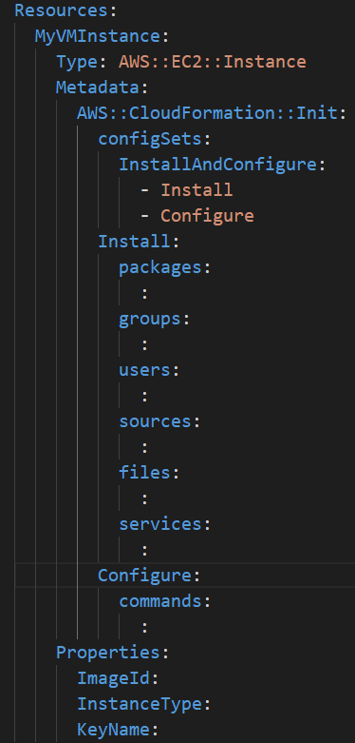
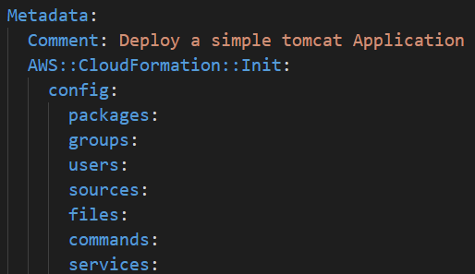
Step-01: Metadata: Structure
If we want to process it in different order, we need to separate them into different config keys and then use the order of execution for config keys in a configset.
In this step we will just add the metadata section with structure.
We will incrementally build the metadata sections in upcoming steps.
Metadata Structure:

Slide 87
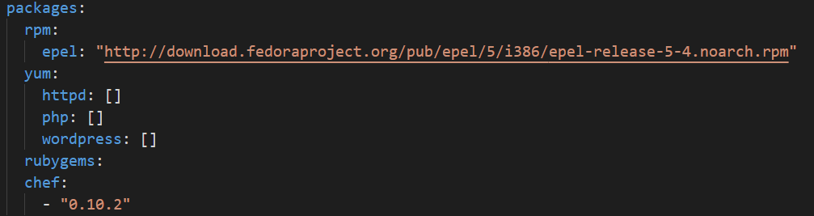
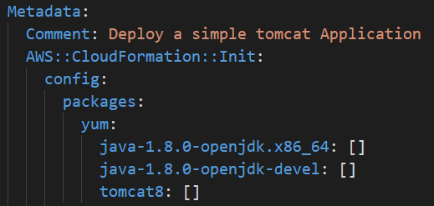
Step-02: Metadata: packages
We can use packages key to download and install pre-packaged applications.
On windows systems packages key supports only the MSI Installer.
Supported Package Formats:
apt
msi
python
rpm
rubygems
yum
Packages with Versions:
Our Example:

Slide 88
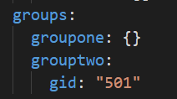
Step-03: Metadata: groups
We can use groups to create Linux/Unix groups and assign to group id’s.
Groups key is not supported for windows systems.
We can create multiple groups as required.
We can create without group id or create with a desired group id.
Syntax:

Slide 89
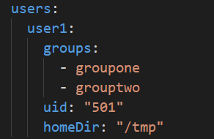
Step-04: Metadata: users
We can use the users key to create Linux/Unix users in EC2 Instance.
Users key is not supported for windows systems.
The following are the supported keys
uid
groups
homeDir
Users are created as non-interactive system users with a shell of /sbin/nologin.
This is by design and cannot be modified
Syntax

Slide 90
Step-05: Metadata: sources
We can use the sources key to download an archive file and unpack it in a target directory on EC2 Instance.
This key is fully supported for both Linux and Windows systems.
Supported Archive formats
tar
tar + gzip
tar + bz2
zip
Syntax / Example:

Slide 91
Step-05: Metadata: sources
Create S3 bucket
Disable block public access to bucket.
Create cfn folder
Upload the zip files demo1.zip, demo2.zip which contains demo.war (two versions v1 and v2)
Unzip AWS-CloudFormation.zip to local directory
Navigate to 11-cfn-init/WAR-Files folder
Upload the demo1.zip, demo2.zip to S3 bucket cfn folder.
Path: /AWS-CloudFormation/11-cfn-init/WAR-files
Make the demo1.zip, demo2.zip as public file.
Copy the S3 http url for both files and perform public access test.
Update demo1.zip url in sources section of template.

Slide 92
Step-06: Metadata: files
We can use the files key to create files on EC2 Instance.
The content can be either inline in the template or the content can be pulled from a URL.
The files are written to disk in alphabetical order.
Supported Keys
content
source
Encoding (plain or base64)
group
owner
mode
authentication
context

Slide 93
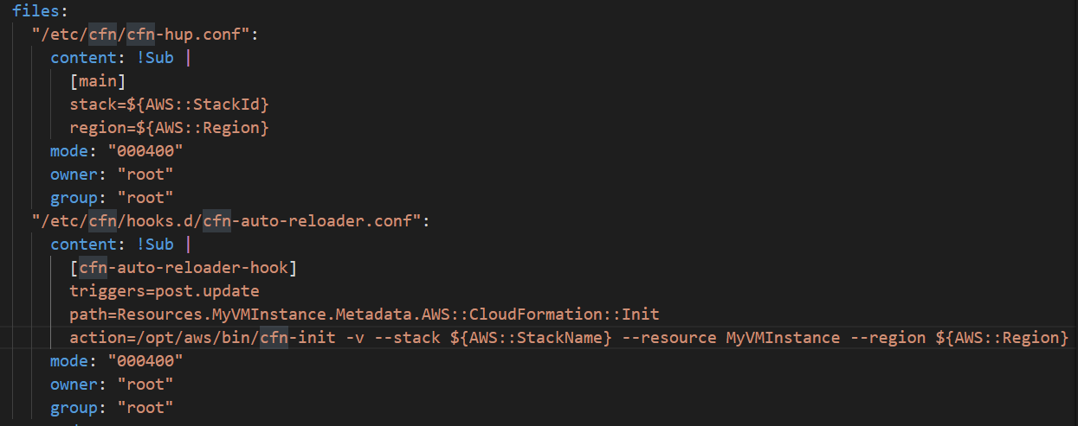
Step-06: Metadata: files
Syntax / Sample:

Slide 94
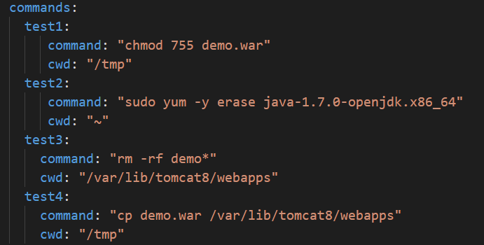
Step-07: Metadata: commands
We can use commands key to execute commands on EC2 Instance.
The commands are processed in alphabetical order by name.
Supported Keys
command
env
cwd
test
ignoreErrors
waitAfterCompletion
Syntax / Example:

Slide 95
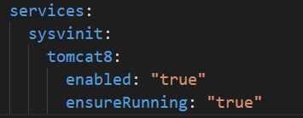
Step-08: Metadata: services
We can use services key to define which services should be enabled or disabled when the instance is launched.
On Linux systems this key is supported by using sysvinit.
On Windows systems, it is supported by using Windows Service Manager.
Services key also allows us to specify dependencies on sources, packages and files so that if a restart is needed due to files being installed, cfn-init will take care of the service restart.
Supported Keys
ensureRunning
enabled
files
sources
packages
commands

Slide 96
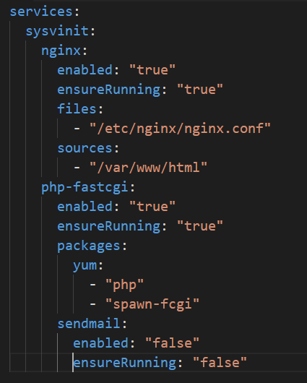
Step-08: Metadata: services
The nginx service will be restarted if either /etc/nginx/nginx.conf or /var/www/html are modified by cfn-init.
The php-fastcgi service will be restarted if cfn-init installs or updates php or spawn-fcgi using yum.
The sendmail service will be stopped and disabled.

Slide 97
UserData

Slide 98
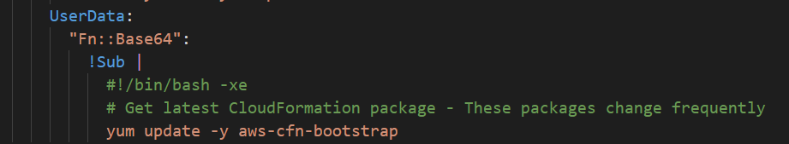
Step-09: UserData: aws-cfn-bootstrap
Helper Scripts are updated periodically.
We need to ensure that the below listed command is included in UserData of our template before we call the helper scripts to ensure that our launched instances get the latest helper scripts.

Slide 99
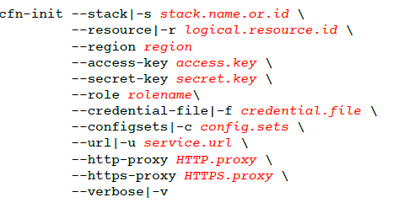
Step-10: UserData: cfn-init
The cfn-init helper script reads template metadata from the AWS::CloudFormation::Init key and acts accordingly to:
Fetch and parse metadata from AWS CloudFormation
Install packages
Write files to disk
Enable/disable and start/stop services
If we use cfn-init to update an existing file, it creates a backup copy of the original file in the same directory with a .bak extension.
cfn-init does not require credentials. However, if no credentials are specified, AWS CloudFormation checks for stack membership and limits the scope of the call to the stack that the instance belongs to.
Command Syntax:
Command Usage in UserData:

Slide 100

Step-11: UserData: cfn-signal
The cfn-signal helper script signals AWS CloudFormation to indicate whether Amazon EC2 instances have been successfully created or updated.
If we install and configure software applications on instances, we can signal AWS CloudFormation when those software applications are ready.
We can use the cfn-signal script in conjunction with a CreationPolicy.
Command Syntax:

Slide 101

Step-11: UserData: cfn-hup
Important Note: From here on we will start creating the stack using v12 template file, we will add cfn-hup command also to template UserData section even though we discuss that section in step 14. Reason for doing that is UserData related changes should be included during instance creation time only.
Final Look of UserData:

Slide 102

Step 12 - Outputs
Add outputs in the template.
We will add AppURL output for easily accessing the application after stack creation.
Sample

Slide 103
Step 12: Create Stack using template 11-12-cfn-init-v12-Outputs.yml
Observations
CloudFormation gets the signal as soon as VM Instance resource gets created.
In other words, we will see that stack status “CREATE_COMPLETE” even though in the back ground application installations are going on in the EC2 Instance.
With this approach we have problems like
Applications installs fails and we see the stack status as “CREATE_COMPLETE” in green.
We will not know what happened to our application installs or configurations until we login to instance.
To overcome such type of issues, we need to use “Creation Policy” which we will see in next step (step 13).

Slide 104
Step-13: Creation Policy
Associate the CreationPolicy attribute with a resource to prevent its status from reaching create complete until AWS CloudFormation receives a specified number of success signals or the timeout period is exceeded.
To signal a resource we can use cfn-signal helper script.
The creation policy is invoked only when AWS CloudFormation creates the associated resource.
Currently, the only AWS CloudFormation resources that support creation policies are
AWS::AutoScaling::AutoScalingGroup
AWS::EC2::Instance
AWS::CloudFormation::WaitCondition

Slide 105


Step-13: Creation Policy
Use the CreationPolicy attribute when you want to wait on resource configuration actions before stack creation proceeds.
For example, if we install and configure software applications on an EC2 instance, we might want those applications to be running before proceeding. In such cases, we can add a CreationPolicy attribute to the instance, and then send a success signal to the instance after the applications are installed and configured.
Syntax:

Slide 106

Step 13: Create Stack using template 11-13-cfn-init-v13-CreationPolicy.yml
Observations
CloudFormation waits for the status until application installs are completed for that particular resource (in our case its VM Instance).
Either it waits for success signal and if within specified time (time specified in creation policy) if it didn’t get success signal it roll backs the entire stack.

Slide 107


Step-14: UserData: cfn-hup
cfn-hup helper is a daemon that detects changes in resource metadata and runs user-specified actions when a change is detected.
This allows us to make configuration updates on our running EC2 Instance through the Update Stack feature.
cfn-hup.conf
cfn-hup.conf file stores the name of the stack and the AWS credentials that the cfn-hup daemon targets.
Format of cfn-hup.conf
We are creating this file using our Metadata Key named files in our template.
Format of cfn-hup.conf

Slide 108
Step-14: UserData: cfn-hup
cfn-hup.conf file content
stack
credential-file
role
region
umask (default: 022)
Interval (default: 15)
Verbose
hooks.d Directory
To support composition of several applications deploying change notification hooks, cfn-hup supports a directory named hooks.d that is located in the hooks configuration directory.
We can place one or more additional hooks configuration files in the hooks.d directory.

Slide 109


Step-14: UserData: cfn-hup - hooks.conf
User actions that cfn-hup daemon calls periodically are defined in hooks.conf.
Syntax:

Slide 110
Step-14: UserData: cfn-hup - hooks.conf
When the action is run, it is run in a copy of the current environment (that cfn-hup is in), with CFN_OLD_METADATA set to the previous value of path, and CFN_NEW_METADATA set to the current value.
The hooks configuration file is loaded at cfn-hup daemon startup only, so new hooks will require the daemon to be restarted.
A cache of previous metadata values is stored at /var/lib/cfn-hup/data/metadata_db
We can delete this cache to force cfn-hup to run all post.add actions again.

Slide 111
Step 14: Create Stack using template 11-14-cfn-init-v14-Update-App.yml
Observations
Old war file will be removed
New war file will be deployed successfully.
When we access the app new version of application content will be displayed.

Slide 112
Configsets

Slide 113
Configsets
We can create more than one config key and have cfn-init process them in a specific order.
Single Configset
Multiple Configset

Slide 114
configSets (Single)
Sample:
App1AndApp2
App1
App2

Slide 115
configSets (Multiple)
SingleAppCS
DualAppCS
default
App1
SingleAppCS
App2
DualAppCS
App1
SingleAppCS
App2
Sample:
App1

Slide 116

Step#1: Single Configset
We will define two config keys App1 and App2
We will create a configSet with name as App1AndApp2.
First App1 config key will get executed.
Next App2 config key will get executed.
Order of execution will be based on how we define them in configSets.
Observation
Both applications should be accessible
Sample:

Slide 117

Step#2: Multiple configSets
We have created 3 configSets
SingleAppCS
DualAppCS
default
SingleAppCS: Only App1 should be deployed.
Sample:

Slide 118
Step#3: Multiple configSets
We have created 3 configSets
SingleAppCS
DualAppCS
default
DualAppCS: Both App1 and App2 should be deployed
Sample:

Slide 119
Step#4: Multiple configSets
We have created 3 configSets
SingleAppCS
DualAppCS
default
default: default contains ConfigSet DualAppCS so both apps should be deployed. For default we don’t need to specify “--configSets default” it will pick automatically.
Sample:

Slide 120
Nested Stacks

Slide 121

Nested Stacks
The AWS::CloudFormation::Stack type nests a stack as a resource in a top-level template.
We can add output values from a nested stack within the root stack.
We use Fn::GetAtt function with nested stacks logical name and the name of the output value in nested stack
Syntax:

Slide 122

Nested Stacks – Practice – Create Templates
Step#0:
Step#1:
Step#2:
S3 Bucket
VPC Nested Stack Template
Root Stack Template
Create S3 bucket
This is required for uploading the Nested stack templates to S3
Create Parameters
Create Metadata
Create Resources
Create VPC
Create Subnets
Create Route Table
Associate Subnet & Route Table
Create IGW
Associate IGW to VPC
Create Route
Create Outputs
Test Template
Upload to S3
Create Parameters
Create Resources
Create VPC Stack
Create EC2 Instance
Create Outputs

Slide 123
Nested Stacks – Practice – Create Stack
Step#3:
For VPC Nested Stack
Root Stack
Create Root Stack
It automatically creates the vpc nested stack
VPC Nested Stack

Slide 124
Nested Stacks – Practice – Create Templates
Step#4
Step#5
Security Group Nested Stack Template
Root Stack Template
Create Parameters
Create Resources
Create VPC Stack
Create EC2 Instance
Create Outputs
Create Resource
Create Security Group Stack
Update VM Instance resource with security group
Create Parameters
Create Resources
Create Security Group
Create Outputs

Slide 125
Nested Stacks – Practice – Update Stack
Step#6:
For VPC Nested Stack
Root Stack
For Security Group Nested Stack
Create Root Stack
It automatically creates the vpc nested stack
Update Root Stack with new template.
It automatically creates the security group nested stack
VPC Nested Stack
Security Group Nested Stack

Slide 126
Nested Stacks – Practice – Update Stack 2
Step#7:
For VPC Nested Stack
Root Stack
For Security Group Nested Stack
Create Root Stack
It automatically creates the vpc nested stack
Update Root Stack with new template.
It automatically creates the security group nested stack
Highly Recommended Approach
Always perform updates from Root Stack
Never update nested stacks directly.
For Nested Stack Updates
Update SG nested stack with new security rule.
Upload the new template to S3
Update Root Stack with existing template.
VPC Nested Stack
Security Group Nested Stack
Update Stack

Slide 127
Nested Stacks – Practice – Delete Stack
Step#8:
Root Stack
Always Delete Root Stack
Recommendations
Always delete root stack.
Never delete nested stacks directly.
Whenever we delete the root stack associated nested stacks will get deleted automatically.
VPC Nested Stack
Security Group Nested Stack

Slide 128
Nested Stacks vs Outputs - Pending
A nested stack is a stack that you create within another stack by using the AWS::CloudFormation::Stack (p. 954) resource. With nested stacks, you deploy and manage all resources from a single stack.
You can use outputs from one stack in the nested stack group as inputs to another stack in the group. This differs from exporting values.
If you want to isolate information sharing to within a nested stack group, we suggest that you use nested stacks. To share information with other stacks (not just within the group of nested stacks), export values.
For example, you can create a single stack with a subnet and then export its ID. Other stacks can use that subnet by importing its ID; each stack doesn't need to create its own subnet. Note that as long as stacks are importing the subnet ID, you can't change or delete it.

Slide 129

CodeCommit
CodeBuild
CodeDeploy
CodePipeline
CloudWatch
Simple Notification Service
Amazon EC2
Continuous Integration
&
Continuous Delivery

Slide 130
Stages in Release Process
Source
Build
Test
Production
Check-in source code
Peer review new code
Compile Code & build artifacts (war files)
Unit Tests
Integration tests with other systems.
Load Testing
UI Tests
Security Tests
Deployment to production environments
Monitor code in production to quickly detect errors
Deployment to production environments
Monitor code in production to quickly detect errors

Slide 131
Stages in Release Process
Source
Build
Test
Production

Slide 132
Continuous Integration
Source
Build
Test
Production
Automatically kick off a new release when new code is checked- in
Build and test code in a consistent, repeatable environment
Continually have an artifact ready for deployment

Slide 133
Continuous Delivery
Source
Build
Test
Production
Automatically deploy new changes to staging environments for testing
Deploy to production safely without affecting customers
Deliver to customers faster
Increase deployment frequency, and reduce change lead time and change failure rate

Slide 134
AWS Developer Tools or Code Services
Source
Build
Test
Deploy
Monitor
AWS CodeCommit
AWS CodeBuild
AWS CodeBuild + Third Party
AWS CodeDeploy
AWS X-Ray
Amazon CloudWatch
AWS CodePipeline

Slide 135
AWS Developer Tools or Code Services
Source
Build
Test
Deploy
Monitor
AWS CodeCommit
AWS CodeBuild
AWS CodeBuild + Third Party
AWS CodeDeploy
AWS X-Ray
Amazon CloudWatch
AWS CodePipeline

Slide 136
AWS Developer Tools or AWS Code Services
Source
Build
Test
Deploy
Monitor
CodeCommit
CodeBuild
CodeBuild + Third Party
CodeDeploy
AWS X-Ray
CloudWatch
Version control
service
We can privately
store and manage
source code
Secure & highly
available
Fully managed build service, Compiles source code, Runs tests and produces software packages
Scales continuously and processes multiple builds concurrently.
No build servers to manage.
Pay by minute, only for compute resources we use.
Monitor builds through CloudWatch events.
Supports following programming language runtimes Ruby, Python, PHP, Node, Java, Golang, .Net Core, Docker and Android
Automates code deployments
to any instance and Lambda
Avoids downtime during
application deployment
Roll back automatically if
failure detected
Deploy to Amazon EC2,
Lambda, or on-premises servers
Monitors Source
check-ins and triggers
builds
Monitors builds
Monitors
Infrastructure
Collects logs
Continuous delivery service for fast and reliable application updates
Model and visualize your software release process
Builds, tests, and deploys your code every time there is a code change
Integrates with third-party tools and AWS
CodePipeline

Slide 137
CodeCommit
Build a simple rest service using Java Spring Boot.
Check-in code to Local Repo and push to CodeCommit.
Developer
Local Git Repo
push
AWS Cloud
AWS CodeCommit

Slide 138
CodeBuild – AWS Web Console
CodeBuild – AWS CloudFormation
Developer
Developer
Local Git Repo
Local Git Repo
push
push
AWS Cloud
CodeBuild Stack
AWS Cloud
CodeCommit
CodeCommit
CodeBuild
Service Role
CodeBuild
Simple Storage
Service (S3)
CodeBuild
Simple Storage
Service (S3)

Slide 139
CodeDeploy – AWS Web Console
CodeDeploy – AWS CloudFormation
User
accessing
Rest service
Developer
User
accessing
Rest service
Developer
Local Git Repo
Local Git Repo
Internet
push
Internet
push
AWS Cloud
CodeDeploy Stack
EC2 Apps Stack
AWS Cloud
CodeCommit
CodeCommit
CodeBuild
Service Role
CodeDeploy
Service Role
Role for EC2 Instance Profile
Staging EC2 Instance
CodeBuild
Simple Storage
Service (S3)
CodeDeploy
EC2 Instance
CodeBuild
Simple Storage
Service (S3)
CodeDeploy
Production EC2 Instance

Slide 140
CodePipeline – AWS Web Console
AWS Cloud
CodePipeline
Developer
CloudWatch
Local Git Repo
push
CodeCommit
CodeBuild
Simple Storage
Service (S3)
CodeDeploy
EC2
Instance

Slide 141
CodePipeline – AWS CloudFormation
AWS Cloud
CodePipeline
CI CD CloudFormation Stack
Developer
Local Git Repo
push
CodeCommit
CodeBuild
Simple Storage
Service (S3)
CodeDeploy
Simple Notification
Service
CodeDeploy
Staging EC2 Instance
Role for EC2 Instance Profile
Production EC2 Instance
Authorized
Approver
EC2 Apps CloudFormation Stack

Slide 142
Pre-requisites
Region: us-east-2 (ohio)
In templates, EC2 Instnace ImageID is hardcoded to this region (Amazon Linux AMI). If you want to test in other regions, please update the templates with ImageId equivalent to that respective region.
Default VPC
Ensure we have the default VPC created in the region where we are using these templates.

Slide 143
EC2 CloudFormation
Stack

Slide 144

EC2 CloudFormation Stack
Step 1: Create Security Group with port 22 and 8080 rules for inbound access.
Step 2: Create two EC2 Instances
Staging
Production
Update UserData
Step 3: Create Instance Profile Role and Instance Profile for EC2 Instances to access S3 Buckets.
Step 4: Create stack and verify.
AWS Cloud
VPC
Default VPC
Security group
Port 22 & 8080
Staging EC2 Instance
Role for EC2 Instance Profile
Production EC2 Instance
EC2 Apps CloudFormation Stack

Slide 145
AWS CodeCommit

Slide 146
AWS CodeCommit - Introduction
Version Control Service hosted by AWS
We can privately store and manage documents, source code, and binary files
Secure & highly scalable
Supports standard functionality of Git (CodeCommit supports Git versions 1.7.9 and later.)
Uses a static user name and password in addition to standard SSH..

Slide 147






CodeCommit – Integration with AWS Services
AWS CodeStar
AWS CodeBuild
AWS CodePipeline
AWS Cloud9
AWS Amplify
AWS CloudFormation
AWS CodeCommit
Amazon Simple Notification Service
AWS Key Management Service
AWS Elastic Beanstalk
AWS CloudTrail
Amazon CloudWatch

Slide 148
CodeCommit - Steps
Step#1: Sample Spring Boot Rest Application
Pre-requisites
Install STS IDE
Create Spring boot rest application.
Test it.
Step#2: GIT Repository
Create a local git repository and check-in code.
Create a remote git repository in AWS Code Commit.
Create Code Commit git credentials to connect.
Push the code to remote git repository.
Verify code in AWS Code Commit.
Step#3: CodeCommit Features
Code, Commits, Branches
Settings: Notifications, Triggers
Pull Requests
Developer
Local Git Repo
push
AWS Cloud
AWS CodeCommit

Slide 149
AWS CodeBuild

Slide 150
CodeBuild – AWS Web Console
CodeBuild – AWS CloudFormation
Developer
Developer
Local Git Repo
Local Git Repo
push
push
AWS Cloud
CodeBuild Stack
AWS Cloud
CodeCommit
CodeCommit
CodeBuild
Service Role
CodeBuild
Simple Storage
Service (S3)
CodeBuild
Simple Storage
Service (S3)

Slide 151
CodeBuild - Introduction
CodeBuild is a fully managed build service in the cloud.
Compiles your source code, runs unit tests, and produces artifacts that are ready to deploy.
Eliminates the need to provision, manage, and scale your own build servers.
It provides prepackaged build environments for the most popular programming languages and build tools such as Apache Maven, Gradle, and more.
We can also customize build environments in CodeBuild to use ourown build tools.
Scales automatically to meet peak build requests.

Slide 152


How to run CodeBuild?
How CodeBuild works?

Slide 153





Source
AWS CodeCommit
Amazon Simple Storage Service (S3)
GitHub
GitHub Enterprise
Bitbucket
Managed Image
AWS CodeBuild
Amazon CloudWatch
Logs
Amazon EC2 Container Registry
Amazon Simple Notification Service
External Container Registry
Amazon Simple Storage Service (S3)
Notifications
Environment
Artifacts
AWS CodeBuild Architecture

Slide 154
CodeBuild - Steps
Developer
Local Git Repo
Step#1: Create CodeBuild Project
Create a S3 bucket and folder
Create CodeBuild project
Start build, Verify build logs, Verify build phase details
Step#2: buildspec.yml & Start Build
Create buildspec.yml and check-in code
Start build, Verify build logs, Verify build phase details
Download the artifacts from S3, unzip and review
Run one more build and see versioning in S3.
Step#3: Create Build Notifications
Create state change notification
Create Phase change notification
push
AWS Cloud
AWS CodeCommit
AWS CodeBuild
Simple Storage
Service (S3)

Slide 155
AWS CodeBuild using CloudFormation

Slide 156
CodeBuild – CloudFormation Steps
Developer
Step 1 : Create S3 bucket and enable versioning or use existing bucket.
Step 2: Create buildspec.yml in our rest application and check-in code
Step 3: Create CodeBuild Stack Template
Create CodeBuild Role.
Create CodeBuild project.
Parameters
Step 4: Create Stack and Test the build.
Click on Start Build
Verify logs
Verify artifacts in S3.
Local Git Repo
push
AWS Cloud
CodeBuild Stack
CodeCommit
CodeBuild
Service Role
CodeBuild
Simple Storage
Service (S3)

Slide 157
AWS CodeDeploy

Slide 158




CodeDeploy - Introduction
Compute Platform
CodeDeploy is a deployment service that automates application deployments to
EC2 instances
On-premises instances
AWS Lambda
AWS ECS
We can deploy unlimited variety of application content
code
serverless AWS Lambda functions
web and configuration files
executables
packages
scripts
multimedia files
Amazon EC2
EC2 Auto Scaling
AWS CodeDeploy
On-Premise
AWS Lambda
Amazon ECS

Slide 159
CodeDeploy - Introduction
Benefits
We can rapidly release new features.
Update AWS Lambda function versions.
Avoid downtime during application deployment.
Reduces the complexity of updating applications when compared to error-prone manual deployments.
Service scales with our infrastructure so we can easily deploy to one instance or thousands.

Slide 160

CodeDeploy - When compute is EC2/On-Premise
Compute Platform
Revision Type / Source
Amazon EC2
Amazon Simple Storage Service (S3)
EC2 Auto Scaling
AWS CodeDeploy
GitHub
On-Premise
Elastic Load
Balancing (ELB)

Slide 161
CodeDeploy - Steps
Developer
Step#1: Create CodeDeploy pre-requisite roles
Create a service role for codeDeploy.
Create an IAM Instance profile.
Step#2: Create a EC2 VM
Create EC2 VM
During creation associate IAM instance profile.
Discuss about “Userdata” containing tomcat and codeDeploy Agent
Step#3: Create codeDeploy objects
Create Application
Create Deployment Group
Create Deployment
Step#4: Create codeDeploy files and scripts
Create appspec.yml
Create scripts (before_install script, after_install script, Start up script, Shutdown script) and check-in
Step#5: Run CodeBuild and Create Deployment
Step#6: Verify Deployment
Verify the deployment Events
Verify the tomcat deployment
Verify the codeDeploy agent log
Verify by accessing app
Step#7: New App Release: Make change to Application and re-deploy
Local Git Repo
User
accessing
Rest service
push
Internet
AWS Cloud
AWS CodeCommit
AWS CodeBuild
Simple Storage
Service (S3)
AWS CodeDeploy
Amazon EC2
Instance

Slide 162
AWS CodeDeploy using CloudFormation

Slide 163
CodeDeploy – CloudFormation Steps
User
accessing
Rest service
Developer
Step 1 : Discuss about appspec.yml and scripts.
Step 2: Create CodeDeploy service role
Step 3: Create CodeDeploy Application
Step 4: Create CodeDeploy Deployment Group and also change CodeBuild packaging to ZIP.
Step 5:Create stack and verify the following
Application
Deployment Group
Step 6: Create CodeDeploy Deployment
Create Deployment Object
Run CodeBuild and Verify S3 for ZIP
Update Stack
Verify Deployment
Access Application
Local Git Repo
Internet
push
AWS Cloud
CodeDeploy Stack
EC2 Apps Stack
CodeCommit
CodeBuild
Service Role
CodeDeploy
Service Role
Role for EC2 Instance Profile
Staging EC2 Instance
CodeBuild
Simple Storage
Service (S3)
CodeDeploy
Production EC2 Instance

Slide 164
AWS CodePipeline

Slide 165


AWS CodePipeline
AWS CodeCommit
AWS CloudFormation
Amazon Elastic Container Service
AWS CodeBuild
Amazon CloudWatch
Amazon EC2 Container Registry
AWS CodeDeploy
Amazon Elastic Container Service (Blue/Green)
Simple Storage
Service (S3)
AWS Elastic Beanstalk
Jenkins
GitHub Webhooks
Simple Storage
Service (S3)
GitHub
AWS Service Catalog
Source
Build
Deploy
Monitor Source Changes

Slide 166

Continuous Delivery
©Amazon

Slide 167
CodePipeline - Introduction
AWS CodePipeline is a continuous delivery service to model, visualize, and automate the steps required to release your software.
Benefits
Automate your release processes.
Establish a consistent release process.
Speed up delivery while improving quality.
Supports external tools integration for source, build and deploy.
View progress at a glance
View pipeline history details.

Slide 168
CodePipeline - Steps
Step#1: Create Pipeline
Artifacts: S3
Source: CodeCommit
Build: CodeBuild
Deploy: CodeDeploy
Server: EC2 Instance
Step#2: Make changes & Check-In Code
Make changes to rest app and check-in
Pipeline should trigger the build automatically.
AWS Cloud
AWS CodePipeline
Developer
Amazon CloudWatch
Local Git Repo
push
AWS CodeCommit
AWS CodeBuild
Simple Storage
Service (S3)
AWS CodeDeploy
Amazon EC2
Instance

Slide 169
CodePipeline – Manual Approval & Prod Deployment
Step#1: Create new EC2 Instance with tag name as prod
Step#2: Create new deployment group for prod
Step#3: Create Manual Approval stage in CodePipeline
Step#4: Create Prod Deployment stage in CodePipeline .
Step#5: Check-in changed code to trigger pipeline and monitor the pipeline process.

Slide 170
AWS CodePipeline using CloudFormation

Slide 171
Continuous Integration & Continuous Delivery using CloudFormation
AWS Cloud
CodePipeline
CI CD CloudFormation Stack
Developer
Local Git Repo
push
CodeCommit
CodeBuild
Simple Storage
Service (S3)
CodeDeploy
Simple Notification
Service
CodeDeploy
Staging EC2 Instance
Production EC2 Instance
Authorized
Approver
EC2 Apps CloudFormation Stack

Slide 172
CodePipeline – CloudFormation Steps
Step 1: Create CodePipeline role
Step 2: Create Pipeline stages for staging deployment
Stage 1: Source Stage
Stage 2: Build Stage
Stage 3: Deploy To Staging
Step 3: Create stack and verify the following
Stages: Source, Build, Deploy to Staging
Access Application in staging
Step 4: From IDE make changes to rest app and check-in code and verify the following
Stages: Source, Build, Deploy to Staging
Access Application in staging

Slide 173
CodePipeline – CloudFormation Steps
Step 5: Create SNS Topic and its equivalent parameter and add Production DeploymentGroup
Step 6: Create Pipeline stages for Production deployment
Stage 4: Production email Approval
Stage 5: Deploy To Production
Step 7: Create stack and verify the following
Confirm SNS Subscription in email
Stages: Source, Build, Deploy to Staging, Production email approval and Deploy to production.
Access Application in staging and production
Step 8: From IDE make changes to rest app and check-in code and verify the following
Stages: Source, Build, Deploy to Staging, Production email approval and Deploy to production.
Access Application in staging and production

Slide 174
Infrastructure as Code
using
AWS CloudFormation
and
AWS Web Console

Slide 175
Infrastructure as Code
Source
Build
Test
Production
Source Stage
Build Stage
Test Stage
Prod Stage
AWS CodeCommit
AWS CodeBuild
AWS CodePipeline
AWS CodePipeline

Slide 176
Infrastructure as Code
Source
Build
Test
Production
Source Stage
Build Stage
Test Stage
Prod Stage
Master Branch
Prepare or Validate
Template
Create & Execute
Change set
Create & Execute
Change set

Slide 177
Infrastructure as Code
Source
Build
Test
Production
Benefits
Track Infrastructure changes using version control system like AWS CodeCommit.
Release infrastructure changes using the same tools as code changes (AWS CodeCommit, CodeBuild and CodePipeline).
Replicate production environment in any environment as desired for continuous testing.
Make infrastructure changes repeatable.
Minimize infrastructure buildout time.
Seamless provisioning and de-provisioning of infrastructure resources in minutes or even reduced to seconds.

Slide 178
Infrastructure as Code – Manual AWS Web Console
AWS Cloud
Staging VPC Stack
CodePipeline
Action-1:
Test Stage
Create
Stack
VPC
Subnet
Developer
Internet gateway
Prod Stage
Route table
Source Stage
Prod VPC Stack
Build Stage
Action-1:
Create Change set
Local Git Repo
push
Action-2:
Prod
Approval
CodeCommit
CodeBuild
Simple Storage
Service (S3)
Simple Notification
Service
Authorized
Approver
Action-3:
Execute
Change set
VPC
Subnet
CodeBuild
Service Role
CodePipeline
Role
CloudFormation
Role
Internet gateway
Route table

Slide 179
Infrastructure as Code – CFN Template creation Flow
AWS Cloud
CI CD IAC Pipeline Stack
Staging VPC Stack
CodePipeline
Action-1:
Test Stage
Create
Stack
VPC
Subnet
Developer
Internet gateway
Prod Stage
Route table
Source Stage
Prod VPC Stack
Build Stage
Action-1:
Create Change set
Local Git Repo
push
Action-2:
Prod
Approval
CodeCommit
CodeBuild
Simple Storage
Service (S3)
Simple Notification
Service
Authorized
Approver
Action-3:
Subnet
Execute
Change set
VPC
CodeBuild
Service Role
CodePipeline
Role
CloudFormation
Role
Internet gateway
Route table

Slide 180
Infrastructure as Code – Execution Flow
AWS Cloud
CI CD IAC Pipeline Stack
Staging VPC Stack
CodePipeline
Action-1:
Subnet
Test Stage
Create
Stack
VPC
Developer
Internet gateway
Prod Stage
Route table
Source Stage
Prod VPC Stack
Build Stage
Action-1:
Create Change set
Local Git Repo
push
Action-2:
Prod
Approval
CodeCommit
CodeBuild
Simple Storage
Service (S3)
Simple Notification
Service
Authorized
Approver
Action-3:
Subnet
Execute
Change set
VPC
CodeBuild
Service Role
CodePipeline
Role
CloudFormation
Role
Internet gateway
Route table

Slide 181
Infrastructure as Code
using
AWS Developer Tools
on
AWS Web Console

Slide 182
Usecase
We will create a VPC CloudFormation stack using AWS CodePipeline.
Manage the AWS VPC infrastructure components like Subnets, Routes, Route Tables everything with AWS Developer Tools and CloudFormation.
Any changes to vpc infra, we will change the vpc.yml cfn template and check-in the code to AWS CodeCommit.
CodePipeline will trigger pipeline and push the changes to staging VPC Stack.
CodePipeline creates a Change Set for production.
Approve the Change set using SNS notification
Changes will be pushed to production VPC Stack after approval.
Finally we will achieve Continuous Integration, Continuous Delivery & Infrastructure as code after this usecase implementation.

Slide 183
Infrastructure as Code – Manual AWS Web Console
AWS Cloud
Staging VPC Stack
CodePipeline
Action-1:
Test Stage
Create
Stack
VPC
Subnet
Developer
Internet gateway
Prod Stage
Route table
Source Stage
Prod VPC Stack
Build Stage
Action-1:
Create Change set
Local Git Repo
push
Action-2:
Prod
Approval
CodeCommit
CodeBuild
Simple Storage
Service (S3)
Simple Notification
Service
Authorized
Approver
Action-3:
Execute
Change set
VPC
Subnet
CodeBuild
Service Role
CodePipeline
Role
CloudFormation
Role
Internet gateway
Route table

Slide 184
Infrastructure as Code – Manual AWS Web Console
Step 1: Understand about the VPC source files.
vpc.yml
vpc-config.json
buildspec.yml
Step 2: Create CodeCommit repository vpcrepo and check-in vpc source files.
Step 3: Create a pipeline with source and build stages.
Build stage fails and we will understand the causes of failure and fix it.
Create a CFN policy with validate CFN template permission and associate to CodeBuildRole.
Rerun the pipeline.
Build stage should pass now.
Step 4: Create a Test Stage which creates TestVPCStack
Role#1: Create CFN full access policy and associate it with CodePipeline role
Role#2: Create CFN VPC full access Role by associating “VPC Full Access policy” which is required by CloudFormation to create the VPC Stack.
Create Pipeline stage named VPCTest
Click “Release Change” after stage creation and verify the stack got created in CFN Console.

Slide 185
Infrastructure as Code – Manual AWS Web Console
Step 5: Create Prod Stage
Pre-requisite: Create SNS Topic
Action#1: Create Prod Change Set
Action#2: Create Prod Approval
Action#3: Create Execute Change Set
Verify the stack got created in CloudFormation console.
Step 8: Update vpc.yml with new subnet (subnet02) and check-in file to CodeCommit
Verify the pipeline stages
Source, Build, VPCStage
VPCProd
Create Change Set
Prod Approval
Execute Change Set
Verify the same in VPC

Slide 186
Infrastructure as Code
using
AWS CloudFormation

Slide 187
Infrastructure as Code – CFN Template creation Flow
AWS Cloud
CI CD IAC Pipeline Stack
Staging VPC Stack
CodePipeline
Action-1:
Test Stage
Create
Stack
VPC
Subnet
Developer
Internet gateway
Prod Stage
Route table
Source Stage
Prod VPC Stack
Build Stage
Action-1:
Create Change set
Local Git Repo
push
Action-2:
Prod
Approval
CodeCommit
CodeBuild
Simple Storage
Service (S3)
Simple Notification
Service
Authorized
Approver
Action-3:
Subnet
Execute
Change set
VPC
CodeBuild
Service Role
CodePipeline
Role
CloudFormation
Role
Internet gateway
Route table

Slide 188
Infrastructure as Code – Execution Flow
AWS Cloud
CI CD IAC Pipeline Stack
Staging VPC Stack
CodePipeline
Action-1:
Subnet
Test Stage
Create
Stack
VPC
Developer
Internet gateway
Prod Stage
Route table
Source Stage
Prod VPC Stack
Build Stage
Action-1:
Create Change set
Local Git Repo
push
Action-2:
Prod
Approval
CodeCommit
CodeBuild
Simple Storage
Service (S3)
Simple Notification
Service
Authorized
Approver
Action-3:
Subnet
Execute
Change set
VPC
CodeBuild
Service Role
CodePipeline
Role
CloudFormation
Role
Internet gateway
Route table

Slide 189
Infrastructure as Code – CloudFormation Pipeline
Step 1: Understand about the VPC source files.
vpc.yml
vpc-config.json
buildspec.yml
Step 2: Create CodeCommit repository vpcrepo and check-in vpc source files. (Note: check-in base vpc.yml and vpc-config.json)
Step 3: Create a CodeBuild related template objects
Create Parameters (Repo Name, Artifact storage bucket)
Create CodeBuild Role
Create CodeBuild Project
Step 4: Create Other roles
Create CodePipeline Role
Create CloudFormation Role

Slide 190
Infrastructure as Code – CloudFormation Pipeline
Step 5: Crete Pipeline stages
Source Stage
Build Stage
Test Stage
Step 6: Create Pipeline stage and actions for production
Create SNS Topic Resource
Create Parameter for email notifications.
Prod Stage
Action-1: Create Change Set
Action-2: Prod Approval
Action-3: Execute Change Set
Step 7: Add subnet02 in vpc.yml and verify the pipeline end to end.

Slide 191
Thank You

