Slide 1
uber case study 2020
PYTHON CAPSTONE PROJECT ---- BY SUDHIR MALIK

Slide 2
DATA ANALYSIS AND VISUALIZATION IN PYTHON

Slide 3
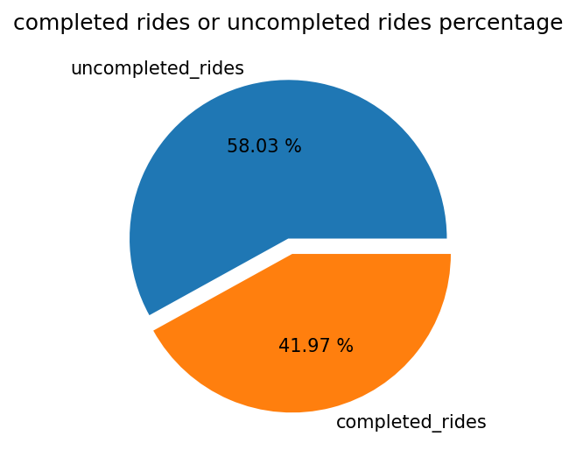
TOTAL COMPLETED RIDES AND UNCOMPLETED RIDES PERCENTAGE
THERE ARE MORE COMPLETED UNCOMPLETED RIDES THEN COMPLETED .
IT SHOWS THAT LOSS IS HUGE , THE SCOPE OF PROFIT IN FUTURE IS MORE .

Slide 4
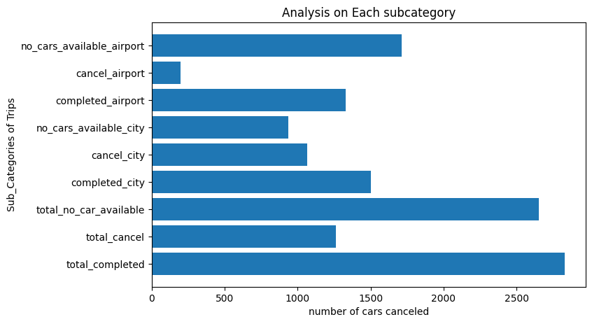
ANALYSIS ON EACH SUBCATEGORY
Here we can see further subcategories of trips .
CRITICAL ISSUES --
No car Available in Airport
Cancellation in city
NO car Available in Airport

Slide 5
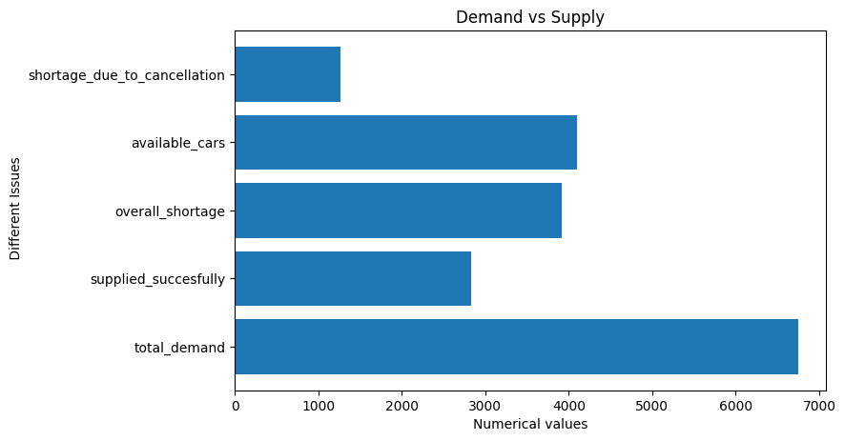
DEMAND VS SUPPLY
Now on this point it is clear that the suuply is really less and the Demand is very high
And the Reasons of Shortage also .

Slide 6
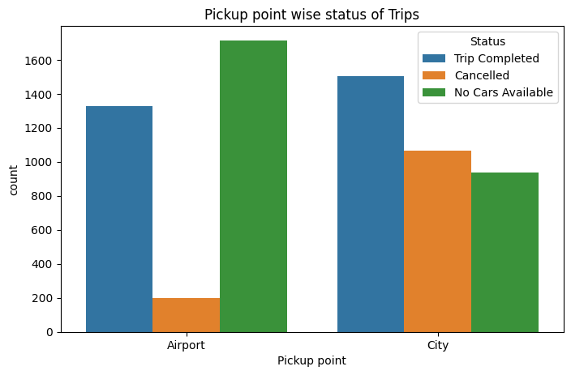
PICKUP POINT WISE STATUS OF TRIPS
Pickup point – AIRPORT
No car Available is super High in ratio of other and Cancellation is not a Big issue .
Pickup point – City
Cancellation and No cars Available is equally concern issue

Slide 7
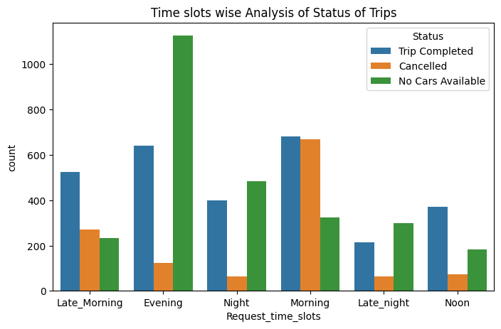
Time slots wise analysis of status of trips
Main issues find here in deep are
EVENING/NIGHT - NO CARS AVAILABLE ISSUES .
IN MORNING – CANCELLATION

Slide 8
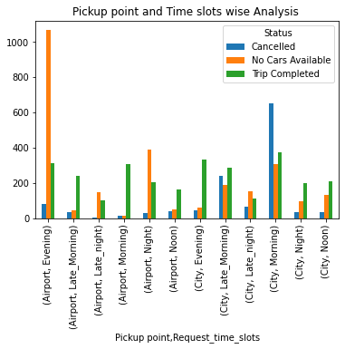
Pickup point and Time slots wise Analysis
NO cars Available in Evening/ Night but when pickup point is Airport then only it is more crucial issue .
Cancellation in Morning is the issue only when it is major issue when the pickup point is City .

Slide 9
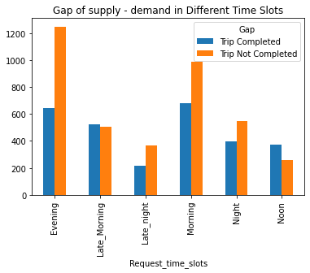
Gap of supply - demand in Different Time Slots
AS we see clearly the main Gap in Supply Demand is in Evening/morning/night shifts .
So the most concern Slots are these three .

Slide 10
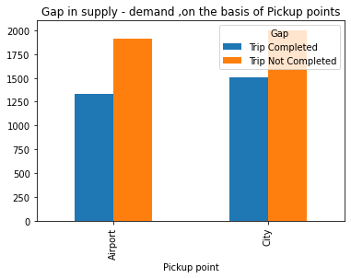
Gap in supply - demand ,on the basis of Pickup points
AS we can see the Gap b/w supply and demand is almost same for both The pickup points .

Slide 11
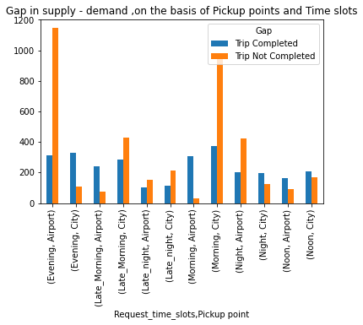
Gap in supply - demand ,on the basis of Pickup points and time slots
THE GAP IS THE MOST IN EVENING/NIGHT WHEN THE AIRPORT IS THE PICKUP POINT AND WHEN THE PICKUP POINT IS CITY THEN THE GAP IS MAXIMUM IN MORNING .

Slide 12
CONCLUSION OF THE CASE STUDY WITH SOLUTIONS .
#For Early morning/Morning - cancellation issue
1) We should provide some Incentives to the Drivers for AIRPORT RIDES/WAITING .
2) We should Make some policies for Our Drivers so that they make more money for the time they wait
in morning traffic by decreasing our commission .
3) If Drivers Cancel their Rides multiple times then we should give Penalty to Drivers
# For "NO CAR AVAILABLE " issue at Airport in EVENING/Night .
1) We should provide high Incentives specially for night times and for AIRPORT Rides and extra weightage to the rides .
2) We should make extra Stands for AIRPORTS .
3) We should provide Extra Cars at low cost EMI to drivers , so that as much as Drivers can connect to us
, And we can make profits in Long term .

