Slide 1
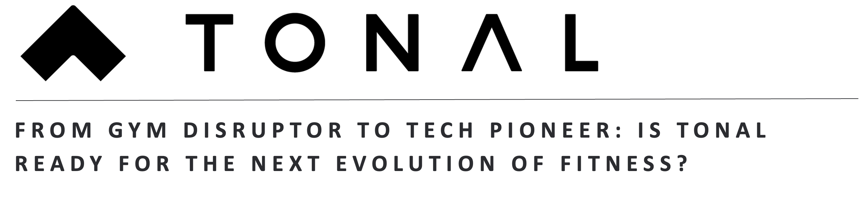
Amrit Chugani
Harsh Jain
Nupur Mohapatra
Sneh Pandey
Sudhire Rahul Karunakaran
Vaishnavi Cherukuri

Slide 2
Executive Summary
Amid the increasing consumer preference for gyms and the fluctuations in consumer spending patterns, the at-home fitness industry faces a precarious future
As budgets tighten, the fitness industry pivots to affordable options and social gym memberships, while rising disposable incomes drive innovation in premium home fitness tech, blending communal and at-home workouts
In the evolving fitness tech market, established brands will expand offerings, innovative startups will focus on AI personalization, and tech giants may enter with integrated health ecosystems
Strategic partnerships and building on existing AI capabilities will position Tonal for growth and innovation in a shifting social and economic landscape
Tonal must introduce affordable offerings to grow its customer base, expand through strategic partnerships and leverage its AI-driven strength training expertise to navigate this challenging landscape

Slide 3
Amid the increasing consumer preference for gyms and the fluctuations in consumer spending patterns, the at-home fitness industry faces a precarious future
S
T
E
E
P
SOCIETAL
TECHNOLOGICAL
ECONOMICAL
ENVIRONMENTAL
POLITICAL
As of 2023, gym usage has surpassed pre-pandemic levels, with a 60% increase in traditional gym check-ins during Q1 2024 compared to Q1 2023
Home workouts rose from 24% in 2019 to a 36% peak in 2021, dropping to 33% in 2022 as a hybrid model emerged
Gyms like Equinox and Lifetime Fitness are seen as aspirational status symbols due to their high fees and exclusive services, offering a sense of elite membership
Big tech players with their vast access of health data through wearables have a distinct advantage and can price out upstarts
Smart home gym equipment use AI and ML to adjust weights according to the exercise and can sometimes over optimize to reduce weight even when the consumer does not want to
Data privacy and security: These devices collect a lot of personal health and fitness data. There are concerns about how this data is stored, used, and shared with third parties
Traditional gym subscriptions typically cost around $25-$50 per month, whereas high-end home gym systems require a significant upfront investment of approximately $4000. Consumer willingness to pay for premium fitness solutions may shift as economic conditions fluctuate
The crowded fitness market demands differentiation. Companies that innovate in personalization, community engagement, or pricing models will have a competitive advantage
The future role of sustainability and eco-conscious products in shaping consumer fitness choices is still developing
Growing concerns about energy consumption and the push for carbon-neutral living could influence consumer choices
With the rapid pace of technological innovation, the lifespan of fitness equipment may shorten leading to regulatory pressures for companies to implement recycling programs or design repurposed
65% of consumers are concerned about how companies use their personal data in AI applications. The evolution of privacy regulations surrounding AI-powered fitness platforms could significantly influence industry practices
Government spending on public health programs is projected to reach $19.7 trillion globally by 2024.The influence of government health initiatives on shaping the fitness market and consumer behavior remains uncertain

Slide 4
As budgets tighten, the fitness industry pivots to affordable options and social gym memberships, while rising disposable incomes drive innovation in premium home fitness tech, blending communal and at-home workouts
Home fitness solutions Valued
Affordable Wellness
With reducing expenditure budget, the fitness industry focuses on providing cost- effective health solutions for the public. People look for more affordable equipment and focus on 'no-equipment' workouts. Companies simplify products to essentials, offering durable, tech-light options and affordable online programs.
Fitness Evolution
With rising disposable income, home fitness soars, making premium systems essential household items. Companies compete to deliver cutting-edge, AI-driven devices that personalize at-home workouts. Strong economy fuels demand for flexible, tech-enabled fitness, driving market growth and competition.
Economic Pressure Increases
CONSUMER PURCHASING
POWER FOR FITNESS SOLUTIONS
Economic Pressure Decreases
FITNESS SOLUTION PREFERENCES
Gym Resurgence
Affordable fitness subscriptions overpower the home fitness solution providers. With tighter budgets, consumers rely on flexible memberships and group classes. Companies partner with gyms to integrate budget-friendly tech that supports group exercise. Gyms become essential, community-focused spaces for fitness and social connection.
Social Workouts
Premium fitness offerings see a surge in memberships as people see in- person workouts as a community building experience. At- home fitness equipment become less appealing to the public and pushes the industry to work on offering a hybrid approach for the health enthusiasts. Increase in disposable income provides room for innovation for the at- home fitness solution providers.
Home fitness solutions Disfavored
Timeline : 6 years

Slide 5




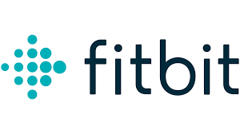













In the evolving fitness tech market, established brands will expand offerings, innovative startups will focus on AI personalization, and tech giants may enter with integrated health ecosystems
Home fitness solutions Valued
Incumbents hybridize, Insurgents emerge, Adjacents collaborate
Incumbents grow, Insurgents transform, Adjacents expand offerings
INCUMBENTS | INSURGENTS | ADJACENTS
Technogym: Introduce flexible payment plans and digital subscription services. Nautilus: Innovate and reduce cost on their compact multi-use equipment offerings | Peleton: Increase their video library and introduce affordable options of their premium products. Mirrors: Offer affordable membership and collaborate with fitness influencers. | Fitbit: Innovate nutrition tracking and collaborate with gyms for discounts. Nike: Offer discounts on apparels and collaborate with fitness influencers to create a rich content library.
INCUMBENTS | INSURGENTS | ADJACENTS
Peloton: Expand product line to include strength training equipment. NordicTrack: Integrate advanced AI for personalized workout experiences. | Tempo Studio: Enhance AI-driven feedback for more precise form correction. HydroRower: Develop hybrid rowing-strength training machines. | Apple: Launch comprehensive fitness ecosystem integrating wearables. Google Fitbit: Partner with equipment manufacturers to create AI-powered solutions.
Economic Pressure Increases
CONSUMER PURCHASING
POWER FOR FITNESS SOLUTIONS
Economic Pressure Decreases
FITNESS SOLUTION PREFERENCES
Incumbents go cheap, insurgents innovate, Adjacents integrate
Incumbents thrive, Insurgents rise, Adjacents disrupt
INCUMBENTS | INSURGENTS | ADJACENTS
Planet Fitness: Maintain its budget-friendly cost model and focus on promotions. Anytime Fitness: Offer promotion and leverage its location and 24/7 accessibility to differentiate. | Xponential : Innovate its diversified offerings through community fitness activities. Peleton: Introduce budget-friendly membership tiers on hybrid fitness and reduce its retail footprint. | Apple Fitness+: affordable offering and integrate wearable fitness tracking with gym memberships. Hammer Strength: Develop durable, lower cost variants of their premium products.
INCUMBENTS | INSURGENTS | ADJACENTS
Planet Fitness: Introduce tech equipment and virtual trainers in physical locations. Equinox: Develop premium hybrid memberships combining in-gym and at-home experiences. | Mirror: Create portable versions for gym use and expand content for in-gym workouts. FightCamp: Develop gym-based boxing classes with smart equipment. | Amazon: Launch fitness-focused Alexa devices for gym and home use. Microsoft: Develop mixed reality fitness experiences for gyms using HoloLens technology.
Home fitness solutions Disfavored
Timeline : 6 years

Slide 6



Strategic partnerships and building on existing AI capabilities will position Tonal for growth and innovation in a shifting social and economic landscape
DRIVERS
OPPORUNITIES
THREATS
STRATEGIC RESPONSE
Fitness Solution Preferences
As of 2023, gym usage has surpassed pre-pandemic levels, with a 60% increase in traditional gym check-ins during Q1 2024 compared to Q1 2023
Strategic Partnerships with Top Players: Collaborating with existing top brands will allow Tonal to combine brand strengths and expand customer bases through shared resources and expertise.
Low – Cost Fitness Integration: Through low-cost subscriptions with access to online classes and community challenges, Tonal can attract budget-conscious consumers
Community Driven Experiences: Tonal can host hybrid events that combine virtual and in-person experiences, such as live workout sessions, challenges, and meetups enabling increased user engagement
Leverage Advanced AI Features: ̌Tonal can differentiate itself by offering its AI capabilities to a variety of players in the fitness space and position itself as a tech leader in the fitness industry.
Economic Downturns: Consumers may prioritize essential expenses over discretionary spending on fitness equipment and a shift towards more affordable fitness options.
Changing Consumer Preferences: Potential shift back to traditional gym memberships with an increase of 60% in gym check-ins from 2023 to 2024.
Motivation and Engagement: Some users may find it challenging to stay motivated when exercising alone at home, leading to a higher dropout rate compared to group fitness settings.
Price Sensitivity : Competitors offering more affordable options could attract price-sensitive consumers, potentially shrinking Tonal's market share. The rise of DIY fitness and free online workout resources, which may appeal to cost-conscious consumers
Establish a strong community and expand brand partnerships
Building an exclusive community of Tonal users will enhance brand appeal and foster a sense of belonging and social interaction that surpasses the offerings of traditional gyms
Enrich brand image and enhancing user retention by creating seasonal events and creating economic incentives
Creating economic incentives for workouts fosters an engaging experience, while in-person events enhance brand visibility and position Tonal as an aspirational product that customers are willing to invest in.
Expand product offerings and license AI features to drive revenue which can reduce selling price
Improving the product and exploring licensing opportunities will boost revenue, enabling a reduction in selling price and making it more affordable for customers.
Consumer Purchasing Power
Traditional gym subscriptions typically cost around $25-$50 per month, whereas high-end home gym systems require a significant upfront investment of approximately $4000. Consumer willingness to pay for premium fitness solutions may shift as economic conditions fluctuate

Slide 7
Tonal must introduce affordable offerings to grow its customer base, expand through strategic partnerships and leverage its AI-driven strength training expertise to navigate this challenging landscape
NOW
NEXT
NEW
Grow customer base with fitness brand partnerships
Launch a freemium model to attract budget customers
Build a premium community through events
License advanced AI features
Launch Tonal Experience Centers
Support Multi-Activity Fitness Programs
Value
Establish economic incentives
Expand Corporate Wellness Programs
Update Premium Content
HORIZON 1
(0-2 years)
HORIZON 2
(2-4 years)
HORIZON 3
(4-6 years)
Time
Partner with top fitness brands like Orangetheory and SoulCycle to add strength training to their offerings and build an in-person community
Introduce a freemium, tiered subscription model offering basic workouts and tracking to attract price-sensitive customers and encourage long-term product engagement
Leverage city-based events, like run clubs, to offer Tonal’s high-net-worth users exclusive networking, social, and dating opportunities, building an elite community around the brand
Establish economic incentives around workout metrics to create a points system which users can use to buy tonal apparel, merchandise
Partner with corporations and health insurers to place Tonal units in corporate wellness centers and employee gyms increasing Tonal’s B2B reach.
Offer seasonal fitness series, holiday challenges, and exclusive classes led by guest influencers to keep subscribers engaged and improve retention
License Tonal’s advanced AI features (e.g., adaptive weight adjustment, form feedback) to gym chains(24-Hour Fitness or Equinox) and fitness app providers
Establish Tonal Experience Centers that offer customers an opportunity to try the product, engage in social workouts, driving brand awareness
Leverage Tonal's existing AI technology by developing software for additional fitness activities like Pilates, cycling, dance, and yoga, broadening the platform’s appeal
CAPABILITY BUILDING
Build on proprietary AI capabilities that go beyond fitness, integrating health monitoring, nutrition recommendations
Build retail and operational expertise, including store management, customer service, and physical product demonstration capabilities
Position Tonal as a tech leader by licensing AI, opening experience centers, and expanding into diverse fitness activities

Slide 8
Tonal must introduce affordable offerings to grow its customer base, expand through strategic partnerships and leverage its AI-driven strength training expertise to navigate this challenging landscape
NOW
NEXT
NEW
Focus on integrating AI capabilities across all product lines
Launch affordable subscription models in emerging economies
Implement privacy focused features across all products and services
Innovate using emerging AI capabilities to build sustainable products
Explore partnerships in health and wellness
Develop new features to anticipate user needs while maintaining data privacy
Value
Integrate AR/VR in existing devices and services offered by Apple
Explore opportunities in health and wellness
Update Product and Services catalogue to cater to localized markets
HORIZON 1
(0-2 years)
HORIZON 2
(2-4 years)
HORIZON 3
(4-6 years)
Time
Expand the capabilities of Siri and integrate with Apple AI to capitalize on the evolving technology
Develop new subscription models alongside existing ones for various services offered by Apple to reach a wider audience
Leverage the Privacy feature of Apple to build on and promote Private Cloud Computing for enhanced data protection
Invest in innovation around integration of AR/VR in existing devices at affordable price points
Focus on optimization of wearables and seamless integration and expansion in both physical and mental health wellness
Develop tailored products and services for emerging economies and explore local partnerships to enhance market penetration
Research brain-computer interfaces and explore quantum computing capabilities and its integration in consumer products
Partner with health and fitness providers, solutions and insurers to leverage the privacy policy and Apple ecosystem advantages
Create new features, services and products that better understand user needs and differentiates Apple from its competitors
CAPABILITY BUILDING
Build on existing devices to integrate emerging AI capabilities into the existing Apple ecosystem
Build products to tap into emerging markets and invest in innovation in wearables and health technology
Position Apple as Tech leader across various lines of products and innovator in the evolving AI environment

Slide 9
APPENDIX

Slide 10
Post Covid, declining interest in home fitness solutions drives consumers to take gym memberships. The home fitness industry deals with slow growth, reducing market share and profits.
Consumer preferences for home fitness solutions increases. The industry finds varied opportunities to capture market and make profit off the increasing demand for home fitness solutions.
Home- fitness solutions Disfavoured
Fitness Solution preferences
Home- Fitness solutions Valued
SOCIETAL
Ongoing inflation and rising consumer debt drives the public toward cheaper options, reducing demand for higher-priced equipment. The industry faces shrinking margins, cost pressures, and slowed growth.
Inflation stabilizes, and the industry adapts with flexible pricing and financing options. Public demand remains strong as the disposable income of the people increases.
Consumer purchasing power for fitness solutions
Economic Pressure Increases
Economic pressure Decreases
ECONOMIC

Slide 11
Tech giants face strict AI ethics laws, data localization requirements, and antitrust scrutiny. Companies navigate complex compliance landscapes, potentially limiting AI development and deployment.
Favorable regulations prioritize innovation over restrictions. Data privacy laws are relaxed allowing greater freedom in data collection and usage. Minimal regulations lead to rapid innovation.
Scrutiny and potential regulations on AI technologies
Regulatory pressure Increases
Regulatory pressure Decreases
POLITICAL
Recession impacts consumer spending and tech investments. Demand for high- end devices plummets and companies struggle to innovate and investments in research goes down.
Inflation stabilizes, and consumer spending on premium devices increases. Corporate investments in cloud services see a surge and companies invest in research and development.
Consumer purchasing power for high priced technology
Economic Pressure Increases
Economic pressure Decreases
ECONOMIC

Slide 12
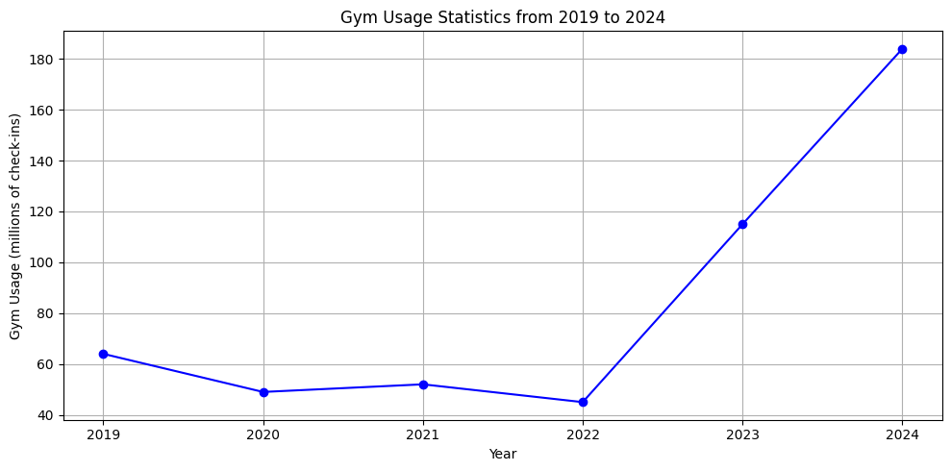
2019: Gym usage was around 64 million check-ins.
2020: There was a significant drop to about 49 million check-ins, likely due to the COVID-19 pandemic.
2021: A slight increase to approximately 52 million check-ins.
2022: Another slight decrease to about 45 million check-ins.
2023: A substantial jump to around 115 million check-ins.
2024: A dramatic increase to 184 million check-ins.
Charts are AI generated

Slide 13
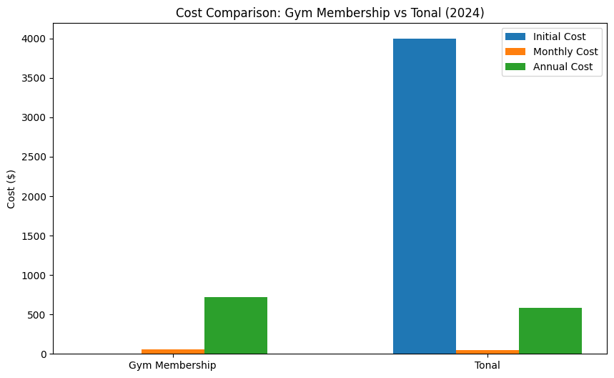
This bar chart compares the costs associated with a gym membership versus owning a Tonal home gym system in 2024. It shows:
Initial Cost: Tonal has a high upfront cost of $3,995, while gym memberships typically have no initial cost.
Monthly Cost: Gym memberships have a slightly higher monthly cost compared to Tonal's subscription.
Annual Cost: The annual cost for a gym membership is higher than Tonal's annual subscription cost.

Slide 14
REFERENCES
https://fortune.com/well/article/gym-use-increase-pandemic-gen-z/
https://www.exercise.com/grow/fitness-industry-recession/
https://www.forbes.com/sites/benmidgley/2018/09/26/the-six-reasons-the-fitness-industry-is-booming/
https://www.cnet.com/health/fitness/tonal-review/
https://blog.chaddickerson.com/2023/09/14/tonal-home-gym-review/
https://www.mensjournal.com/health-fitness/tonal-review
https://www.whipsaw.com/work/tonal-strength-training-system
https://www.smallbizgenius.net/by-the-numbers/fitness-industry-statistics/
https://www.fool.com/the-ascent/personal-finance/articles/this-is-how-much-the-average-american-really-spends-on-gym-memberships/
https://renewbariatrics.com/gym-membership-statistics/

