Slide 1



WHO AM I
SECURITY TEST ANALYST/PEN TESTER
Working for OS GB
Survey and produce maps for various govt. organisations
Produce maps nationally and international (e.g. Ghana)

Slide 2


Other side of me
Coding enthusiast
Cricket and volleyball player
Photography (portraiture, macro)
Licensed pharmacist

Slide 3
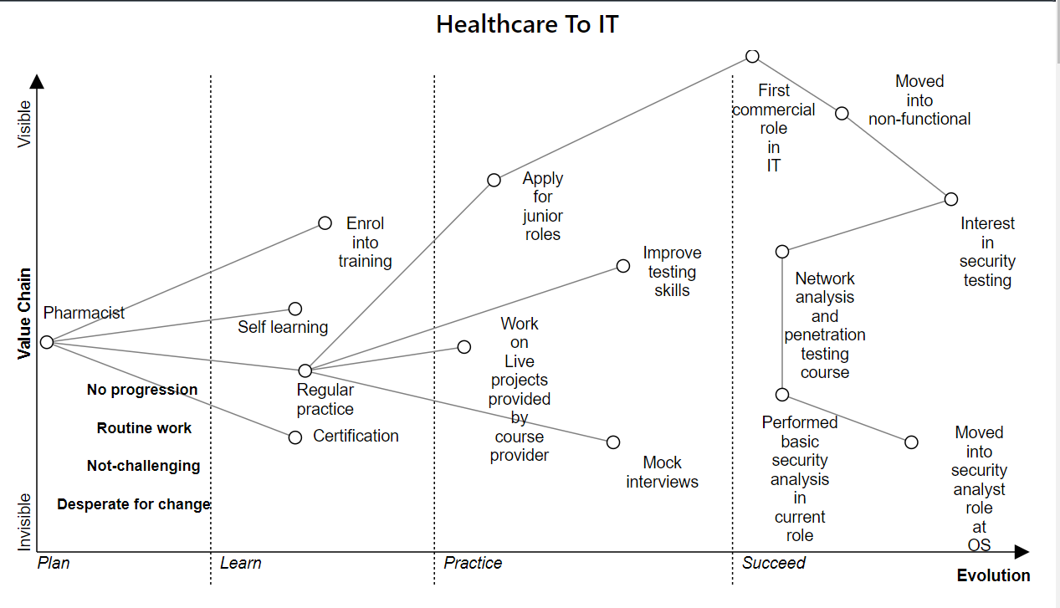















Slide 4
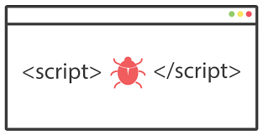
Attack on IT System
XSS
Cross site scripting (XSS) is a type of computer security vulnerability typically found in web applications, which allows attackers to inject java script code to steal cookies that lead to session hijacking.

Slide 5
Threat Analysis
Attack Point:
All the input fields in the web application and the Malicious urls.
Severity Level:
Critical
Attack Techniques:
Inject malicious java script code to steal cookie or create a malicious link and send it to attacker.
Eg: <script>alert(document.cookie)</script>
Main Remediation: Input validation or sanitization and security headers

Slide 6
Risk
XSS Vulnerability rated as critical.
Potential for damage is high. (spoofed identities etc.,)
Cookie can be stolen any time but is only useful until expired.
Anybody can run a packet sniffer; XSS Attacks require Moderate skill.
All users could be effected in stored XSS but in reflected XSS all users won’t click malicious links.
Easy to find/Attack: just check with <script>alert(1)</script>

Slide 7
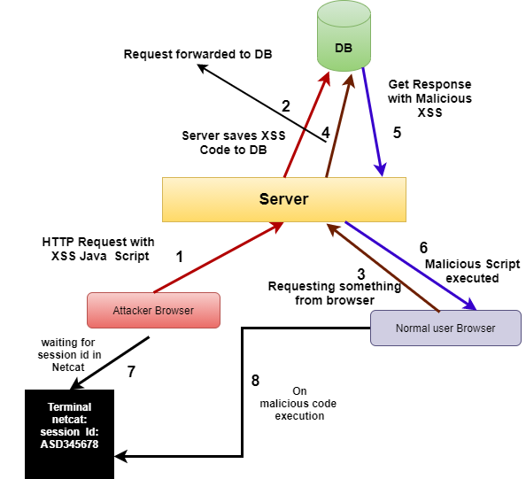
Attack Tree

Slide 8
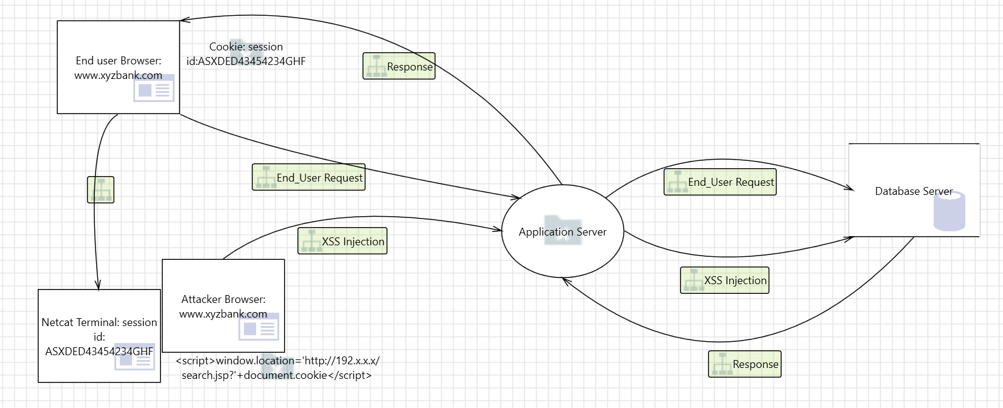
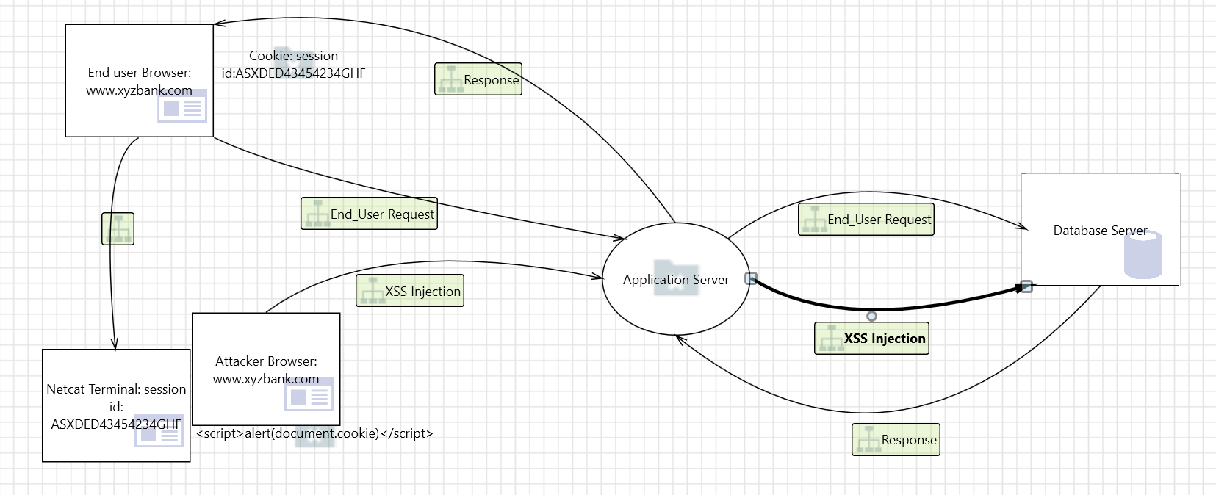
Threat Modelling

Slide 9

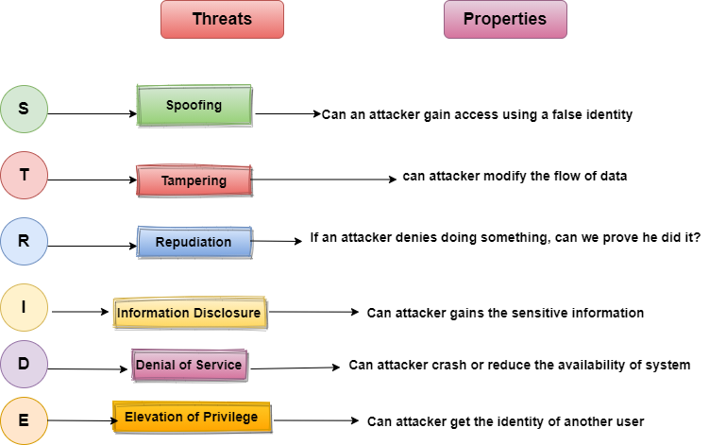
STRIDE Methodology

Slide 10
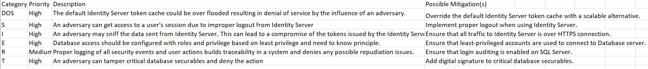
STRIDE Methodology (Few Vulnerabilities and Mitigations)

Slide 11
Questions?

