Slide 1
Named Entity Recognition
By: Sudhir Kumar
Email: sudhirln92@gmail.com

Slide 2
Introduction
Named-entity recognition (NER) is a problem that has a goal to locate and classify named entities mentioned in unstructured text into pre-defined categories such as person names, organizations, locations, medical codes, time expressions, etc.
Data Processing: Processing text
BERT (Bidirectional Encoder Representations from Transformers) is a neural network that is capable of parsing language in the same way a human does. It uses word embeddings to translate words into numbers and then back again, allowing it to understand word context and meaning.
AWS SageMaker Training And Deployment use Amazon SageMaker to quickly build, train, and deploy machine learning (ML) models at any scale. As a proactive measure against model degradation, you can use Amazon SageMaker Model Monitor to continuously monitor the quality of your ML models in real time.

Slide 3
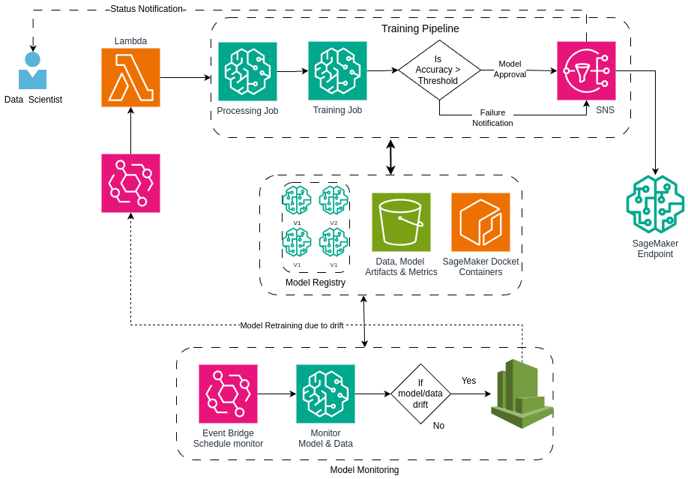
AWS Architecture

