Slide 1
Title
Authored by: Sudhir Sharma Presented by : Sudhir Sharma
1

Slide 2
Agenda
Day 1
Introduction to Angular
MVC
Module
Scope
Controllers
Expressions
Two Way Binding
Directives
Filter
Validation
Day 2
Bootstrapping of AngularJS
Event loop (Digesting cycle)
Scope
Dependency Injection
Controllers and Service
Promise Reslove
Day 3
Custom Directive
Communication
Routing
2

Slide 3
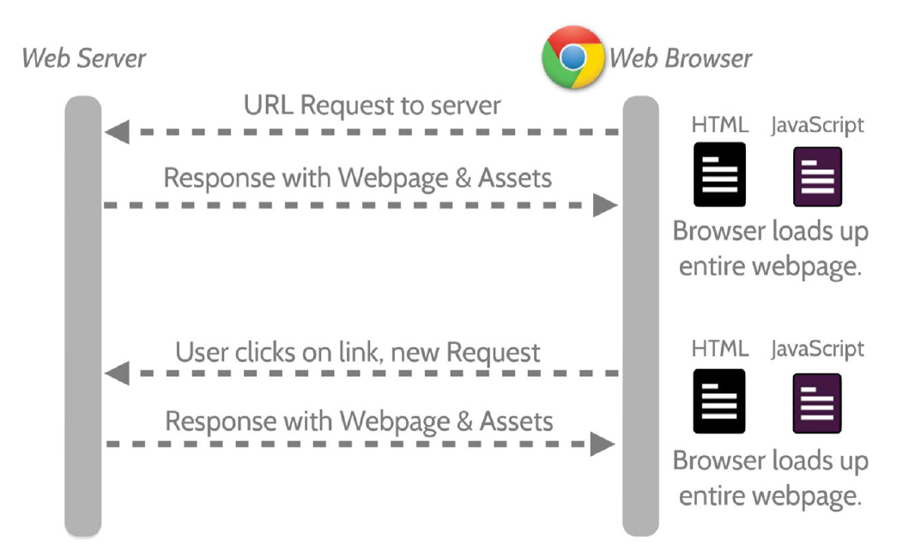
Introduction – Angular JS

Slide 4
Introduction – Angular JS
MV* Javascript Framework by Google for Rich Web Application Development
Open Source
GitHub: https://github.com/angular/angular.js
MIT License
Uses jQuery
jQuery 1.7.1 or above
jQLite
Load AngularJS
Add angular.js in your HTML
Create the module
Apply angular attribute to html
4
Notes:
4

Slide 5
MVC
Model
The data
Controller
The behavior
Modifying / updating the models
View
The interface
How the data is presented to the user
JavaScript
HTML
5
Notes:
5

Slide 6
Module
Using modules gives us a lot of advantages, such as:
Keeping our global namespace clean
Making tests easier to write and keeping them clean so as to more easily target isolated functionality
Making it easy to share code between applications
Allowing our app to load different parts of the code in any order
Using modules gives us a lot of advantages, such as:
a module is the main way to define an AngularJS app
declare a module using the angular.module()
An app can contain several modules, each one containing code that pertains to specific functionality.

Slide 7
Controllers and Scope
Controller is a JavaScript constructor function that is used to augment the Angular Scope.
The purpose of controllers is to expose variables and functionality to expressions and directives.
Controller is attached to the DOM via the ng-controller directive,
Use controllers to:
Set up the initial state of application’s model ($scope object).
Add behaviour to view through the $scope object.
Do not use controllers to:
Manipulate DOM
Format input
Filter output
Share code or state across controllers
7
Notes:
7

Slide 8
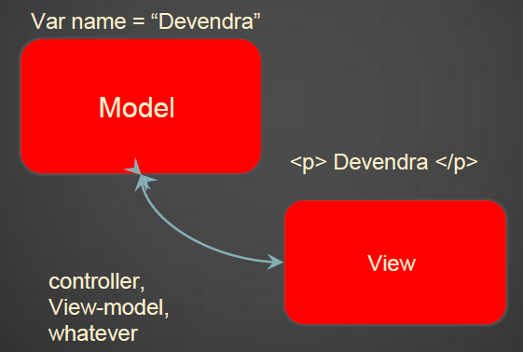
Data Binding
Automatic synchronization of data between the model and view.
Model - as single source of the truth
When the model changes, view reflects the same and vice versa using scope and $watch
Controllers do not need to directly manipulate the view
Changes in the models / data are automatically reflected in the view
Updates are managed by the frameworks
8
Notes:
8

Slide 9
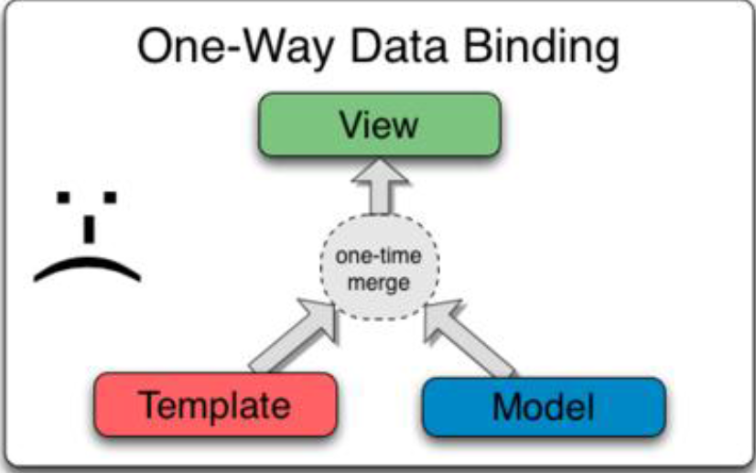
1 Way Data Binding
9
Notes:
9

Slide 10
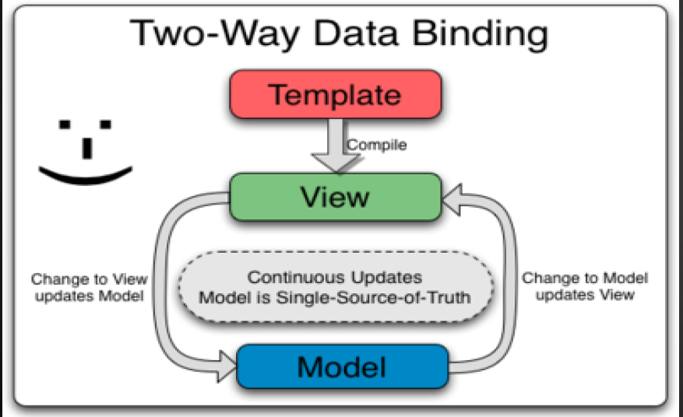
2 Way Data Binding
10
Notes:
10

Slide 11
View
Make use of special ng attributes (directives) on the HTML elements
ng-app - Determines which part of the page will use AngularJS, If given a value it will load that application module
ng-controller- Determines which Javascript Controller should be used for that part of the page
ng-model - Determines what model the value of an input field will be bound to Used for two-way binding
Ng-<event> : Execute the event in angular context
CSS class and Style ng-class and ng-style - Takes expression, result of expression will be a class to be applied
11
Notes:
11

Slide 12
Directive
At a high level, directives are markers on a DOM element
4 Type of directive
element
Attribute
comment
CSS
Built in Directives: ng-model, ng-bind, ng-repeat
AngularJS event listener directives:
ng-click, ng-dbl-click
ng-mousedown, ng-mouseup, ng-mouseenter, ng-mouseleave, ng-mousemove, ng-mouseover
ng-keydown, ng-keyup, ng-keypress
ng-change
12
Notes:
12

Slide 13
Filter
Function to format your input to output
In built filters
Filters in view templates
{{expression | filter}}
{{expression | filter:argument1, ...}}
Custom filters
13
Notes:
13

Slide 14
Validation
Angular Form Properties
$valid,$invalid,$pristine,$dirty
Validation Rules
Ng-required
Ng-minlength
Ng-maxlength
Ng-pattern
Ng-change
Disabling HTML5 Validation
Novalidate
Disabling the Submit Button
Ng-disabled
Custom validations
14
Notes:
14

Slide 15
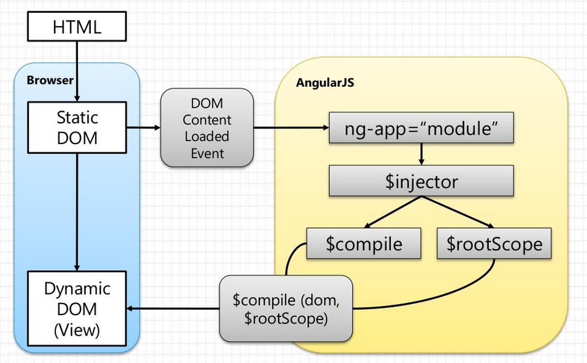
Bootstrapping of AngularJS
15
Notes:
15

Slide 16
Bootstrapping of AngularJS
Angular Script is evaluted when document.readyState is complete
Important step
Load Module associated with ng-app
Create the Injector
Compile the DOM treating the ng-app as root of compilation, processing any directives and bindings found along the way
During compilation injector create the root scope treating ng-app as root that will become the context for the model of our application.
Wait for incoming browser events that might change the model. Once such an event occurs, it will execute the event loop
16
Notes:
16

Slide 17
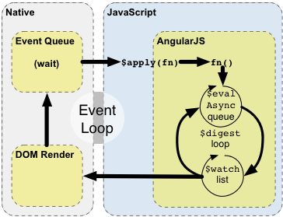
Event Loop
17
Notes:
17

Slide 18
Event Loop
Enter the Angular execution context by calling scope.$apply(someFunction)
Angular executes the stimulusFn(), which typically modifies application state.
Angular enters the $digest loop, which execute 2 small loop
The $evalAsync queue is used to schedule work which needs to occur outside of current stack frame, but before the browser's view render. This is usually done with setTimeout(0), but the setTimeout(0) approach suffers from slowness and may cause view flickering since the browser renders the view after each event.
The $watch list is a set of expressions which may have changed since last iteration. If a change is detected then the $watch function is called which typically updates the DOM with the new value.
Once the Angular $digest loop finishes the execution leaves the Angular and JavaScript context
18
Notes:
18

Slide 19
Scope
Scope is an object that refers to the application model.
Scope characteristics
$watch API to observe model mutations
$apply API to propagate any model changes
Scope as Data-Model
glue between application controller and the view.
During the template linking phase the directives set up $watchexpressions on the scope
Scope Hierarchies
$rootscope - singleton object
Isolation →Directive
Nesting → Controller
Shadow property → Parrent clinet controller
Scope Events Propagation
broadcasted
Emitted
19
Notes:
19

Slide 20
Scope...
Scope life cycle
Creation
Watcher registration
Model mutation
Mutation observation
Scope destruction
20
Notes:
20

Slide 21
Dependince injection
Software design pattern
❖ Deals with how components resolve their dependencies
❖ $injector in Angular
Creates components
Resolve dependencies
Provide them as and when requested
Dependency annotation
Implicit annotation - will not work in minification:
myApp.controller(“myAppController”, function($scope, customService) {})
// Assime function parameter name are the name of dependency, won't work in minification
$inject property annotation:
var myAppController = function($scope, customService){};
myAppController.$inject(‘$scope’, ‘customService’);
myApp.controller(‘myAppController’. MyAppController);
//order is importent, unnecessery temporary variable
Using the inline arrays:
myApp.controller(“myAppController”, [‘$scope’, ‘customService’, function() {}])
21
Notes:
21

Slide 22
Service
Services are substitutable objects that are wired together using dependency injection (DI). You can use services to organize and share code across your app.
Using a Service :you add it as a dependency for the component (controller, service, filter or directive) that depends on the service. Angular's dependency injection subsystem takes care of the rest.
Explicit Dependency Injection
Inline array injection annotation (preferred):
$inject property:
Implicit Dependency Injection
Creating Services
Application developers are free to define their own services by registering the service's name and service factory function, with an Angular module.
Dependencies
22
Notes:
22

Slide 23
Routing
Using Angular module ngRoute.
❖Distributed separately from core framework.
❖Application routes are provided by $routeProvider - provider of $route service.
❖$route is used in conjunction with ng-view.
❖Providers should be injected into config function only.
23
Notes:
23

Slide 24
Directives
Restrict option
➢‘A’ - Attributes
➢‘E’- Element
➢‘C’- Class
Prefixes for scope
➢“@” Text binding / One way binding (Local soope properties)
➢“=” Direct model binding / Two way binding
➢“&” behavior binding / method binding (Parent execution binding)
Link function
➢Code to be run after compilation
➢DOM manipulation in link function
➢Child directives link function get executed first.
Controller function
➢Code to be run at compile time
➢Dir to dir communication
➢To expose an API to other directives
Other Option
➢Priorty
➢Template (string|function) & Template URL
function takes two arguments – tElement and tAttrs, and return string value representing html
➢replace (boolean)
➢transclude is optional
Controller (String | functuion) -
24
Notes:
24

Slide 25
Communication
❖Directive to Controller communication ()
❖Directive to Directive communication
❖Controller-Controller communication
Broadcast service
Emit
25
Notes:
25

Slide 26
Promise-Resolve
❖$q – helps you run function asynchronously
❖Deffered API: New instance can be created using $q.defer()
❖Promise API: new instance will get created when we create defer object.
❖Create $q.defer()
❖Resolve on data
❖Reject on error
26
Notes:
26

Slide 27
Any Questions?
27

Slide 28
Test Your Knowledge Quotient for <Topic Name>…
Q1)
Q2)
Q3)
Q4)
Q5)
Q6)
Q7)
Q8)
Q9)
Q10)
28

Slide 29
Thank you!
29

