Slide 1

JQUERY

Slide 2
JQUERY
jQuery is a small, fast and lightweight JavaScript library.
jQuery is platform-independent.
jQuery means "write less do more".
jQuery simplifies AJAX call and DOM manipulation.
Adding jQuery to Your Web Page
Download the jQuery library from jQuery.com
Include jQuery from a CDN, like Google

Slide 3
Syntax
$(selector).action()
A $ sign to define/access jQuery
A (selector) to "query (or find)" HTML elements
A jQuery action() to be performed on the element(s)
Example:
$(“h1").hide() - hides all <p> elements.
Document Ready Event
$(document).ready(function(){ // jQuery methods go here... });

Slide 4
jQuery Selectors
jQuery selectors allow you to select and manipulate HTML element(s).
jQuery selectors are used to "find" (or select) HTML elements based on their name, id, classes, types, attributes, values of attributes and much more. It's based on the existing CSS Selectors, and in addition, it has some own custom selectors.
All selectors in jQuery start with the dollar sign and parentheses: $().
The element Selector
The jQuery element selector selects elements based on the element name.
$("p")

Slide 5
The #id Selector
The jQuery #id selector uses the id attribute of an HTML tag to find the specific element.
$("#test")
class Selector
$(".test")
---Site---
jQuery Effects
jQuery enables us to add effects on a web page. jQuery effects can be categorized into fading, sliding, hiding/showing and animation effects.

Slide 6
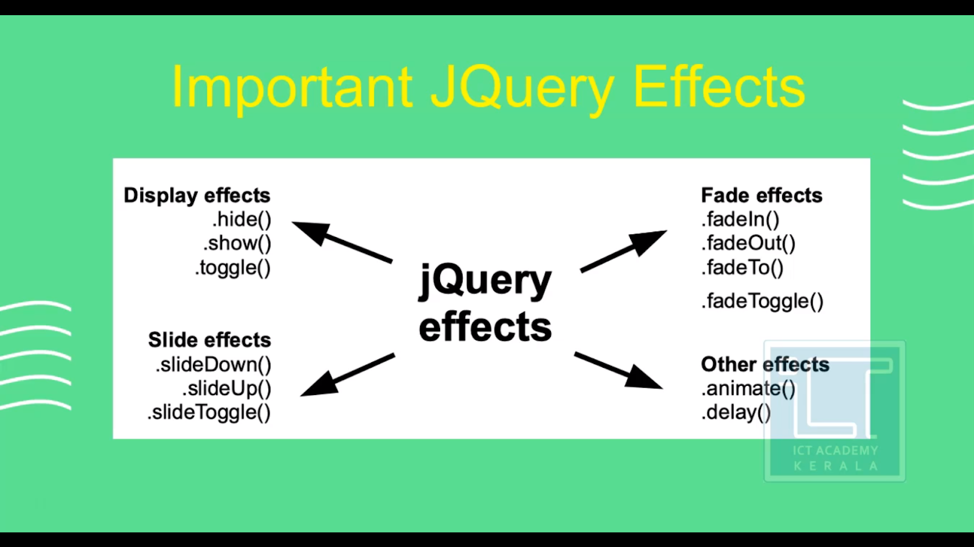

Slide 7
jQuery - css() Method
<script>
$(document).ready(function(){
$("button").click(function(){
$("p").css("background-color", "yellow");
});
});
</script>
jQuery AJAX
jQuery load() Method
The load() method loads data from a server and puts the returned data into the selected element.

Slide 8
jQuery - AJAX get() and post() Methods
The jQuery get() and post() methods are used to request data from the server with an HTTP GET or POST request.

