Slide 1


SMART INDIA HACKATHON 2025
TITLE PAGE
Problem Statement ID – 25050
Problem Statement Title- Smart Traffic Management system for urban congestion
Theme- Transportation and logistics
PS Category- Software
Team Name- Team DUI

Slide 2
Solving traffic Using MARL models
Team DUI
Uniqueness of our solution
Builds on QMIX but extends it with richer real-world traffic data integration.
Leverages MARL cooperation, enabling global optimization beyond local decisions.
Data-driven approach ensures adaptability across cities and conditions.
Outperforms traditional systems in efficiency, coordination, and sustainability.
Grounded in latest MARL research, while moving beyond simulation to practical deployment.
A Custom Dashboard And A Sim
A user-friendly dashboard displays real-time traffic metrics, agent decisions, and performance statistics, allowing city authorities to monitor, analyze, and fine-tune traffic control strategies effectively.
This also allows the user to do manage traffic hands on, providing a safe guard against any malfunctions
SUMO is a very helpful tool which allows a lot of customizability.
Proposed Solution
Using Multi-Agent Reinforcement Learning (MARL) to control traffic lights, where each signal acts as an intelligent agent.
Start with QMIX as the baseline algorithm for cooperative learning.
Integrate traffic data from OpenCV along with contextual features (time of day, road layout, etc.) to guide learning.
The baseline model was trained in a SUMO simulation environment to achieve a reliable level of performance.
Addressing The Problem
Adapts in real-time: Unlike fixed timers (like in Odisha), our system actually learns and adjusts to current traffic instead of running on a set schedule.
Cuts congestion: By letting traffic lights “talk” to each other, intersections don’t get stuck and long queues are avoided.
Saves time & fuel: Less waiting at red lights means smoother flow, lower fuel use, and fewer emissions.

Slide 3
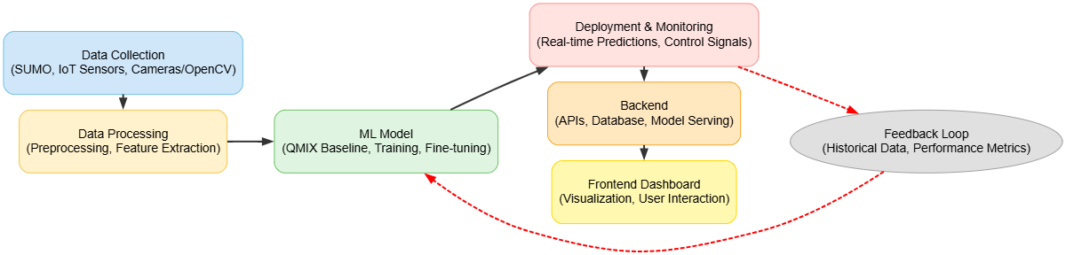
TECHNICAL APPROACH
Team DUI
Software
Front End: HTML, JavaScript, CSS
Back End: Python (Flask)
Simulator: SUMO
AI/ML Model Code: Python
Connector: TraCI API
Module for Traffic Volume: Python (OpenCV)
Hardware
IOT sensors, Cameras, Traffic lights
Process Flow Architecture

Slide 4
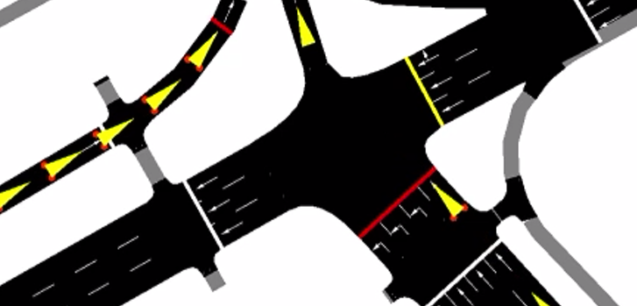
FEASIBILITY AND VIABILITY
Team DUI
Why is it feasible?
Proven approach: MARL with QMIX has shown success in multi-agent coordination, making it suitable for traffic optimization.
Simulation support: SUMO provides a realistic environment for training and benchmarking models.
Scalable design: Centralized training and decentralized execution allow stepwise deployment, from single intersections to citywide networks.
Impact: Long-term benefits include reduced congestion, fuel savings, lower emissions, and improved travel times.
Overcoming the challenges
Domain adaptation & transfer learning: Bridge the gap between SUMO simulations and real-world deployment.
Advanced MARL methods: Use hierarchical or graph-based MARL to manage large-scale road networks efficiently.
Data integration: Combine OpenCV datasets with sensor, GPS, and crowdsourced mobility data.
Incremental deployment: Start with hybrid AI-assisted systems in areas with limited infrastructure.
QMIX Variation- Using a different variation of QMIX like QTRAN++ can improve scalability of the model.
Potential Challenges and risks
Simulation-to-reality gap: Models trained in SUMO may not directly translate to real-world conditions.
Scalability: Coordinating a large number of intersections increases complexity and is hard.
Data limitations: Real-time traffic data may be inconsistent or unavailable in some areas.
Infrastructure readiness: Not all cities have the digital systems needed for MARL-based control.
In India: A QMIX model hasn’t been used within India’s context, so it may lead to some very glaring issues

Slide 5
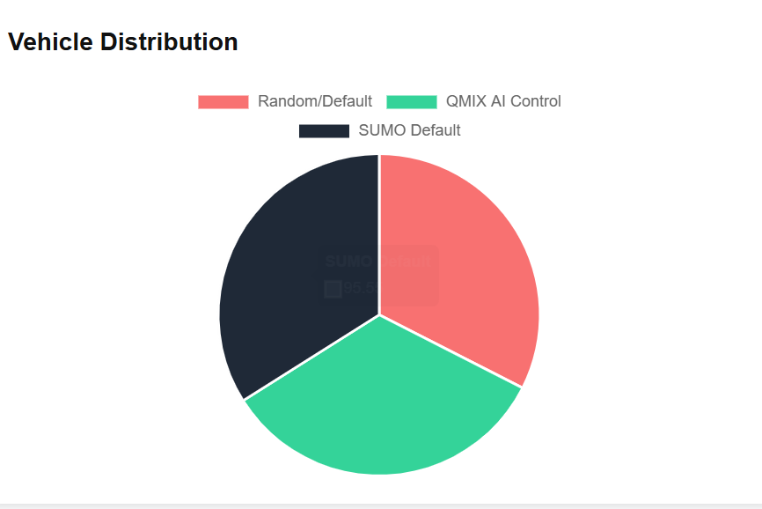
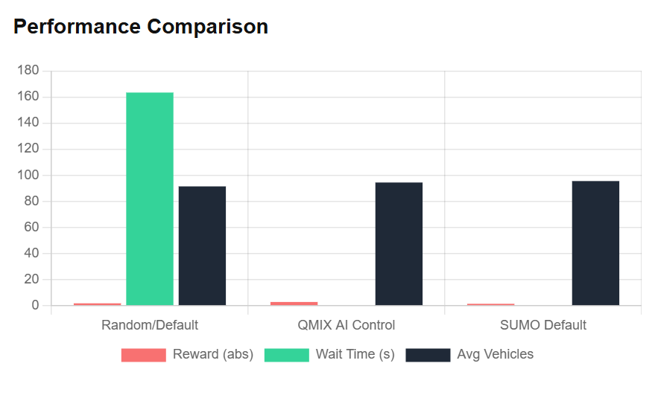
IMPACT AND BENEFITS
Team
DUI
Potential Impact on the Target Audience
Commuters: Reduced waiting times at traffic lights, smoother journeys, and less daily stress.
Public transport: Buses and other services experience fewer delays, improving reliability.
Emergency services: Ambulances, fire trucks, and other priority vehicles can navigate traffic more efficiently.
City authorities: Provides a data-driven system that simplifies traffic management and planning.
General public: Cleaner air, lower noise levels, and more organized traffic flow.
Benefits of the Solution
Social: Safer streets, smoother traffic flow, and improved pedestrian experiences.
Economic: Less fuel consumption, shorter travel times, and increased overall productivity.
Environmental: Reduced vehicle emissions and lower pollution from idling traffic.
Technological/Future-ready: System can integrate with IoT devices and smart city infrastructure as they become available.

Slide 6
RESEARCH AND REFERENCES
Team DUI
https://dl.acm.org/doi/abs/10.5555/3455716.3455894
https://ieeexplore.ieee.org/document/10887881/
https://arxiv.org/abs/1803.11485
https://www.researchgate.net/publication/349020721_Multiple_agents_cooperative_control_based_on_QMIX_algorithm_in_SC2LE_environment
https://www.youtube.com/watch?v=mAkGYR0ykX4

