Slide 1

Object Inspection Project (Computer Graphics)
- Sudiksha Sharma

Slide 2
Project Plan
TimeLine : 21.11.2022. - 31.3.2023. ~ 19 weeks
1. 21.11.2022 - 02.12.2022
Get acquainted with basics of UE
Setup C++ environment for UE
2. 02.12.2022 - 23.12.2022
Setup the Light source in the scene
Load the mesh and place it into the scene
Write a shader from OSL to UE material graph
Setup git repository of the Project

Slide 3
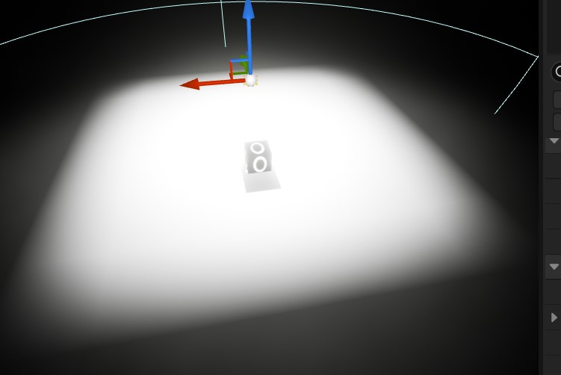
2.1 Setup Lightsource in the scene
Tried 2 light setups to replica the lights of the inspection device :
1. Area Light
Light is emitted from surface of a shape. In UE, there's generally rect-light available for area light (light emitting from rectangular source).
Current Issues :
Need to extract out the torus shape from rectangle light to mimic the light source of inspection model which will take extra efforts. (As discussed with Juraj, masking the central pixels in form of torus using circle equations). Also, there's no prewritten configuration available in UE to do the same.
Emissive materials are quicker and give better visual results.

Slide 4
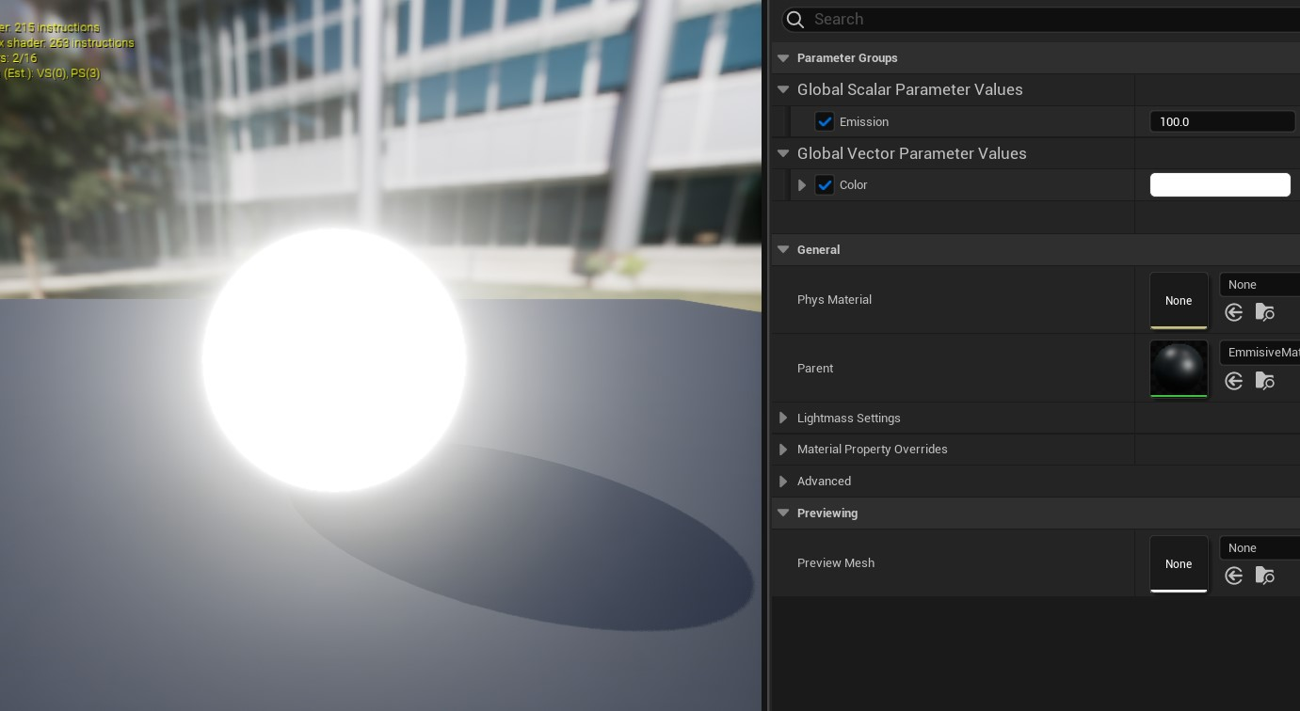
2.1 Setup Lightsource in the scene
2 Types of LightSources to mimic the scene :
2. Emissive material
Self illuminating materials.
Created two 2d torus mesh in Blender with the measurements provided. (Circular Torus and Hexagonal Torus)
Created custom emissive material in UE, with emission value (emissive intensity) and rgb range, both defined by user.
Turned off eye adaptation (doesn't support by real camera) and other unnecessary properties which take up computational power.

Slide 5
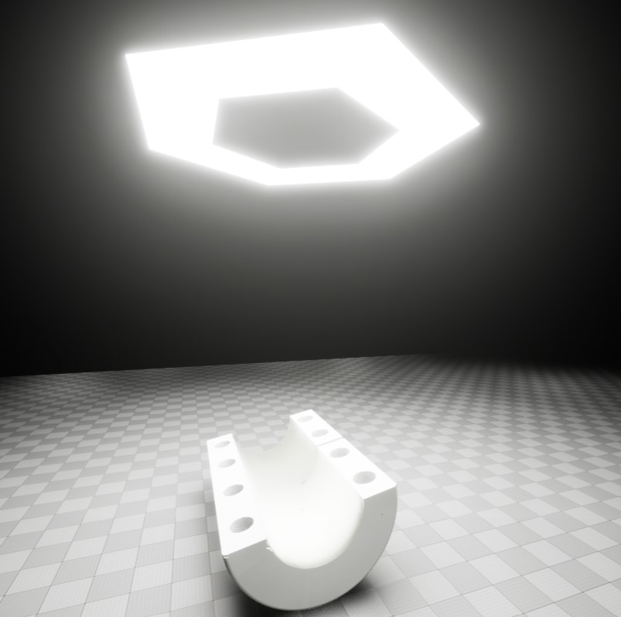
2.1 Setup Lightsource in the scene
Scene With Emissive Material and object

Slide 6
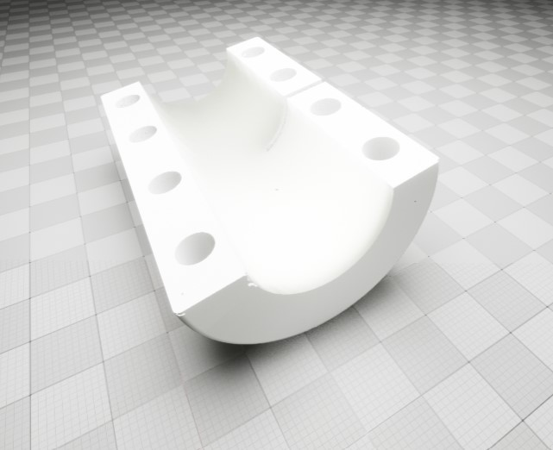
2.2 Load the mesh and place it into the scene
Since mesh was available in .obj file, this file format is NOT fully supported by UE.
So, loaded the .obj file in Blender and exported it in .fbx format in parts and manually added materials to them in UE.

Slide 7
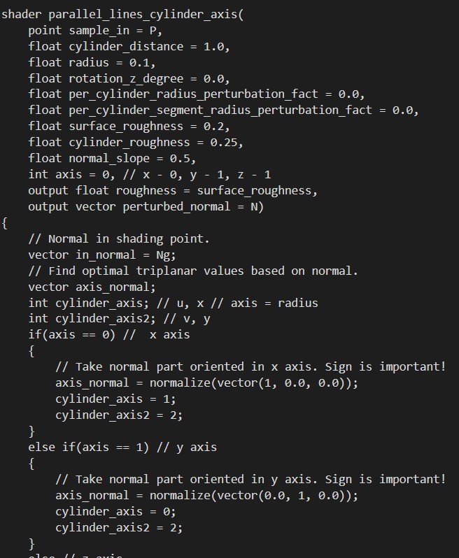
2.3 Write a shader from OSL to UE material graph
OSL (Open Shading Language) is a programmable shading language used to describe lighting, materials and other shading properties.
UE Material Graphs are the visual programming editor used to write shaders in UE in form of visual connected components forming a graph. It doesnot support OSL.
Sample OSL

Slide 8
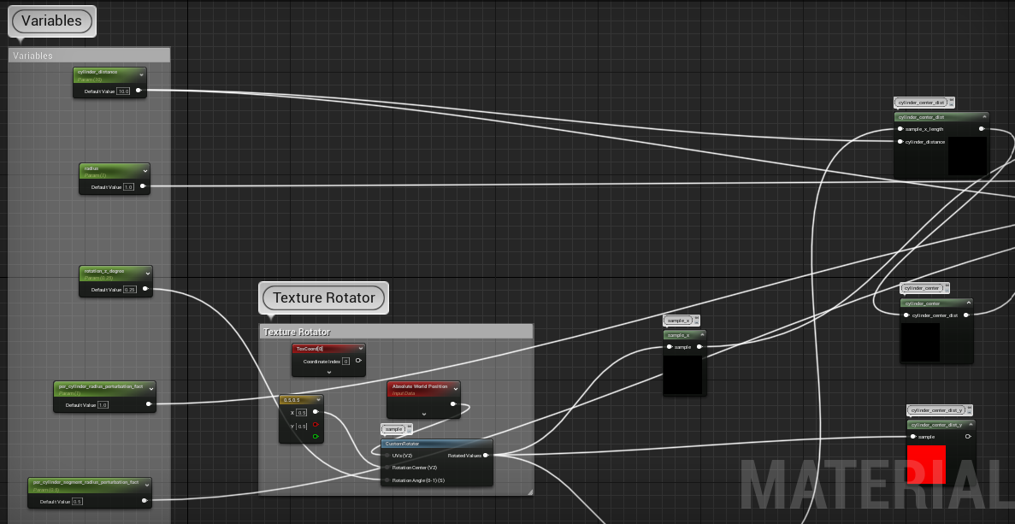
2.3 Write a shader from OSL to UE material graph
UE Material Graph sample of an OSL

Slide 9
2.3 Write a shader from OSL to UE material graph
Understood some important OSL concepts.
Understood the material editor in Unreal. Unlike OSL and other shader languages, it is visually scripted in the form of connected graphical components. Though, there is scope of writing code as well but graphs are mostly preferred and are quick to use.
Tried to translate the 2 sample OSL shaders written by Lovro in UE material graphs.

Slide 10
2.3 Write a shader from OSL to UE material graph
Problems Faced :
In OSL, there are some in-built methods like rotate, cellnoise(to add noise). Unreal provides somewhat similar methods but not exactly the same, e.g. some parameters are different which may result in different output. So, the resulted rasterized image is different.
Artifacts : Shaders needs hit and trial with the lighting, scene properties etc. because it is giving out many artifacts at the moment.
Debugging :Strongly requires a way to debug the shader compilation, as there are large number of nodes, so its difficult to figure out which node is giving out wrong output and hence tearing the shader. Once we get it, then it will be relatively easy and quick to fix and implement all other shaders as well. Some small tricks can be used, as suggested by Juraj.

Slide 11
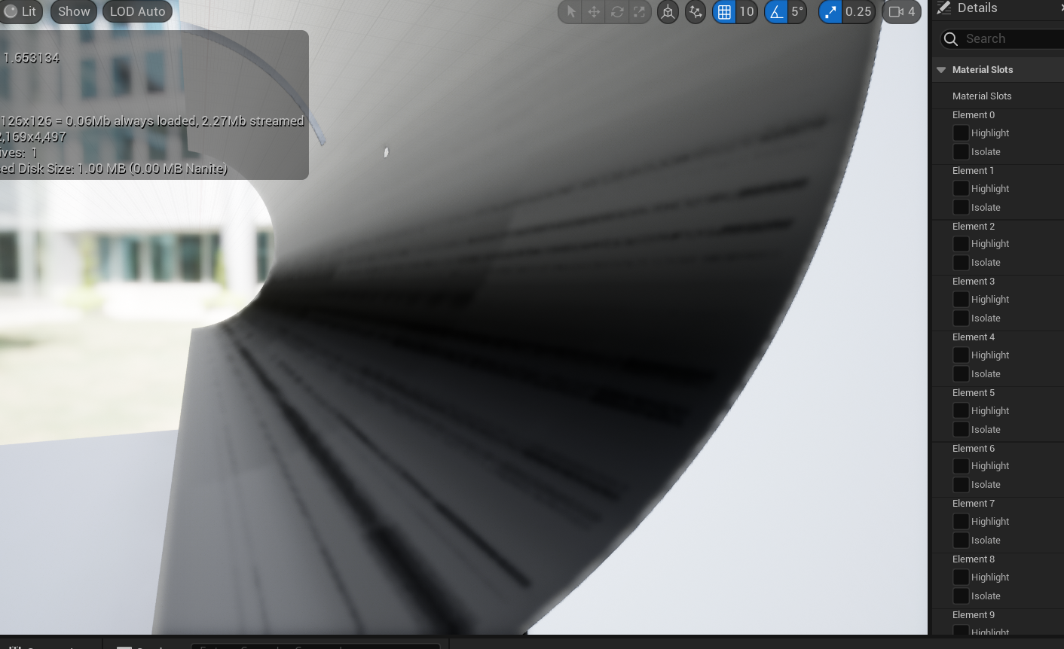
2.3 Write a shader from OSL to UE material graph
Currently, as it is apparent in the image, the basic cylindrical texture that we want to achieve is there but its nowhere near to the renders from OSL. (No noise)
There might be a need to tweak some parameters or change some code approach on importing to material graph.
Also, there's might be a good scope of optimization in currently implemented material graph.
TODO : Read Lovro's paper on Texture Synthesis for Surface Inspection to get a better insight on the logic behind the texture generation.

Slide 12
2.4 Setup git repository of the Project
Setup Git repository to track the and store the project files and ppts.
Github Link : https://github.com/sudikshasharma/object-inspection-project (Checkout branch 'dev')

Slide 13
Object Inspection Project (Computer Graphics)
Thank You so much
QUESTIONS PLEASE ?

