Slide 1
Project Presentation
More to this in the report here
Thursday, May 4, 2023
Sudi Murindanyi
Reg No: 2022/HD05/5583X
Student No: 2200705583

Slide 2
Outline
Data Split
Preprocessing of images
Model Architecture
Results
Grad-CAM Results

Slide 3
Data Split
Total images used: 715
Train | Validation | Test
70% | 15% | 15%
499 | 106 | 110

Slide 4
Image Preprocessing
Image Pipe
Use image data generator to create folders and data
Image resize 225x225
Convert labels to matrix
Use Preprocessing from resnet50

Slide 5
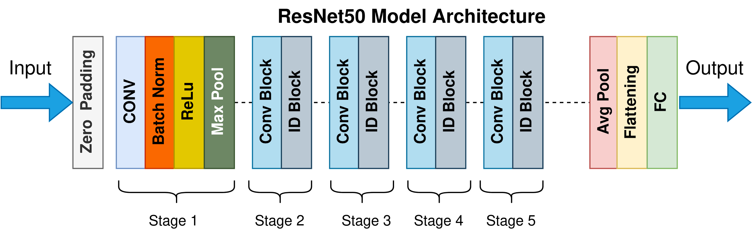
Model Architecture
Resnet50

Slide 6
Model Architecture
Train Accuracy | Validation Accuracy
98% | 97%
Loss: 0.0613 | Loss: 0.1458

Slide 7
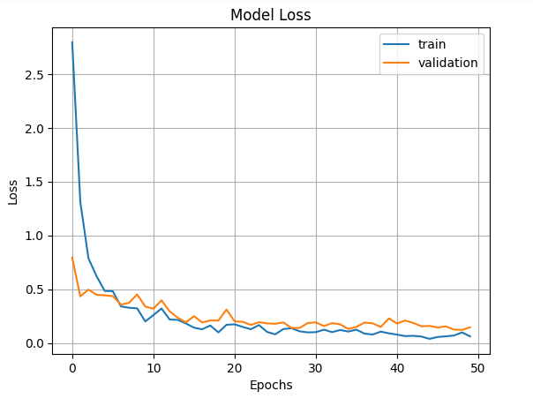
Model Results

Slide 8
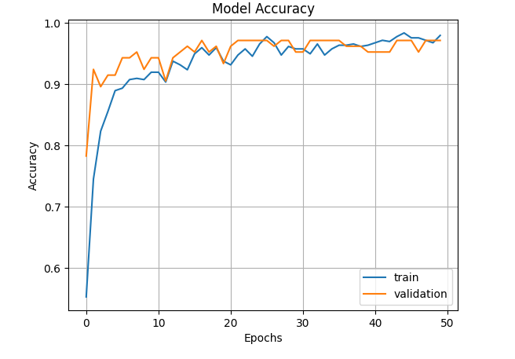
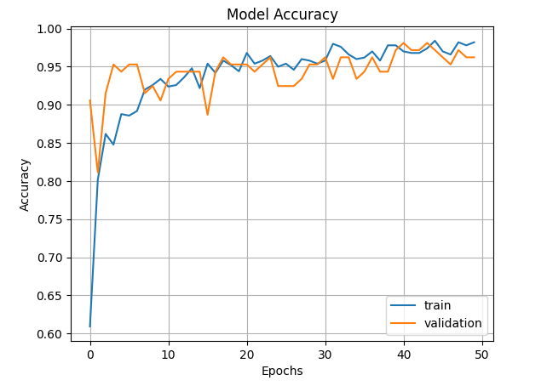
Model Results

Slide 9
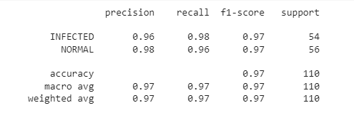
Model Results
Test set

Slide 10
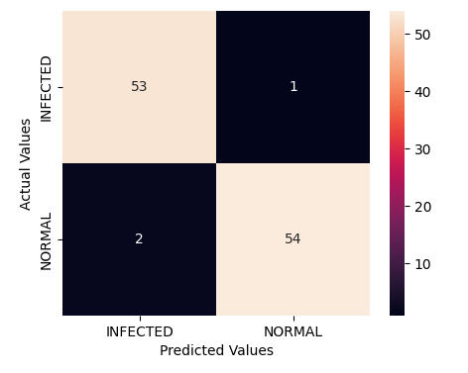
Model Results
Test set

Slide 11
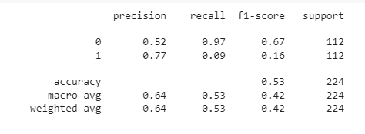
Model Results on dataset 2

Slide 12
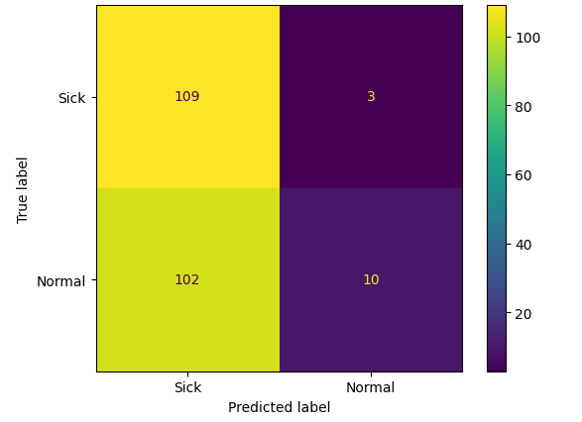
Model Results on dataset 2

Slide 13
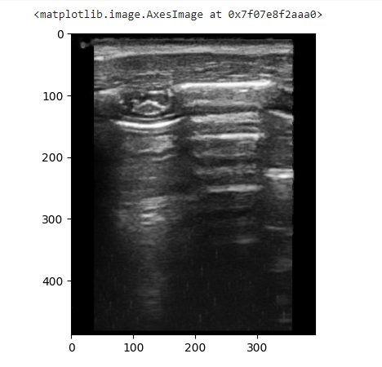
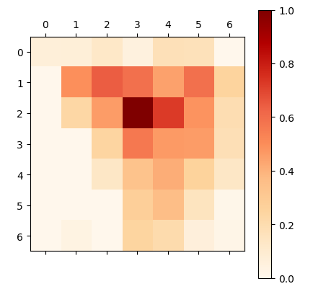
Model Explainability

Slide 14
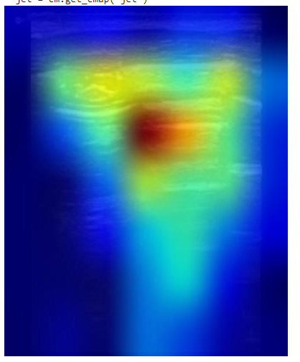
Model Explainability

Slide 15
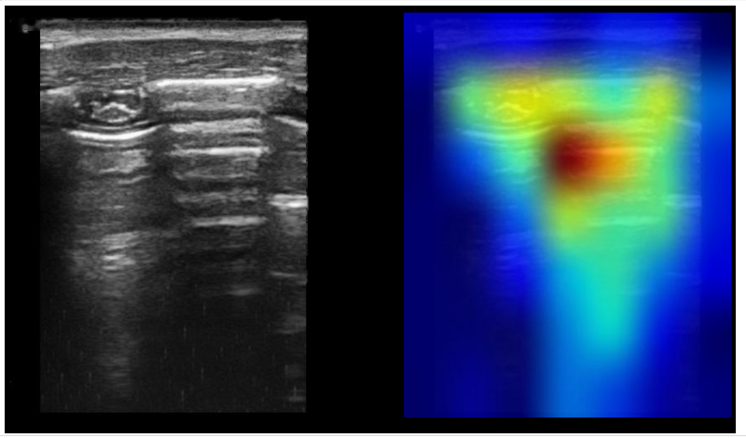
Model Explainability

Slide 16
Next Steps
Highly preprocessing images in dataset2 and test on those
Try other explainable AI techniques like LIME
More to this in the report here

