Slide 1

COGNIVITI
AI-Driven Payment Integrity
Revolutionizing Healthcare Claims Review with Pattern Recognition & Agentic AI
Notes:
Good morning. We're here to talk about Cogniviti, our AI-driven solution that's set to redefine payment integrity in healthcare. We're not just improving a process; we're revolutionizing how healthcare claims are reviewed. Our approach leverages advanced pattern recognition and agentic AI to bring unprecedented precision and transparency. Let's dive into the problem we're solving.

Slide 2

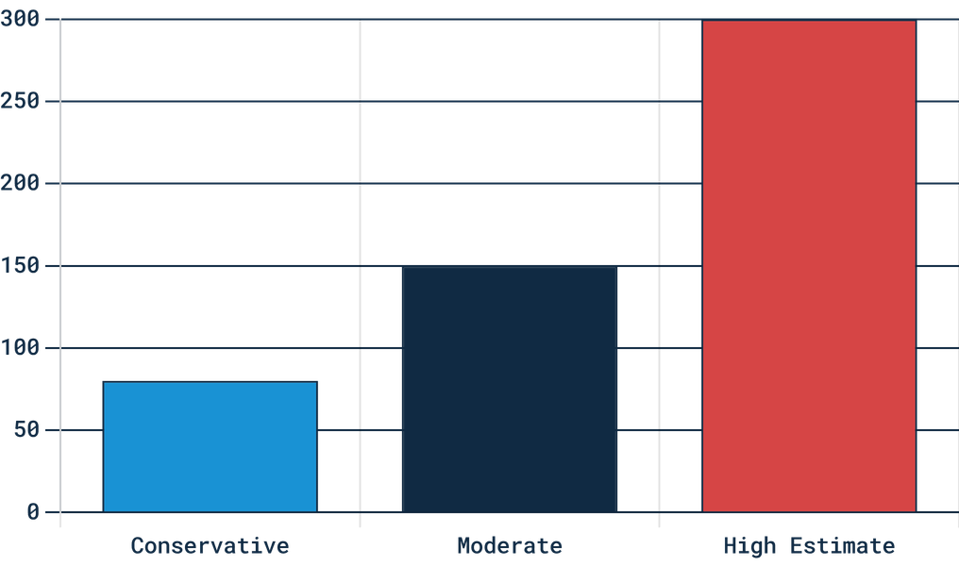
THE $300 BILLION CRISIS
FWA IMPACT
ANNUAL LOSS (BILLION USD)
Fraud, Waste, and Abuse account for 3% to 10% of total U.S. healthcare spending annually.
THE BOTTLENECK
Payers process millions of claims daily. Manual review is impossible to scale, leading to massive financial leakage.
THE RISK
"Black-box" automated systems cause provider abrasion and face increasing legal scrutiny from 25+ states.
*Estimated annual loss due to healthcare FWA.
SOURCE: NHCAA & COGNIVITI RESEARCH 2026
Notes:
The healthcare industry faces a staggering challenge: a $300 billion crisis fueled by fraud, waste, and abuse. This isn't just a number; it's a massive drain on our healthcare system. Payers are overwhelmed, processing millions of claims daily, making manual review impossible to scale. And current automated systems, often 'black boxes,' create more problems than they solve, leading to provider abrasion and legal scrutiny. This problem demands a smarter solution.

Slide 3

INDUSTRY INFLECTION POINT
2024
2026
2028+
MANUAL TRIAGE
AI ADJUDICATION
EXPLAINABLE AI
Legacy systems rely on manual investigation review. High administrative cost and low scalability.
Gartner forecasts that by 2028, 80% of ambulatory claims will move through AI-enabled, real-time adjudication.
The market gap: Existing models are either accurate but unexplainable or articulate but unreliable. Cogniviti fills this critical gap.
SOURCE: GARTNER & COGNIVITI MARKET ANALYSIS 2026
Notes:
This massive problem has brought us to a critical industry inflection point. We're moving rapidly from manual triage to AI adjudication, with Gartner predicting 80% of ambulatory claims will be AI-processed by 2028. But there's a significant gap: existing AI models are either accurate but unexplainable, or articulate but unreliable. This creates a near-term opportunity for Cogniviti to set the standard for explainable AI in payment integrity. We're ready to seize that opportunity.

Slide 4

INTRODUCING COGNIVITI
Cogniviti bridges the gap between raw data and actionable insight by combining Deterministic ML with Agentic GenAI for a complete "Hybrid Intelligence" approach.
01. DETERMINISTIC ML
02. AGENTIC GENAI
03. COMPLIANCE-BY-DESIGN
Statistical precision to flag anomalies based on peer groups, temporal shifts, and coding norms. Auditable and reproducible.
Human-like reasoning to retrieve policies and explain why a claim was flagged in plain, citable English.
Built-in audit trails, bias testing, and human-in-the-loop checkpoints to meet emerging state regulations.
Notes:
That's where Cogniviti comes in, offering a hybrid intelligence approach that bridges the gap between raw data and actionable insight. We combine deterministic machine learning for statistical precision, flagging anomalies based on peer groups and coding norms. Then, our agentic GenAI provides human-like reasoning, retrieving policies and explaining exactly why a claim was flagged. And critically, we've built compliance-by-design into our system, ensuring audit trails and human-in-the-loop checkpoints. This is how we deliver trust and transparency.

Slide 5




THREE LAYERS OF TRUST
DETECTION LAYER
GENAI LAYER
INTERFACE LAYER
DETERMINISTIC & AUDITABLE
AGENTIC & INTERPRETIVE
HUMAN-IN-THE-LOOP
Statistical ML (Z-Score, Isolation Forest)
>
RAG-powered policy retrieval
>
Reviewer-facing triage dashboard
>
Chain-of-thought reasoning rationale
>
Rationale + Recommended Action
>
Peer-group & coding norm analysis
>
Full audit trail for compliance
>
Plain-English, cited explanations
>
Reproducible numeric anomaly scores
>
Notes:
Our architecture is built on three layers of trust, designed for both accuracy and auditability. The detection layer uses deterministic algorithms like Z-Score and Isolation Forest to compute reproducible anomaly scores. The GenAI layer then takes these numeric flags and, using RAG-powered policy retrieval, transforms them into cited, plain-English explanations. Finally, our interface layer provides a reviewer-facing dashboard that prioritizes claims and gives a clear 'Rationale + Action' for every flag. This layered approach ensures both precision and explainability.

Slide 6

THE PROOF OF CONCEPT (POC)
01 // DATA
02 // REASONING
03 // OUTPUT
SYNTHETIC PIPELINE
RAG RETRIEVAL
NL RATIONALE
Reproducible claim generation with seeded anomalies.
>
Gemini Embeddings API for semantic policy matching.
>
Agentic generation of plain-English explanations.
>
Fixed random seeds for reliable, repeatable demonstrations.
>
Curated CMS policy corpus (NCD/LCD excerpts).
>
Direct citations of retrieved policy clauses.
>
Simulates real-world billing patterns and coding errors.
>
Context-aware retrieval based on claim CPT/ICD-10 codes.
>
Actionable recommendations: Pend, Deny, or Auto-Pay.
>
Notes:
Our architecture isn't just theoretical; we've built a robust Proof of Concept that demonstrates the entire pipeline. We're not just flagging anomalies; we're explaining them with precision. This POC uses a synthetic pipeline to generate claims with seeded anomalies, ensuring reliable and repeatable demonstrations. We then leverage RAG-powered retrieval with Gemini Embeddings to match claim context to a curated CMS policy corpus. This allows us to move beyond vague alerts to natural language rationales, like "This claim exceeds peer billing norms for CPT 99214 as defined in CMS NCD 123.4." This level of detail is crucial for trust and adoption, and it leads us directly to our next point on explainability.

Slide 7

STRATEGIC DIFFERENTIATOR: EXPLAINABILITY
[ REGULATORY LANDSCAPE ]
[ THE COGNIVITI ADVANTAGE ]
STATE OVERSIGHT
REASONING CHAIN
As of 2026, 25+ states have adopted guidance requiring insurers to document AI oversight and demonstrate explainability.
Cogniviti provides a citable audit trail for every flag, moving beyond "unusual" to specific policy violations.
REDUCED ABRASION
PROHIBITED "BLACK-BOXES"
Clear, policy-backed explanations reduce provider disputes and appeals, fostering trust across the ecosystem.
Texas, California, and Maryland now prohibit using AI as the sole basis for adverse claim determinations without human-readable rationale.
REFERENCE: NAIC AI MODEL BULLETIN & STATE LEGISLATIVE TRACKER 2026
Notes:
Building on our POC's ability to generate clear rationales, explainability isn't just a feature; it's our strategic differentiator and a regulatory imperative. Over 25 states now require documented AI oversight and explainability, with some, like Texas and California, prohibiting "black-box" denials. Cogniviti provides the "Reasoning Chain" required by law, offering a citable audit trail for every flag. This transparency reduces provider abrasion, leading to fewer appeals and better relationships. This compliance-by-design approach translates directly into significant market opportunity and ROI.

Slide 8

MARKET OPPORTUNITY & ROI
94%
3X
80%
SPEED
EFFICIENCY
SAVINGS
Reducing time-to-results from 90+ days to under 5 days through integrated pre- and post-pay automation.
Automated drafting of review rationales allows analysts to triple their daily claim validation volume.
Realizing 80% of overpaid findings as actual cost savings for health plans by reducing provider friction.
SOURCE: COTIVITI CLIENT RESULTS & COGNIVITI PROJECTIONS 2026
Notes:
The market opportunity here is immense, and our explainability directly drives ROI for health plans. We're reducing time-to-results from over 90 days to under 5 days, a 94% improvement. Our automated rationale drafting allows analysts to triple their daily claim validation volume, boosting efficiency. Most importantly, we're capturing 80% of overpaid findings as actual cost savings for health plans, minimizing provider friction. These are tangible benefits that transform cost centers into value drivers, and we'll explore how to scale this impact next.

Slide 9

STRATEGIC RECOMMENDATIONS
"DETECT AND EXPLAIN"
01
Pair current data-mining models with an AI explanation layer for instant, policy-based citations on every flagged claim.
AGENTIC COPILOT
02
Build an analyst-first tool that automatically drafts rationales and routes claims for human oversight, tripling review capacity.
COMPLIANCE-AS-A-SERVICE
03
Prioritize audit logs and bias testing as core product features to outpace legacy competitors in the new regulatory landscape.
COGNIVITI STRATEGIC ROADMAP 2026-2027
Notes:
Now, let's talk about how we'll scale Cogniviti to market. Our strategic recommendations focus on immediate impact and long-term differentiation. First, we'll implement "Detect and Explain," pairing our current data-mining models with an AI explanation layer. This provides instant, policy-based citations for every flagged claim, moving beyond simple anomaly detection. Second, we'll build an Agentic Copilot, an analyst-first tool that drafts rationales and routes claims for human oversight. This can triple review capacity, drastically improving efficiency. Finally, we'll prioritize Compliance-as-a-Service, embedding audit logs and bias testing as core product features. This will allow us to outpace legacy competitors in the new regulatory landscape. These steps build directly on the significant ROI we just discussed, ensuring we capture maximum value.

Slide 10

CAPTURING THE OPPORTUNITY
01 // EXPERTISE
02 // INNOVATION
DOMAIN DEPTH
AGENTIC AI
Deep understanding of Clinical Decision Making and Pattern Recognition in TPO domains.
Leading-edge use of Agentic Generative AI to bridge the gap between data and interpretation.
03 // GOVERNANCE
04 // VISION
HUMAN-CENTRIC
MARKET LEADERSHIP
Commitment to human-in-the-loop systems and explainable AI as a core product feature.
Capturing the $300B FWA opportunity without the legal exposure of "black-box" legacy systems.
COGNIVITI: THE FUTURE OF PAYMENT INTEGRITY // 2026
Notes:
This slide outlines how we'll capture the immense opportunity before us. Our approach is built on four pillars: expertise, innovation, governance, and vision. Our deep understanding of clinical decision-making and pattern recognition gives us unparalleled domain depth. We're leveraging leading-edge Agentic Generative AI, bridging the gap between raw data and actionable interpretation. Our commitment to human-in-the-loop systems and explainable AI is a core product feature, not an afterthought. This commitment to governance allows us to capture the $300 billion FWA opportunity without the legal exposure that plagues black-box legacy systems. We're not just building a product; we're defining the future of payment integrity.

Slide 11

THANK YOU
Sudip Manchare
Owner & Lead Architect
Hackathon POC: Clinical Decision Making and Pattern Recognition in Health Care Cotiviti Intern Assessment 2026
Notes:
In closing, Cogniviti stands for precision detection and human explanation. We've demonstrated a clear path to revolutionize healthcare claims review. My name is Sudip Manchare, and I'm the owner and lead architect. This hackathon POC for Cotiviti's intern assessment highlights our commitment to innovation and impact. Thank you.

