Slide 1
Career AI – Your Smart Career Planner
An AI-powered web application for personalized career
learning paths

Slide 2

Addressing the Career Planning Challenge
Many students and professionals face major challenges in navigating their career paths—ranging from a lack of structured guidance to overwhelming information overload and fragmented, unorganized resources. This underscores the growing need for an intelligent, user-friendly, and well-structured solution to simplify and streamline the career development journey.

Slide 3




Introducing Career AI: Your Personalized Solution
AI-Powered Recommendations
Career AI is a web-based application that leverages artificial intelligence to recommend personalized learning paths tailored to individual aspirations.
Structured Learning Paths
Users simply input their desired career goal, and Career AI generates step-by-step plans, complete with relevant topics, essential tools, and curated resources.
Intuitive & Growth-Oriented
Designed with an intuitive and beginner-friendly interface, it ensures a smooth onboarding process for all users, fostering continuous learning and growth.

Slide 4
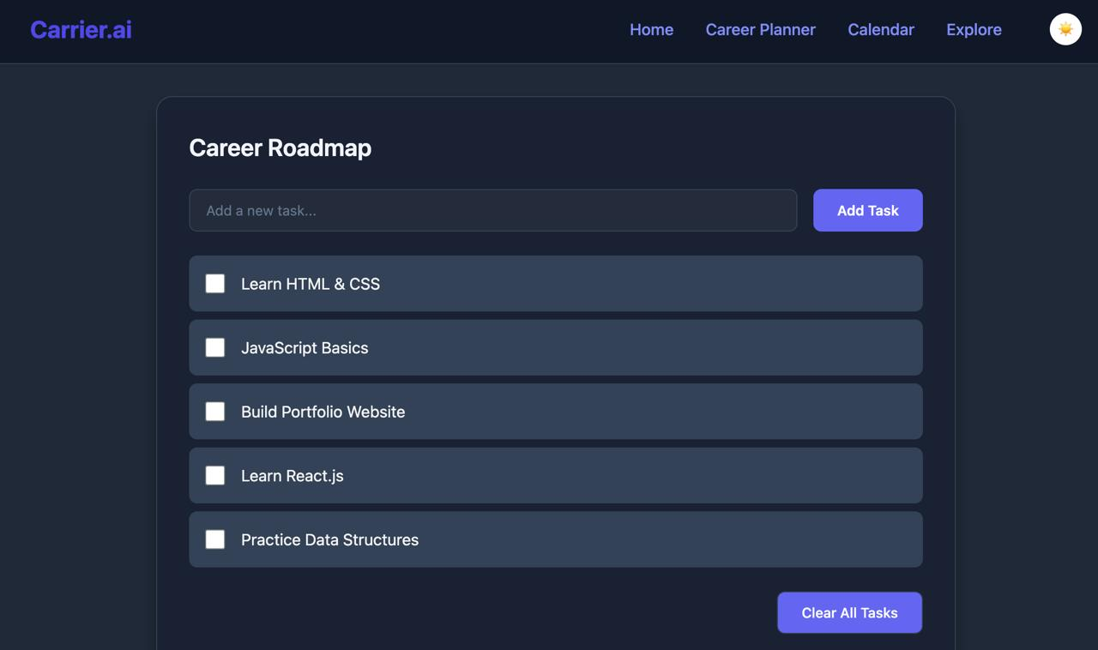
Key Features at a Glance
Personalized AI-generated learning plans for diverse career goals.
Intuitive career goal input form directly on the homepage.
Distinct user and admin roles with dedicated dashboards for efficient management.
Accessible profile menu with a convenient top-right offcanvas display.
Integrated theme toggle (dark/light mode) within the offcanvas menu for personalized viewing.
Essential supplementary tools: a comprehensive planner, integrated calendar, and an expansive course explorer.

Slide 5





Robust Technology Stack
Backend: Flask (Python)
Ensures robust server-side logic and efficient data handling.
Database: SQLite
Lightweight and reliable data storage for user information and learning paths.
Animations: Smooth Transitions
Subtle fade-in and slide-in effects enhance the user experience and visual appeal
Frontend: HTML, CSS, JavaScript
Delivers a dynamic and responsive user interface, enhanced by styles.css, profile.css, script.js, and profile.js.
Deployment: Vercel/Render
Leveraging modern platforms for scalable and efficient application deployment.

Slide 6
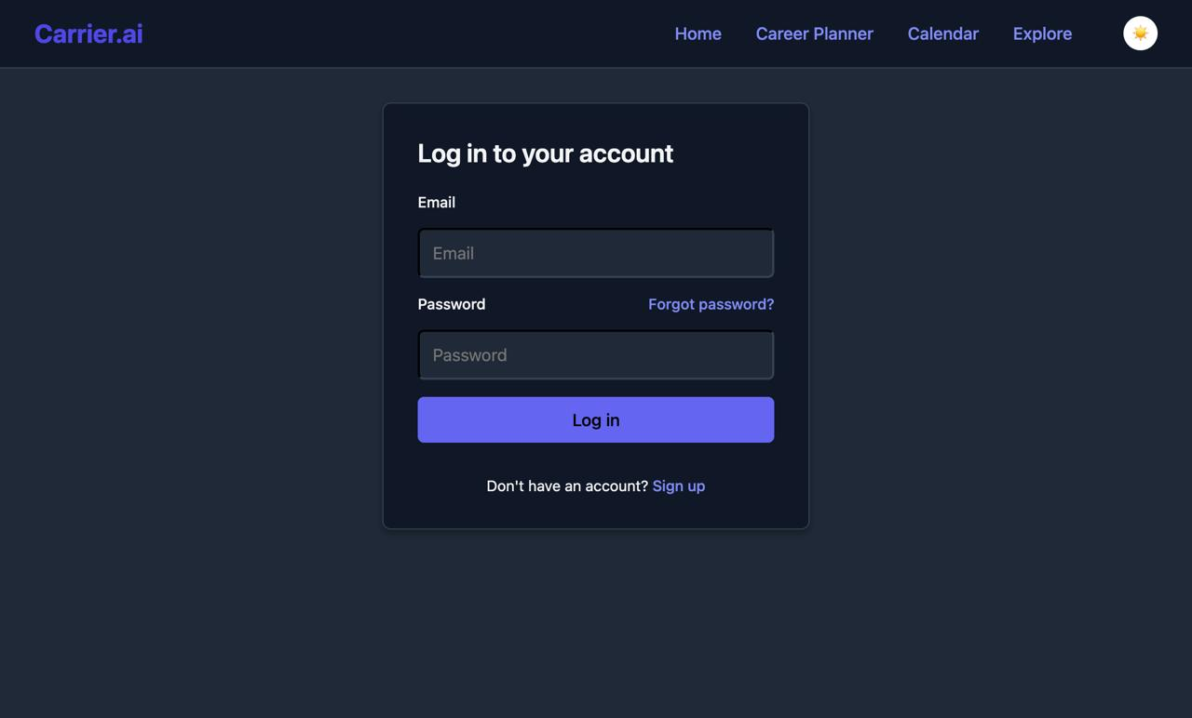
Intuitive UI & Engaging UX
Clean, minimalist layout ensures clarity and ease of navigation.
Fully responsive design adapts seamlessly across all devices, from desktop to mobile.
Integrated navbar with a profile icon triggers a sleek top-right offcanvas menu.
Theme toggle within the offcanvas menu allows users to switch between light and dark modes.
Smooth animations and transitions provide a modern, fluid user experience.
Clear segmentation of user actions and immediate feedback enhance usability and efficiency.

Slide 7
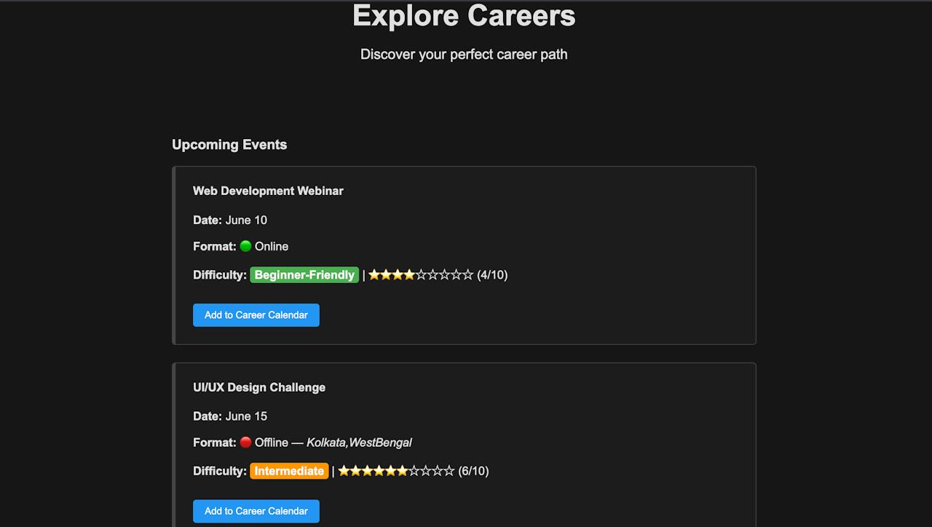
The Explore Page
Central Hub for Opportunities Curates relevant upcoming events, making it easy for users to stay updated and engaged
Guided Discovery Helps users find events that match their skill level and career interests, reducing overwhelm.
Informed Decision-Making Provides key info like format, location, difficulty, and ratings at a glance — aiding in better planning.

Slide 8



User Journey
Register & Login
Enter Career Goal
View Personalized Plan
Utilize Planner/Calendar
Personalization
Profile Management
Theme Preferences
Seamless User & Admin Workflow
Admin Operations
Login to Dashboard
Monitor & Manage Content

Slide 9
Future Enhancements & Vision
Progress Tracking & Reminders
Implement features to monitor learning progress and send timely reminders.
MOOC Platform Integration
Seamlessly link with platforms like Coursera and edX for direct course access
Resume Feedback & AI Expansion
AI-driven resume feedback with continuous improvement via
user input.
Mobile App Development
Develop a native mobile application using Flutter or React Native
for on-the-go access.

Slide 10




Add a Team Members Page
Elaborate on what you want to discuss.
NAME
NAME
NAME
NAME
Title or Position
Title or Position
Title or Position
Title or Position

Slide 11
THANK YOU

