Slide 1

FEEDING NEPAL
Presented By Sudip Sapkota

Slide 2

Nami
13 may 2025
Introduction
Aim & Objectives
Problem domain & solution
comparable system
System interface Design
Implementation
Conclusion
CONTENT

Slide 3
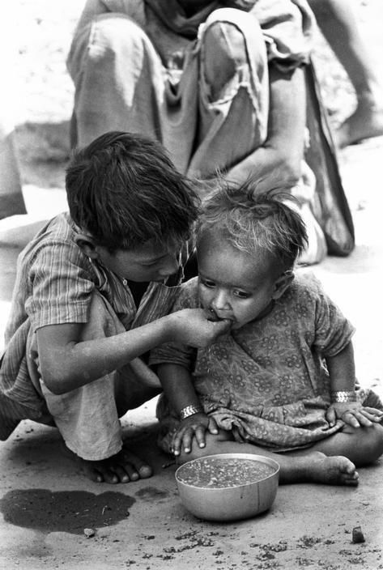
Nami
13 may 2025
INTRODUCTION
• Feeding Nepal is a web platform to reduce food waste and feed the hungry.
• Connects food donors with nearby volunteers for timely collection.
• Built with HTML, CSS, JavaScript, Django, and MySQL.
• Role-based system: Donor, Volunteer, and Admin with secure access.
Notes:
The platform connects food donors — such as restaurants, households, and stores — with nearby volunteers who can collect and deliver the food to those in need. This ensures timely food redistribution before it goes to waste.
Feeding Nepal is built using HTML, CSS, JavaScript on the frontend, Django as the backend framework, and MySQL for data storage.
It features a role-based access system with three types of users:
Donors, who register and make food donations
Volunteers, who collect and distribute food
Admins, who manage users, donations, and system notifications
Each user has secure, dedicated access to features based on their role. This makes the system efficient, organized, and scalable."

Slide 4
Nami
13 may 2025
AIMS
OBJECTIVE
• To build a secure and user-friendly system that connects food donors and volunteers to reduce food wastage and hunger in Kathmandu.
• Create clear dashboards for Donors, Volunteers, and Admin.
• Secure login and registration with validation and hashing.
• Enable food donation with real-time location-based volunteer search.
• Build admin tools for user management and data monitoring.
Notes:
"Here are the key objectives of the Feeding Nepal project:
First, we aimed to create clear and user-friendly dashboards tailored for each role — Donors, Volunteers, and Admin — so users can access only the features relevant to them and operate efficiently.
Second, we implemented secure login and registration processes. This includes input validation and password hashing to protect user data and prevent unauthorized access.
Third, the system enables real-time, location-based volunteer search during food donation. This helps in finding nearby volunteers quickly, ensuring that food is collected and delivered before it goes to waste.
Lastly, we built admin tools for user management and data monitoring. These tools help admins oversee system activities, manage users, track donations, and monitor performance for transparency and control.
Together, these objectives ensure the system is functional, secure, and impactful."

Slide 5
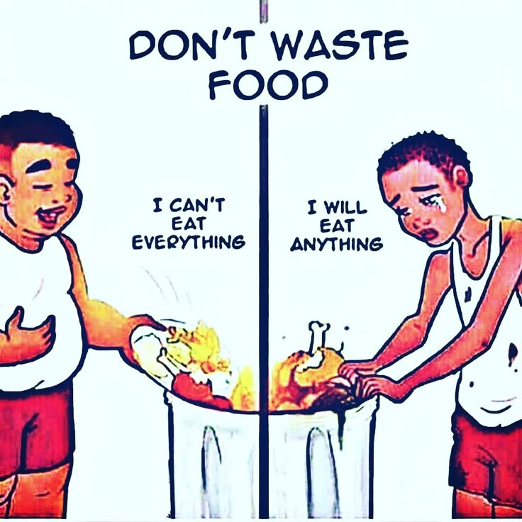
Nami
13 may 2025
PROBLEM DOMAIN & SOLUTION
• High rates of food wastage in Kathmandu despite high levels of food insecurity.
• Lack of a structured platform to connect food donors and volunteers.
• Donors have no reliable way to ensure their food reaches people in need.
• Volunteers lack a centralized system to find and manage donation opportunities.
• Develop a web-based platform to connect food donors and volunteers in real time.
• Allow donors to register and submit details of surplus food donations.
• Enable volunteers to browse available donations, accept them, and get pickup details.
• Equip admin with tools to manage users, view reports, and maintain system integrity.
Notes:
"Before developing Feeding Nepal, we identified several key problems in our community:
Firstly, there are high levels of food wastage in Kathmandu, even though many people still suffer from food insecurity. This shows a clear gap between food surplus and food need.
Secondly, there is a lack of a structured platform that connects food donors with volunteers who can collect and deliver food. Without this connection, a lot of food goes to waste.
Third, donors currently have no reliable way to ensure their donated food actually reaches people in need. This uncertainty discourages regular donations.
And finally, volunteers lack a centralized system to find, manage, and track donation opportunities. This makes it difficult for them to contribute consistently and effectively.
These problems inspired us to create a digital solution that bridges these gaps."
Feeding Nepal is a proposed web-based platform designed to address the issue of food wastage and hunger by connecting food donors and volunteers in real time. The system allows donors to register and submit details about surplus food, making it easier to share resources that would otherwise go to waste. Volunteers can browse available donations, accept tasks based on location and availability, and access pickup details for smooth collection and delivery. Additionally, the platform equips administrators with tools to manage users, oversee donation activities, generate reports, and ensure the overall integrity and effectiveness of the system.

Slide 6
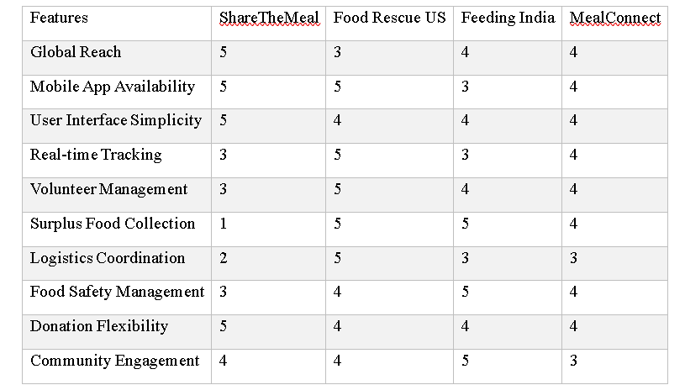
Nami
13 may 2025
COMPARABLE SYSTEMS
Notes:
"Now, let me explain the comparison between four food donation systems: ShareTheMeal, Food Rescue US, Feeding India, and MealConnect.
We compared them based on 10 important features. Each feature is rated from 1 to 5, where 5 means excellent and 1 means poor.
First, for Global Reach, ShareTheMeal scores the highest with a 5, because it is a global app supported by the UN. The others mostly work in specific countries.
Second, all platforms except Feeding India have Mobile Apps, with ShareTheMeal and Food Rescue US scoring 5. This shows how accessible the systems are on phones.
Third, for User Interface Simplicity, ShareTheMeal again scores highest. It’s very easy for users to navigate.
Next, Real-time Tracking is strong in Food Rescue US and MealConnect, but weaker in ShareTheMeal and Feeding India.
In terms of Volunteer Management, Food Rescue US scores highest, meaning it has a strong system for handling volunteers.
Surplus Food Collection is very strong in Food Rescue US and Feeding India, but very weak in ShareTheMeal since it focuses more on donations than food pickup.
For Logistics Coordination, again, Food Rescue US leads. This shows it is strong in organizing transport and pickups.
Food Safety Management is done well by Feeding India, showing they focus a lot on hygiene and safe food practices.
Donation Flexibility is highest in ShareTheMeal because users can donate easily in small amounts anytime.
Lastly, Community Engagement is strongest in Feeding India, which runs awareness campaigns and local programs.
In conclusion, each system has its strengths. Food Rescue US is great in logistics and volunteer work. ShareTheMeal is best for global reach and simplicity. Feeding India balances food safety and community work. MealConnect performs well across many areas too."

Slide 7
Nami
13 may 2025
SYSTEM INTERFACE DESIGN
•Simple and clean navigation bar
•Separate dashboards for donor, volunteer, and admin
•Donation form with pickup time and location
•Volunteer confirmation screen after accepting donation

Slide 8
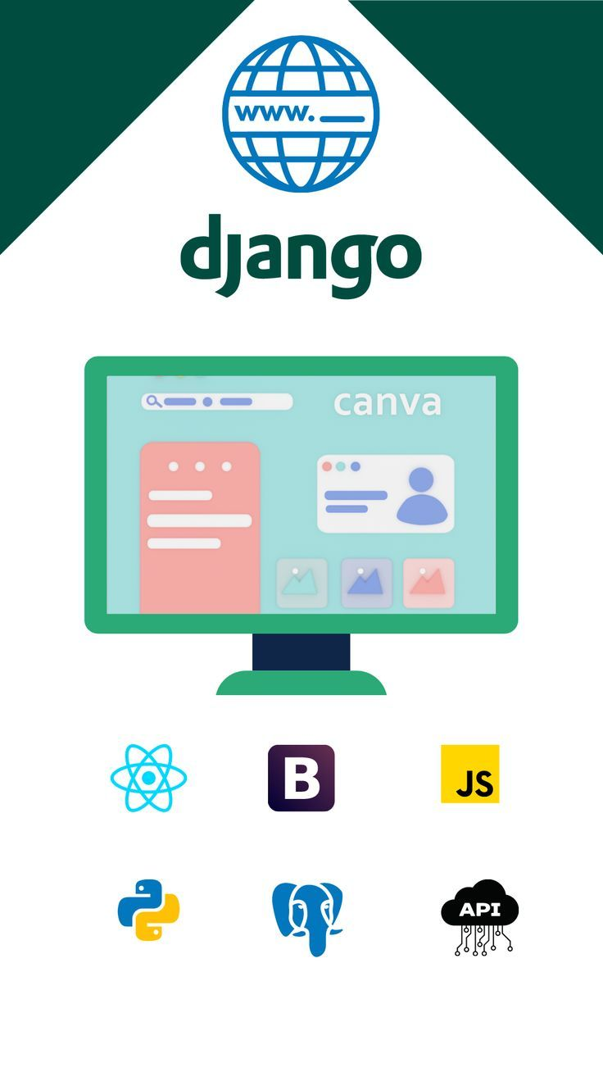
Nami
13 may 2025
IMPLEMENTATION
•Frontend: HTML, CSS, JavaScript
•Backend: Python Django framework
•Database: MySQL
•User and donation APIs created and integrated

Slide 9

Nami
13 may 2025
CONCLUSION
•Feeding Nepal provides a structured and digital solution for food redistribution.
•It empowers donors, volunteers, and admins with a clean interface and efficient flow.
•The system reduces food waste and supports local communities.
•Future enhancements include a mobile app and real-time maps.
Notes:
In conclusion, Feeding Nepal offers a structured and digital solution for efficient food redistribution, helping to combat hunger and reduce food waste. By empowering donors, volunteers, and administrators with a clean, role-based interface and streamlined workflow, the system ensures that surplus food reaches those who need it most. It not only supports local communities but also promotes a culture of sharing and responsibility. Looking ahead, future enhancements such as a dedicated mobile application and real-time mapping features will further improve accessibility and responsiveness.

