Slide 1
NLP Trainer
A Virtual Assistant for Mastering NLP Interview Questions
By
Sudip Das

Slide 2





Project Overview
Target users
Students - prepare for exams
Job seekers - prepare for interviews
Data Collection
scraping websites and PDFs
Text Preprocessing

Slide 3

RAG Pipeline
Embedding Model: MiniLM-L6-v2
Indexing & Retrieval: FAISS for fast similarity search
Context Filtering: Top 3 passages, similarity threshold 0.7
Output: Context-driven, precise answers

Slide 4
Results and Optimization
Evaluation metrics - BLEU and ROUGE on 30 NLP questions
LLMs tested:
Llama-3.2 - Higher contextual depth & lexical precision
Flan-T5 - More concise but slightly lower scores
Output post processing:
Cleaned answer
Refined context

Slide 5
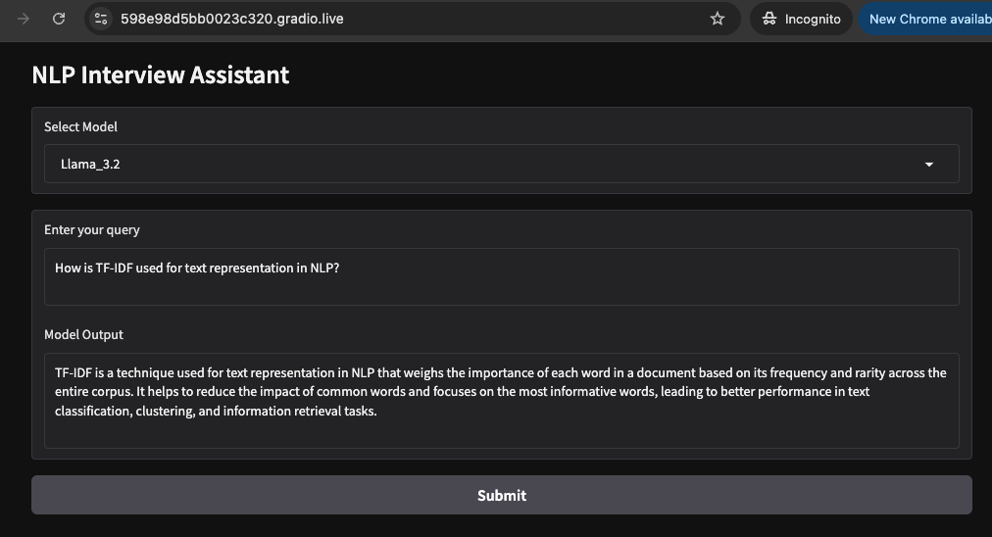
User Interface (UI)
Interface
Gradio-based Web UI
Features
Model Selection
Real-time Q&A

Slide 6

Challenges & Future Work
Challenges:
Handling ambiguous queries
Balancing detail with brevity
Continuous corpus expansion needed
Next Steps:
Refine retrieval & prompt engineering
Domain-specific fine-tuning
Enhanced evaluation metrics aligned with user satisfaction

Slide 7
Thank you for Listening!
Question?

