Slide 1
What is the Ring Election Algorithm?
A method used in distributed systems to elect a coordinator node.
Works in a ring topology, where each node is connected to two others.
Ensures efficient communication and coordination among nodes.

Slide 2
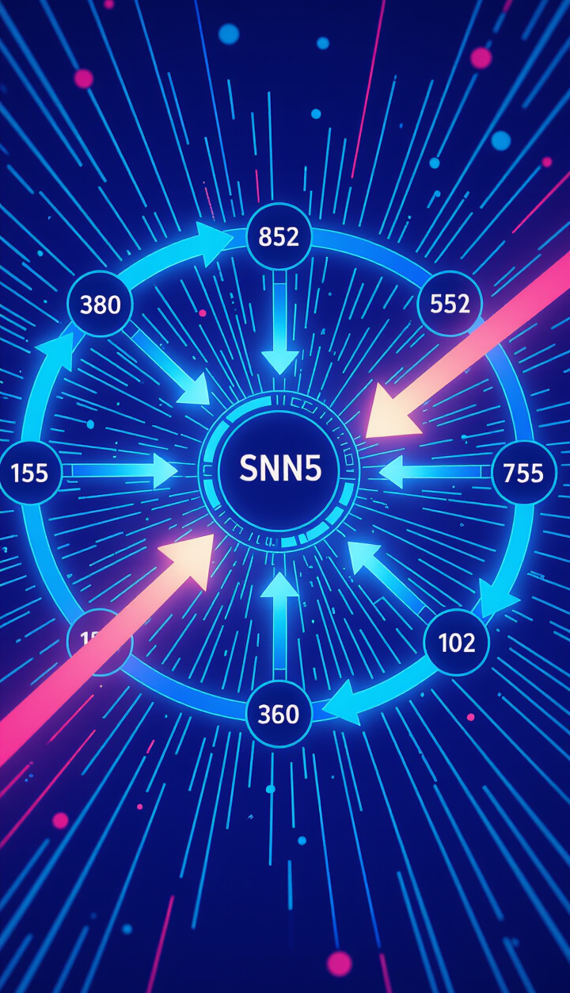
How Does Ring Election Algorithm Work?
Nodes send messages in a cyclical manner around the ring.
Each node compares its ID with the received ID.
The node with the highest ID becomes the coordinator.
If a node fails, the algorithm adapts by skipping it.

Slide 3

Real-World Example
Imagine a group project where each member must vote for a leader.
Each member (node) passes a vote around the table (ring).
The member with the most votes (highest ID) becomes the project leader (coordinator).

Slide 4

Use Cases
Telecommunications: Managing call routing and network coordination.
Cloud Computing: Ensuring resource allocation and load balancing.
Distributed Databases: Electing a primary node for data consistency.

Slide 5
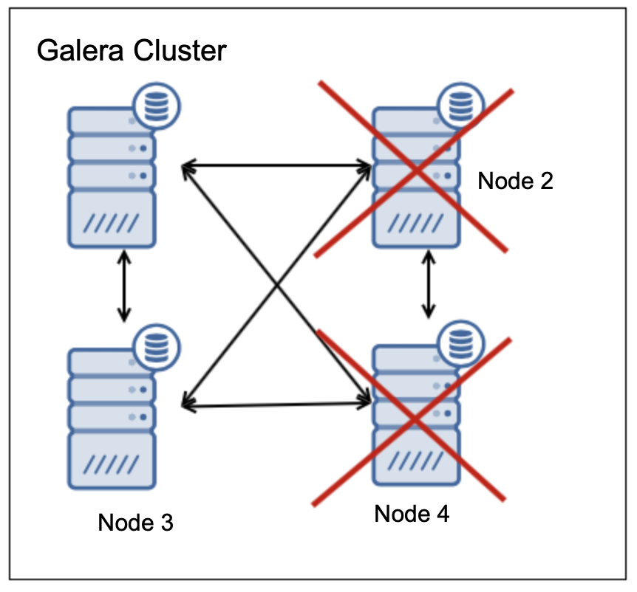
Implementation Considerations
Node Failures: Must handle situations where a node goes offline.
Message Delays: Consideration for latency in communication.
Scalability: Effectiveness in larger networks.

Slide 6

Performance Analysis
Advantages:
Simple and easy to implement.
Efficient in small to medium-sized networks.
Potential Bottlenecks:
Increased message overhead in larger networks.
Delay in electing a coordinator if nodes fail.

Slide 7

Optimization Techniques
Reducing Message Traffic: Use techniques like token passing to minimize overhead.
Fault Tolerance: Implement backup coordinators to handle node failures.
Dynamic Adjustments: Adapt the algorithm based on network size and conditions.

Slide 8
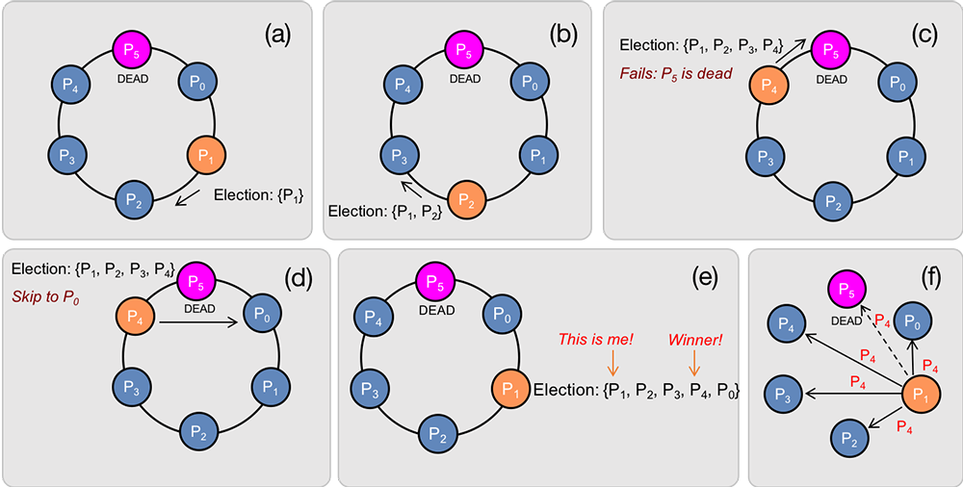
Conclusion
The Ring Election Algorithm is vital for maintaining effective communication in distributed systems.
Its simplicity, adaptability, and efficiency make it a popular choice.
Understanding this algorithm helps us appreciate the coordination in complex networks!

