Slide 1
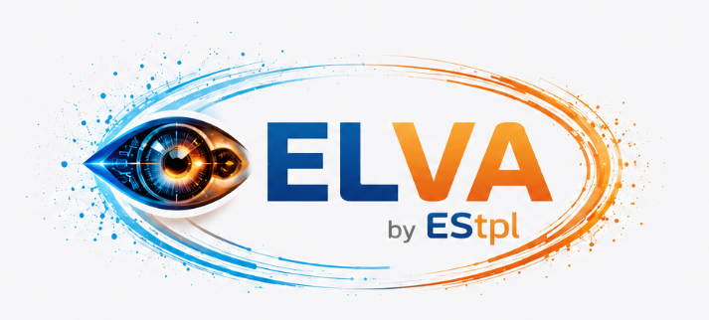

ELVA Visual AI
Transforming Vision into Intelligence
DETECT • VERIFY • OPTIMIZE • SECURE

Slide 2
What is ELVA?
How It Works
Key Differentiators
• Ingest: 4K/AI IoT cameras, microscopes, and production
line cameras.
• Understand: AI models for OCR, detection,
anomaly spotting and classification.
• Act: Real-time alerts, dashboards,
audit trails and automation workflows.
• Integrate: ERP, POS, RFID, barcode systems and
access control.
• Jewellery-specific AI datasets and pre-trained models.
• Micron-level defect and inclusion detection.
• Enterprise-grade audit and security controls.
• Hybrid deployment with edge + cloud architecture.
AI-Driven Security • Operational Visibility • Process Automation • Compliance Intelligence

Slide 3
Industry Challenges We Solve
Jewellery Retail
Manufacturing Plants
• Shrinkage and pilferage detection.
• Counter crowd monitoring and staff analytics.
• Stock mismatch and display inconsistencies.
• Customer service and operational visibility.
• Micro-defect and quality inspection.
• Packing and dispatch verification.
• Safety and PPE compliance monitoring.
• Traceability and production analytics.
AI-Driven Security • Operational Visibility • Process Automation • Compliance Intelligence

Slide 4
Visual AI Use Cases Retail Industry - Challenges
Store Intelligence
Business Impact
• Customer footfall analytics
• Counter-wise crowd analysis
• Salesperson activity tracking
• Suspicious behaviour detection
• Queue and wait-time monitoring
• Reduced operational losses
• Improved customer engagement
• Optimized staff productivity
• Enhanced compliance visibility
AI-Driven Security • Operational Visibility • Process Automation • Compliance Intelligence

Slide 5
Visual AI Use Cases Manufacturing Industry - Challenges
Factory Intelligence
Operational Benefits
• AI-based PDI inspection
• OCR & barcode verification
• Surface defect detection
• Packing line validation
• Worker safety compliance
• Reduced rework and wastage
• Higher quality consistency
• Automated inspection workflows
• Improved production visibility
AI-Driven Security • Operational Visibility • Process Automation • Compliance Intelligence

Slide 6
Advanced AI Capabilities
Core Technologies
Enterprise Integration
• Computer Vision
• Object Detection
• OCR & Text Analytics
• Behavioural AI
• Predictive Intelligence
• ERP & BI integration
• Centralized AI dashboards
• Cloud & edge deployment
• Multi-location monitoring
AI-Driven Security • Operational Visibility • Process Automation • Compliance Intelligence

Slide 7



Successfully Delivered Projects
Core Use Cases
Clients
AI-based retail intelligence platform.
People counting & behavior analytics.
Intrusion detection systems.
Smart surveillance with automated alerts.
Planogram compliance analytics.
Workplace safety monitoring.
PDI Monitoring.
Senco Gold Limited.
Dhunseri Polyfilms Pvt. Limited.
Gibraltar Airsprings.
AI-Driven Security • Operational Visibility • Process Automation • Compliance Intelligence

Slide 8
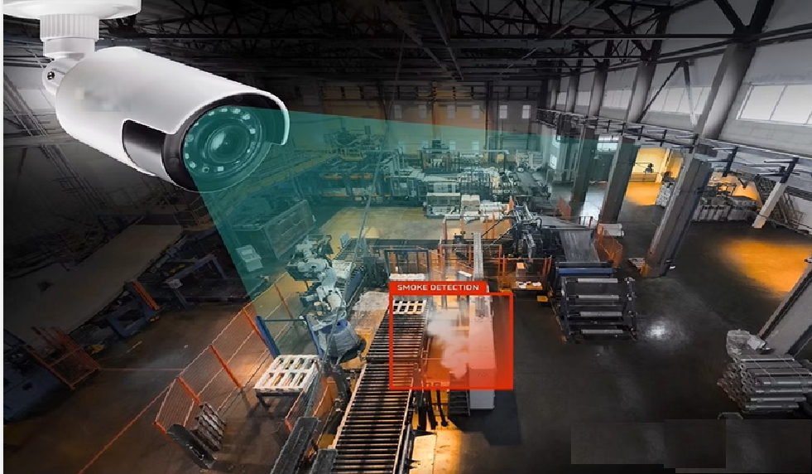
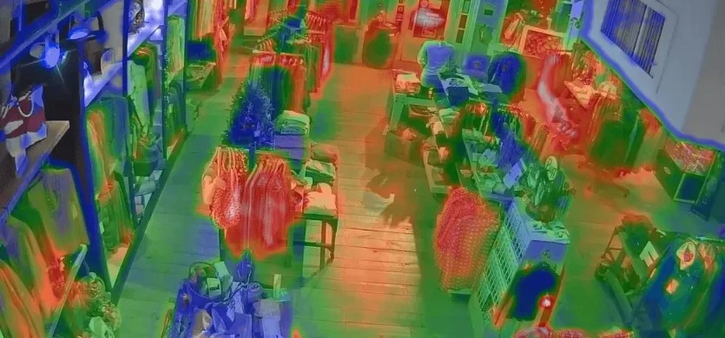
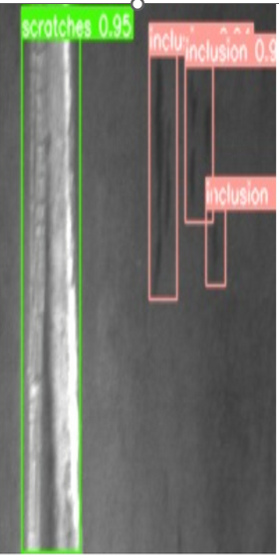
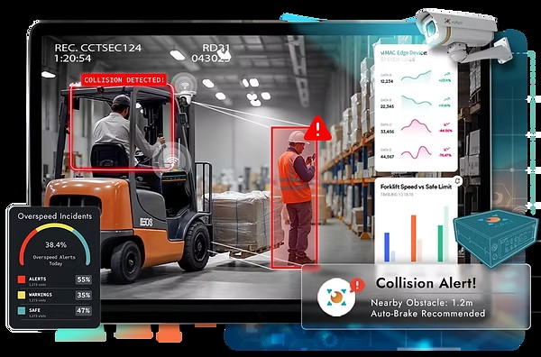
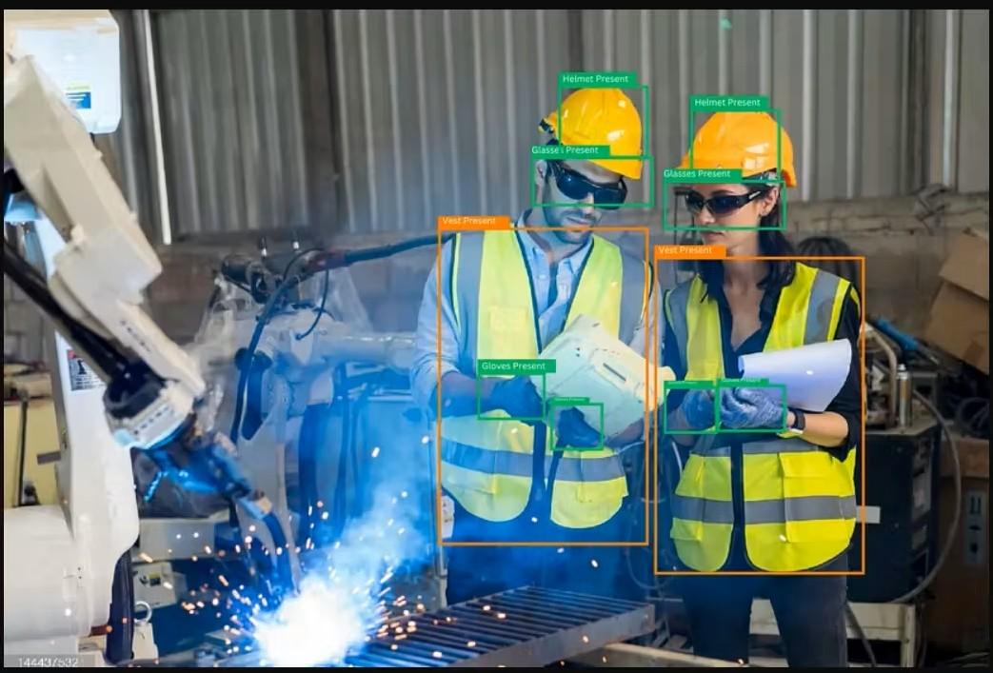
Common Use Cases Detections
AI-Driven Security • Operational Visibility • Process Automation • Compliance Intelligence

Slide 9
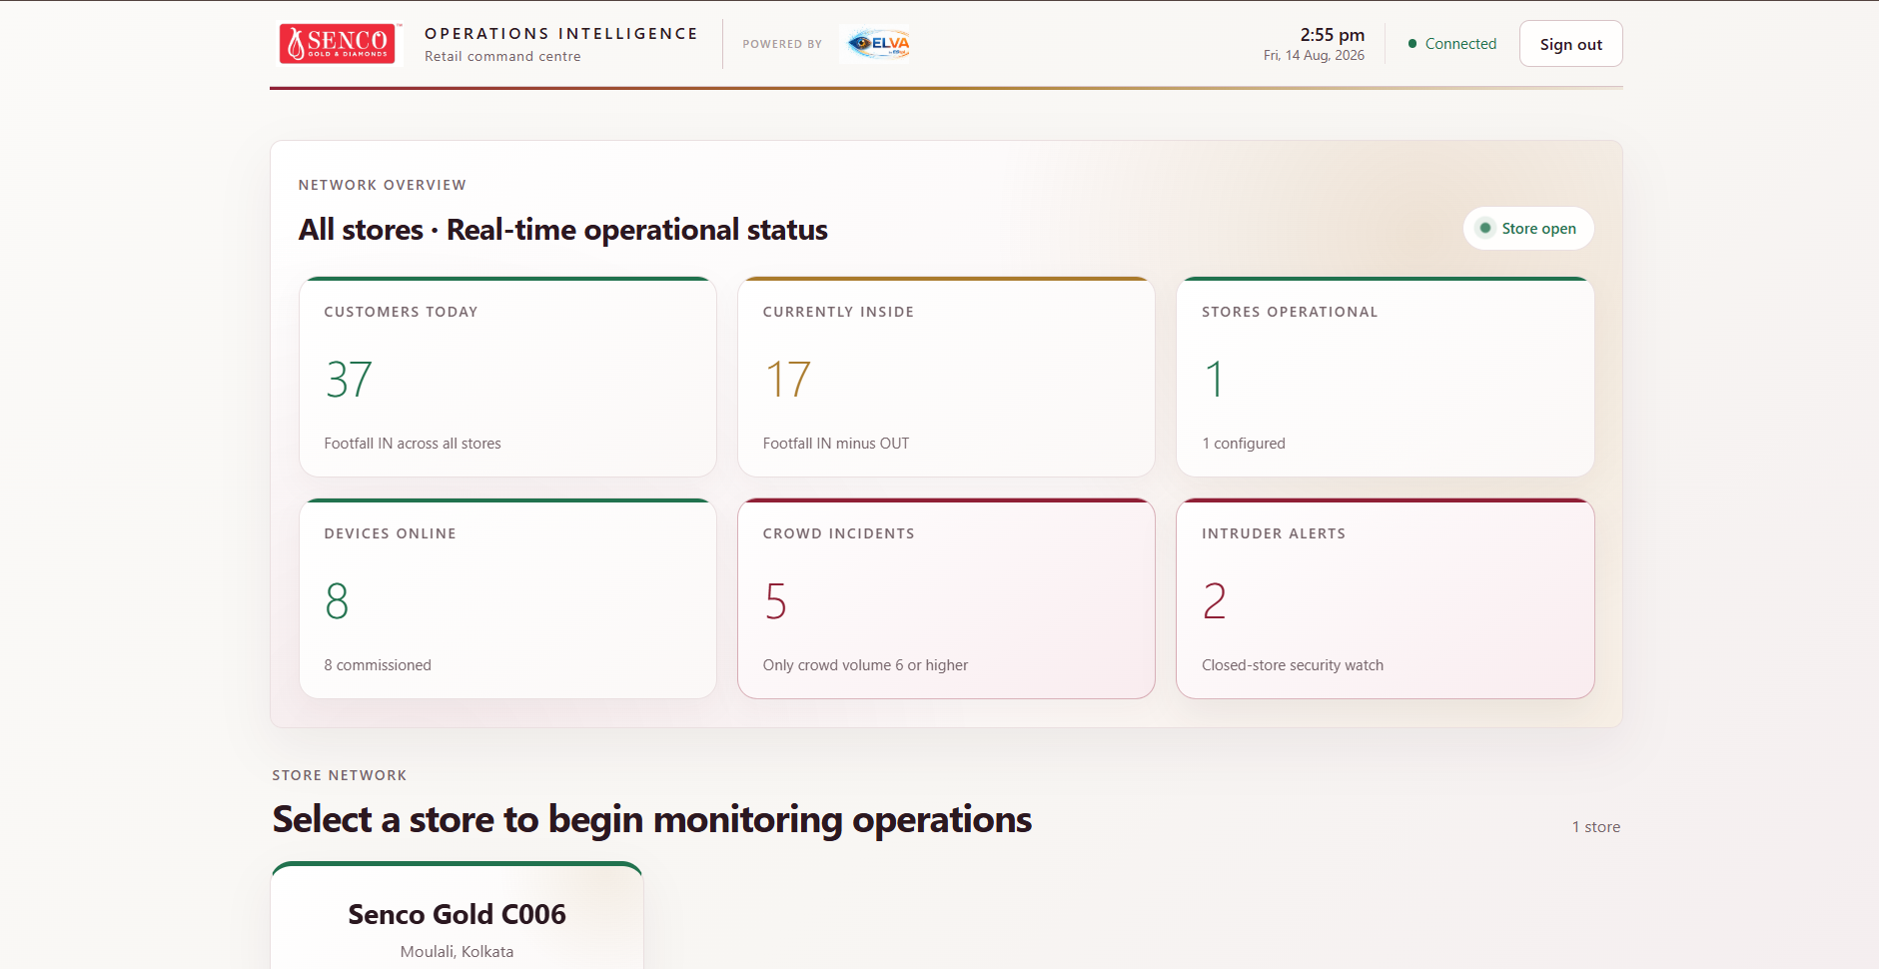

Slide 10
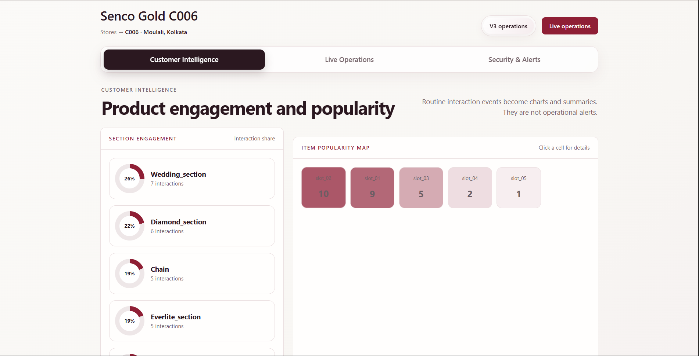

Slide 11
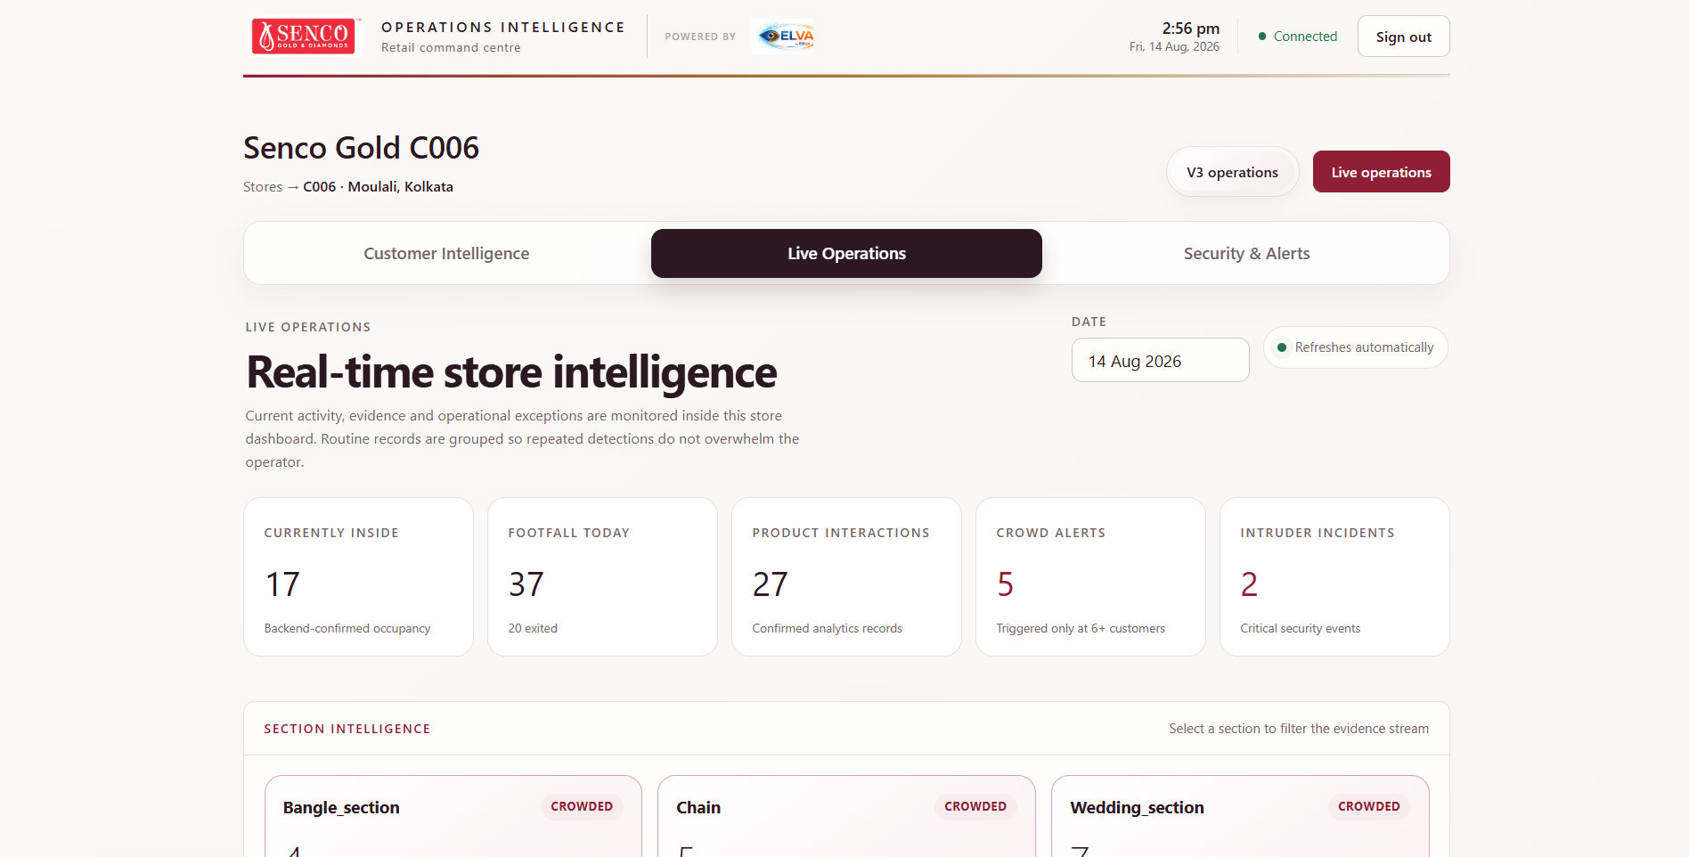

Slide 12
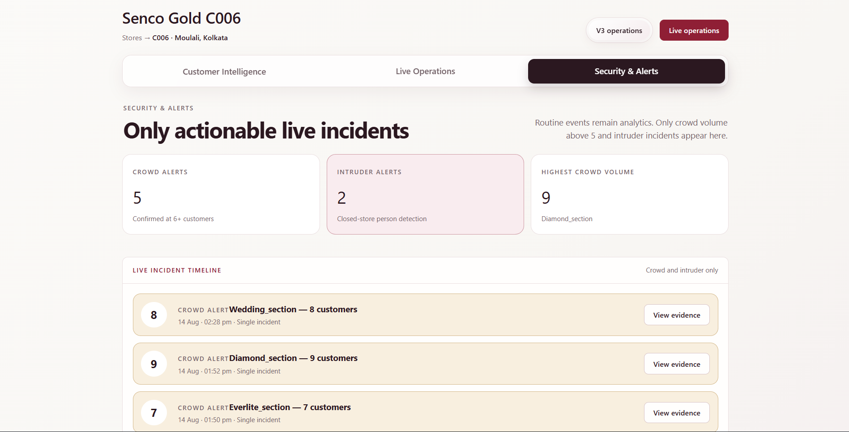

Slide 13
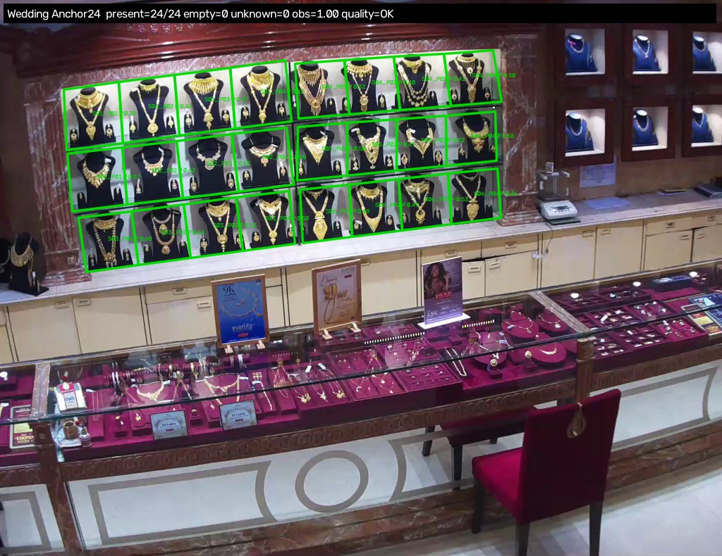

Slide 14
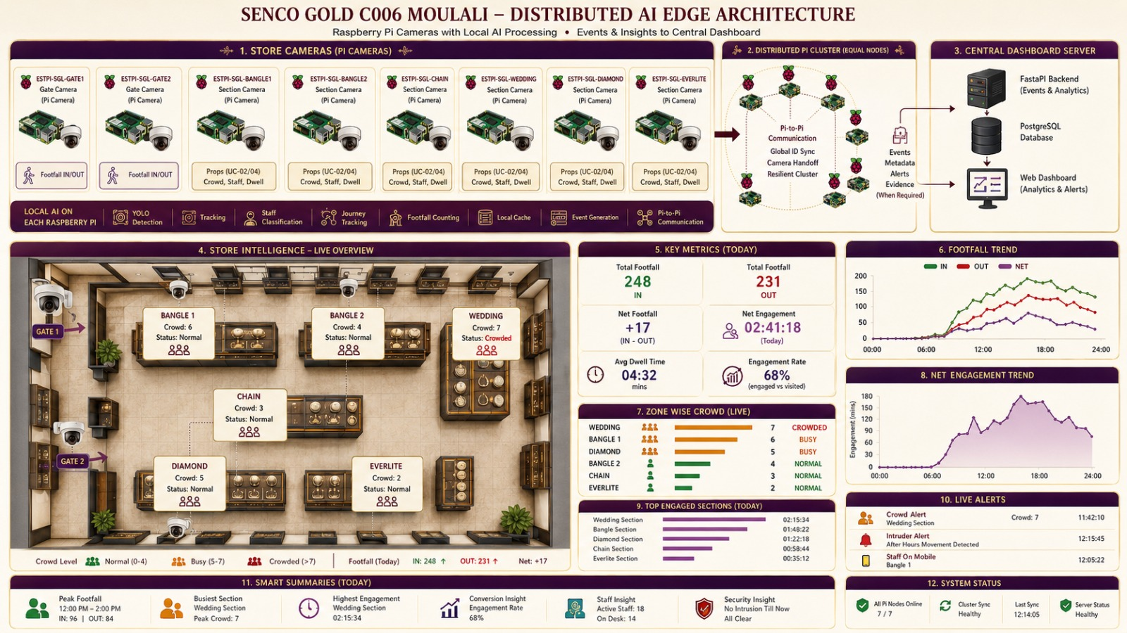

Slide 15
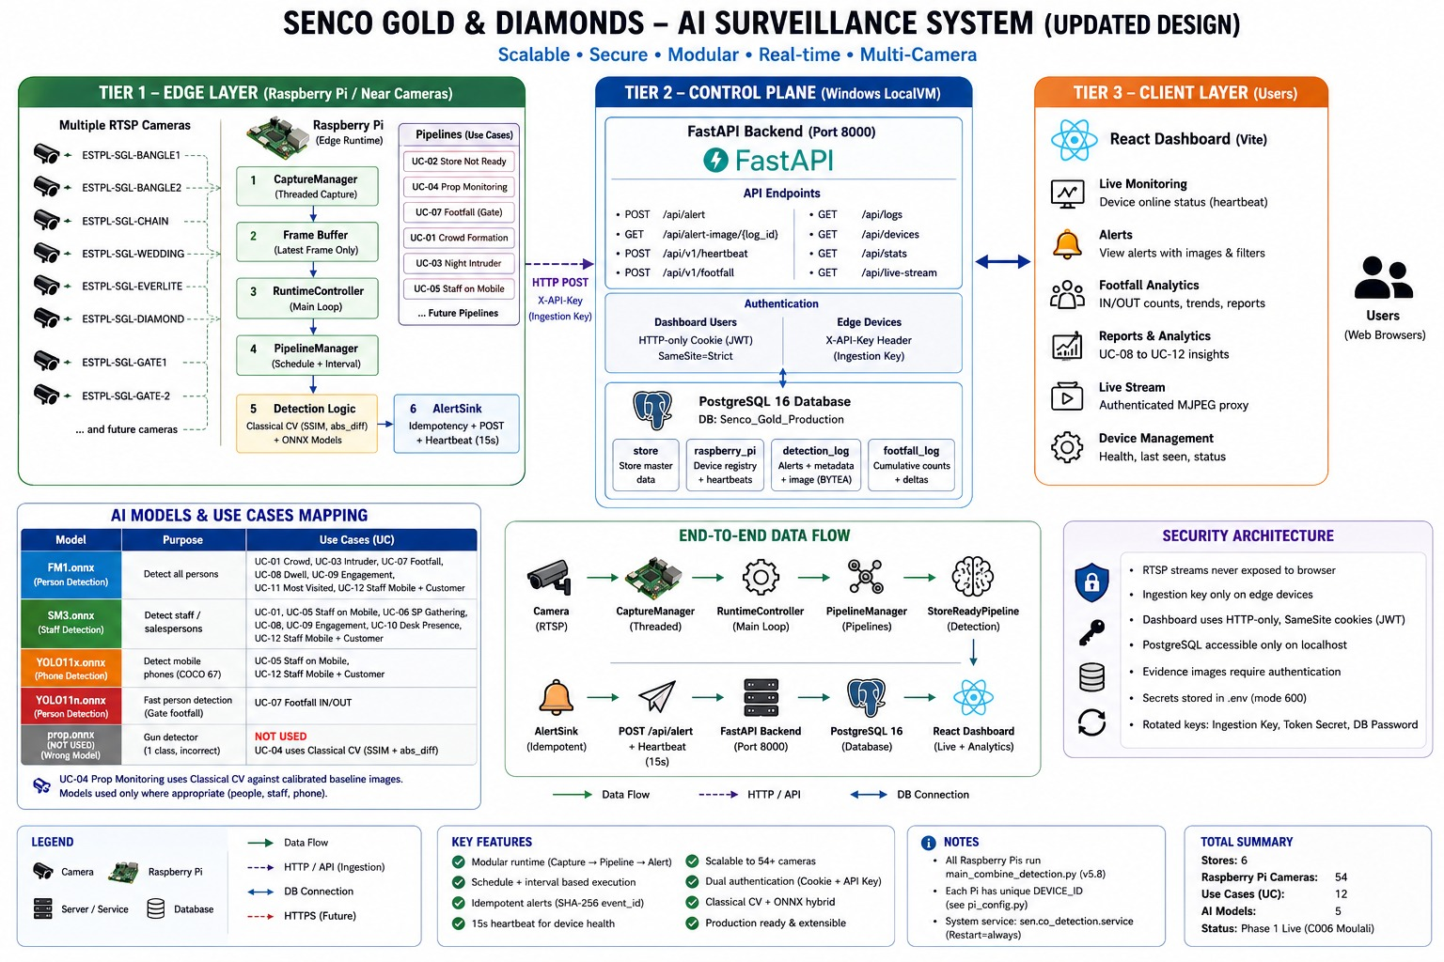

Slide 16
THANK YOU
Transforming Vision into Intelligence
ELVA by ESTPL
Address: Eltern Segen Technologie Pvt. Ltd.
P-116 Nani Gopal Roy Chowdhury Avenue.
Kolkata -700014
Mail – info@elternsegen.ai
www.elternsegen.ai
Contact - +91 98312 64720

