Slide 1
Solar Inverter

Slide 2

Presented By,
Abhranil Das, Roll no. 13
Ranjan Kumar, Roll no. 14
Sudipta Sarkar, Roll no. 15
Nov,2022
Under the guidance of, Hon’ble Professor,
Prof. Arijita Das
DEPARTMENT OF ELECTRICAL & ELECTRONICS ENGINEERING INSTITUTE OF ENGINEERING & MANAGEMENT SECTOR V, SALTLAKE ELECTRONIC COMPLEX, KOLKATA-700091

Slide 3
Overview
Introduction
Components Required
Block Diagram
Working Procedure
Future Scope
Conclusion

Slide 4
Introduction
The world demand for electric energy is constantly increasing and conventional energy resources are diminishing . For all these reasons, the need for alternative energy sources has become necessary and solar energy in particular has proved to be a very promising alternative. An inverter is basically a converter that converts DC-AC power. It is a common inverter, but uses energy from the sun that is termed "solar energy". This kind of inverter helps in changing the DC- AC uses solar power.

Slide 5
Components
Circuit Components for solar charger circuit:
1)Solar panel – 12V
2) LM317 voltage regulator
3) DC battery
4) Diode – 1n4007
5)Capacitor – 0.1uF
6)Schottky diode – 3A, 50V
7) Resistors – 220, 680 ohms
8) Pot – 2K
9) Connecting wires
Circuit Components for inverter circuits:
1) IC CD4047
2)POT-100K
3) Step-up Transformer (230v primary 9v-0-9v, 1.5A , secondary
transformer connected in reverse)
4) Capacitor – 2200uf(25V), 0.01uf, 0.1uf (600v) , 22uf(200V)
5) 1N4007-Diode
6) Resistors- 20K , 330, 820, 220, 220 ohms
7) Led-1
8) IRF540 MOSFET -2
9) MOV RDN240

Slide 6
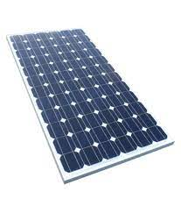
Solar panel
Photo voltaic solar panels absorb sunlight as a source of energy to generate electricity.
A photo voltaic system typically includes an array of photo voltaic modules, an inverter, a battery pack for storage.
The most common application of solar panels is solar water heating systems.

Slide 7
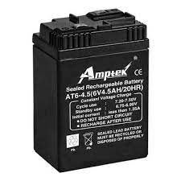
4.5A Rechargeable Battery
A rechargeable battery, secondary cell, is a electrical battery that can be charged, discharged into a load, and recharged many times.
The energy used to charge rechargeable batteries usually comes from a battery charger using AC mains electricity.

Slide 8
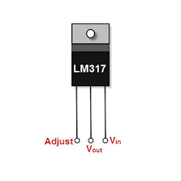
LM317 Voltage Controller
It is a type of positive-linear-voltage regulator used for voltage regulation.
If we connect a fixed resistor between the output and adjustment of the LM317 regulator, then the LM317 circuit can be used as a precision current regulator.

Slide 9
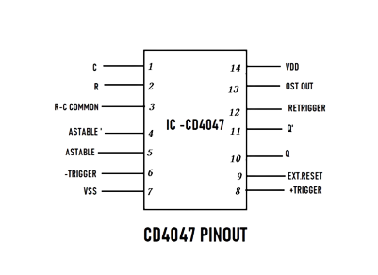
IC CD4047
CD4047 is also a multivibrator IC. It can operate in two modes.
A capacitor is connected externally between pins 1 and 3 to determine the pulse width of the output signal in the astable mode.

Slide 10
Block Diagram
Solar
Panel
Regulator Battery Charger
Inverter Circuit
Switching Device
Step Up Transformer

Slide 11
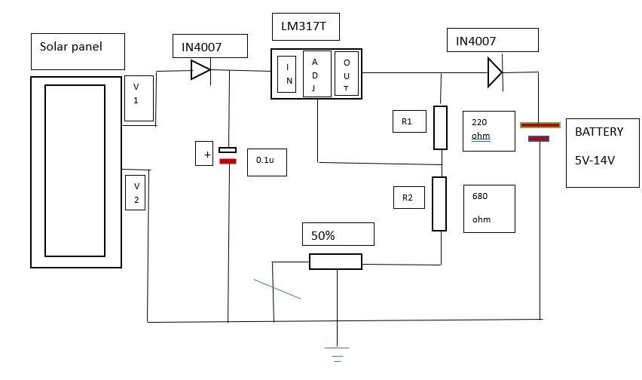
Circuit Diagram: Solar Charger Circuit

Slide 12
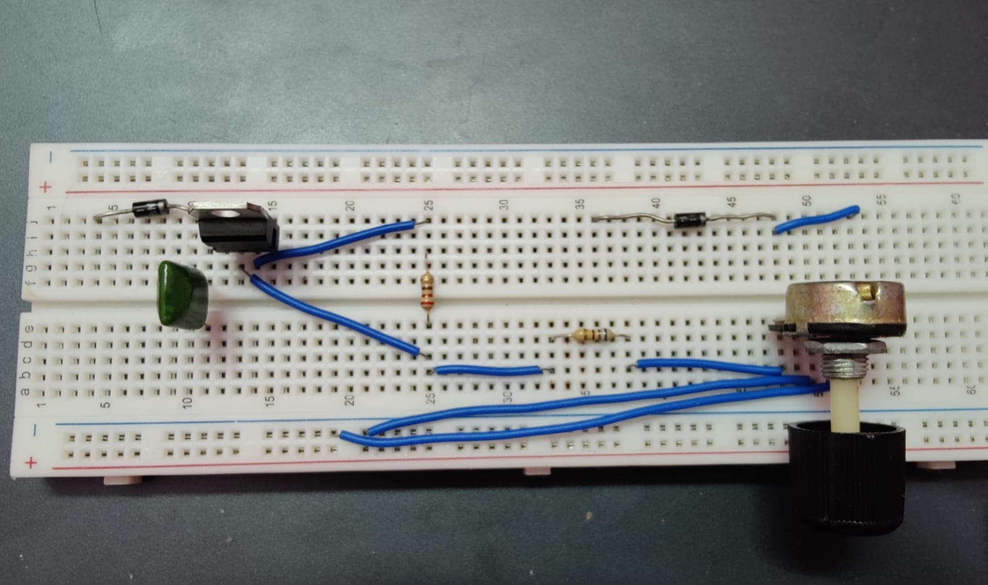
Implementation

Slide 13
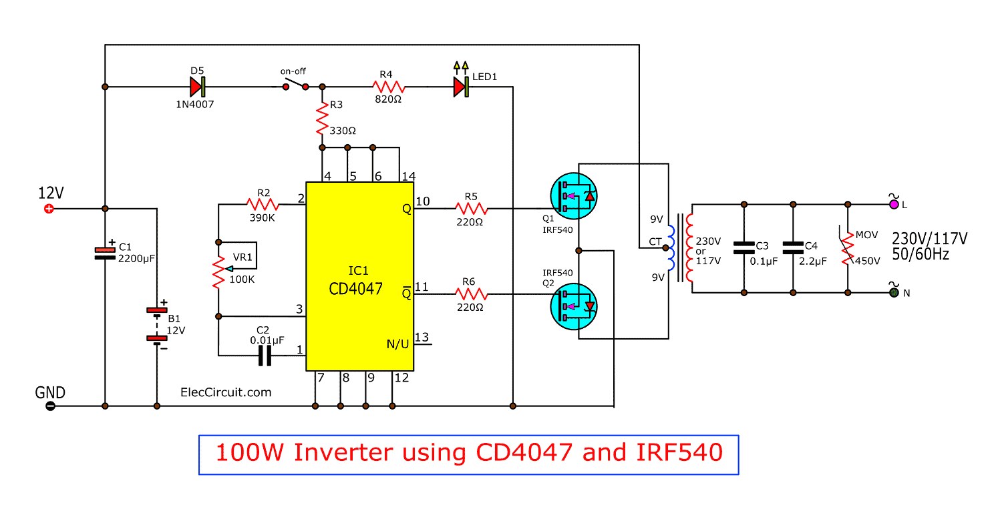
Circuit Diagram
Solar Inverter Circuit

Slide 14
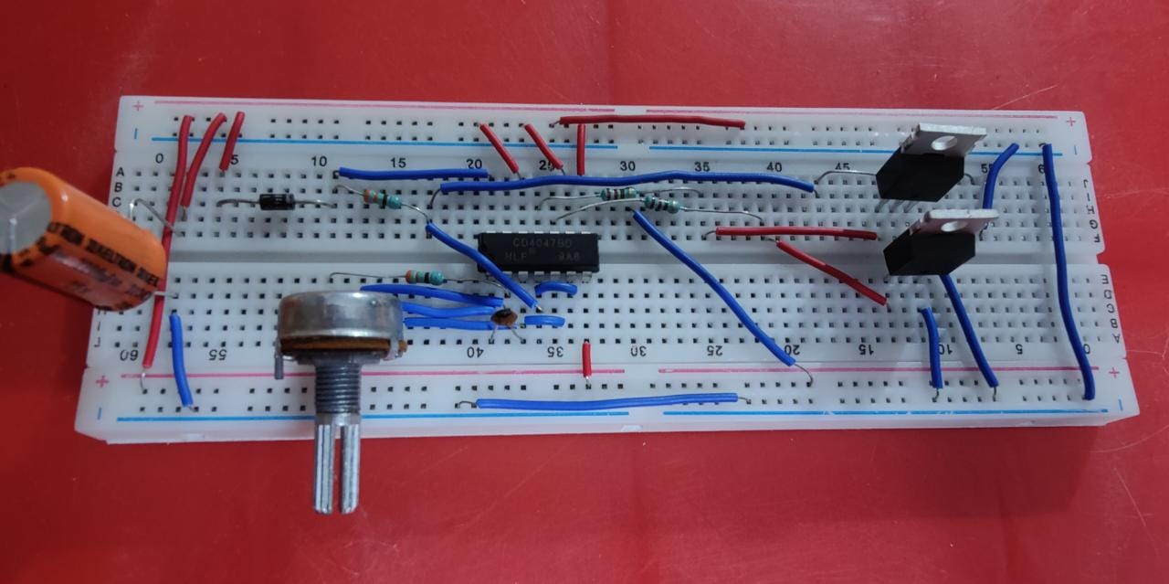
Implementation

Slide 15
Working Procedure
Regulator / Battery Charger
Inverter Circuit using IC CD4047 (Switching Pulse Oscillator)
𝑓 = 1/4.4𝑅𝐶.
IRF540 N Channel power mosfet used as driver to the transformer

Slide 16
Future Scope
Solar energy is an infinite source of energy. The main motto of our project is to promote the use of renewable energy sources. This project is most useful in our life because in this project one time investment is fixed on a lifetime.
There is more advancements pending in this field which will revolutionize the energy stream and solar energy will be playing the most important role of all.

Slide 17
Conclusion
From this project it is observed that the hybrid inverter with solar battery charging provides an uninterrupted power supply during the power cuts.
A solar hybrid system stores your excess solar energy and can also provide back-up power during a blackout.

Slide 18


