Slide 1
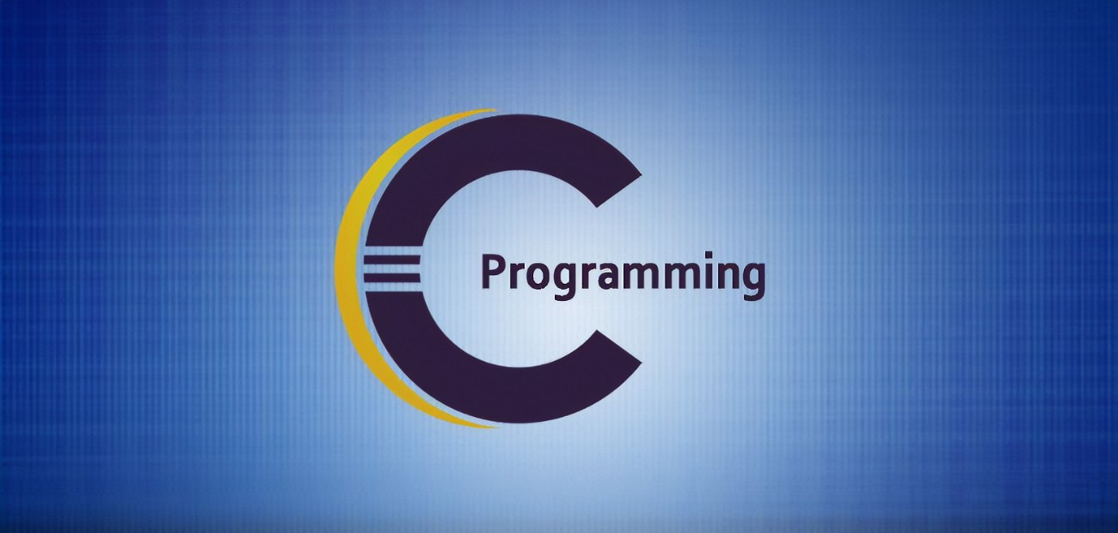
A Brief History Of Programming Language
Created By:
Sudipto Dey Himel
Dept. of Computer Science & Engineering
Metropolitan University, Sylhet, Bangladesh

Slide 2
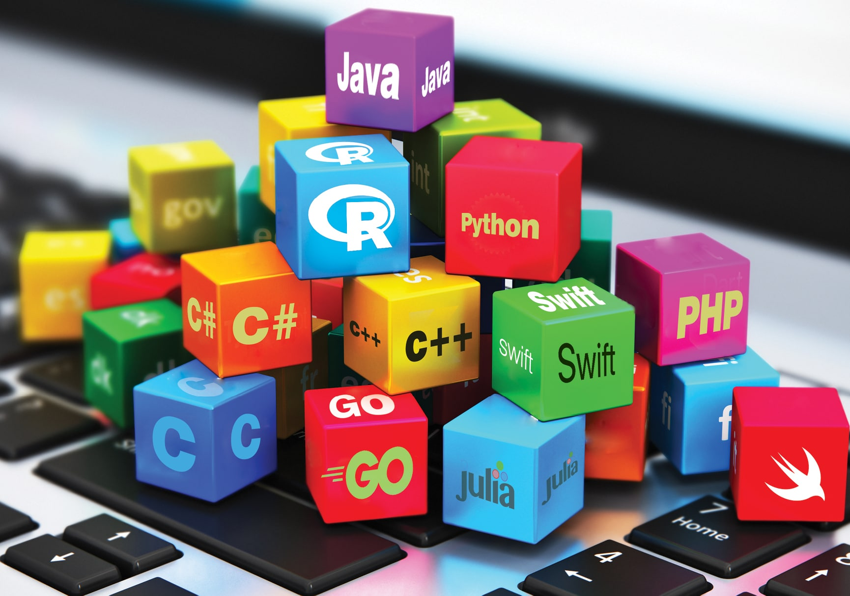
What is Programming Language ?
Like human being, computers have their own language, which is called programming language.
A programming language is a computer language that is used by the programmers (developers) to communicate with computer. It is a set of instructions written in any specific language (C,C++, Java, Python, etc.) to perform a specific task.

Slide 3
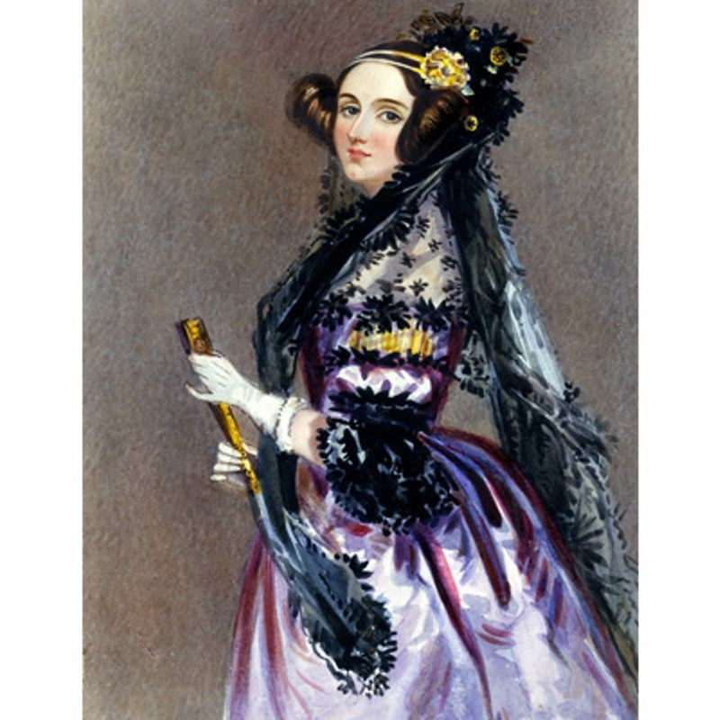
Frist Concept Of Programming:
The first concept of programming comes from the beginning of the invention of computers. In 1833, when the father of modern computers Charles Babbage, was intoxicated by the invention of computer called the Analytical Engine, Augusta Ada, who is known as Ada Lovelace, realize that there was a mathematical connection with this computer. On 5 June 1833, for using this Analytical Engine, Ada gave him the idea of “Programming”. Which was basically a kind of mathematical instruction. And this is where the concept of programming begins.
Ada Lovelace
1815-1852
Gave the first concept of “Programming”

Slide 4
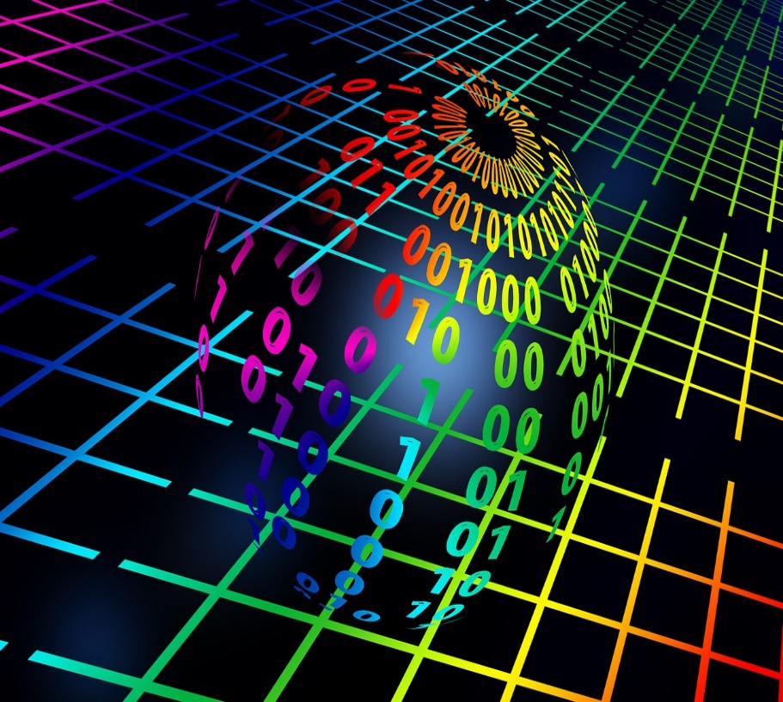
Evaluation of C Programming
1.Machine Language:
The first programming language ever discovered in the world is “Machine Language”. It was created in 1945. Machine language is a low-level programming language that can be directly understood by computers. Machine language is basically written in binary code, i.e. 0's and 1's. Writing programs in machine language was so difficult that if there was a small mistake in the code, it was almost impossible to find the mistake between such huge 0 and 1. Due to which the code had to be written from scratch.
Machine code

Slide 5
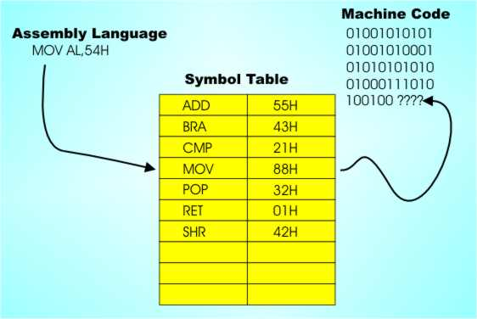
2.Assembly Language:
After that, scientists keep thinking new ways to solve these problems. And plans to make a kind of translator that can easily connect human thoughts with computers. And in 1949, “Assembly Programming Language” was invented. which is capable of converting English alphabets into machine language. To write code in assembly language, a person needs to have a good understanding of the architecture and peripherals of a computer processor. Otherwise he will not be able to understand and use the commands. Which was a very difficult thing.

Slide 6
3. In 1950, an American computer scientist Dr. Grace Hopper created three programming languages MATH-MATIC, FLOW-MATIC & A2.
4. Then James Backus created ForTran.
5. In 1960, the ALGOL(Algorithmic Language) was created.
Basically these languages ​​are the predecessors of modern programming languages. But those languages ​​were used for different tasks.
6. After that, the ALGOL60(Algorithmic Language 60) and CPL(Combined Programming Language) was creted. But CPL was very difficult to learn and use.

Slide 7
7. In 1967, Martin Richard created BCPL(Basic Combined Programming Language) based on CPL. But it was essentially less powerful to specific and typeless programming language. At that time scientist Thomson created a programming language called B at Bell Laboratory in United States.
8. Dennis Ritchie later followed B and BCPL and, using his own ideas, developed the C Language in 1972. Since then, many version of the C language have been developed. In 1983, the American Standard Organization formed a committee to develop a standard version of C language, and in 1989, the standard C Language known as ANSI C was created. Later in 1990, ANSI approved this standard version of C.

Slide 8
Machine Language
First programming language
Assembly Language
Invented in 1949
MATH-MATIC , FLOW-MATIC, A2
Invented in 1950
ALGOL
(Algorithmic Language)
Invented in 1949
BCPL
(Basic Combined Programming Language)
Invented in 1967
B
Invented in 1970
C_{(traditional)}
Invented in 1972
ANSI C
Invented in 1989
C₉₀
_{Approved Version}
C₉₉
1999 Edition
C₁₁
2011 Edition
C₁₇
2018 Edition

Slide 9
Thank you

