Slide 1


TakaTracker
টাকাট্র্যাকার — হিসাব রাখুন, ব্যবসা বাড়ান
A Mobile Financial Management Application for Bangladeshi Micro & Small Businesses
Course: SE331 — Software Engineering Design Capstone Project
Daffodil International University | Spring 2026 | Section: E1 | Batch: 40
Instructor: Rahat Uddin Azad (Lecturer, Dept. of Software Engineering)
Team: Sudipto Biswas • Shah Shazid Askary • Masud Hassan Sakib
IDs: 0242310005341163 • 0242310005341201 • 0242310005341046

Slide 2
00
Presentation Agenda
Overview of today's presentation
01
Problem Statement & Solution
[Sudipto]
07
Quality Assurance & Testing
[Shazid]
02
Stakeholders & Requirements
[Sudipto]
08
Technical Challenges & Solutions
[Masud]
03
System Architecture
[Sudipto]
09
Team Responsibility Matrix
[Masud]
04
Technology Stack
[Sudipto]
10
Future Enhancements
[Masud]
05
Use Case Diagram
[Shazid]
11
Thank You & Q&A
[Masud]
06
Entity Relationship Diagram
[Shazid]

Slide 3
01
Problem Statement
Why do Bangladeshi small merchants need TakaTracker?
📝 Manual Bookkeeping
📊 The Reality in Numbers
7.8M+ small businesses still use pen & paper (খাতা)
7.8M+
Small businesses in Bangladesh
💸 Lost Revenue
Inaccurate records, forgotten dues, calculation errors
80%
Still use manual bookkeeping
🌐 Language Barrier
Most solutions in English — merchants prefer বাংলা
~40%
Revenue leakage from forgotten dues
📡 Connectivity Issues
65%
Merchants prefer Bengali interfaces
Rural areas lack stable internet — cloud-only apps fail
30%
Areas with unreliable internet
🔒 Data Loss Risk
Paper records damaged, lost, or destroyed in floods
References
Bangladesh Bureau of Statistics - MSME Survey 2019
Presented by: Sudipto

Slide 4
01
Proposed Solution
TakaTracker — হিসাব রাখুন, ব্যবসা বাড়ান
📱
🌐
💰
📦
Offline-First
Bengali UI
Smart Tracking
Inventory Mgmt
100% functionality
without internet
Full বাংলা interface
for local merchants
Auto-calculate dues,
profit & expenses
Product catalog with
low-stock alerts
💳
☁️
📊
🔐
QR Payments
Cloud Sync
Reports
Secure Auth
bKash, Nagad, Rocket
QR code support
Background sync
when online
Daily/weekly/monthly
PDF & Excel export
OTP-based login
JWT tokens
Presented by: Sudipto

Slide 5
02
Stakeholders & Requirements
Who uses TakaTracker and what do they need?
🧑‍💼
👷
🔧
👨‍🏫
Small Merchants
Shop Staff
System Admin
Suppliers
Primary users
recording daily transactions
Employees recording
transactions for owners
Managing infrastructure
and deployments
Track credit extended to merchants
Key Needs:
Key Needs:
Key Needs:
Key Needs:
Easy UI, offline, বাংলা
Simple interface,
restricted access
Reliable API,
monitoring
Easy UI, offline, বাংলা
📋 Key Functional Requirements
ID | Requirement | Priority | Status
FR-01 | OTP Authentication | High | ✅ Done
FR-02 | Transaction Recording (7 types) | High | ✅ Done
FR-03 | Contact & Dues Tracking | High | ✅ Done
FR-04 | Offline-First Architecture | High | ✅ Done
FR-05 | Bengali Localization | High | ✅ Done
FR-06 | Inventory Management | Medium | ✅ Done
FR-07 | QR Payment Generation | Medium | ⏳ Partial
Presented by: Sudipto

Slide 6
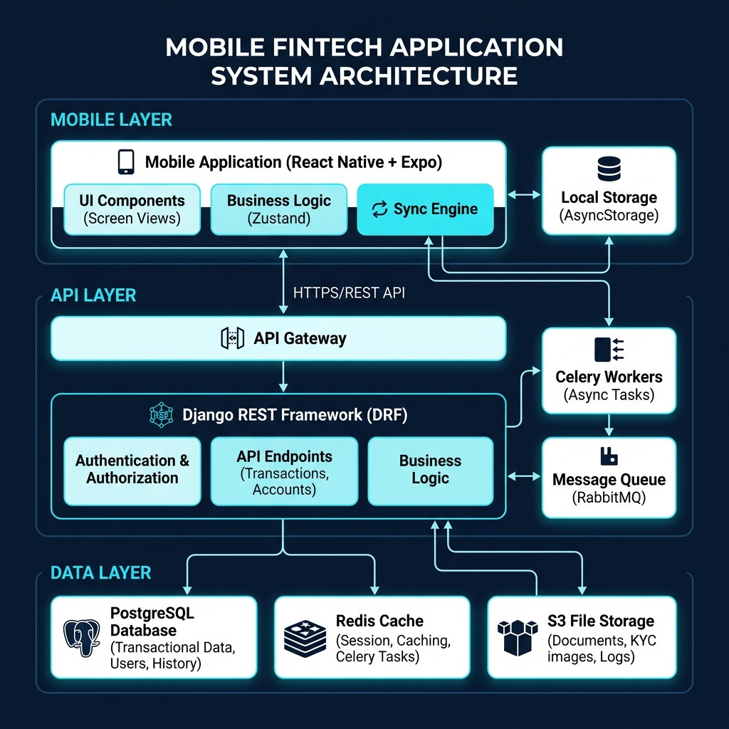
03
System Architecture
Three-tier architecture with offline-first design
📱 Mobile Layer
• React Native + Expo SDK 54
• Zustand state management
• AsyncStorage persistence
• Custom sync engine
🌐 API Layer
• Django REST Framework
• JWT (SimpleJWT) auth
• Celery + Redis workers
• RESTful HTTPS protocol
💾 Data Layer
• PostgreSQL (primary DB)
• Redis (cache + queue broker)
• S3 / local file storage
• UUID primary keys
Presented by: Sudipto

Slide 7
04
Technology Stack
Modern, scalable, and developer-friendly choices
📱 Mobile App
⚙️ Backend
🛠️ DevOps & Tools
React Native + Expo
Django 5.x
Git + GitHub
Cross-platform framework
Python web framework
Version control & CI/CD
TypeScript
Django REST Framework
GitHub Actions
Type-safe development
RESTful API builder
Automated workflows
Zustand
SimpleJWT
EAS Build
Lightweight state mgmt
Token-based auth
Mobile APK builds
React Navigation 6
PostgreSQL 15
Railway
Stack & Tab navigation
Relational database
Backend hosting
AsyncStorage
Redis
Docker
Offline data persistence
Cache + task broker
Containerization
i18next
Celery
VS Code
Bengali/English i18n
Async processing
Primary IDE
Axios
Gunicorn
Postman
HTTP client for APIs
WSGI HTTP server
API testing & docs
CASL
Django CORS
pgAdmin
Role-based access control
Cross-origin support
Database UI
Presented by: Sudipto

Slide 8
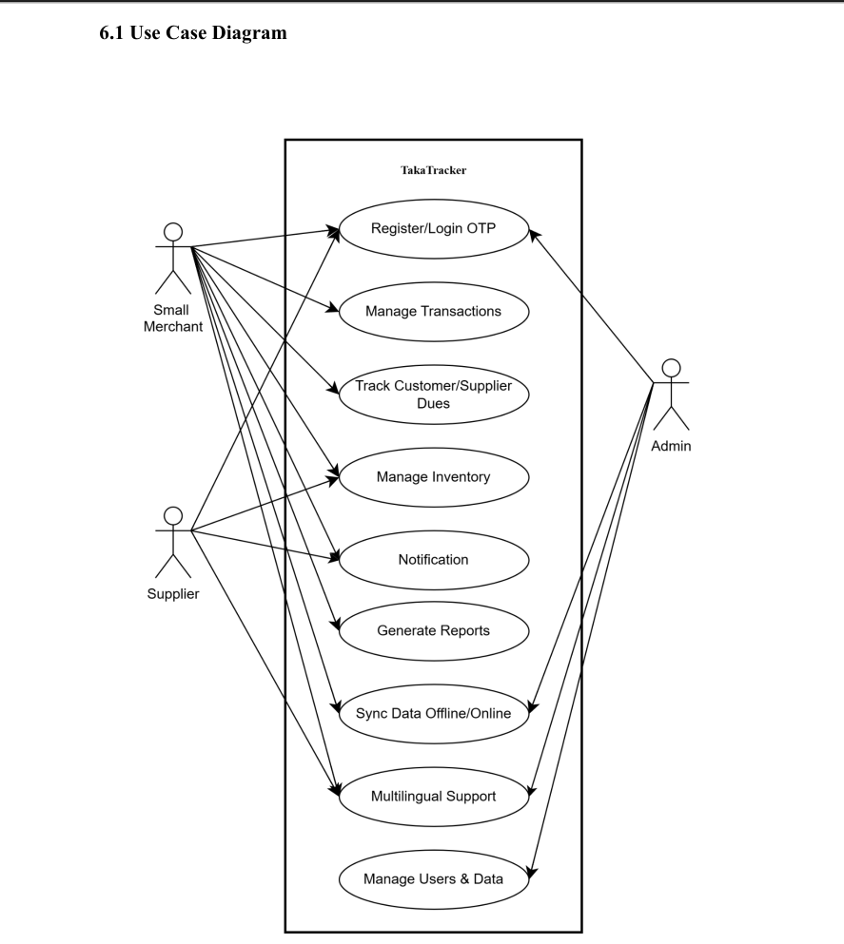
05
Use Case Diagram
System interaction model for all user roles
👤 Actor Permissions
▸ Merchant (Primary)
• Register / Login via OTP
• Record all 7 transaction types
• Manage contacts & inventory
• Notification
• View dashboard & reports
• Generate QR payments
• Switch BN / EN language
▸ Supplier
• Manage Inventory
• Notification
• Multiilingual Support
▸ Admin (Backend)
• Register/Login OTP
• Sync Data Offline/Online
• Multiilingual Support
• Manage Users & Data
Presented by: Shazid

Slide 9
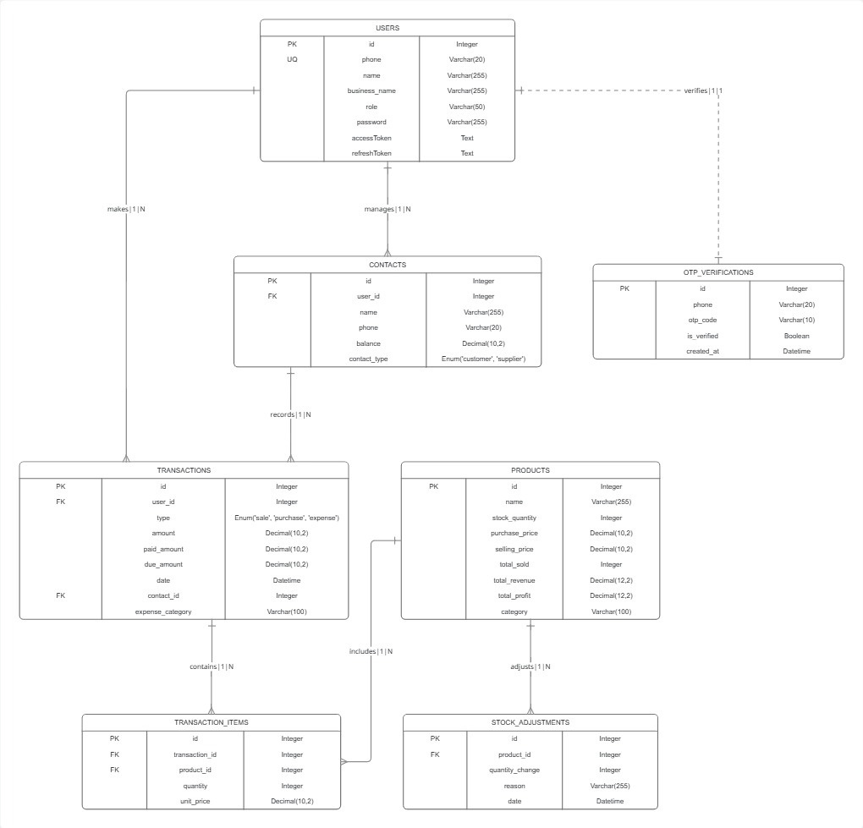
06
Entity Relationship Diagram
Database follows Third Normal Form (3NF)
🔗 Key Entities & Relationships
▸ User
With phone, name, and role.
▸ Contact
Customer or supplier with auto-calculated balance.
▸ Transaction
supporting 7 types including sale, purchase, and expense.
▸ Product
SKU, barcode, stock tracking, low-stock alerts
▸ OTP Verification
User verification for security
▸ Transaction Items
Products, Quantity & Price
▸ Stock Adjustment
Adjust product quantity after sale or purchase
✅ 3NF • UUID PKs • Soft Delete • Sync-ready
Key: User→Contact (1:N), User→Transaction (1:N), Contact→Transaction (1:N)
Transaction→Items (1:N), Product→Items (1:N), User→Wallet (1:1)
Presented by: Shazid

Slide 10

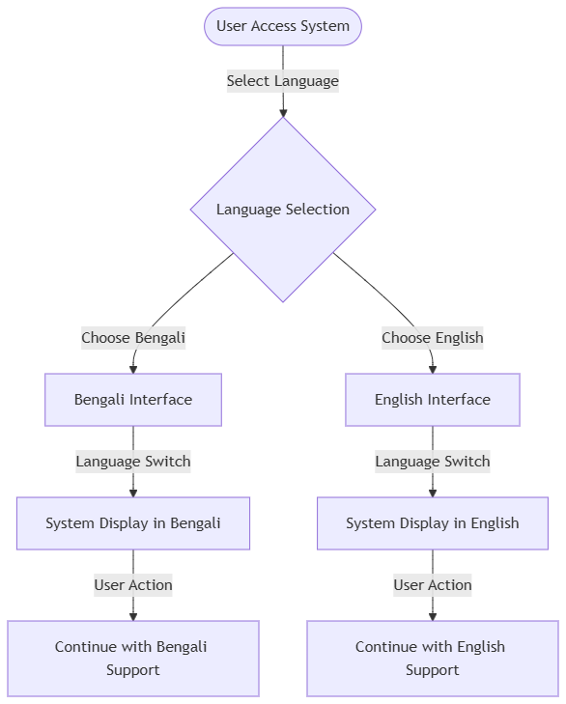
07
Activity Diagram
🔗 Multilingual Interface
Dual-Language Support: Seamlessly switch between Bengali (BN) and English (EN) interfaces at any time.
Instant Toggle: Verified instant language switching for immediate system display updates.
Inclusive Accessibility: Native Bengali UI designed with 48dp touch targets to ensure usability for all merchants.
Consistent Experience: Language selection persists across registration, dashboards, and reporting
Presented by: Shazid

Slide 11
08
Quality Assurance & Testing
Comprehensive test strategy for reliable software
🧪 Functional
🔒 Security
⚡ Performance
📱 Usability
8 test cases covering
all core features
JWT, OTP rate limiting
HTTPS encryption
Dashboard < 2s load
Transaction < 1s save
Bengali UI, 48dp touch
targets, accessibility
📋 Test Cases
Test ID | Test Scenario | Result
TC-AUTH-01 | OTP login with valid phone | Pass ✅
TC-AUTH-02 | Language toggle EN ↔ BN instantly | Pass ✅
TC-TXN-01 | Record ৳500 sale with contact link | Pass ✅
TC-CON-01 | Contact balance auto-update on sale | Pass ✅
TC-INV-01 | Stock auto-decrease on sale (10→7) | Pass ✅
TC-SYNC-01 | Offline sale → auto-sync when online | Pass ✅
VAL-01 | Reject negative transaction amount | Pass ✅
VAL-02 | Invalid phone format rejection | Pass ✅
Presented by: Shazid

Slide 12
09
Technical Challenges & Solutions
Key engineering problems we solved
🔄 Offline-to-Online Sync Conflicts
Challenge: Multiple offline edits conflict when syncing
✅ Solution: Last-write-wins with UUID conflict resolution + retry queue
🌐 Bangla-first i18n with Live Switching
Challenge: Bengali rendering + toggle without app restart
✅ Solution: i18next + Zustand reactivity triggers instant re-render
⚡ Performance on Low-end Devices
Challenge: Budget Android phones (2GB RAM) must run smoothly
✅ Solution: FlatList lazy loading, Zustand partialize, memoized summaries
🔐 Secure Offline Authentication
Challenge: JWT tokens expire but users need offline access
✅ Solution: Encrypted local credentials + 30-day refresh token auto-renew
💰 Accurate Dues Calculation
Challenge: Contact balances must stay correct across 7 txn types
✅ Solution: Centralized update_balance() on every transaction mutation
Presented by: Masud

Slide 13
10
Team Responsibility Matrix
Who built what — Individual contributions
👨‍💻 Sudipto Biswas
🌐 Shah Shazid Askary
🎨 Masud Hassan Sakib
Team Lead
i18n & Contacts
Frontend Dev
Modules:
Modules:
Modules:
• Overall Architecture & Design
• Navigation & Theme Setup
• Mobile UI/UX Design
• Django APIs & Database Models
• Contact Management
• Dashboard Screen
• Auth System (OTP + JWT)
• Payments UI
• Transaction Screens
• Offline Sync Engine
• Localization (i18n)
• Inventory Management
• RBAC Implementation
• Auth Screens
• Sync & Offline Engine
Key Files:
Key Files:
Key Files:
📄 backend/apps/users/
📄 ContactsScreen.tsx
📄 DashboardScreen.tsx
📄 backend/apps/transactions/
📄 ContactDetailScreen.tsx
📄 AddTransactionScreen.tsx
📄 mobile/src/store/syncStore.ts
📄 en.json / bn.json translations
📄 InventoryScreen.tsx
⚡ Challenge:
⚡ Challenge:
⚡ Challenge:
Designing offline-first sync
to prevent data conflicts
Contact balances accurate
across all transaction types
Complex form state in
AddTransactionScreen
📚 Learned:
📚 Learned:
📚 Learned:
Django ORM signals, UUID PKs,
Redis job queues
i18next dynamic language
swapping in React Native
Zustand state management,
FlatList optimizations
Presented by: Masud

Slide 14
11
Future Enhancements
What's next for TakaTracker v2.0+
🤖
🎤
📷
AI-Powered Insights
Bengali Voice Input
Barcode Scanner
Sales predictions, trend
analysis, smart categories
Hands-free recording
using speech recognition
Quick product entry
via camera scanning
👥
📱
🏦
Multi-User Access
SMS Notifications
Bank Integration
Shared access for
partners & employees
Due date reminders
& payment alerts
Direct reconciliation
& auto statements
Presented by: Masud

Slide 15
Thank You!
Questions & Answers

