Slide 1

Tutor Scheduling

Slide 2
Tutor Scheduling
Two or more tutoring sessions needs to be scheduled for a student
Multiple sessions need to occur on the same day
Number of sessions could be two or more
The goal of the scheduling is to achieve
Efficiency: Minimize total wait time for student and tutors
Fairness: Minimize bias for distributing wait times
Scheduling concurrently for multiple students is out of scope

Slide 3
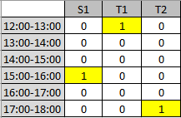
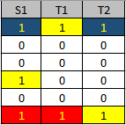
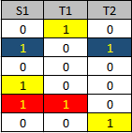
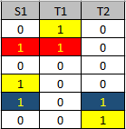
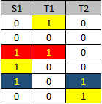
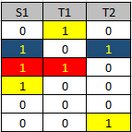
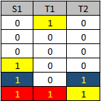
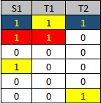
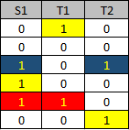
Scheduling Examples

Slide 4

Solution Constraints (+Vocabulary)
Can’t offer tutoring when student is already booked
Student can attend only one session at a time
Total waiting time could be used as a good indicator of inefficiency
Fairness? Sum-Square of waiting time is a good inverse proxy
Solution Vocabulary
Base List:
Availability List:

Slide 5
Scheduling Steps
Filter Tutor schedules [can’t offer tutoring if student is not available]
Convert BaseList to AvailabilityList
Create combinations using AvailabilityList
Discard AvailabilityLists containing non-unique elements [Student can attend only one session at a time]
Create schedules from remaining availability combinations
Rank/sort the schedules based on
firstly efficiency
secondly fairness

Slide 6
Parting thoughts
What can we do better?
Is there a way to adjust relative priority of student’s time vs tutors’ time?
Is this solution extensible to >2 tutors?

