Slide 1

EDA for EPL
Presented by Sudipto Dutta

Slide 2
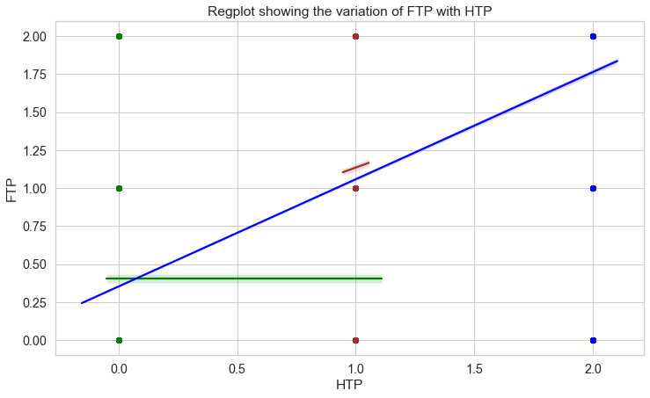
Relation between Half Time Results and Full Time Results
HAD
- Full Time Results are positively correlated with Half Time Results, which means Half Time results are likely to stay the same as Full Time Results especially when Home team is winning or match finishing as Draw in Half time, chances of turn-around are not very likely in EPL.

Slide 3
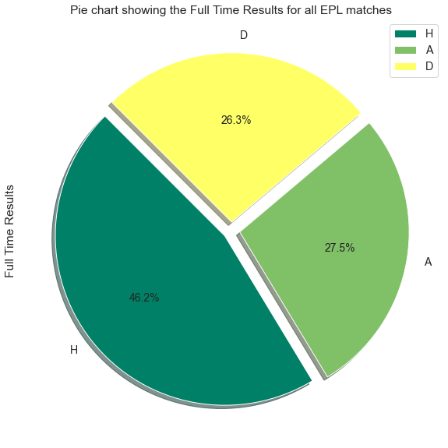
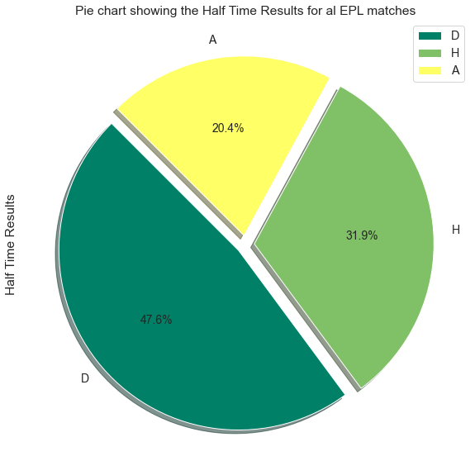
Full Time Results & Half Time Results Statistics
- Home Team always has slight advantage of winning the game (46.2%)
- HTR is more likely to be Draw (47.6%)

Slide 4
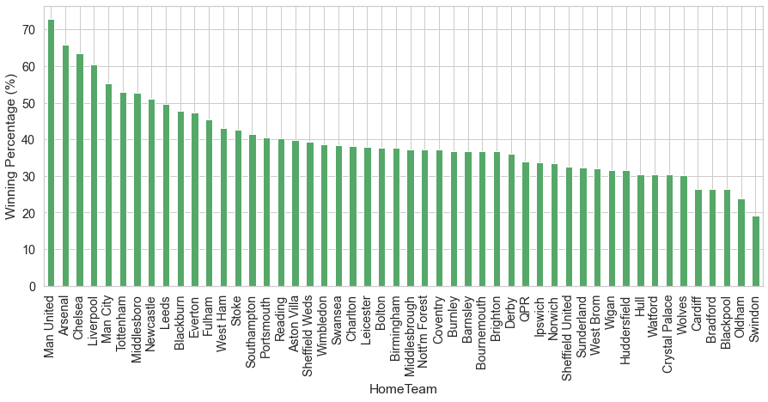
Home Teams’ Performance in EPL
- Manchester United is the most successful team in Home Ground. They have more than 70% winning rate. Few other Successful teams are Arsenal, Chelsea, Liverpool, Man City

Slide 5
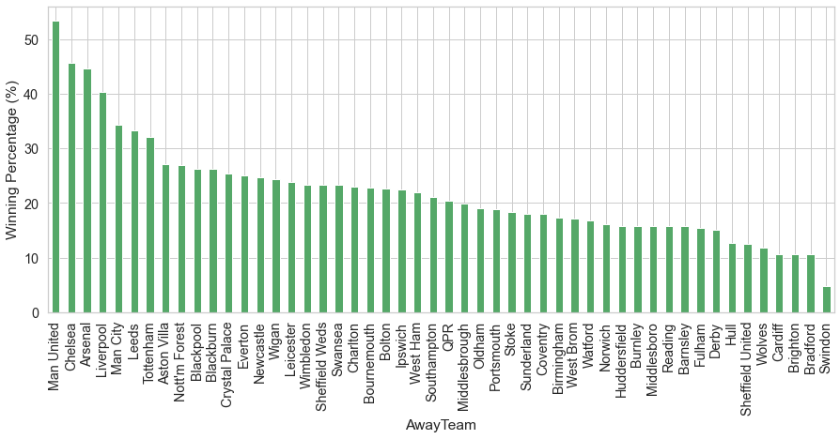
Away Teams’ Performance in EPL
- Manchester United is the most successful team in Away matches. They have more than 50% winning rate. Few other Succesful teams are Chelsea, Arsenal, Liverpool, Man City

Slide 6
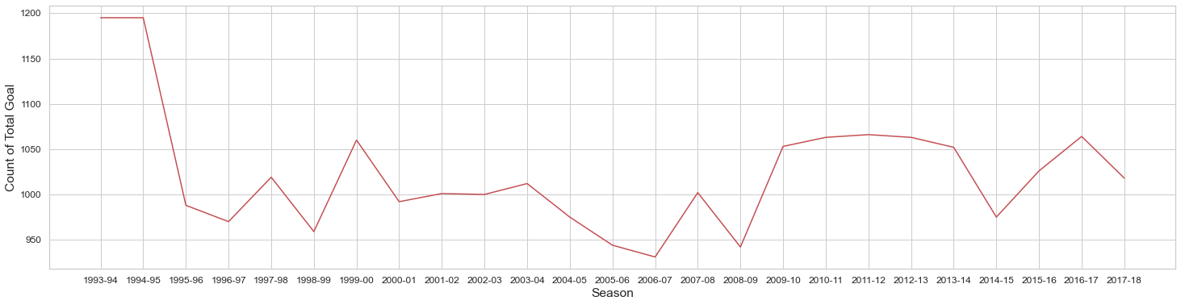
Total Number of Goal scored per Seasons
- Goal scored in first two EPL sessions are slightly higher, but usually the total goals scored are more or less same in each EPL seasons, so we can not infer anything from the above figure

Slide 7
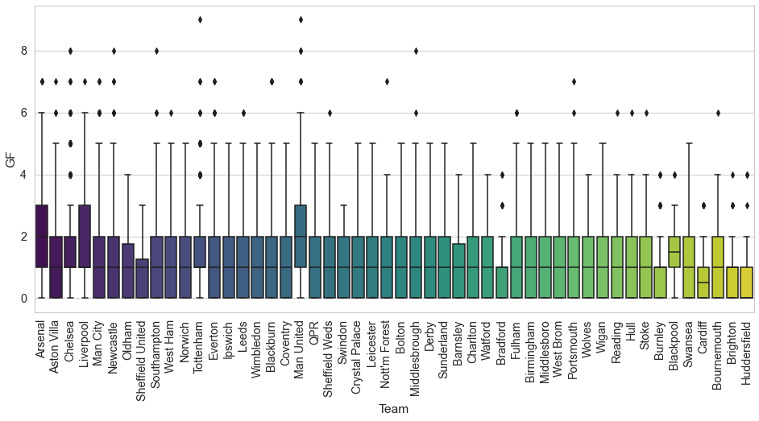
Teams’ Performance (Goal scoring ability) analysis from Goal Statistics
- Man United & Arsenal goal score rate is close 2 (median) goals per game which means they have a good side to play attacking football.
- Teams, good in attack/score Goals (normally score 1-3 goals per game) are
- Man United
- Arsenal
- Liverpool

Slide 8
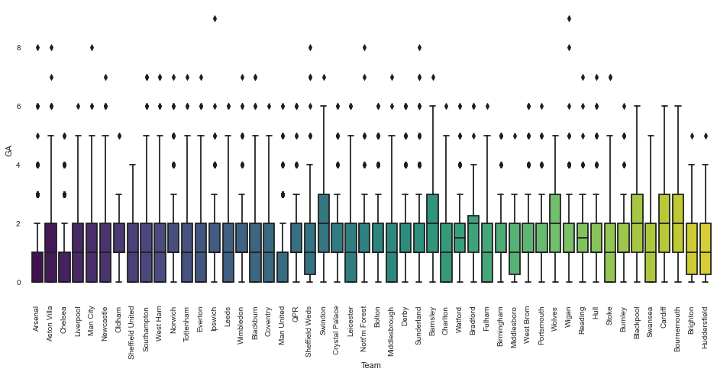
Teams’ Performance (Defensive capability) analysis from Goal Statistics
- Arsenal, Chelsea & Man United goal consumed (GA) rate is 0 (median) goal per game which means their defense is very strong.
- Teams, good in defense (normally consume 0-1 goal per game) are
- Man United
- Chelsea
- Arsenal

Slide 9
EPL League Winners This has been calculate based on highest number of points achieved by a Team in that EPL Season (considering Win – 2, Draw – 1, lose – 0)
Team | No of EPL Titles
Arsenal | 3
Blackburn | 1
Chelsea | 6
Leicester | 1
Man City | 3
Man United | 11

Slide 10
Conclusions
- Total 20 Teams play in EPL every season, every teams plays twice with each other, one in home ground and other one in away ground.
- Full Time Result (FTR) are heavily depending on Half Time Result (HTR) especially when Home team is leading or match ending in Draw during first half.
- Man United, Arsenal & Liverpool are good attacking sides among all the EPL teams, they normally score 1-3 goals per match.
- Man United, Chelsea & Arsenal are good in defense, they normally consume 0-1 goal per match.
- Man United, Arsenal, Chelsea, Liverpool, Man City are the most successful teams in EPL history in terms of winning & Arsenal, Man United, Liverpool, Chelsea appeared in all EPL seasons.
- Total 50 Teams have participated in EPL so far, but ony 6 teams have won the EPL and they are Man United, Chelsea, Arsenal, Man City, Leicester, Blackburn.

Slide 11
THANK YOU!!

