Slide 1



On the Generalization vs Fidelity Paradox in Knowledge Distillation
Suhas Kamasetty Ramesh*, Ayan Sengupta*, Tanmoy Chakraborty
Laboratory for Computational Social Systems (LCS2),
Indian Institute of Technology Delhi
Notes:
Hello Everyone, my name is Suhas.
I will be presenting our work titled "On the Generalization vs Fidelity Paradox in Knowledge Distillation"
This work has been accepted to the findings of ACL 2025
I will be presenting this on behalf of my co-authors Ayan Sengupta and professor Tanmoy Chakraborty.
All three of us are affiliated to Laboratory for Computational Social Systems at Indian Institute of Technology Delhi.

Slide 2
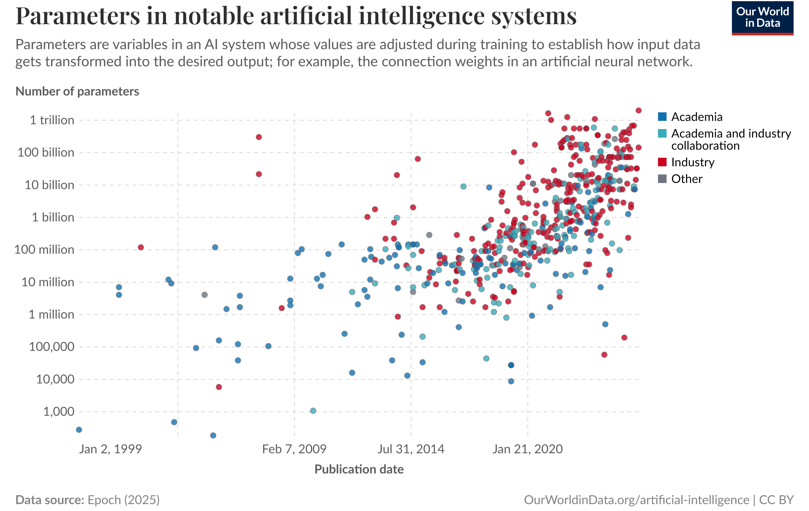
Knowledge Distillation and It’s Importance
Rapid advancement of pre-trained language models(LMs) has led to the development of large-scale language models that achieve state-of-the-art performance across various NLP tasks.
Deploying these large models presents significant challenges due to their high computational & memory requirements
Notes:
With significant advancements in pretrained models, the current state-of-art in most NLP tasks today are dominated by large pre-trained language models.
The model sizes have been growing exponentially and currently few of the models have also crossed the trillion parameter count.
The largest model in this plot, Llama 4 Behemoth has a total of 2 trillion parameters with 288B active parameters
As we can see, deploying these models for end use-cases have become increasingly difficult

Slide 3
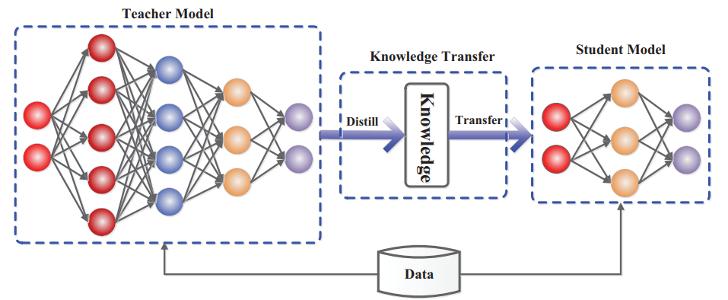
Knowledge Distillation and It’s Importance
Knowledge Distillation is a model compression technique that aims to transfer knowledge from a large model(teacher model) to a smaller model(student model)
Broadly, the goal is to train a small student network to match the predictions made by the larger teacher network
Picture source: https://arxiv.org/pdf/2006.05525
Notes:
Model compression has emerged as a crucial technique to mitigate these challenges by reducing model size while preserving performance.
Among various compression techniques, knowledge distillation (KD) has gained significant attention as it enables a smaller student model to learn from a larger teacher model, maintaining strong performance with reduced resource demands
Lets look at a few of the Knowledge Distillation methods for language models

Slide 4
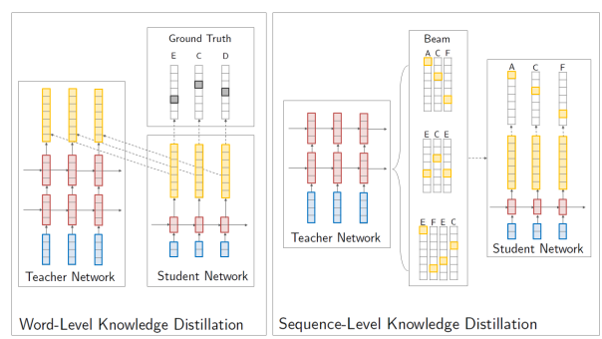
Sequence-Level KD for LLMs
Kim and Rush extended the idea to word-level and sequence-level KD for language models, which aligns the student model with the teacher’s output distributions
Notes:
Kim and & Rush were the first to introduce Knowledge Distillation in language models
They extended the concept to word-level and sequence-level
In word-level knowledge distillation (left) cross-entropy is minimized between the student/teacher distributions (yellow) for each word in the actual target sequence (ECD), as well as between the student distribution and the degenerate data distribution, which has all of its probability mass on one word (black).
In sequence-level knowledge distillation (right) the student network is trained on the output from beam search of the teacher network that had the highest score (ACF).

Slide 5
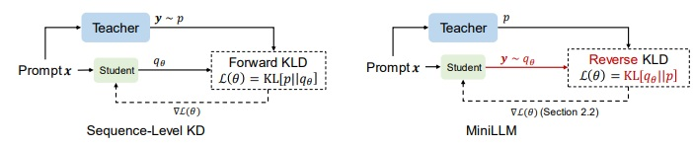
MiniLLM
Gu et al, replace the forward Kullback-Leibler divergence (KLD) objective in the standard KD approaches with reverse KLD, which is more suitable for KD on generative language models.
This prevents the student model from overestimating the low-probability regions of the teacher distribution.
Notes:
Gu et al show that Forward KL divergence is not well suited for generative models and replace it with reverse-KL divergence objective
This prevents the student model from overestimating the low probability regions of the teacher distribution

Slide 6
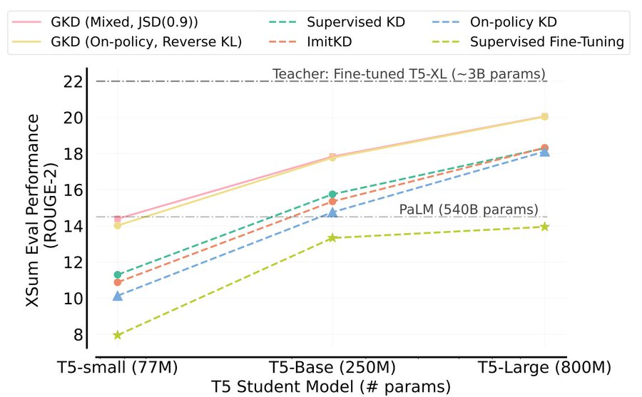
Generalized KD for LLMs
Current KD methods for auto-regressive sequence models suffer from distribution mismatch between output sequences seen during training and those generated by the student during inference.
Instead of solely relying on a fixed set of output sequences, GKD trains the student on its self-generated output sequences by leveraging feedback from the teacher on such sequences.
Notes:
Agarwal et al, show that there is a distribution mismatch between the output sequences seen during training time and those generated by the student models during inference time
Instead of just relying on fixed output sequences for training, GKD trains the student on self-generated output sequences.

Slide 7


Analytical Understanding of KD (Our Current Work)
Despite the recent traction of KD research, its effectiveness for smaller language models (LMs) and the mechanisms driving knowledge transfer remain underexplored.
Most existing studies overlook explainability of KD
We present the first large-scale empirical and statistical analysis of KD across models ranging from 0.5B to 14B
Models
KD Methods
Benchmarks
Rev-KD
Mathematical Reasoning
Seq-KD
GKD
Commonsense Reasoning
Qwen 2.5
Llama 3
Instruction Following
Notes:
Despite the recent traction of KD research, its effectiveness for smaller language models (LMs) and the mechanisms driving knowledge transfer remain underexplored.
Most existing studies overlook explainability of KD
We present the first large-scale empirical and statistical analysis of KD across models ranging from 0.5B to 14B
We study a total of 21 teacher-student pairs from Qwen2.5 and Llama-3 model sfamilies
We consider the three popular KD methods that we just saw – Sequence–Knowledge Distillation, Rev-KD and GKD
We verify on reasoning benchmarks and instruction following including a total of 19 diverse tasks

Slide 8
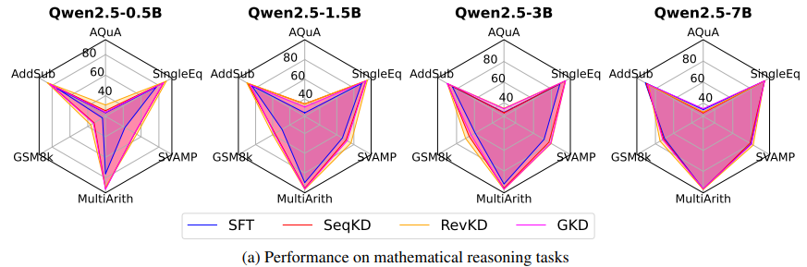
Effectiveness of KD
KD consistently outperforms SFT in all three benchmarks
KD significantly improves model generalization
Zero-shot performance of smaller LMs (<1B size) can be improved by up to 10% with peak task gains reaching 22% post distillation
A one-way ANOVA test reveals no significant difference on math and commonsense reasoning benchmarks – suggesting that all KD methods perform similarly on these two benchmarks
Notes:
We first test to see whether Knowledge Distillation is effective or not
We see that KD consistently outperforms SFT in all three benchmarks and also significantly improves model generalization
Performance of the small 0.5B models improves by up to 10% with peak task gains reaching 22% post distillation
But surprisingly in case of math and commonsense reasoning tasks, a one-way ANOVA test reveals no significant difference among KD methods – suggesting that all KD methods perform similarly on these two benchmarks

Slide 9
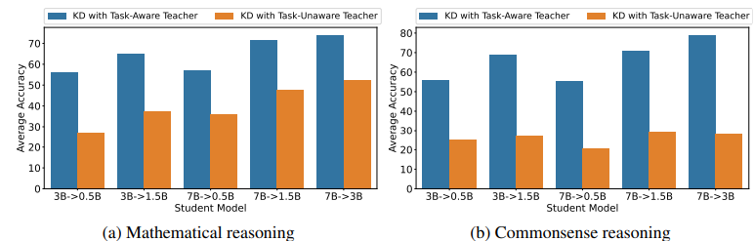
Does KD depend on teacher performance?
We conducted a Spearman rank correlation between student improvement after KD and teacher performance.
In commonsense reasoning and instruction following tasks and most of mathematical reasoning tasks, correlations are generally weak or negative, indicating that teacher quality alone does not dictate KD success.
Most importantly, a task-unaware teacher can significantly degrade student performance.
Post-distillation performance of student model can drop up to 40%, if teacher is not fine-tuned on downstream domain.
Notes:
In most of the tasks, there is a weak correlation between student improvement and teacher performance
This shows that teacher quality alone does not guarantee better student performance
But very importantly, if the teacher is not fine-tuned on the task, the student performance drops by up to 40%
This highlights that domain knowledge is more important than general performance of the teacher model

Slide 10
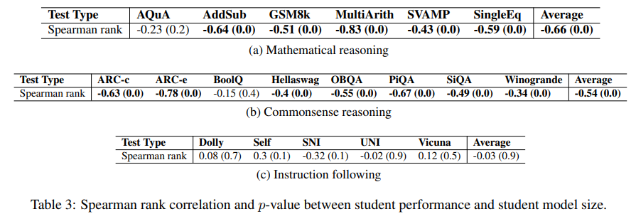
Does KD Depend on student model size?
We find a negative correlation (−0.66, p-value=0.0) between performance improvement and student model size, indicating diminishing returns as model size increases.
While smaller models (< 1B) improved by upto 10%, larger (7B) models exhibit only ~1.3% improvement after distillation, indicating that KD is most effective for smaller LMs.
Notes:
KD is most effective for smaller Language Models
We find a negative correlation between performance improvement and student model size
While the small 0.5 billion model improving by upto 10%, the larger 7B models improved by a modest 1.3%

Slide 11
Teacher Student Agreement & Fidelity
Apart from performance analysis of student model, we propose two metrics to understand alignment between teacher and student post-KD.
Teacher-Student Agreement - quantifies how often student replicates the teacher’s outputs and is measured using top-1 agreement (fraction of matching predictions). (this metric only relies on the final answer and does not measure the quality of the intermediate reasoning steps)
Reasoning Fidelity - captures how well the student mirrors the teacher’s reasoning process rather than just final predictions. We use BLEU score between teacher and student reasoning outputs to compute fidelity
Notes:
Apart from metrics that solely consider student model’s responses, we propose two new metrics to understand alignment between teacher and student post-KD.
Namely Teacher-Student Agreement that quantifies how often student replicates the teacher’s outputs
And Reasoning Fidelity that captures how well the student mirrors the teacher’s reasoning process rather than just final predictions.
We use BLUE score between teacher and student reasoning outputs to compute fidelity
Apart from BLUE score, we also used cosine similarity between sentence embeddings of teacher and student responses.
The Spearman correlation between BLEU scores and cosine similarity is 0.97 (p-value = 1e-9), indicating strong agreement.

Slide 12
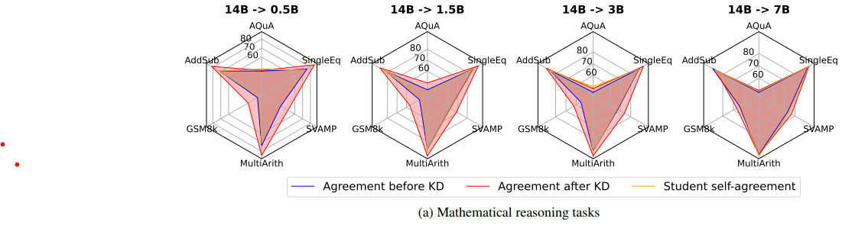
Teacher-Student Agreement
KD significantly improves teacher-student agreement (as seen before it is more effective in smaller models than larger models)
Smaller models (0.5B & 1.5B) exhibit higher agreement with larger Qwen-14B model in structured mathematical tasks like AddSub (89.1%) and MultiArith (94.5%), indicating effective transfer of well-defined rules.
However, a statistical test shows no significant corelation between student performance and teacher student agreement, suggesting that effective students deviate from teacher outputs rather than mimicking them.
Notes:
Knowledge Distillation significantly improves teacher-student agreement
A higher improvement is seen in structured mathematical tasks like AddSub and MultiArithmetic, indicating effective transfer of well-defined rules
But a statistical test shows no significant correlation between student performance and teacher student agreement.
This suggests that effective students deviate from teacher outputs rather than mimicking them.

Slide 13
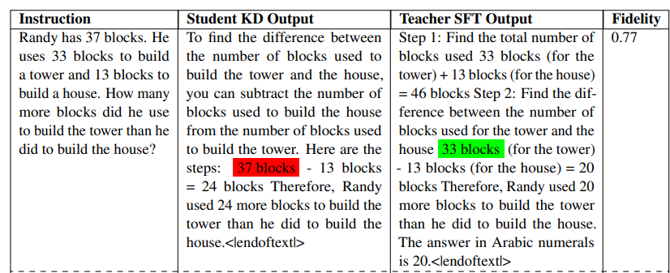
Reasoning Fidelity
Although KD improves Fidelity over SFT, there is a weak correlation between fidelity and student performance, implying that strict imitation does not necessarily enhance performance
The mismatch between student accuracy and poor fidelity suggests that while KD improves performance, it may fail to preserve the teacher’s structured decision-making process, raising concerns about interpretability and reliability in critical applications.
Error analysis on SVAMP test-set further highlights the feeble connection between teacher-student fidelity and student accuracy.
Notes:
Although KD improves Fidelity over SFT, there is a weak correlation between fidelity and student performance, implying that strict imitation does not necessarily enhance performance
The mismatch between student accuracy and poor fidelity suggests that while KD improves performance, it may fail to preserve the teacher’s structured decision-making process
Error analysis on SVAMP test-set further highlights that high fidelity does not guarantee correct answer
In this example, although the student model’s response is very similar to the teacher’s response, a small error in calculation leads to an incorrect final answer.

Slide 14
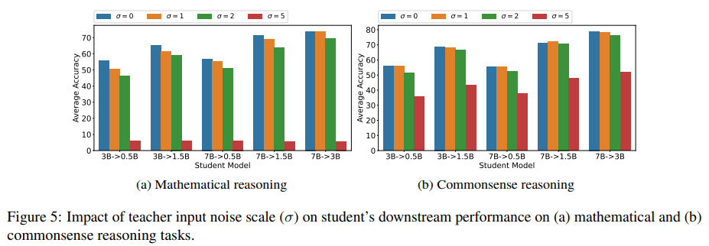
Impact of noisy teacher signals
We investigate the significance of teacher signals by injecting Gaussian noise(ϵ ∼ N (0, σ)) into teacher logits before distillation
Increasing σ from 0 (no noise) to 1 and 2 slightly reduces performance. At σ = 5, performance collapses, confirming that excessive noise disrupts knowledge transfer.
Notes:
We investigate the significance of teacher signals by injecting Gaussian noise into teacher logits before distillation
For low noise levels sigma set to 1 and 2, performance of student degrades slightly on all tasks
But with sigma set to 5, the performance complete collapses
This indicates that teacher signal is crucial for the learning of student model

Slide 15
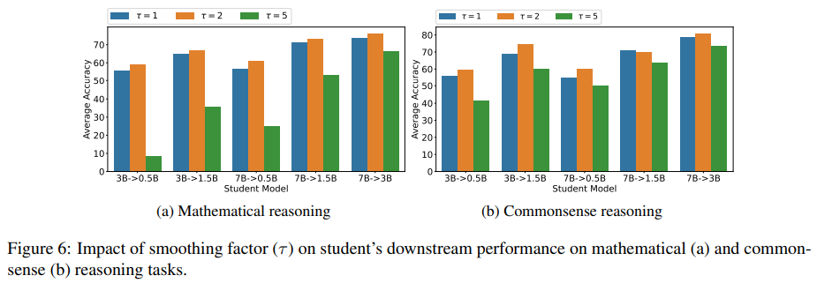
Impact of temperature scaling
Temperature (τ) significantly impacts KD effectiveness.
A moderate τ = 2 consistently yields the best results in most tasks.
However, τ = 5 leads to severe performance drops, especially for smaller students.
Commonsense reasoning follows a similar pattern to mathematical reasoning, but performance degradation at τ = 5 is less severe compared to mathematical tasks.
These findings emphasize that temperature tuning is crucial, with optimal τ values varying by student size and task complexity.
Notes:
Temperature hyper-parameter (tau) significantly impacts KD effectiveness.
A moderate tau of 2 gives best results in most tasks
With very high values of tau, performance significantly degrades in case of mathematical reasoning tasks, but the effect is less severe in case of common-sense reasoning tasks
Temperature tuning is crucial, with optimal τ values varying by student size and task complexity.

Slide 16
Conclusion
We elaborate on the impact of KD on small LMs
We considered factors like teacher performance, student size, teacher-student agreement, reasoning fidelity etc. across multiple tasks.
Results underscore the need for task-aware KD strategies and adaptive distillation techniques tailored to student’s learning dynamics.
Future research can explore refined teacher-student alignment strategies to improve both performance and reasoning fidelity.
Notes:
We elaborated on the impact of KD on small LMs
We considered factors like teacher performance, student size, teacher-student agreement, reasoning fidelity etc. across multiple models and tasks.
Results underscore the need for task-aware KD strategies and adaptive distillation techniques tailored to student model’s learning dynamics.
Future research can explore refined teacher-student alignment strategies to improve both performance and reasoning fidelity.

