Slide 1

Sprocket Central Pty Ltd
Data Analytics Approach
Sudipto Ghosh
Data Analytics Consulting Virtual Intern

Slide 2
Agenda
Introduction
Data Exploration
Model Development
Interpretation

Slide 3
Introduction
Data Quality Assessment
 | Customer Demographic | Customer Addresses | Transaction Data
Accuracy | DOB: Inaccuracy Job Industry Category: Misspelling
Completeness | DOB: Blanks Job Title: Blanks Job Industry Category: Blanks Tenure: Blanks Customer IDs: Not in Sync | Customer IDs: Not in Sync | Standard Cost: Blanks Brand: Blanks Product Line: Blanks Product Class: Blanks Product Size: Blanks Product First Sold Date: Blanks Customer IDs: Not in Sync
Consistency | Gender: Inconsistency | States: Inconsistency
Currency | Deceased Customers: Filter Out
Relevancy | Default: Exclude Field |  | Order Status: Exclude Cancelled
Validity |  |  | Product First Sold Date: Format

Slide 4
Introduction
Data Cleaning
Records with Missing Fields were Dropped.
Join Keys between Tables were considered and conflicting Records were Dropped.
Age, Last Purchase (Days Ago) and Profit Fields were Added.
Records pertaining to Deceased Customers were Dropped.
Transactions more than a year old were Dropped.
Distinct Customer IDs As Received | 4,000
Distinct Customer IDs after Data Cleaning | 3,492

Slide 5
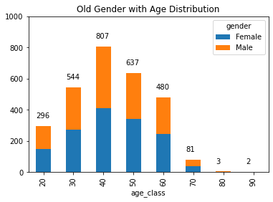
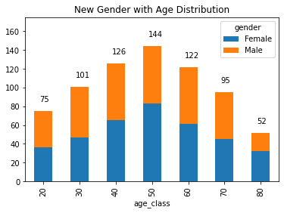
Data Exploration
Gender with Age Distribution

Slide 6
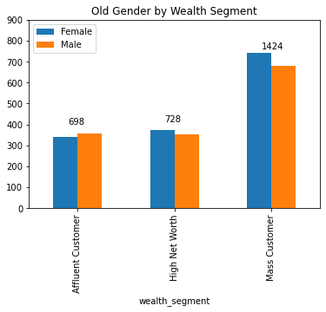
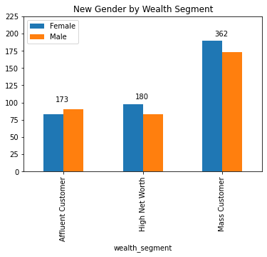
Data Exploration
Gender with Wealth Segment

Slide 7
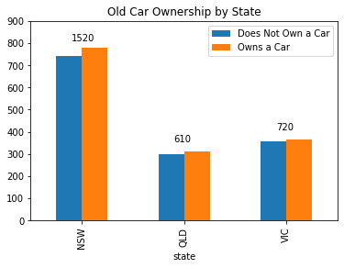
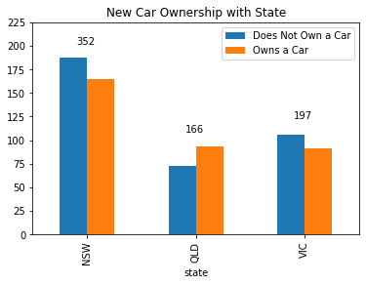
Data Exploration
Car Ownership with State

Slide 8
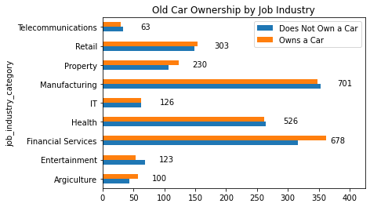
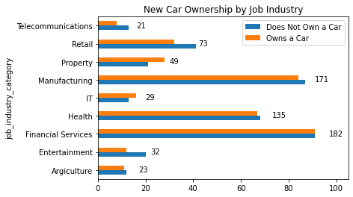
Data Exploration
Car Ownership with Job Industry

Slide 9
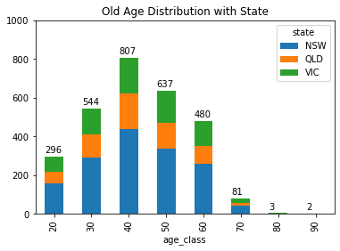
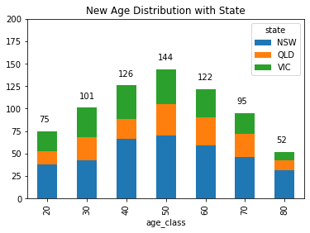
Data Exploration
Age Distribution with State

Slide 10
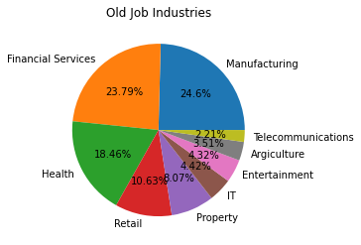
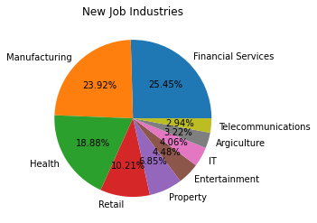
Data Exploration
Job Industry Diversity

Slide 11
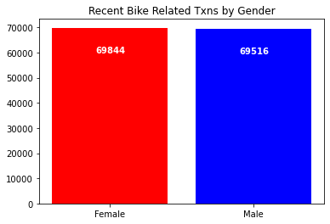
Data Exploration
Recent Transactions

Slide 12
Model Development
RFM Analysis
Recency
The last day on which a customer performed a transaction was taken as the recency parameter.
Customers were divided into 4 quartiles and given a R_Score.
Frequency
The frequency of transactions done by a particular customer was taken as the frequency parameter.
Customers were divided into 4 quartiles and given a F_Score.
Monetary Value
The average profit per customer was taken as the monetary value parameter.
Customers were divided into 4 quartiles and given a M_Score.

Slide 13
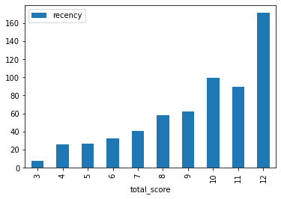
Model Development
RFM Analysis

Slide 14
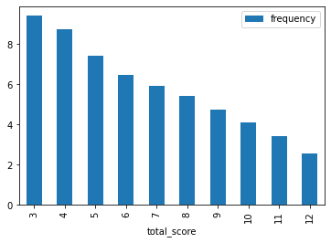
Model Development
RFM Analysis

Slide 15
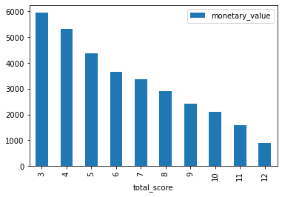
Model Development
RFM Analysis

Slide 16
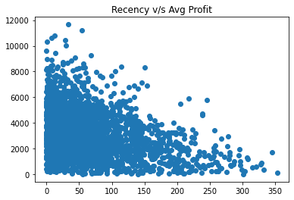
Model Development
RFM Analysis

Slide 17
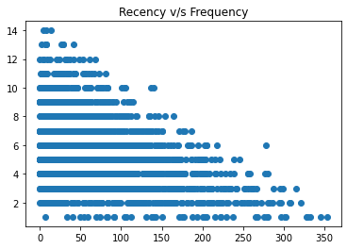
Model Development
RFM Analysis

Slide 18
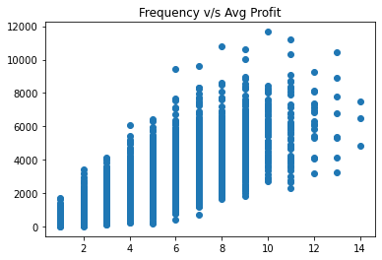
Model Development
RFM Analysis

Slide 19
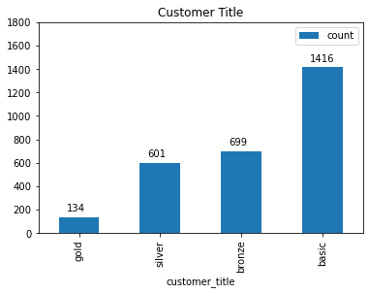
Model Development
RFM Analysis
Based on the RFM Class, four customer tiers were identified:
Gold Class: These customers have recently made a purchase, are frequent and are most profitable.
Silver Class
Bronze Class
Basic Class: These customers have not made any recent purchase, are not frequent and do not contribute majorly.

Slide 20
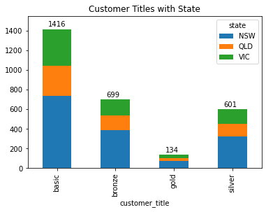
Interpretation
Customer Tiers by State

Slide 21
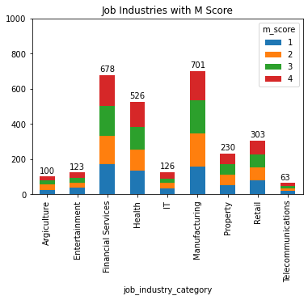
Interpretation
Profitable Job Industries

Slide 22
Interpretation
Customer Segments
Segment | RFM Score | Cumulative
Platinum Customer | 3 | 134
Very Loyal | 4 | 296
Becoming Loyal | 5 | 558
Recent Customer | 6 | 891
Average Customer | 7 | 1300
High Risk Customer | 8 | 1712
Evasive Customer | 9 | 2110
Losing Customer | 10 | 2417
Inactive Customers | 11 | 2595
Lost Customers | 12 | 2850

Slide 23
Interpretation
Targeting Methodology
Customers having high RFM Scores can be filtered and targeted.
The customers have made recent purchases, are frequent, and drive the most profits.

Slide 24
Appendix

Slide 25
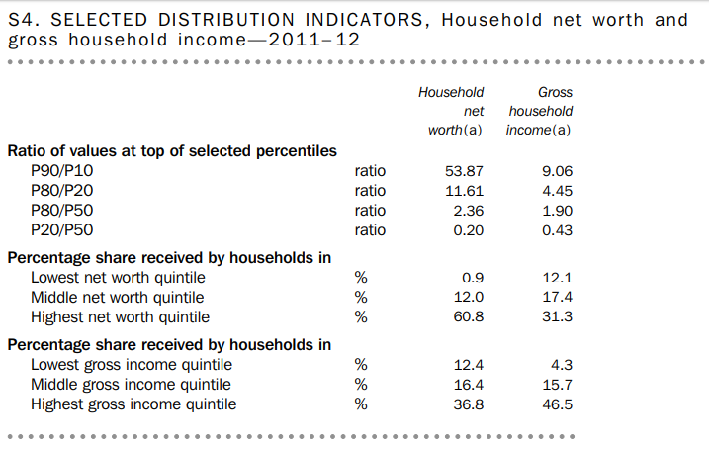
Appendix
Source: Australian Bureau of Statistics

